Slide 1

OOPS (JAVA)
Lec-4
Saif Nalband

Slide 2
Contents
Primitive Data type
Variables
Scope
Comparators Operators
Arrays

Slide 3
Identifiers
An identifier is a sequence of characters that consist of letters, digits, underscores (_), and dollar signs ($).
An identifier must start with a letter, an underscore (_), or a dollar sign ($). It cannot start with a digit.
An identifier cannot be a reserved word. (See Appendix A, “Java Keywords,” for a list of reserved words).
An identifier cannot be true, false, or
null.
An identifier can be of any length.

Slide 4
Primitive Types
Java defines eight primitive types of data:
• Integers: This group includes byte, short, int, and long, which are for whole-valued signed numbers.
• Floating-point numbers: This group includes float and double, which represent numbers with fractional precision.
• Characters: This group includes char, which represents symbols in a character set, like letters and numbers.
• Boolean: This group includes boolean, which is a special type for representing true/false values.

Slide 5
Integers
Name | Width | Range
long | 64 | –9,223,372,036,854,775,808 to 9,223,372,036,854,775,807
int | 32 | –2,147,483,648 to 2,147,483,647
short | 16 | –32,768 to 32,767
byte | 8 | –128 to 127
Demo1

Slide 6
Floating Point Types
Name | Widths | Range
double | 63 | 1.7e–308 to 1.7e+308
float | 32 | 3.4e–038 to 3.4e+038
Demo2

Slide 7
Characters
In Java, the data type used to store characters is char.
In C/C++, char is an integer type that is 8 bits wide
Java uses Unicode to represent characters. Unicode defines a fully international character set that can represent all of the characters found in all human languages.
Java char is a 16-bit type
Demo3
Demo4

Slide 8
Booleans
For logical values with two possible : TRUE or FALSE
Demo5

Slide 9
Variables
The name of some location of memory used to hold a data value
Different types of data require different amounts of memory. The compiler’s job is to reserve sufficient memory
Variables need to be declared once
Variables are assigned values, and these values may be changed later
A variable is defined by the combination of an identifier, a type, and an optional initializer
Example
int width = 3;
int height = 4;
int area = width * height;
width = 6;
area = width * height;

Slide 10
Variable Names
Valid Variable Names: These rules apply to all Java names, or identifiers, including methods and class names
Starts with: a letter (a-z or A-Z), dollar sign ($), or underscore (_)
Followed by: zero or more letters, dollar signs, underscores, or digits (0-9).
Uppercase and lowercase are different (total ≠ Total ≠ TOTAL)
Cannot be any of the reserved names. These are special names (keywords) reserved for the compiler. Examples:
class, float, int, if, then, else, do, public, private, void, …

Slide 11
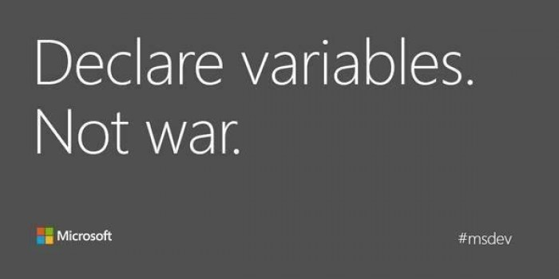
Variables

Slide 12
Data Types and Variables
Java Strongly-type language
Strong Type Checking Java checks that all expressions involve compatible types
int x, y; // x and y are integer variables
double d; // d is a double variable
String s; // s is a string variable
boolean b; // b is a boolean variable
char c; // c is a character variable

Slide 13
Data Types and Variables
x = 7; // legal (assigns the value 7 to x)
b = true; // legal (assigns the value true to b)
c = ‘#’; // legal (assigns character # to c)
s = “cat” + “bert”; // legal (assigns the value “catbert” to s)
d = x – 3; // legal (assigns the integer value 7 – 3 = 4 to double d)
b = 5; // illegal! (cannot assign int to boolean)
y = x + b; // illegal! (cannot add int and boolean)
c = x; // illegal! (cannot assign int to char)

Slide 14
The scope and Lifetime of variables
all of the variables used have been declared at the start of the main( ) method.
Java allows variables to be declared within any block.
In Java, the two major scopes are those defined by a class and those defined by a method.
The scope defined by a method begins with its opening curly brace.
variables declared inside a scope are not visible (that is, accessible) to code that is defined outside that scope.
Scopes can be nested.
variables are created when their scope is entered, and destroyed when their scope is left.
Demo6 Demo7

Slide 15
Numeric Operators
Arithmetic Operators:
Unary negation: -x
Multiplication/Division: x * y x/y
Division between integer types truncates to integer: 23/4 5
x % y returns the remainder of x divided by y: 23%4 3
Division with real types yields a real result: 23.0/4.0 5.75
Addition/Subtraction: x+y x-y
Comparison Operators:
Equality/Inequality: x == y x != y
Less than/Greater than: x < y x > y
Less than or equal/Greater than or equal: x <= y x >= y
These comparison operators return a boolean value: true or false.

Slide 16
Comparison operators
The result is boolean, always
< less than
> greater than
== equal to
<= less than or equal to
>= greater than or equal to
!= not equal to

Slide 17
Arrays
An array is a group of like-typed variables that are referred to by a common name.
The general form of a one-dimensional array declaration is
type var-name[ ];
int month_days[];
No array actually exists. No memory allocation.

Slide 18
Arrays
The keyword new has to be used
array-var = new type[size];
month_days = new int[12];
month_days[1] = 28;
int month_days[] = new int[12];
Demo8
Demo9

Slide 19
2D Arrays
int twoD[][] = new int[4][5];
Demo11

Slide 20
Thank you and
Stay Home and Stay safe

