Slide 1

OOPS (JAVA)
Lec-5
Saif Nalband

Slide 2
Contents
Operators
Bitwise Operators
Logical operators
Boolean Logical Operators
Control Statements

Slide 3
The Modular Operator
returns the remainder of a division operation
applied to floating-point types as well as integer types
Demo51
%

Slide 4
Arithmetic Compound Assignment Operators
Eg
a = a + 4
a += 4
Eg2
a = a % 2
a %=2
Demo52

Slide 5
Increment and Decrement
x = x + 1; can be written as x++;
x = x - 1; can be written as x--;
Demo53

Slide 6
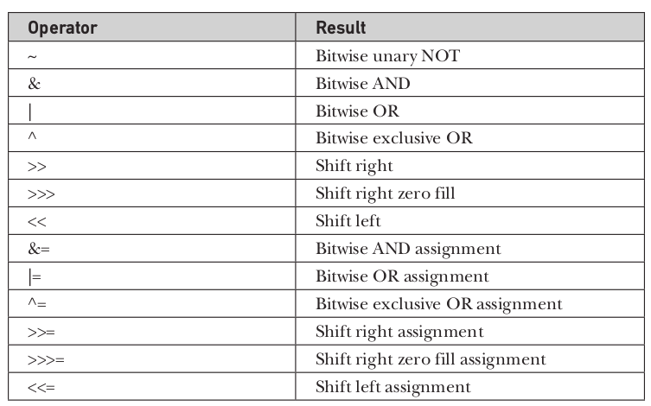
BITWISE Operator

Slide 7
The BITWISE Logical
A | B | A | B | A & B | A ^ B | ~A
0 | 0 | 0 | 0 | 0 | 1
1 | 0 | 1 | 0 | 1 | 0
0 | 1 | 1 | 0 | 1 | 1
1 | 1 | 1 | 1 | 0 | 0

Slide 8
BITWISE
NOT
00101010
11010101
AND
00101010 42
& 00001111 15
00001010 10
OR
00101010 42
| 00001111 15
00101111 47
Demo54

Slide 9
The Left Shift
Left shift operators <<
Eg value << num //num specifies the number of positions to left shift in value.
For each shift left, the high-order bit is shifted out (and lost), and a zero is brought in on the right.
Demo55, Demo56

Slide 10
The Right Shift
shifts all of the bits in a value to the right a specified number of times
value >> num

Slide 11
The ? Operator
ternary (three-way) operator that can replace certain types of if-then-else statements.
expression1 ? expression2 : expression3
Demo57

Slide 12
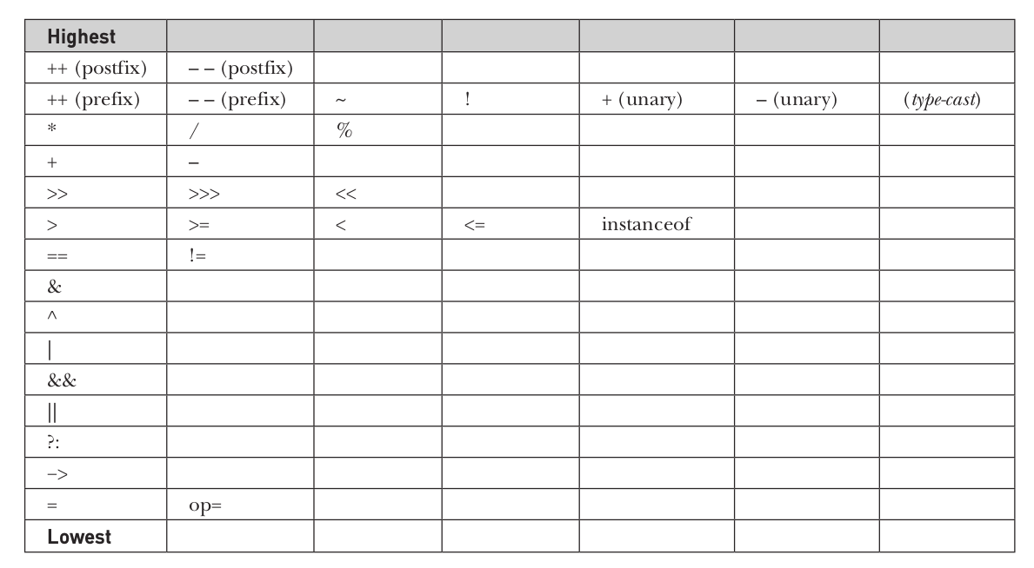
Precedence

Slide 13
Control Statements
If -else
switch
while (iteration statements )
do while
for

Slide 14
If else
if(condition)
statement;
else if(condition)
statement;
.
.
else
statement
Demo58

Slide 15
Switch
switch (expression) {
case value1:
// statement sequence
break;
case value2:
// statement sequence
break;
.
.
.
case valueN :
// statement sequence
break;
default:
// default statement sequence
}
Demo59

Slide 16
while
while(condition) {
// body of loop
}
Demo510, Demo511

Slide 17
do while
do {
// body of loop
} while (condition);
Demo512

Slide 18
For loop
for(initialization; condition; iteration) {
// body
}
Demo513

Slide 19
Thank you and
Stay Home and Stay safe

