Slide 1

OOPS (JAVA)
Lec-8
Saif Nalband

Slide 2
Contents
Problem Solving

Slide 3
Problem Solving
https://www.hackerrank.com/challenges/java-1d-array-introduction/problem --Demo82
https://www.hackerrank.com/challenges/simple-array-sum/problem --Demo80
https://www.hackerrank.com/challenges/mini-max-sum/problem --Demo85
https://www.hackerrank.com/challenges/java-datatypes/problem?h_r=next-challenge&h_v=zen --Demo81
https://www.hackerrank.com/challenges/plus-minus/problem --Demo83
https://www.hackerrank.com/challenges/diagonal-difference/problem -- Demo84

Slide 4
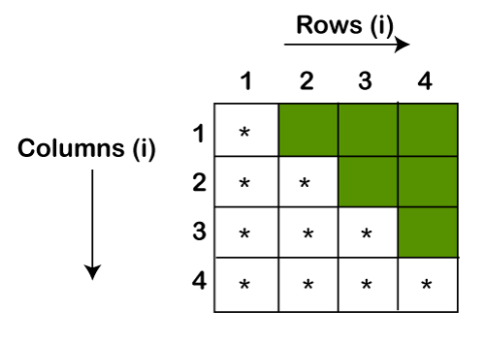

Slide 5
Thank you and
Stay Home and Stay safe

