Slide 1

OOPS (JAVA)
Lec-9
Saif Nalband

Slide 2
Contents
Problem Solving

Slide 3
Problem Solving
https://www.hackerrank.com/challenges/diagonal-difference/problem -- Demo90
https://www.hackerrank.com/challenges/java-substring/problem --Demo91

Slide 4
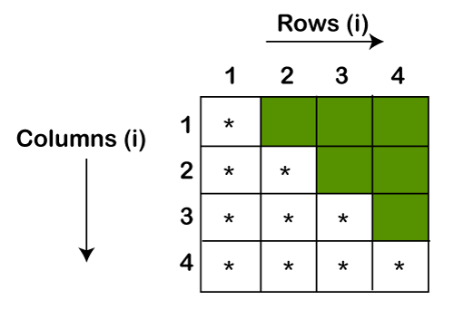
Solving Pattern and Matrix Related Problems

Slide 5


Pattern
Demo92
Demo93

Slide 6
Lab Instructions

Slide 7
Thank you and
Stay Home and Stay safe

