Slide 1
UES103 Programming for Problem Solving Saif Nalband, PhD 1A27-31/1A42-46 cslab768

Slide 2
Topics covered
Introduction to Computer Fundamentals- Computer Memory Hierarchy, Types of Software Binary number system, Algorithm, Flowchart, Formulate simple algorithms for logical and arithmetic problems.
Notes:
2

Slide 3
About Myself
90’s Kid From Mumbai
Completed my PhD BITS-Pilani, Goa Campus (YUP, I studied in GOA!)
Taught at IIIT Pune
Went for Post-Doctoral Researcher at Cork, Ireland for a year.
Pandemic→DYPIU→IIIT Pune→TIET
Social Acitve on Linkdin, twitter
Hobbies ; Football, MUFC, binge watch some series, courses

Slide 4
I can be found on (Contact)
Preference on EMAILS:
Email: saif.nalband@thapar.edu
Mob: 9322317570
Avoid WhatsApp unless its emergency!!!
Chamber No: 710, CSED Building /
Venue: Activity Space -1

Slide 5
OutCome of Course
Programming paradigm → First Step
Initial Steps for Software development.

Slide 6
How to pass this course
Will keep you update on this. Regarding the weightage of marking scheme
Attendance is MUST!!!
DO NOT MUG THE PROGRAMS.
PRACTICE CODING .. It’s FUN.

Slide 7
Weightage Scheme : Theory : 100 marks
Modules | Weightage
MST | 40*
EST | 40*
Lab Sessional(x2) | (10+10) 20

Slide 8
Lecture (1A42 -- 46)
Tuesday :-- 9:40 AM – 10:30 AM → LP103
Wednesday :-- 12:10 PM – 1:00 PM → LP102
Thursday :-- 10:30 AM – 11:20 AM → LP104
Office Hours :
Monday – 3:30 PM → 5:10 PM
Tuesday – Tuesday 2:40 PM → 5:10 PM

Slide 9
Lecture (1A27-- 31)
Monday :-- 2:40 PM – 3:30 PM → LP102
Wednesday :-- 4:20 PM – 5:10 PM → LP102
Friday :-- 8:00 AM – 8:50 AM → LP102
Office Hours :
Monday – 3:30 PM → 5:10 PM
Tuesday – 2:40 PM → 5:10 PM

Slide 10
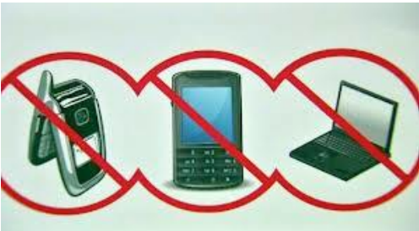
Lecture
Keeping the class interesting
Humor breaks
Actually helps with attention span!
Not surprisingly, most of it will be computer humor!
Lecture etiquette
Please don’t use electronic devices during lectures
Plus no earbuds

Slide 11
Books
Text Books
C Programming Language, Brian W. Kernighan Dennis M. Ritchie, 2nd ed, 2012.
Programming in ANSI C, Balagurusamy G., 8th ed., 2019
Reference Books
Let Us C, Kanetkar Y., 16th ed., 2017
Programming with C, Byron S Gottfried, McGraw Hill Education, Forth edition, 2018

Slide 12
Let Cook some codes

Slide 13
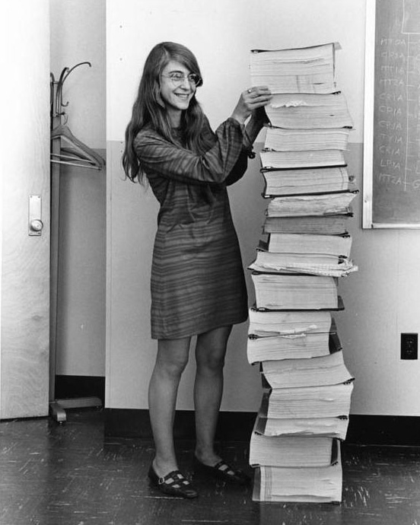
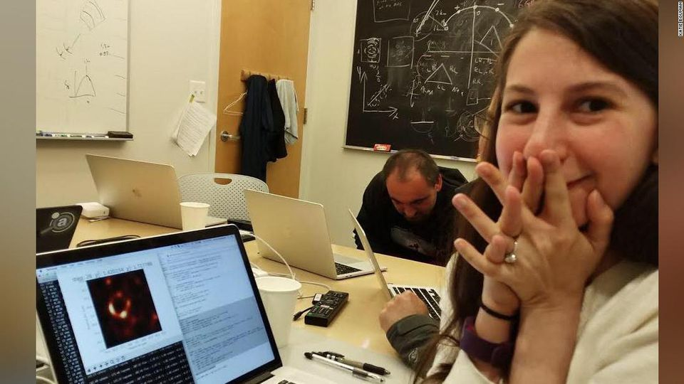
Programming ? why
Why Do we Write codes ?
Notes:
Margaret Hamilton :

Slide 14
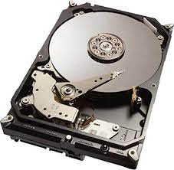
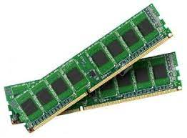
Computer Memory
Memory is the electronic holding place for the instructions and data a computer needs to reach quickly.
Two types of memory - primary and secondary
Need for memory hierarchy – To minimize the memory access time

Slide 15
Memory hierarchy
Register – Memory that is built directly into the CPU
Cache – Chip based memory closest to CPU
RAM – Random access memory (main memory for computer calculations or temporary storage
ROM – Read only memory; permanent memory; stores booting instructions for smooth computer operations
Removable memory - pen drive or external hard drive)

Slide 16
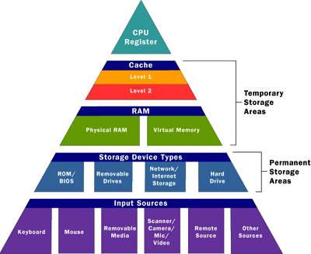
Memory classification
Notes:
16

Slide 17
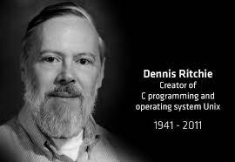
The C Programming Language
Who? Dennis Ritchie
When? ~1972
Where? Bell Labs
Why? Develop the Unix OS

Slide 18
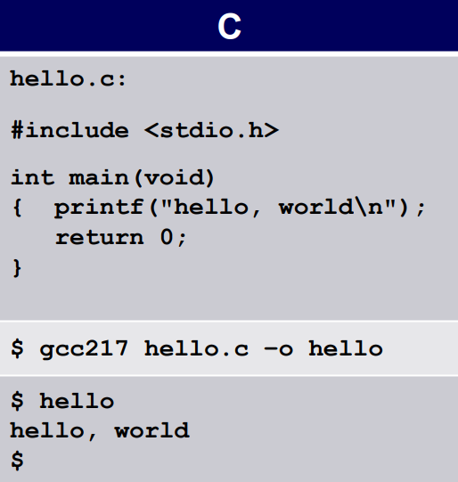
C: Details

Slide 19
Types of Errors
There are five different types of errors in C.
Syntax Error
Run Time Error
Logical Error
Semantic Error
Linker Error

Slide 20
Computer Software
The instructions that control what a computer does; computer programs. For example:
Operating system (System software)
C compiler (application software)
MS office – (which type of software)
Python (Anaconda, Pycharm, Jupiter) - ?
WhatsApp - ?
MAC - ?
Notes:
OS is an interface between computer user and computer hardware. OS is a system software. Application software performs specific functions for the user.

Slide 21
Why !!
A power programmer must know number systems and data representation to fully understand C’s primitive data types

Slide 22
Number Systems
Number Systems
Finite representation of unsigned integers
Finite representation of signed integers
Finite representation of rational numbers (if time)

Slide 23
The Decimal Number System
Name
“decem” (Latin) => ten
Characteristics •
Ten symbols • 0 1 2 3 4 5 6 7 8 9
Positional
2945 ≠ 2495
2945 = (2*103) + (9*102) + (4*101) + (5*100)
(Most) people use the decimal number system

Slide 24
The Binary Number System
Name • “binarius” (Latin) => two
Characteristics
Two symbols
---0 1 ---
Positional
1010B ≠ 1100B
Most (digital) computers use the binary number system
Terminology
Bit: a binary digit
Byte: (typically) 8 bits

Slide 25
Binary number system
A system in which every number is represented in two digits (either 0 or 1).
For example, 1100 0111 is an 8-bit binary number or binary string.
Digital computer only understands only two signals (on and off) and thus only two alphabets (0 and 1)

Slide 26
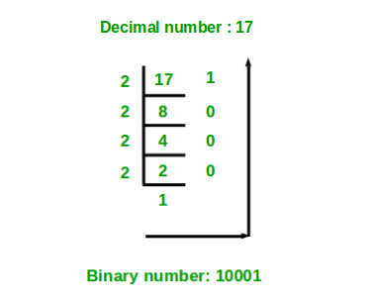
Decimal to binary

Slide 27
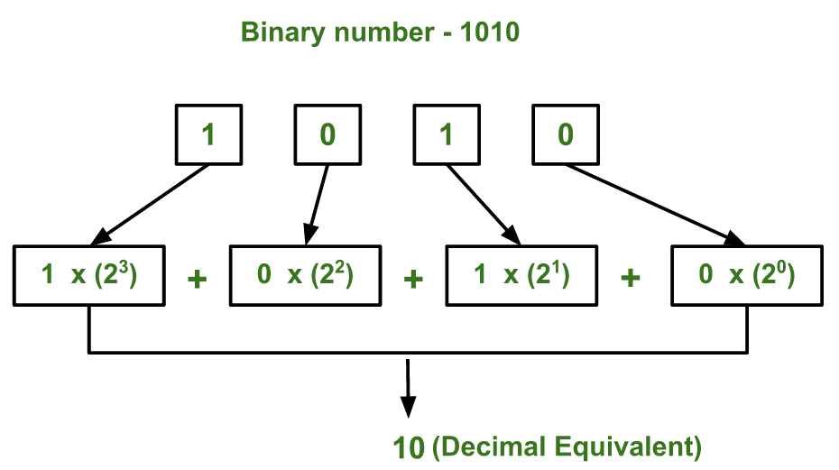
Binary to decimal

Slide 28
Notation
(1010)₂ or 1010 (base 2) means that 1010 is in binary

Slide 29
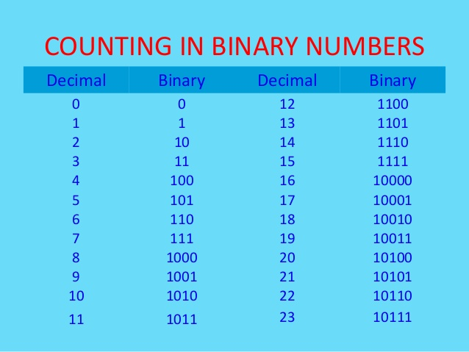
Notes:
29

Slide 30
Signed binary numbers
In case of 4 bits we have 2^4 permutations (why?)
So we have total 16 representations {0000,…,1111} (why?)
If all positives then we have {0, 1, …, 15} (why?)
If we have negatives then {-8,-7,…,-1, 0,…7} (why)

Slide 31
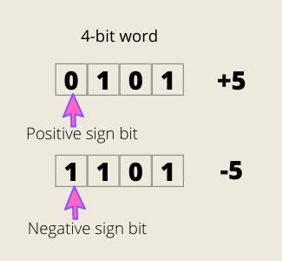
First type of notation - sign bit

Slide 32
Q: Use sign bit to find the range of 4-bit binary numbers
All possibilities of 4-bit numbers
0000, 0001, 0010, 0011
0100, 0101, 0110, 0111
1000, 1001, 1010, 1011
1100, 1101, 1110, 1111

Slide 33
Use sign bit to find the range of 4-bit binary numbers
ANS: Problem in representing 0
1111 = -7
1000 = -0
0000 = +0
0111 = 7

Slide 34
Second type of notation – 2’s complement
It resolves the the limitation of the signed bit representation.

Slide 35
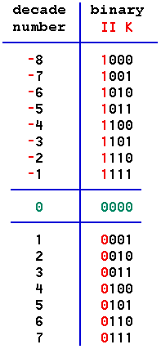
Negative binary numbers: 2’s complement Flip zeros and ones and add 1
Notes:
35

Slide 36
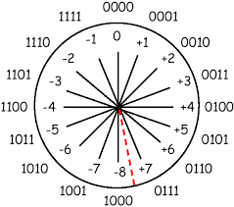
Notes:
36

Slide 37
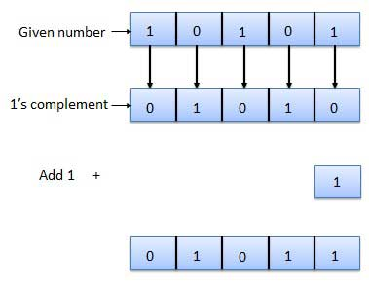
Notes:
37

Slide 38
1101 into unsigned and signed
Unsigned (+): So 1101 = 13 in decimal
Signed (+/-): If the most significant bit (MSB) is 1 then number is negative. So 1101 means a negative number. Then find its 2’s complement to find its value which is 0011.
So 1101 = -3.
Find signed decimal values for 10100101 and 01111111.

Slide 39
Algorithm
Finite sequence of explicit and unambiguous instructions, which when provided with a set of input values produces an output and then terminates.
Notes:
39

Slide 40
Pseudo code
(1) Pseudo code is a generic way of describing an algorithm without using any specific programming language-related notations.
(2) It is an outline of a program, written in a form, which can easily be converted into real programming statements.
Notes:
40

Slide 41
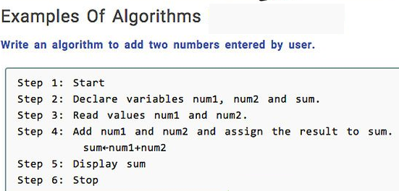
Notes:
41

Slide 42
Flowchart
It is a pictorial form of an algo
Boxes represent operations and arrows represent sequence in which the operations are executed
Notes:
42

Slide 43
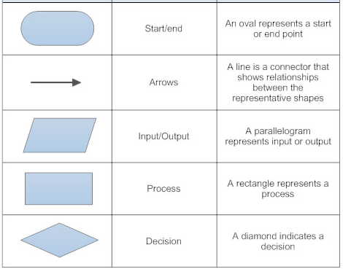
Flowchart – types of boxes

Slide 44
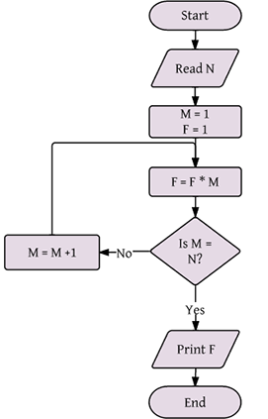
Notes:
44

Slide 45
Practice
Write and algorithm to input a positive integer and print its multiplication table from 1 to 10. For example if input n = 4 then the table should print 4 x 1 = 4 … 4 x 10 = 40.
Draw the flow chart for the above algorithm

