Slide 1
UES103 Programming for Problem Solving Saif Nalband, PhD 1A27-31/1A42-46 Lab Password: cslab768

Slide 2
Topics covered Structure of C Program, Life Cycle of Program from Source code to Executable, Compiling and Executing C Code, Keywords, Identifiers, Primitive Data types in C, variables, constants, input/output statements in C, operators, type conversion and type casting. Conditional branching statements, iterative statements, nested loops, break and continue statements.

Slide 3
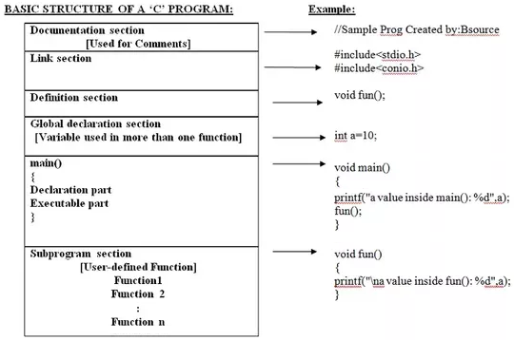

Slide 4
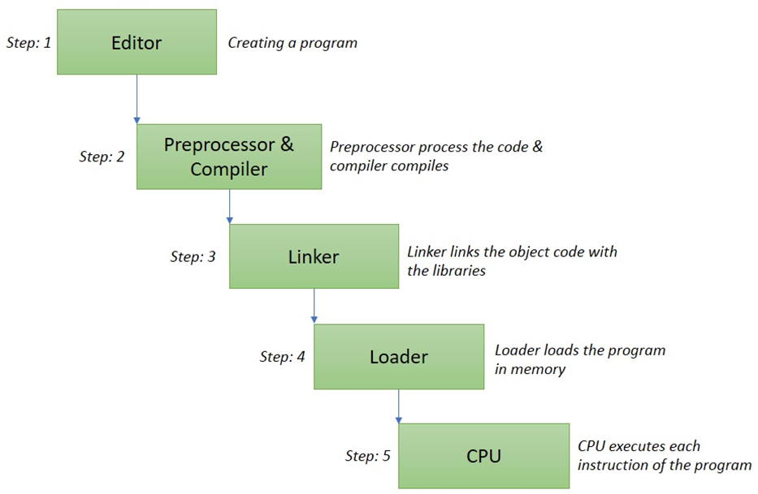

Slide 5
C Tokens
C Tokens are of 6 types, and they are classified as:
Identifiers,
Keywords,
Constants,
Operators,
Special Characters and
Strings.

Slide 6
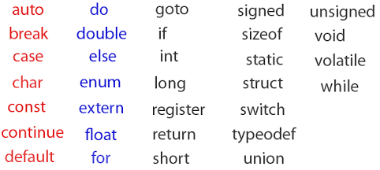
Keywords or reserved words
You cannot use them for variable names

Slide 7
Identifiers – variable names
They must start with an alphabet
May contain digits or alphabets.
int abc123, abc_123, abc; //valid identifiers

Slide 8
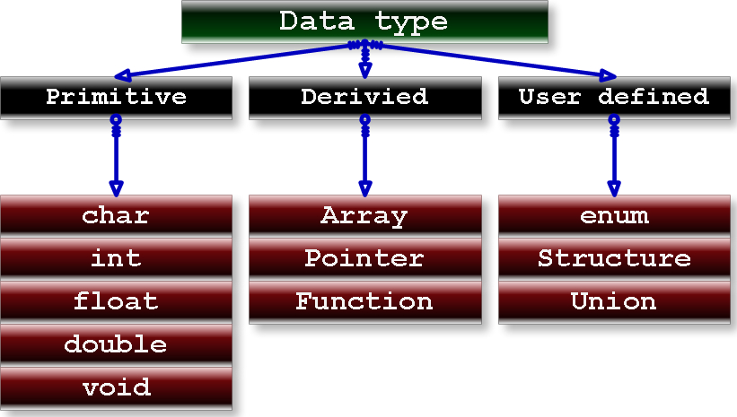
Datatypes in C

Slide 9
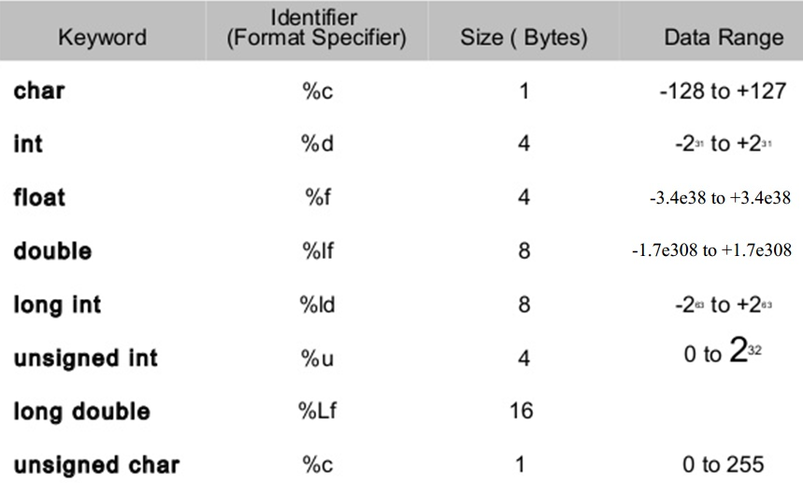
Primitive Data types in C

Slide 10
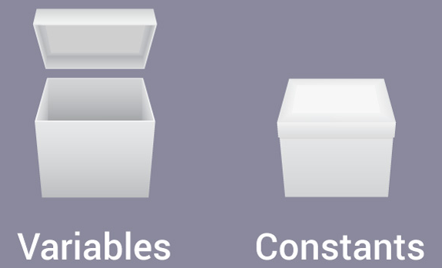
Variables and constants

Slide 11
I/O statements in C
Input: scanf(), gets()
Output: printf(), puts()
main(){
char s[20]; //string is array of char
puts("Enter a string: "); gets(s);
puts("Here is your string"); puts(s);
}

Slide 12
Operators in C
Uniary (1 var) x = x+1; or x++;
Binary (2 var) a = b*c;
Ternary operator (3 var) ?:
main(){
int a=1,b=2,c;
c = a>b?a:b; //condition?option1:option2
printf("c = %d\n",c);
} //output is 2

Slide 13
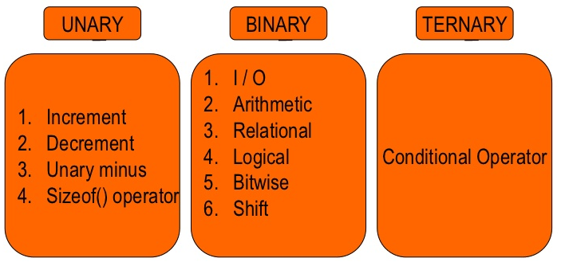
Operators – 3 types

Slide 14
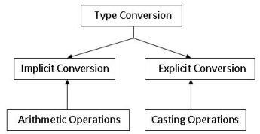
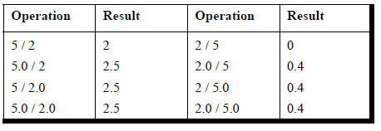

Slide 15
Integer and double are default
main(){
printf("%d\n",sizeof('x')); //int
printf("%d\n",sizeof(55)); //int
printf("%d\n",sizeof(55.0)); //double
}
//Output will be 4 4 8 because ‘x’ will become integer for its ASCII value

Slide 16
Type conversion - implicit
#include<stdio.h>
main(){
//implicit typecasting to float
float f = 10.0;
printf("\n f = %f",f);
printf("\nsize of 10.0 = %d",sizeof(10.0));
printf("\nsize of f = %d",sizeof(f));
}
//output: f = 10.0000 size of 10.0 = 8 size of f = 4

Slide 17
Type conversion - explicit
main(){
//explicit typecasting to float
float f = (float)10.0;
printf("\n value of = %f",f);
}

Slide 18
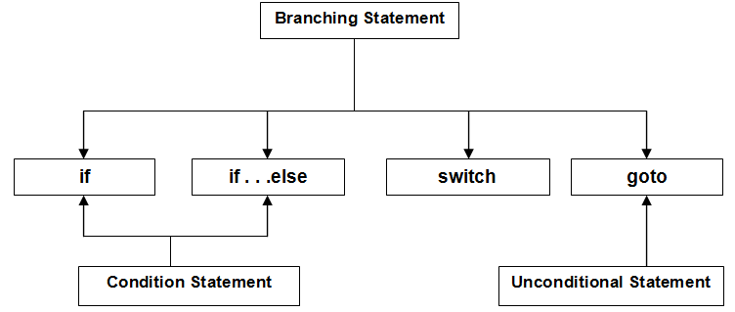
Conditional branching statements

Slide 19
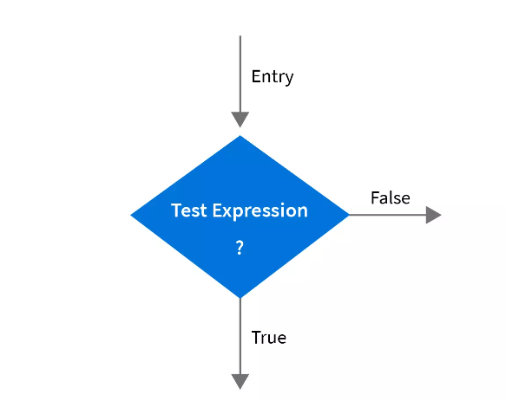
if
Types of If Statement
if statement may be implemented in different forms depending on the complexity of testing conditions to be evaluated.
Simple if Statement
if-else Statement
Nested if-else Statement
else-if Ladder

Slide 20
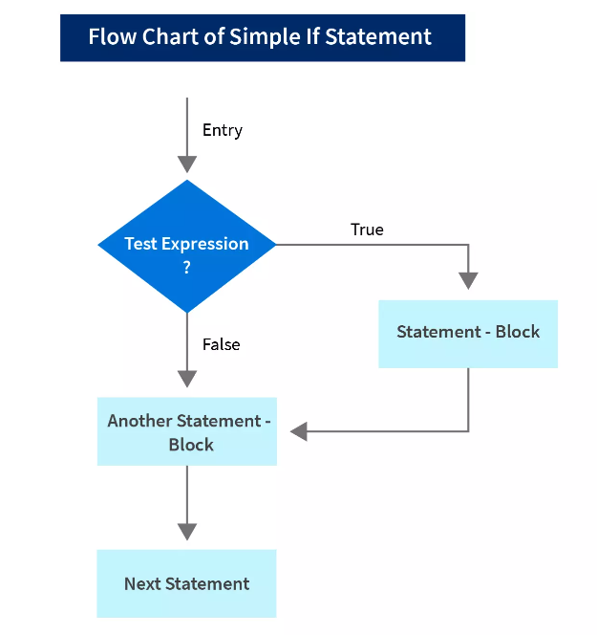
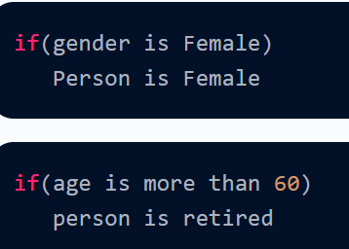
Simple If

Slide 21
If statement
main(){
int a=10;
if(a<20) {
printf("a<20\n");
}
if(a>20) {
printf("a>20\n");
}} //output is a<20

Slide 22
If-else
main(){
int a=10;
if(a<20) {
printf("a<20\n");
}
else {
printf("a>20\n");
}} //output is a<20

Slide 23
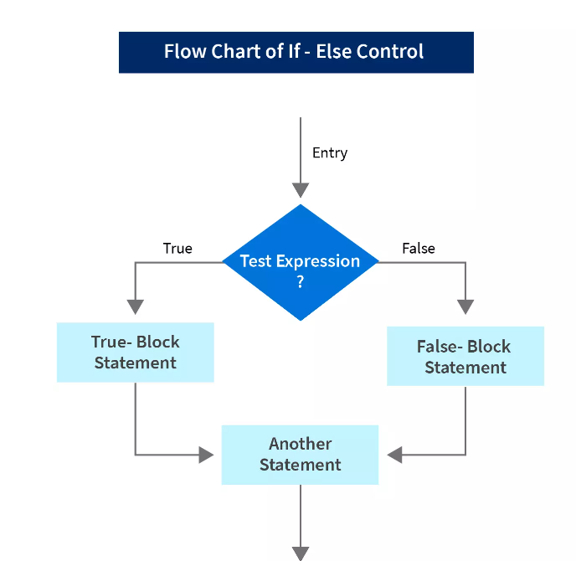
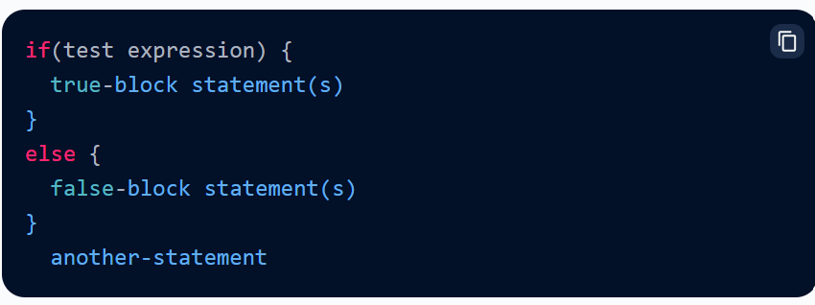
If-else

Slide 24
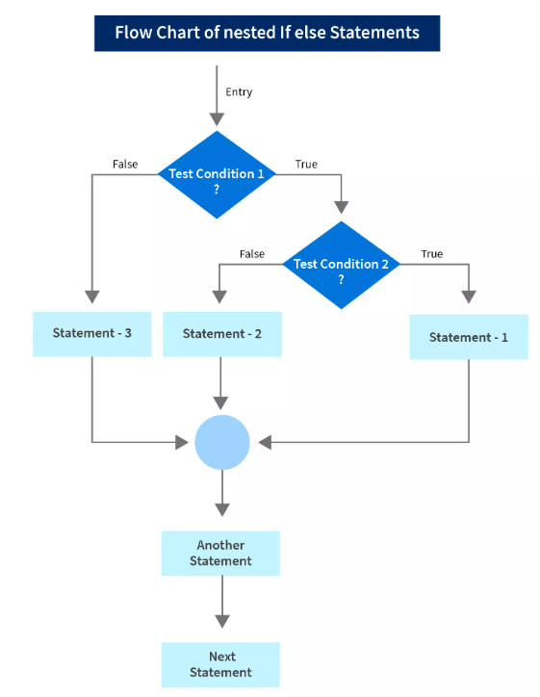
Nested if else

Slide 25
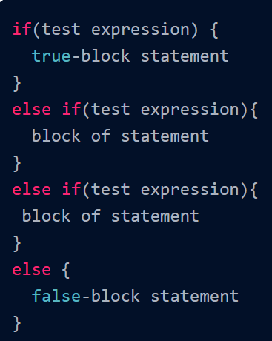
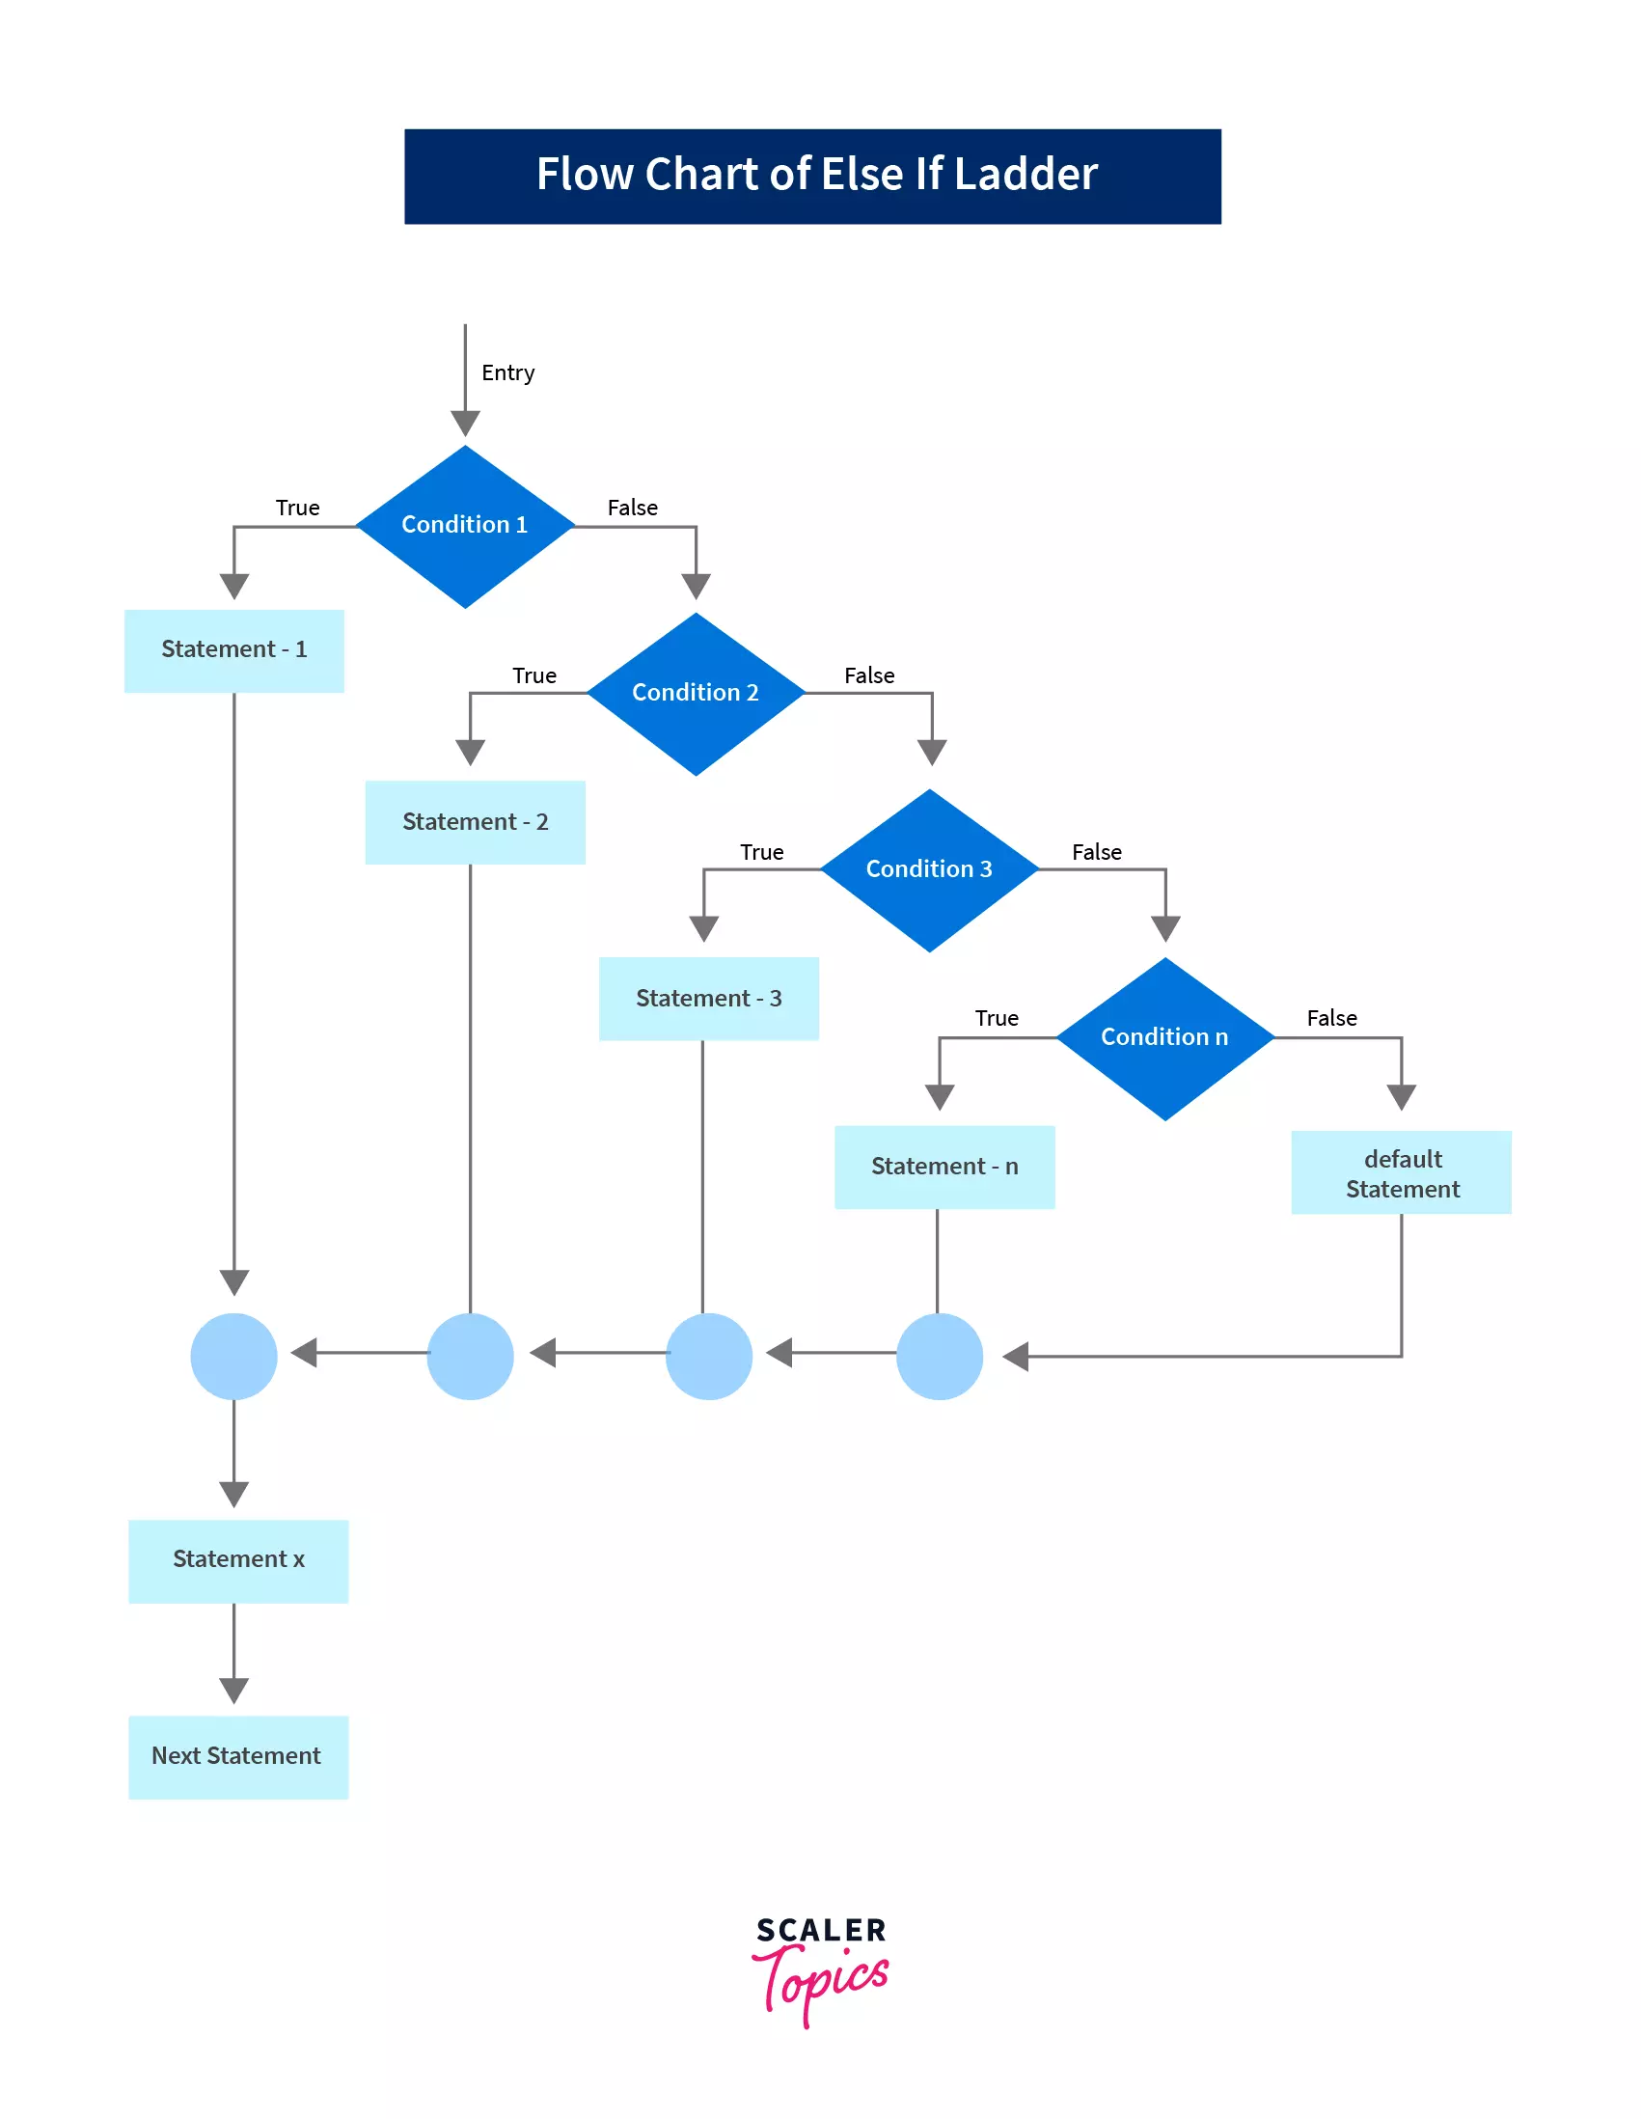
Else-if Ladder:

Slide 26
Important Points Need to Remember
Never put semicolon just after the if(expression).
A non-zero value is considered as true and a zero(0) value is considered as false in C.
We can use more than one condition inside the if statement using the logical operator.
We should always use braces on separate lines to identify a block of statements.
We should always align the opening and closing braces.
Do not ignore placing parentheses for the if condition/expression.
Be aware of dangling else statements.
Avoid using operands that have side effects in a logical binary expression such as (a-- && ++b). The second operand may not be evaluated in any case.

Slide 27
Leap Year?
#include <stdio.h>
int main() {
int year;
printf("Enter a year: ");
scanf("%d", &year);
// leap year if perfectly divisible by 400
if (year % 400 == 0) {
printf("%d is a leap year.", year);
}
// not a leap year if divisible by 100
// but not divisible by 400
else if (year % 100 == 0) {
printf("%d is not a leap year.", year);
}
// leap year if not divisible by 100
// but divisible by 4
else if (year % 4 == 0) {
printf("%d is a leap year.", year);
}
// all other years are not leap years
else {
printf("%d is not a leap year.", year);
}
return 0;
}

Slide 28
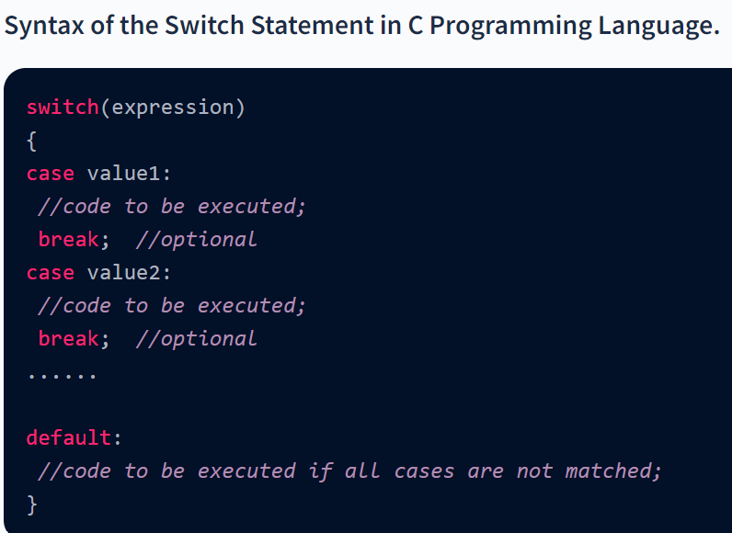
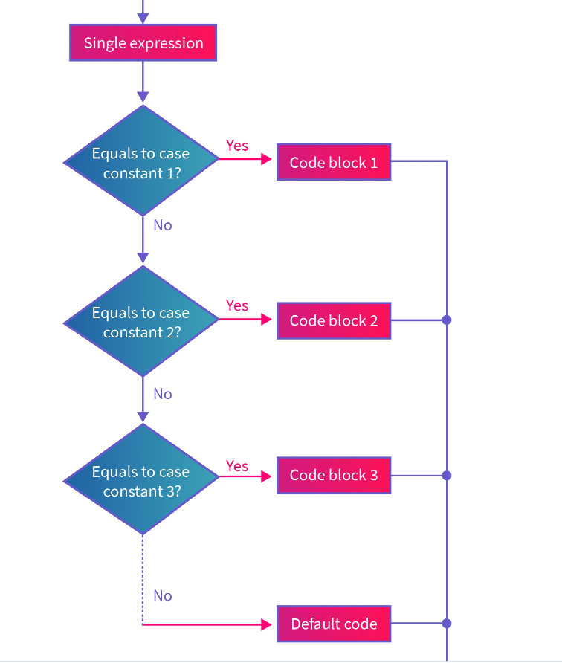
Switch Case

Slide 29
Switch statement
main(){
int a=10;
switch(a) {
case 20: printf("a=20\n"); break;
case 10: printf("a=10\n"); break;
default: printf("unknown");
}} //output is a=10

Slide 30
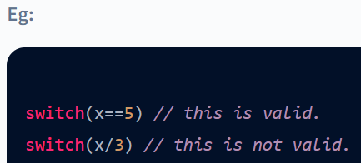
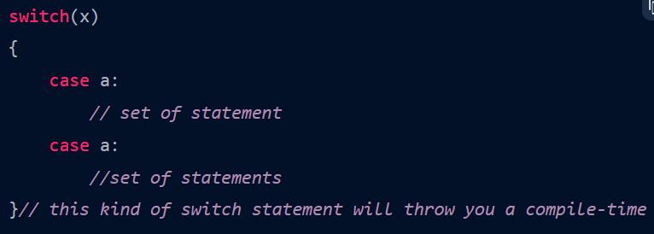
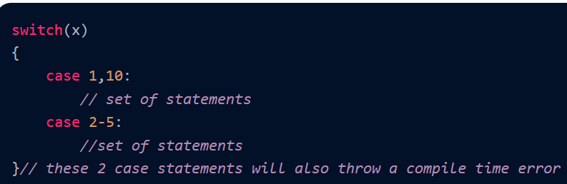
Rules for Switch Statement in C Language
The expression provided in the switch statement should always be either an integer value or a char value.
You can't use two case labels with the same value. Duplicate case values would throw an error.
You can't define ranges within a case statement, nor can you use a single case label for more than one value.

Slide 31
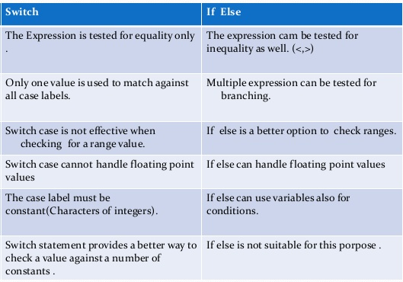

Slide 32
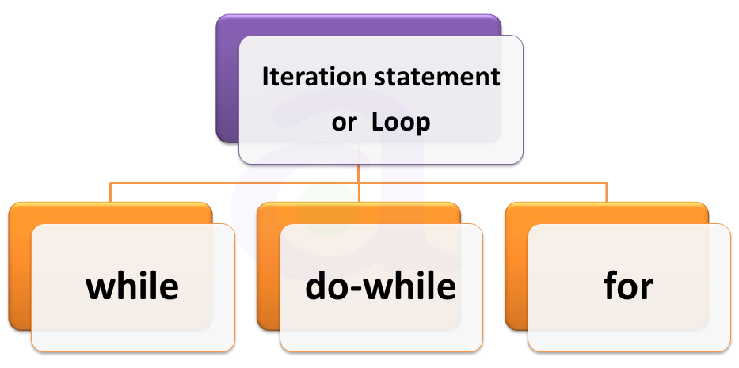
Iterative statements - repetitions

Slide 33
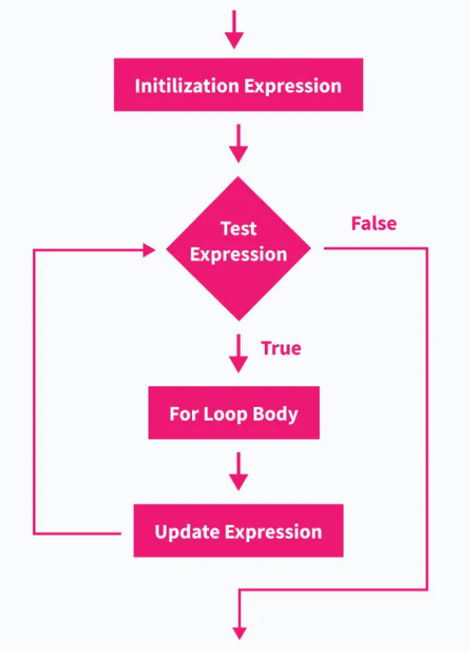
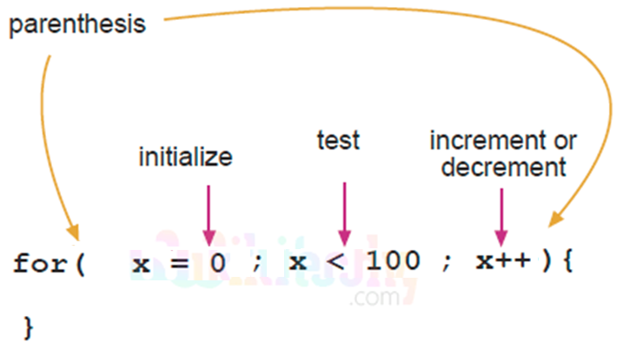
A for loop is a control structure that is used to run a block of instructions multiple times until a certain condition fails.

Slide 34
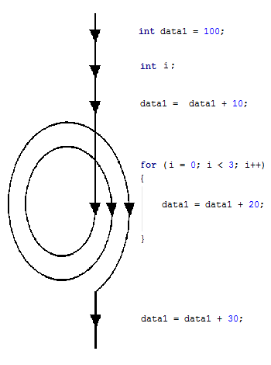
for loop

Slide 35
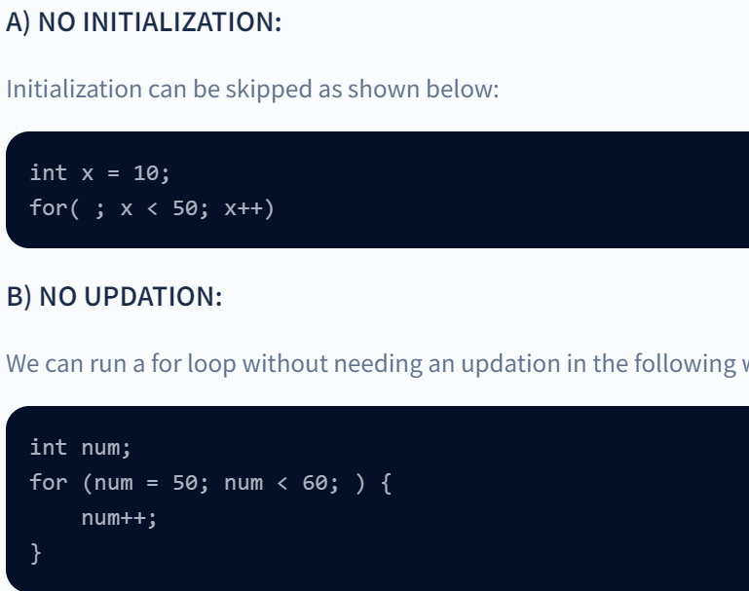
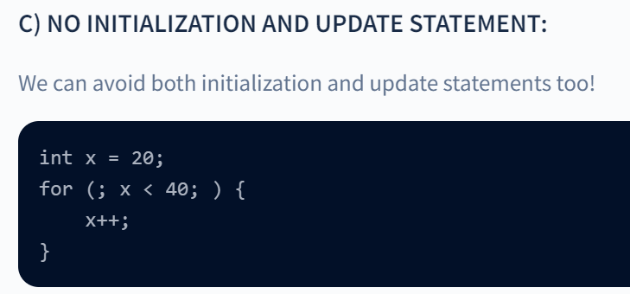
Forms of for loop

Slide 36
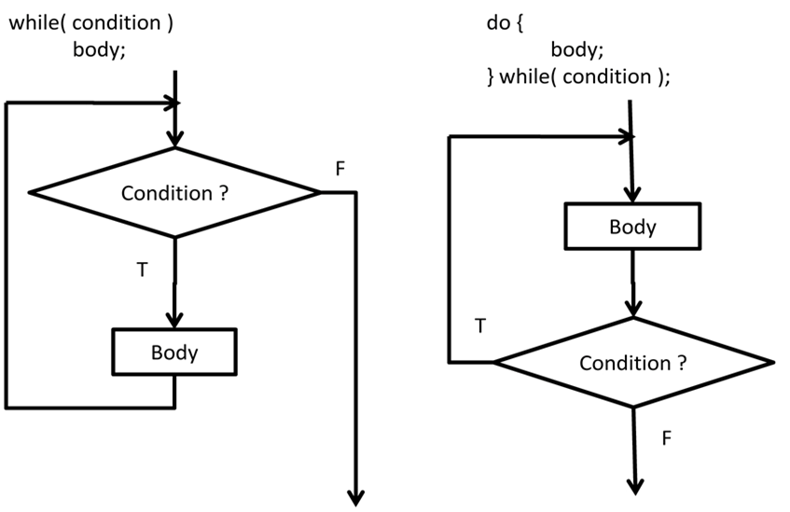

Slide 37
Factorial using while
main(){
int i=1,n=5,f=1;
while(i<=n){
f = f*i;
i++;
}
printf("%d",f);
}

Slide 38
Factorial using while
main(){
int i=1,n=5,f=1;
do{
f = f*i;
i++;
} while(i<=n);
printf("%d",f);
}

Slide 39
Factorial using for
main(){
int i,n=5,f=1;
for(i=1;i<=n;i++){
f = f*i;
}
printf("%d",f);
}

Slide 40
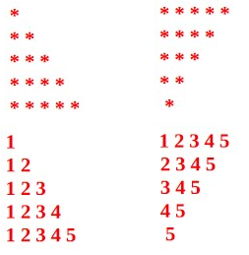
Nested loops – loop within loop

Slide 41
What is the output?
main(){
int i,j,n=6;
for(i=1;i<=n;i++){
for(j=1;j<=i;j++){
printf("*");
}
printf("\n");
}}

Slide 42
break and continue
Break statement helps to break from the immediate local loop for certain condition.
main(){
int i,j;
for(i=1;i<=10;i++){
if(i%6==0) break; //if the number is div by 6
}
printf("i=%d",i); //output i=6
}

Slide 43
Continue – skip to next iteration
main(){
int i,j;
for(i=1;i<=10;i++){
if(i%3!=0) printf("i=%d\n",i);
else continue; //skip to next iteration
}}
//output – 1 2 4 5 7 8 10

