Slide 1
Number System Number Representation

Slide 2
Topics to be Discussed
How are numeric data items actually stored in computer memory?
How much space (memory locations) is allocated for each type of data?
int, float, char, etc.
How are characters and strings stored in memory?

Slide 3
Number System :: The Basics
We are accustomed to using the so-called decimal number system.
Ten digits :: 0,1,2,3,4,5,6,7,8,9
Every digit position has a weight which is a power of 10.
Base or radix is 10.
Example:
= 2 x 10² + 3 x 10¹ + 4 x 10⁰
250.67 = 2 x 10² + 5 x 10¹ + 0 x 10⁰ +
6 x 10⁻¹ + 7 x 10⁻²

Slide 4
Binary Number System
Two digits:
0 and 1.
Every digit position has a weight which is a power of 2.
Base or radix is 2.
Example:
110 = 1 x 2² + 1 x 2¹ + 0 x 2⁰
101.01 = 1 x 2² + 0 x 2¹ + 1 x 2⁰ +
0 x 2⁻¹ + 1 x 2⁻²

Slide 5
Counting with Binary Numbers
Values with more than two states require multiple bits
A collection of two bits has four possible states:
00,01,10,11
a collection of eight possible states:
000,001,010,011,100,101,110,111
A collection of n bits has 2n possible states
0
1
10
11
100
101
110
111
1000
.

Slide 6
Multiplication and Division with base
Multiplication with 10 (decimal system)
435 x 10 = 4350
Multiplication with 10 (=2 ) (binary system)
1101 x 10 = 11010
Division by 10 (decimal system)
435 / 10 = 43.5
Division by 10 (=2) (binary system)
1101 / 10 = 110.1
Left Shift and add
zero at right end
Right shift and drop
right most digit or
shift after decimal
point

Slide 7
Adding two bits
Carries
0 + 0 = 0
0 + 1 = 1
1 + 0 = 1
1 + 1 = 10
1 1 1 0
1 0 1 1
+ 1 1 1 0
1 1 0 0 1
carry

Slide 8
Binary addition: Another example
The initial carry
in is implicitly 0
1 1 0 0 (Carries)
1 1 0 1
+ 1 1 0 0
1 1 0 0 1 (Sum)
most significant
bit (MSB)
least significant
bit (LSB)

Slide 9
Binary-to-Decimal Conversion
Each digit position of a binary number has a weight.
Some power of 2.
A binary number:
B = b_{n-1} b_{n-2} …..b₁ b₀ . b₋₁ b₋₂ ….. b_{-m}
Corresponding value in decimal:
D = Σ b_{i} 2^{i}
n-1
i = -m

Slide 10
Examples
101011 ➔ 1x2⁵ + 0x2⁴ + 1x2³ + 0x2² + 1x2¹ + 1x2⁰
= 43
(101011)₂ = (43)₁₀
.0101 ➔ 0x2⁻¹ + 1x2⁻² + 0x2⁻³ + 1x2⁻⁴
= .3125
(.0101)₂ = (.3125)₁₀
101.11 ➔ 1x2² + 0x2¹ + 1x2⁰ + 1x2⁻¹ + 1x2⁻²
5.75
(101.11)₂ = (5.75)₁₀

Slide 11
Decimal-to-Binary Conversion
Consider the integer and fractional parts separately.
For the integer part,
Repeatedly divide the given number by 2, and go on accumulating the remainders, until the number becomes zero.
Arrange the remainders in reverse order.
For the fractional part,
Repeatedly multiply the given fraction by 2.
Accumulate the integer part (0 or 1).
If the integer part is 1, chop it off.
Arrange the integer parts in the order they are obtained.

Slide 12
Example 1 :: 239
239
2 119 --- 1
59 --- 1
2 29 --- 1
14 --- 1
2 7 --- 0
3 --- 1
2 1 --- 1
2 0 --- 1
(239)₁₀ = (11101111)₂

Slide 13
Example 2 :: 64
64
2 32 --- 0
16 --- 0
2 8 --- 0
4 --- 0
2 2 --- 0
1 --- 0
2 0 --- 1
(64)₁₀ = (1000000)₂

Slide 14
Example 3 :: .634
.634 x 2 = 1.268
.268 x 2 = 0.536
.536 x 2 = 1.072
.072 x 2 = 0.144
.144 x 2 = 0.288
:
:
(.634)₁₀ = (.10100……)₂

Slide 15
Example 4 :: 37.0625
(37)₁₀ = (100101)₂
(.0625)₁₀ = (.0001)₂
(37.0625)₁₀ = (100101 . 0001)₂

Slide 16
Hexadecimal Number System
A compact way of representing binary numbers.
16 different symbols (radix = 16).
0 → 0000 8 → 1000
1 → 0001 9 → 1001
2 → 0010 A → 1010
3 → 0011 B → 1011
4 → 0100 C → 1100
5 → 0101 D → 1101
6 → 0110 E → 1110
7 → 0111 F → 1111

Slide 17
Binary-to-Hexadecimal Conversion
For the integer part,
Scan the binary number from right to left.
Translate each group of four bits into the corresponding hexadecimal digit.
Add leading zeros if necessary.
For the fractional part,
Scan the binary number from left to right.
Translate each group of four bits into the corresponding hexadecimal digit.
Add trailing zeros if necessary.

Slide 18
Example
(1011 0100 0011)₂ = (B43)₁₆
(10 1010 0001)₂ = (2A1)₁₆
(.1000 010)₂ = (.84)₁₆
(101 . 0101 111)₂ = (5.5E)₁₆

Slide 19
Hexadecimal-to-Binary Conversion
Translate every hexadecimal digit into its 4-bit binary equivalent.
Examples:
(3A5)₁₆ = (0011 1010 0101)₂
(12.3D)₁₆ = (0001 0010 . 0011 1101)₂
(1.8)₁₆ = (0001 . 1000)₂

Slide 20
Some Important (number) data Types
Unsigned integers: 0,1,2,3,4…..
Signed integers: -3, -2, -1, 0, 1, 2, 3
Floating point numbers:
PI=3.14154 X 10⁰

Slide 21
Unsigned Binary Numbers
An n-bit binary number
B = b_{n-1}b_{n-2} …. b₂b₁b₀
2^{n} distinct combinations are possible, 0 to 2^{n}-1.
For example, for n = 3, there are 8 distinct combinations.
000, 001, 010, 011, 100, 101, 110, 111
Range of numbers that can be represented
n=8 ➔ 0 to 2⁸-1 (255)
n=16 ➔ 0 to 2¹⁶-1 (65535)
n=32 ➔ 0 to 2³²-1 (4294967295)

Slide 22
Word size
Every real computer has base word size:
16 bit, 32 bit, and 64 bit
Memory fetches are word by word
Even if you want 8 bit (a byte)

Slide 23
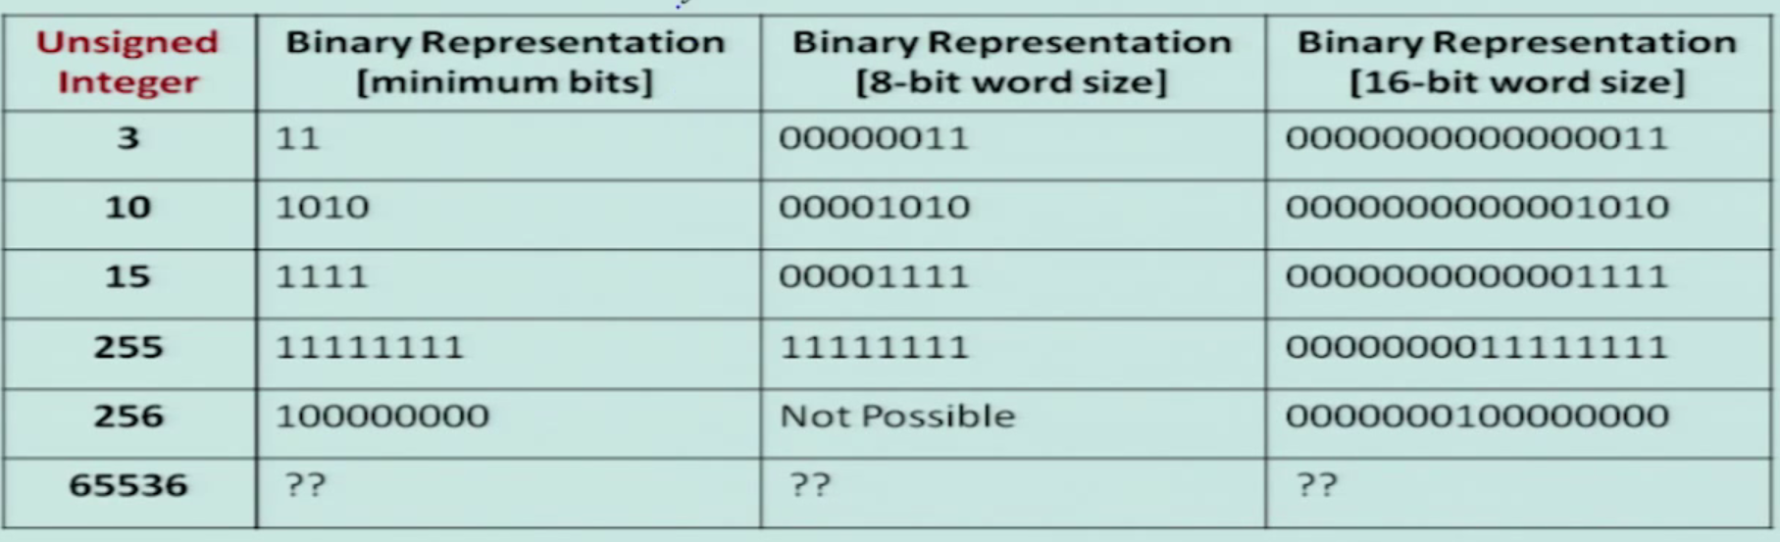
Word Size

Slide 24
Signed Integer Representation
Many of the numerical data items that are used in a program are signed (positive or negative).
With n bits we have 2^{n} distinct values.
Assign about half to positive integers (1 through 2^{n} -1)
and another half - 2^{n} -1 through -1
Question:: How to represent sign?
Three possible approaches:
Sign-magnitude representation
One’s complement representation
Two’s complement representation

Slide 25
Sign-magnitude Representation
For an n-bit number representation
The most significant bit (MSB) indicates sign
0 → positive
1 → negative
The remaining n-1 bits represent magnitude.
b_{n-1}
b_{n-2}
b₁
b₀
Sign
Magnitude

Slide 26
Representation and ZERO
Range of numbers that can be represented:
Maximum :: + (2^{n-1} – 1)
Minimum :: − (2^{n-1} – 1)
A problem:
Two different representations of zero.
+0 → 0 000….0
-0 → 1 000….0

Slide 27
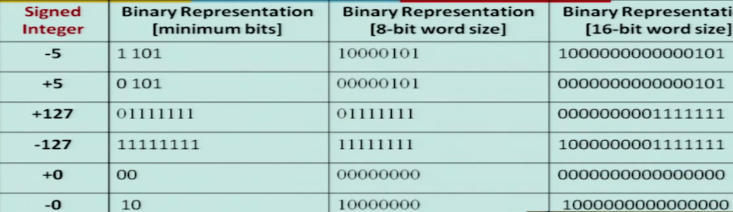
Examples

Slide 28
Sign Magnitude Representation
Easy to understand and encode
One problem : two representation of 0 (-0 and +0)
Addition of K + (-K) does not give 0
-5 + 5 = (1000 0101)₂ + (0000 0101)₂
= (1000 1010)₂
= (10)₁₀

Slide 29
One’s Complement Representation
Basic idea:
Positive numbers are represented exactly as in sign-magnitude form.
Negative numbers are represented in 1’s complement form.
How to compute the 1’s complement of a number?
Complement every bit of the number (1→0 and 0→1).
MSB will indicate the sign of the number.
0 → positive
1 → negative

Slide 30
Example :: n=4
0000 → +0
0001 → +1
0010 → +2
0011 → +3
0100 → +4
0101 → +5
0110 → +6
0111 → +7
1000 → -7
1001 → -6
1010 → -5
1011 → -4
1100 → -3
1101 → -2
1110 → -1
1111 → -0
To find the representation of -4, first note that
+4 = 0100
-4 = 1’s complement of 0100 = 1011

Slide 31
One’s Complement Representation
Range of numbers that can be represented:
Maximum :: + (2^{n-1} – 1)
Minimum :: − (2^{n-1} – 1)
A problem:
Two different representations of zero.
+0 → 0 000….0
-0 → 1 111….1
Advantage of 1’s complement representation
Subtraction can be done using addition.
Leads to substantial saving in circuitry.

Slide 32
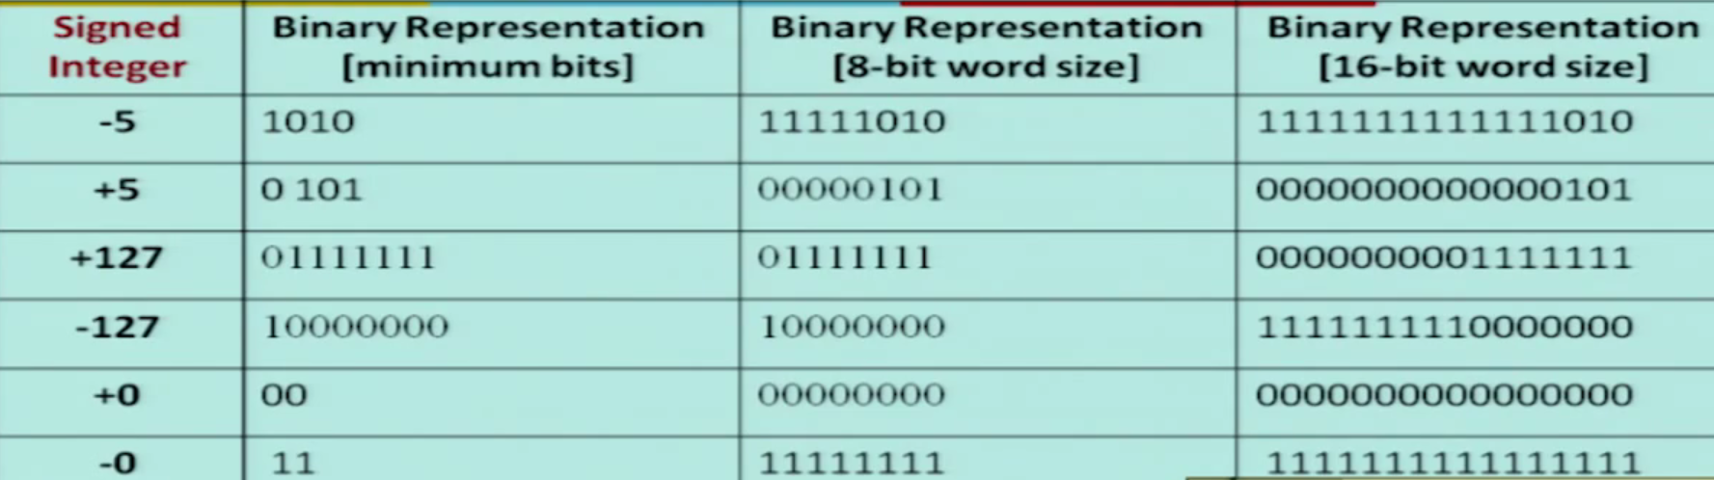
Examples

Slide 33
Two’s Complement Representation
Basic idea:
Positive numbers are represented exactly as in sign-magnitude form.
Negative numbers are represented in 2’s complement form.
How to compute the 2’s complement of a number?
Complement every bit of the number (1→0 and 0→1), and then add one to the resulting number.
MSB will indicate the sign of the number.
0 → positive
1 → negative

Slide 34
Example :: n=4
0000 → +0
0001 → +1
0010 → +2
0011 → +3
0100 → +4
0101 → +5
0110 → +6
0111 → +7
1000 → -8
1001 → -7
1010 → -6
1011 → -5
1100 → -4
1101 → -3
1110 → -2
1111 → -1
To find the representation of, say, -4, first note that
+4 = 0100
-4 = 2’s complement of 0100 = 1011+1 = 1100

Slide 35
Storage and number system in Programming
In C
short int
16 bits ➔ + (2¹⁵-1) to -2¹⁵
int
32 bits ➔ + (2³¹-1) to -2³¹
long int
64 bits ➔ + (2⁶³-1) to -2⁶³

Slide 36
Storage and number system in Programming
Range of numbers that can be represented:
Maximum :: + (2^{n-1} – 1)
Minimum :: − 2^{n-1}
Advantage:
Unique representation of zero.
Subtraction can be done using addition.
Leads to substantial saving in circuitry.
Almost all computers today use the 2’s complement representation for storing negative numbers.

Slide 37
Subtraction Using Addition :: 1’s Complement
How to compute A – B ?
Compute the 1’s complement of B (say, B₁).
Compute R = A + B₁
If the carry obtained after addition is ‘1’
Add the carry back to R (called end-around carry).
That is, R = R + 1.
The result is a positive number.
Else
The result is negative, and is in 1’s complement form.

Slide 38
Example 1 :: 6 – 2
A = 6 (0110)
B = 2 (0010)
6 – 2 = A - B
1’s complement of 2 = 1101
6 :: 0110
-2 :: 1101
1 0011
1
0100 ➔ +4
A
Assume 4-bit representations.
Since there is a carry, it is added back to the result.
The result is positive.
B₁
R
End-around carry

Slide 39
Example 2 :: 3 – 5
1’s complement of 5 = 1010
3 :: 0011
-5 :: 1010
1101
A
B₁
R
Assume 4-bit representations.
Since there is no carry, the result is negative.
1101 is the 1’s complement of 0010, that is, it represents –2.
-2

Slide 40
Subtraction Using Addition :: 2’s Complement
How to compute A – B ?
Compute the 2’s complement of B (say, B₂).
Compute R = A + B₂
Ignore carry if it is there.
The result is in 2’s complement form.

Slide 41
Example 1 :: 6 – 2
2’s complement of 2 = 1101 + 1 = 1110
6 :: 0110
-2 :: 1110
1 0100
A
B₂
R
Ignore carry
+4

Slide 42
Example 2 :: 3 – 5
2’s complement of 5 = 1010 + 1 = 1011
3 :: 0011
-5 :: 1011
1110
A
B₂
R
-2

Slide 43
Example 3 :: -3 – 5
2’s complement of 3 = 1100 + 1 = 1101
2’s complement of 5 = 1010 + 1 = 1011
-3 :: 1101
-5 :: 1011
1 1000
Ignore carry
-8

Slide 44
Floating-point Numbers
The representations discussed so far applies only to integers.
Cannot represent numbers with fractional parts.
We can assume a decimal point before a 2’s complement number.
In that case, pure fractions (without integer parts) can be represented.
We can also assume the decimal point somewhere in between.
This lacks flexibility.
Very large and very small numbers cannot be represented.

Slide 45
Representation of Floating-Point Numbers
A floating-point number F is represented by a doublet <M,E> :
F = M x B^{E}
B → exponent base (usually 2)
M → mantissa
E → exponent
M is usually represented in 2’s complement form, with an implied decimal point before it.
For example,
In decimal,
0.235 x 10⁶
In binary,
0.101011 x 2⁰¹¹⁰

Slide 46
Example :: 32-bit representation
M represents a 2’s complement fraction
1 > M > -1
E represents the exponent (in 2’s complement form)
127 > E > -128
Points to note:
The number of significant digits depends on the number of bits in M.
6 significant digits for 24-bit mantissa.
The range of the number depends on the number of bits in E.
10³⁸ to 10⁻³⁸ for 8-bit exponent.
M
E
24
8

Slide 47
Floating point number: IEEE Standard 754
Storage Layout
 | Sign | Exponent | Fraction / Mantissa
Single Precision | 1 [31] | 8 [30–23] | 23 [22–00]
Double Precision | 1 [63] | 11 [62–52] | 52 [51–00]
Single: SEEEEEEE EMMMMMMM MMMMMMMM MMMMMMMM
Double: SEEEEEEE EEEEMMMM MMMMMMMM MMMMMMMM MMMMMMMM MMMMMMMM MMMMMMMM MMMMMMMM

Slide 48
IEEE Standard 754
The sign bit is 0 for positive, 1 for negative.
The exponent base is two.
The exponent field contains 127 plus the true exponent for single-precision, or 1023 plus the true exponent for double precision.
The first bit of the mantissa is typically assumed to be 1.f, where f is the field of fraction bits.
Ranges of Floating-Point Numbers
Since every floating-point number has a corresponding, negated value (by toggling the sign bit), the ranges above are symmetric around zero.

Slide 49
IEEE Standard 754
Ranges of Floating-Point Numbers
Since every floating-point number has a corresponding, negated value (by toggling the sign bit), the ranges above are symmetric around zero.
 | Denormalized | Normalized | Approximate Decimal
Single Precision | ± 2⁻¹⁴⁹ to (1−2⁻²³)×2⁻¹²⁶ | ± 2⁻¹²⁶ to (2−2⁻²³)×2¹²⁷ | ± ≈10^{−44.85} to ≈10^{38.53}
Double Precision | ± 2⁻¹⁰⁷⁴ to (1−2⁻⁵²)×2⁻¹⁰²² | ± 2⁻¹⁰²² to (2−2⁻⁵²)×2¹⁰²³ | ± ≈10^{−323.3} to ≈10^{308.3}

Slide 50
IEEE Standard 754
There are five distinct numerical ranges that single-precision floating-point numbers are not able to represent:
Negative numbers less than −(2−2⁻²³) × 2¹²⁷ (negative overflow)
Negative numbers greater than −2⁻¹⁴⁹ (negative underflow)
Zero
Positive numbers less than 2⁻¹⁴⁹ (positive underflow)
Positive numbers greater than (2−2⁻²³) × 2¹²⁷ (positive overflow)

Slide 51
Special Values
Zero
−0 and +0 are distinct values
Denormalized
If the exponent is all 0s, but the fraction is non-zero, then the value is a denormalized number, which now has an assumed leading 0 before the binary point.
Thus, this represents a number (−1)^{s} × 0.f × 2⁻¹²⁶, where s is the sign bit and f is the fraction.
For double precision, denormalized numbers are of the form (−1)^{s} × 0.f × 2⁻¹⁰²².
From this you can interpret zero as a special type of denormalized number.

Slide 52
Special Values
Infinity
The values +∞ and −∞ are denoted with an exponent of all 1s and a fraction of all 0s. The sign bit distinguishes between negative infinity and positive infinity. Being able to denote infinity as a specific value is useful because it allows operations to continue past overflow situations. Operations with infinite values are well defined in IEEE floating point.
Not A Number
The value NaN (Not a Number) is used to represent a value that does not represent a real number. NaN's are represented by a bit pattern with an exponent of all 1s and a non-zero fraction.

Slide 53
Representation of Characters
Many applications have to deal with non-numerical data.
Characters and strings.
There must be a standard mechanism to represent alphanumeric and other characters in memory.
Three standards in use:
Extended Binary Coded Decimal Interchange Code (EBCDIC)
Used in older IBM machines.
American Standard Code for Information Interchange (ASCII)
Most widely used today.
UNICODE
Used to represent all international characters.
Used by Java.

Slide 54
ASCII Code
Each individual character is numerically encoded into a unique 7-bit binary code.
A total of 2⁷ or 128 different characters.
A character is normally encoded in a byte (8 bits), with the MSB not been used.
The binary encoding of the characters follow a regular ordering.
Digits are ordered consecutively in their proper numerical sequence (0 to 9).
Letters (uppercase and lowercase) are arranged consecutively in their proper alphabetic order.

Slide 55
Some Common ASCII Codes
‘A’ :: 41 (H) 65 (D)
‘B’ :: 42 (H) 66 (D)
………..
‘Z’ :: 5A (H) 90 (D)
‘a’ :: 61 (H) 97 (D)
‘b’ :: 62 (H) 98 (D)
………..
‘z’ :: 7A (H) 122 (D)
‘0’ :: 30 (H) 48 (D)
‘1’ :: 31 (H) 49 (D)
………..
‘9’ :: 39 (H) 57 (D)
‘(‘ :: 28 (H) 40 (D)
‘+’ :: 2B (H) 43 (D)
‘?’ :: 3F (H) 63 (D)
‘\n’ :: 0A (H) 10 (D)
‘\0’ :: 00 (H) 00 (D)

Slide 56
Character Strings
Two ways of representing a sequence of characters in memory.
The first location contains the number of characters in the string, followed by the actual characters.
The characters follow one another, and is terminated by a special delimiter.
5
H
e
l
l
o
H
e
l
l
o
⊥

Slide 57
String Representation in C
In C, the second approach is used.
The ‘\0’ character is used as the string delimiter.
Example:
“Hello” ➔
A null string “” occupies one byte in memory.
Only the ‘\0’ character.
H
e
l
l
o
‘\0’

Slide 58
Problem 7
Given 2 positive numbers n and r, n>=r , write a C function to compute the number of combinations(^{n}C_{r}) and the number of permutations(^{n}P_{r}).
Permutations formula is P(n,r)=n!/(n-r)!
Combinations formula is C(n,r)=n!/(r!(n-r)!)

Slide 59
Problem 8
Scope of variable:
What is the output of the following code snippet?
#include <stdio.h>
int main(){
int i = 10;
for(int i = 5; i < 15; i++)
printf(“i is %d\n”, i);
return 0;
}

Slide 60
Problem 9
Scope of variable: What is the output of the following code snippet?
#include <stdio.h>
int a = 20;
int sum(int a, int b) {
printf ("value of a in sum() = %d\n", a);
printf ("value of b in sum() = %d\n", b);
return a + b;
}
int main ()
{
int a = 10; int b = 20; int c = 0;
printf ("value of a in main() = %d\n", a);
c = sum( a, b);
printf ("value of c in main() = %d\n", c);
return 0;
}

Slide 61
Problem 10
Write a C program which display the entered number in words.
Example:
Input:
Enter a number: 7
Output:
Seven

Slide 62
Problem 11
Write a C program to delete duplicate elements in an array without using another auxiliary array.
Example:
Input:
5 8 5 5 6 9 8 2 1 1 3 3
Output:
5 8 6 9 2 1 3

Slide 63
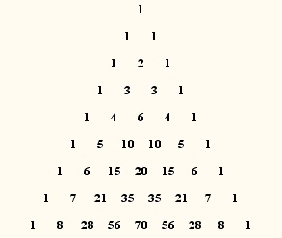
Problem 12
Write a C program to print PASCAL’s triangle.

Slide 64
Problem 13
Given 2 numbers a and b, write a C program to compute the Greatest Common Divisor(GCD) of the 2 numbers.
The GCD of 2 numbers is the largest positive integer that divides the numbers without a remainder.
Example: GCD(2,8)=2; GCD(3,7)=1

Slide 65
Problem 14
Given 2 arrays of integers A and B of size n each, write a C program to calculate the dot product of the 2 arrays.
If A=[a₀, a₁, a₂,….,a_{n-1}] and
B= [b₀, b₁, b₂,….,b_{n-1}],
the dot product of A and B is given by
A.B=[a₀*b₀ + a₁*b₁ + a₂*b₂ + ……. + a_{n-1}*b_{n-1}]

Slide 66
Problem 15
Given a non negative integer n, write a C function to output the decimal integer(base 10) in its binary representation (base 2).
Example: Binary representation of
3 is 11
8 is 1000
15 is 1111

Slide 67
Problem 16
Given two array of sorted numbers A and B, both are of arbitrary sizes, write a C function named merge_arrays that merges both the arrays in sorted order and returns the sorted array C.

