Slide 1
Welcome To
Object Oriented Programing using C++
Lec-2

Slide 2

Lecture 2-3 C++ Basic Constructs

Slide 3
Contents
Structures in C++
Console Input and Output
C++ Tokens
Type Casting
Control Structures

Slide 4
Structure in C++
#include <iostream>
using namespace std;
struct Person{int age;};
int main(){
Person p1; // No need to write struct Person p1 in C++.
cout << "Enter age: ";cin >> p1.age;
cout <<"Age: " << p1.age << endl;
return 0;
}

Slide 5
Structures in C++ vs in C
Functions can be defined inside structure in C++
Using struct keyword not required in C++
C++ structures can have static members
C++ allows data hiding by using access modifiers

Slide 6
#include <iostream>
using namespace std;
struct Person{
int age; //variable
int setAge(int a){age = a;} //function
int display() {cout <<"Age: " << age << endl;} //function
};
int main(){
Person p1;
p1.setAge(20); p1.display();
return 0;
}

Slide 7
Need more knowledge for 3 & 4
Functions can be defined inside structure in C++
Using struct keyword not required in C++
C++ structures can have static members
C++ allows data hiding by using access modifiers

Slide 8
Console Input and Output

Slide 9
Console Input / Output
I/O objects cin, cout
Defined in the C++ library called <iostream>
Must have these lines (called pre-processor directives) near start of file:
#include <iostream> using namespace std;
Tells C++ to use appropriate library so we can use the I/O objects cin, cout

Slide 10
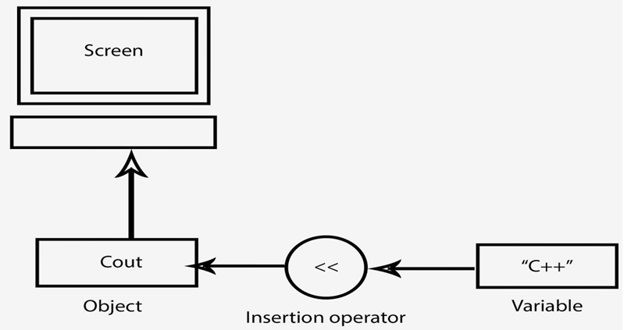
Console Output
Output using Insertion Operator
**cout: Standard Output Stream

Slide 11
Console Output
What can be outputted?
Any data can be outputted to display screen
Variables
Constants
Literals
Expressions (which can include all of above)
cout << numberOfGames << " games played."; 2 values are outputted: "value" of variable numberOfGames, literal string " games played."
Cascading: multiple values in one cout

Slide 12
Separating Lines of Output
New lines in output
Recall: "\n" is escape sequence for the char "newline"
A second method: object endl
Examples:
cout << "Hello World\n";
Sends string "Hello World" to display, & escape sequence "\n", skipping to next line
cout << "Hello World" << endl;
Same result as above

Slide 13
Input Using cin
cin for input, cout for output
Differences:
">>" (extraction operator) points opposite
Think of it as "pointing toward where the data goes"
Object name "cin" used instead of "cout"
No literals allowed for cin
Must input "to a variable"
cin >> num;
Waits on-screen for keyboard entry
Value entered at keyboard is "assigned" to num

Slide 14
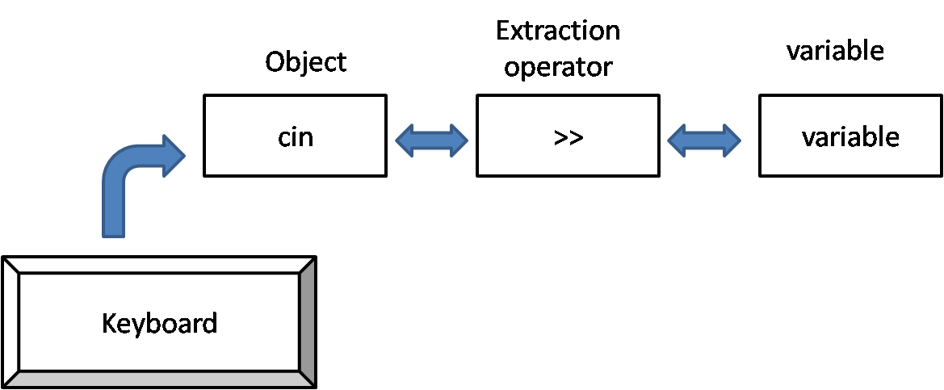
Console Input
Input using Extraction Operator
**cin: Standard Input Stream

Slide 15
Prompting for Input: cin and cout
Always "prompt" user for input cout << "Enter number of dragons: "; cin >> numOfDragons;
Note no "\n" in cout. Prompt "waits" on same line for keyboard input as follows:
Enter number of dragons: ____
Underscore above denotes where keyboard entry is made

Slide 16
Namespaces
Namespaces defined:
Collection of name definitions
For now: interested in namespace "std"
Has all standard library definitions we need
Examples: #include <iostream> using namespace std;
Includes entire standard library of name definitions
#include <iostream>using std::cin; using std::cout;
Can specify just the objects we want

Slide 17
C++ Tokens

Slide 18
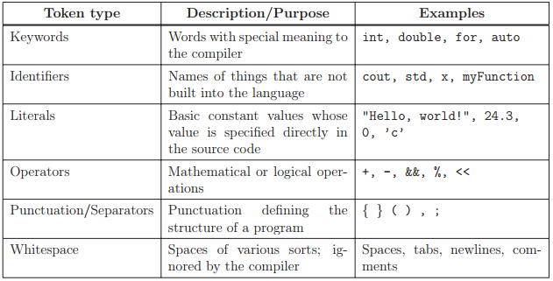
C++ Tokens
Tokens are the minimal chunk of program that have meaning to the compiler – the smallest meaningful symbols in the language.

Slide 19
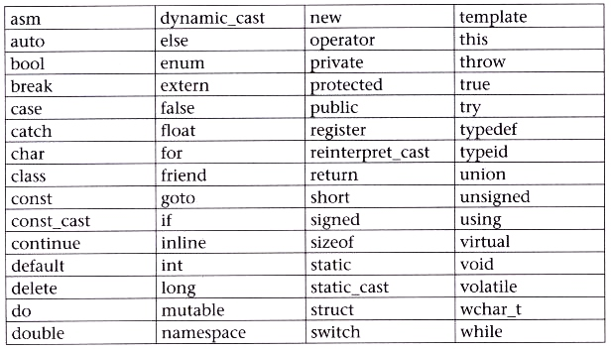
C++ Keywords

Slide 20
C++ Identifiers
User defined names
Rules
An identifier can consist of alphabets, digits and/or underscores.
It must not start with a digit.
C++ is case sensitive i.e., upper case and lower case letters are considered differently.
It should not be a reserved word/ declared keyword.

Slide 21
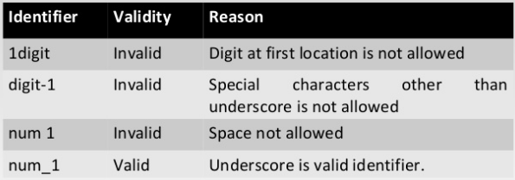
C++ Identifiers

Slide 22
C++ Variables
A memory location to store data for a program
Must declare all data before use in program

Slide 23
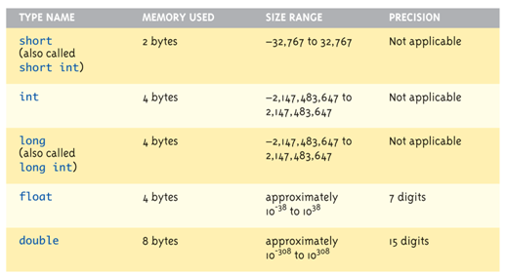
Simple Data Types (1 of 2)

Slide 24
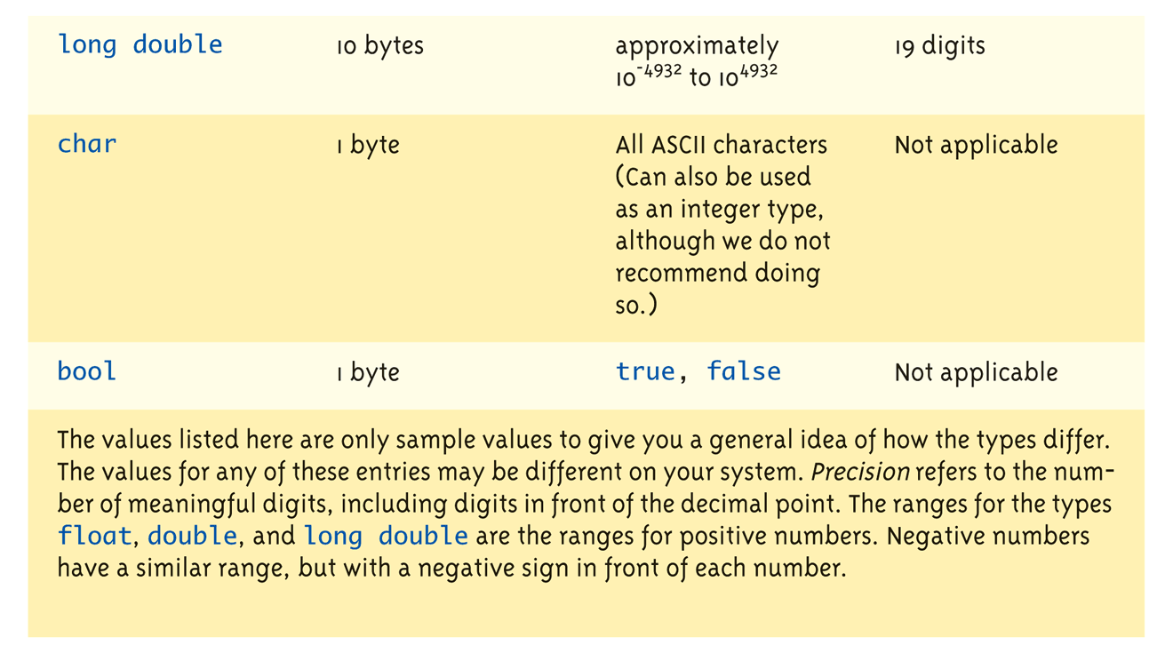
Simple Data Types: (2 of 2)

Slide 25
Literal Data
Literals
Examples:
2 // Literal constant int
5.75 // Literal constant double
‘Z’ // Literal constant char
"Hello World" // Literal constant string
Cannot change values during execution
Called "literals" because you "literally typed" them in your program!

Slide 26
Escape Sequences
"Extend" character set
Backslash, \ preceding a character
Instructs compiler: a special "escape character" is coming
Following character treated as "escape sequence char"

Slide 27
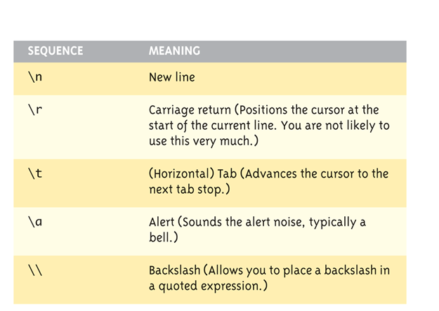
Some Escape Sequences (1 of 2)

Slide 28
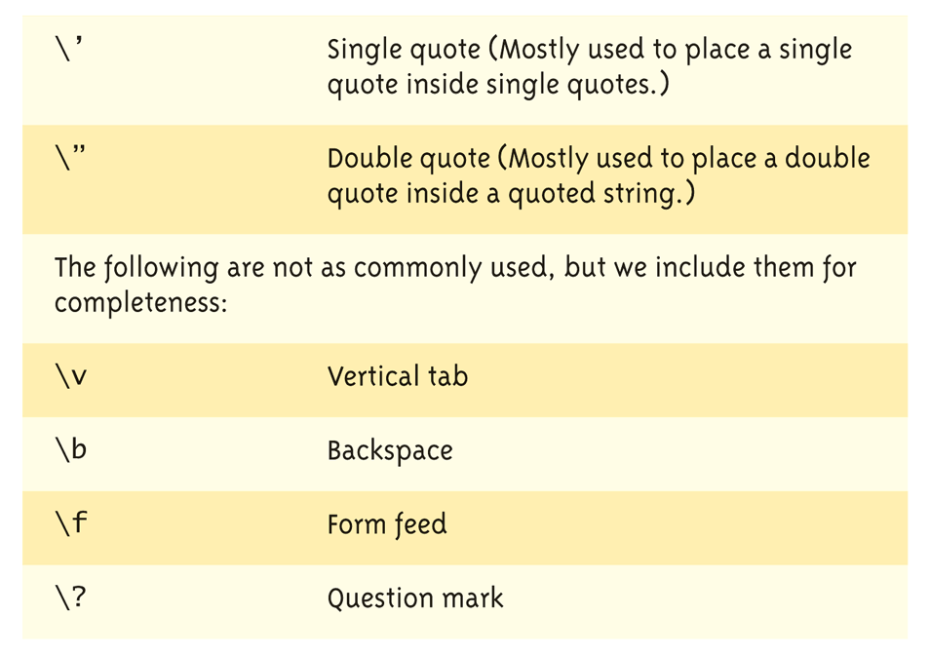
Some Escape Sequences (2 of 2)

Slide 29
C++ Constants
Naming your constants
Literal constants are "OK", but provide little meaning
Use named constants instead
Meaningful name to represent data const int NUMBER_OF_STUDENTS = 24;
Called a "declared constant" or "named constant"
Now use it’s name wherever needed in program

Slide 30
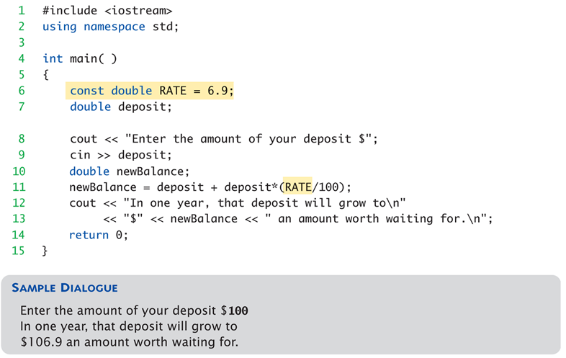
Usage of Named Constant

Slide 31
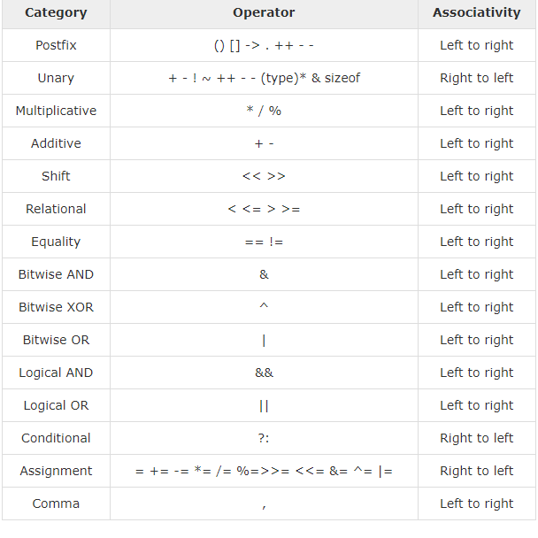
Different Types of Operators

Slide 32
Precedence Examples
Arithmetic before logical
x + 1 > 2 || x + 1 < -3 means:
(x + 1) > 2 || (x + 1) < -3
Short-circuit evaluation
(x >= 0) && (y > 1)
Be careful with increment operators!
(x > 1) && (y++)
Integers as boolean values
All non-zero values 🡪 true
Zero value 🡪 false

Slide 33
Type Casting

Slide 34
Assigning Data
Initializing data in declaration statement
int myValue = 0;
Assigning data during execution
Lvalues (left-side) & Rvalues (right-side)
Lvalues must be variables
Rvalues can be any expression
Example: distance = rate * time; Lvalue: "distance" Rvalue: "rate * time"

Slide 35
Data Assignment Rules
Compatibility of Data Assignments
Type mismatches
General Rule: Cannot place value of one type into variable of another type
intVar = 2.99; // 2 is assigned to intVar!
Only integer part "fits", so that’s all that goes
Called "implicit" or "automatic type conversion"
Literals
2, 5.75, ‘Z’, "Hello World"
Considered "constants": can’t change in program

Slide 36
Arithmetic Precision
Precision of Calculations
VERY important consideration!
Expressions in C++ might not evaluate as you’d "expect"!
"Highest-order operand" determines type of arithmetic "precision" performed
Common pitfall!

Slide 37
Arithmetic Precision Examples
Examples:
17 / 5 evaluates to 3 in C++!
Both operands are integers
Integer division is performed!
17.0 / 5 equals 3.4 in C++!
Highest-order operand is "double type"
Double "precision" division is performed!
int intVar1 =1, intVar2=2; intVar1 / intVar2;
Performs integer division!
Result: 0!

Slide 38
Individual Arithmetic Precision
Calculations done "one-by-one"
1 / 2 / 3.0 / 4 performs 3 separate divisions.
First🡪 1 / 2 equals 0
Then🡪 0 / 3.0 equals 0.0
Then🡪 0.0 / 4 equals 0.0 !!
So not necessarily sufficient to change just "one operand" in a large expression
Must keep in mind all individual calculations that will be performed during evaluation!

Slide 39
Type Casting
Casting for Variables
Can add ".0" to literals to force precision arithmetic, but what about variables?
We can’t use "myInt.0" !

Slide 40
Type Casting
Two types
Implicit—also called "Automatic"
Done FOR you, automatically 17 / 5.5 This expression causes an "implicit type cast" to take place, casting the 17 🡪 17.0
Explicit type conversion
Programmer specifies conversion with cast operator (double)17 / 5.5 Same expression as above, using explicit cast (double) myInt / myDouble More typical use; cast operator on variable

Slide 41
Control Structures

Slide 42
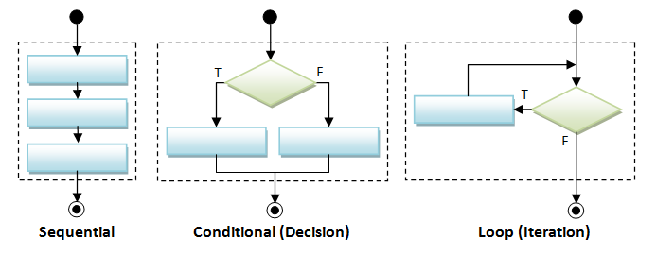
Control Structures

Slide 43
Branching Mechanisms
if-else statements
Choice of two alternate statements based on condition expression
Example: if (hrs > 40) grossPay = rate*40 + 1.5*rate*(hrs-40); else grossPay = rate*hrs;

Slide 44
if-else Statement Syntax
Formal syntax: if (<boolean_expression>)
{ <yes_statement>
} else
{ <no_statement>
}

Slide 45
Common Pitfalls
Operator "=" vs. operator "=="
One means "assignment" (=)
One means "equality" (==)
VERY different in C++!
Example: if (x = 12) 🡨Note operator used! Do_Something else Do_Something_Else

Slide 46
Conditional Operator
Also called "ternary operator"
Allows embedded conditional in expression
Essentially "shorthand if-else" operator
Example: if (n1 > n2) max = n1; else max = n2;
Can be written: max = (n1 > n2) ? n1 : n2;
"?" and ":" form this "ternary" operator

Slide 47
Nested Statements
if-else statements contain smaller statements
Can also contain any statement at all, including another if-else stmt!
Example: if (speed > 55) if (speed > 80) cout << "You’re really speeding!"; else cout << "You’re speeding.";
Note proper indenting!

Slide 48
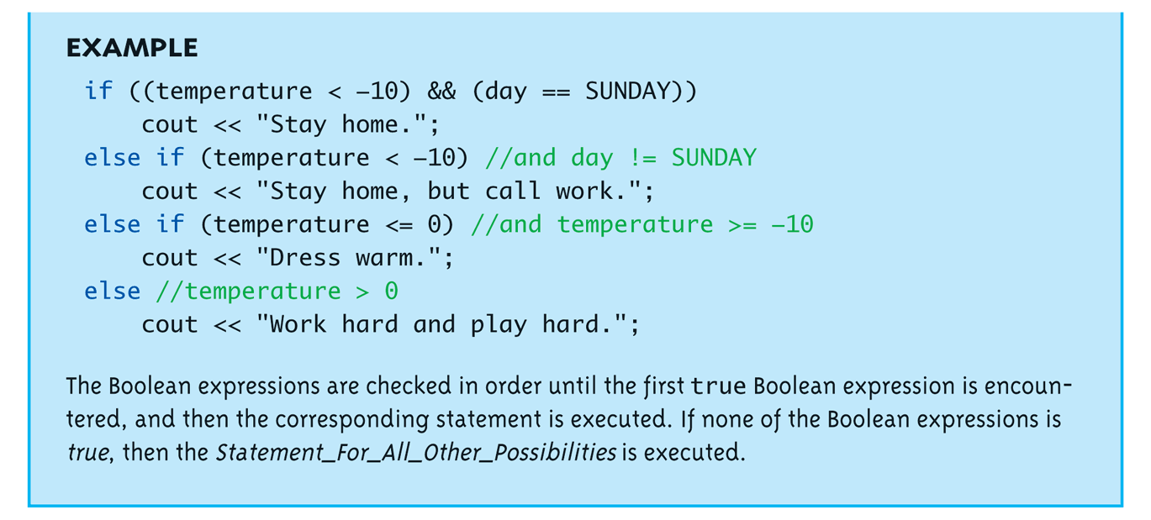
Multiway if-else Example

Slide 49
The switch Statement
A new stmt for controlling multiple branches
Uses controlling expression which returns bool data type (true or false)

Slide 50
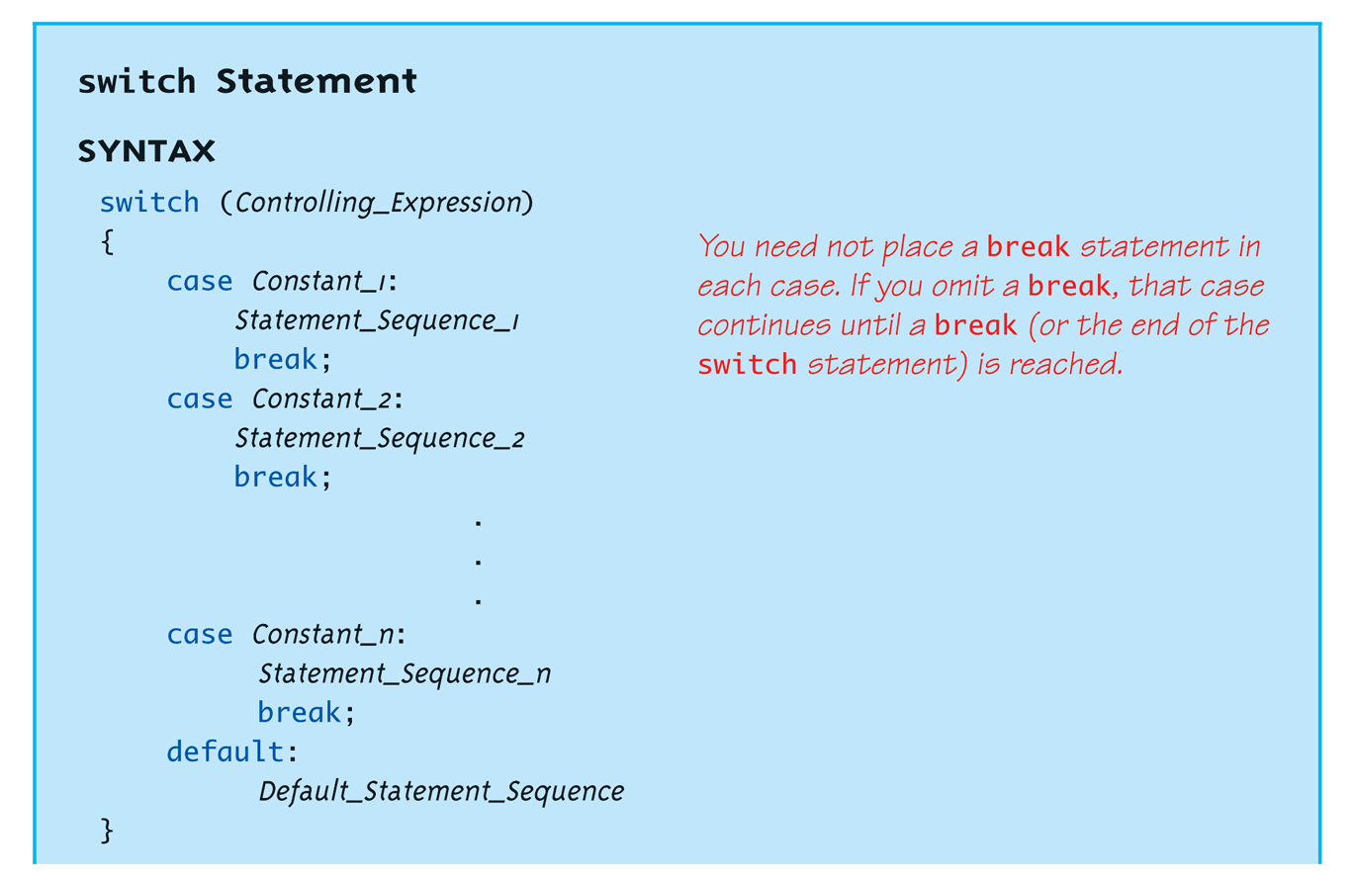
switch Statement Syntax

Slide 51
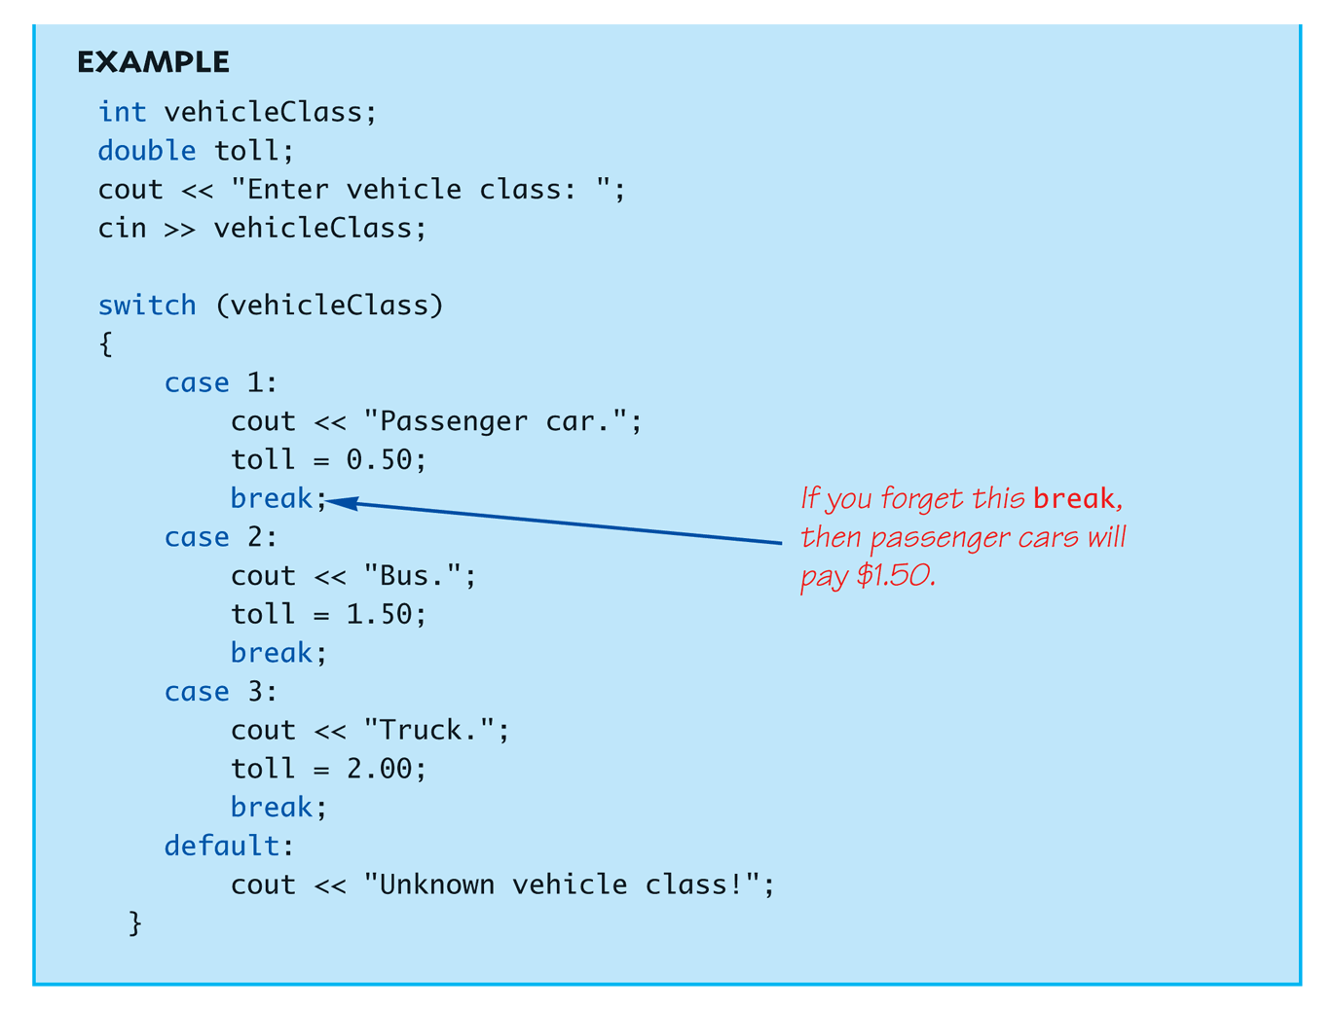
The switch Statement in Action

Slide 52
The switch: multiple case labels
Execution "falls thru" until break
switch provides a "point of entry"
Example: case "A": case "a": cout << "Excellent: you got an "A"!\n"; break; case "B": case "b": cout << "Good: you got a "B"!\n"; break;
Note multiple labels provide same "entry"

Slide 53
Loops
3 Types of loops in C++
while
Most flexible
No "restrictions"
do-while
Least flexible
Always executes loop body at least once
for
Natural "counting" loop

Slide 54
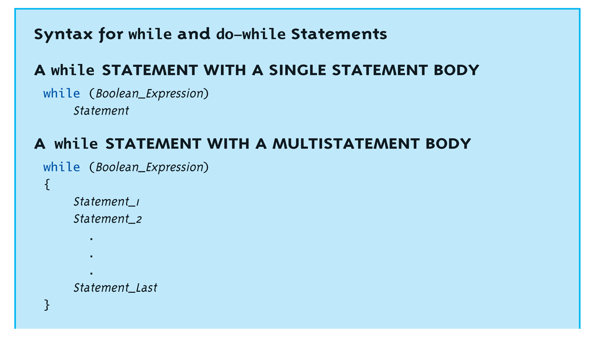
while Loops Syntax

Slide 55
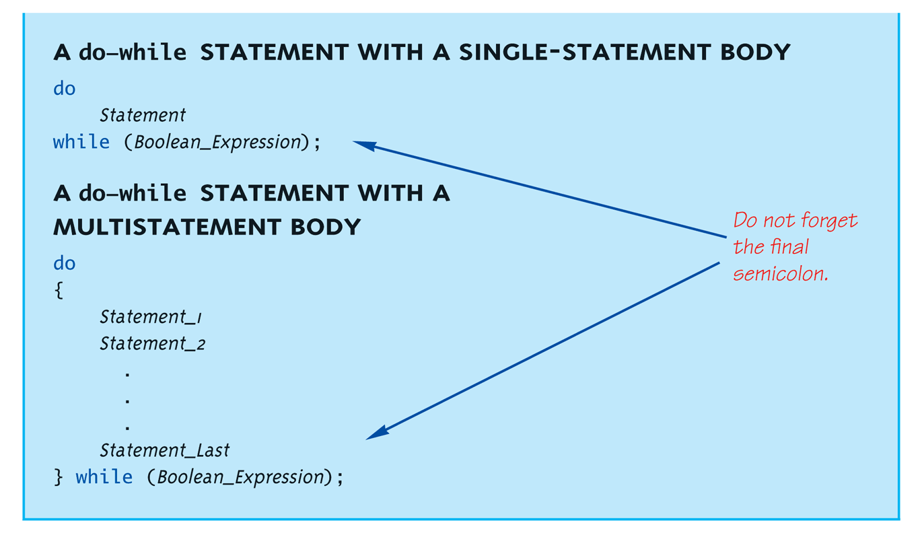
do-while Loop Syntax

Slide 56
while Loop Example
Consider: count = 0; // Initialization while (count < 3) // Loop Condition { cout << "Hi "; // Loop Body count++; // Update expression }
Loop body executes how many times?

Slide 57
do-while Loop Example
count = 0; // Initialization do { cout << "Hi "; // Loop Body count++; // Update expression } while (count < 3); // Loop Condition
Loop body executes how many times?
do-while loops always execute body at least once!

Slide 58
for Loop Syntax
for (Init_Action; Bool_Exp; Update_Action)
Body_Statement
OR
for (Init_Action; Bool_Exp; Update_Action)
{
Body_Statements
}

Slide 59
for Loop Example
for (count=0;count<3;count++) { cout << "Hi "; // Loop Body }
How many times does loop body execute?
Initialization, loop condition and update all "built into" the for-loop structure!
A natural "counting" loop

Slide 60
Nested Loops
Recall: ANY valid C++ statements can be inside body of loop
This includes additional loop statements!
Called "nested loops"
Requires careful indenting:
for (outer=0; outer<5; outer++) for (inner=7; inner>2; inner--) cout << outer << inner;
Notice no { } since each body is one statement

Slide 61
The break and continue Statements
Flow of Control
Recall how loops provide "graceful" and clear flow of control in and out
In RARE instances, can alter natural flow
break;
Forces loop to exit immediately.
continue;
Skips rest of loop body
These statements violate natural flow
Only used when absolutely necessary!

Slide 62
Thank you

