Slide 1
C++ slides - 8
Exception Handling: Exception handling mechanism, Multiple Catch Blocks, Catch All exceptions, Throw an exception, Exception Specification.

Slide 2
Exception handling definition & motivation
Exception is a run-time error, such as divide by zero, array out of bounds, file not found etc.
It helps to continue the normal flow of the application even in the case of runtime errors
It makes the code simpler, cleaner, and less likely to miss errors

Slide 3
if-else vs. exception handling
Only using errno & if-statements can make the error handling intertwine with normal code to result a spaghetti

Slide 4
Try-catch organizes the code
try{
fun1();
fun2();
fun3();
} catch(error){
// … do something if error happens in any of the functions
}
// if any of the fun() is a constructor then you have to use if-else in the constructor to handle the error since it cannot return anything, which is not neat practice.

Slide 5
Exception thrown and caught
Exception is thrown at runtime.
If an exception is not handled (caught), it prints exception message and terminates the program.
Programmer’s job is to handle possible exceptions using try, throw and catch to avoid abnormal program termination

Slide 7
Syntax of exception handling
try {
//some code
throw exception;
}
catch(type arg) {
//some code
}

Slide 8
Exception handling mechanism

Slide 9
// Without exception handling
float division(int x, int y){
return (x/y);
}
int main(){
int i=50, j=0;
float k=0;
k=division(i,j);
cout<<k<<endl;
}

Slide 10
Output
Floating point exception (core dumped)

Slide 11
// With try, throw & catch
float division(int x, int y) {
if( y == 0 ) throw “Custom msg - divide by zero!";
return (x/y);
}
int main () {
int i = 25,j = 0;
float k = 0;
try {
k = division(i, j);
cout << k << endl;
} catch (const char* e) { cout<< e << endl;}
}

Slide 12
Output
Custom msg - divide by zero!

Slide 13
// What will be the output?
float division(int x, int y) {
if( y == 0 ) throw 5;
return (x/y);
}
int main () {
float k = 0;
try {
k = division(25, k);
cout << k << endl;
}
catch (const char* e) { cout<< e << endl;}
catch(int i) {cout<<"caught i = "<<i<<endl;}
}

Slide 14
Output
caught i = 5

Slide 15
Multiple catch is possible
try {
//some code
throw exception;
}
catch(specific type exception) {//some code }
…
catch(generic type exception) { //some code }
Catch blocks must be ordered so that most specific exceptions get caught before generic exceptions.

Slide 16
// Catch all exceptions – catch(…)
int main() {
try {
throw 10;
}
catch (char *e) { cout << "Caught " << e; }
catch (...) { cout << "Default Exception\n"; }
return 0;
}

Slide 17
Output
Default Exception

Slide 18
// What will be the output?
int main() {
try {
throw "10";
}
catch (const char *e) { cout << "Caught " << e; }
catch (...) { cout << "Default Exception\n"; }
}

Slide 19
Output
Caught 10

Slide 20
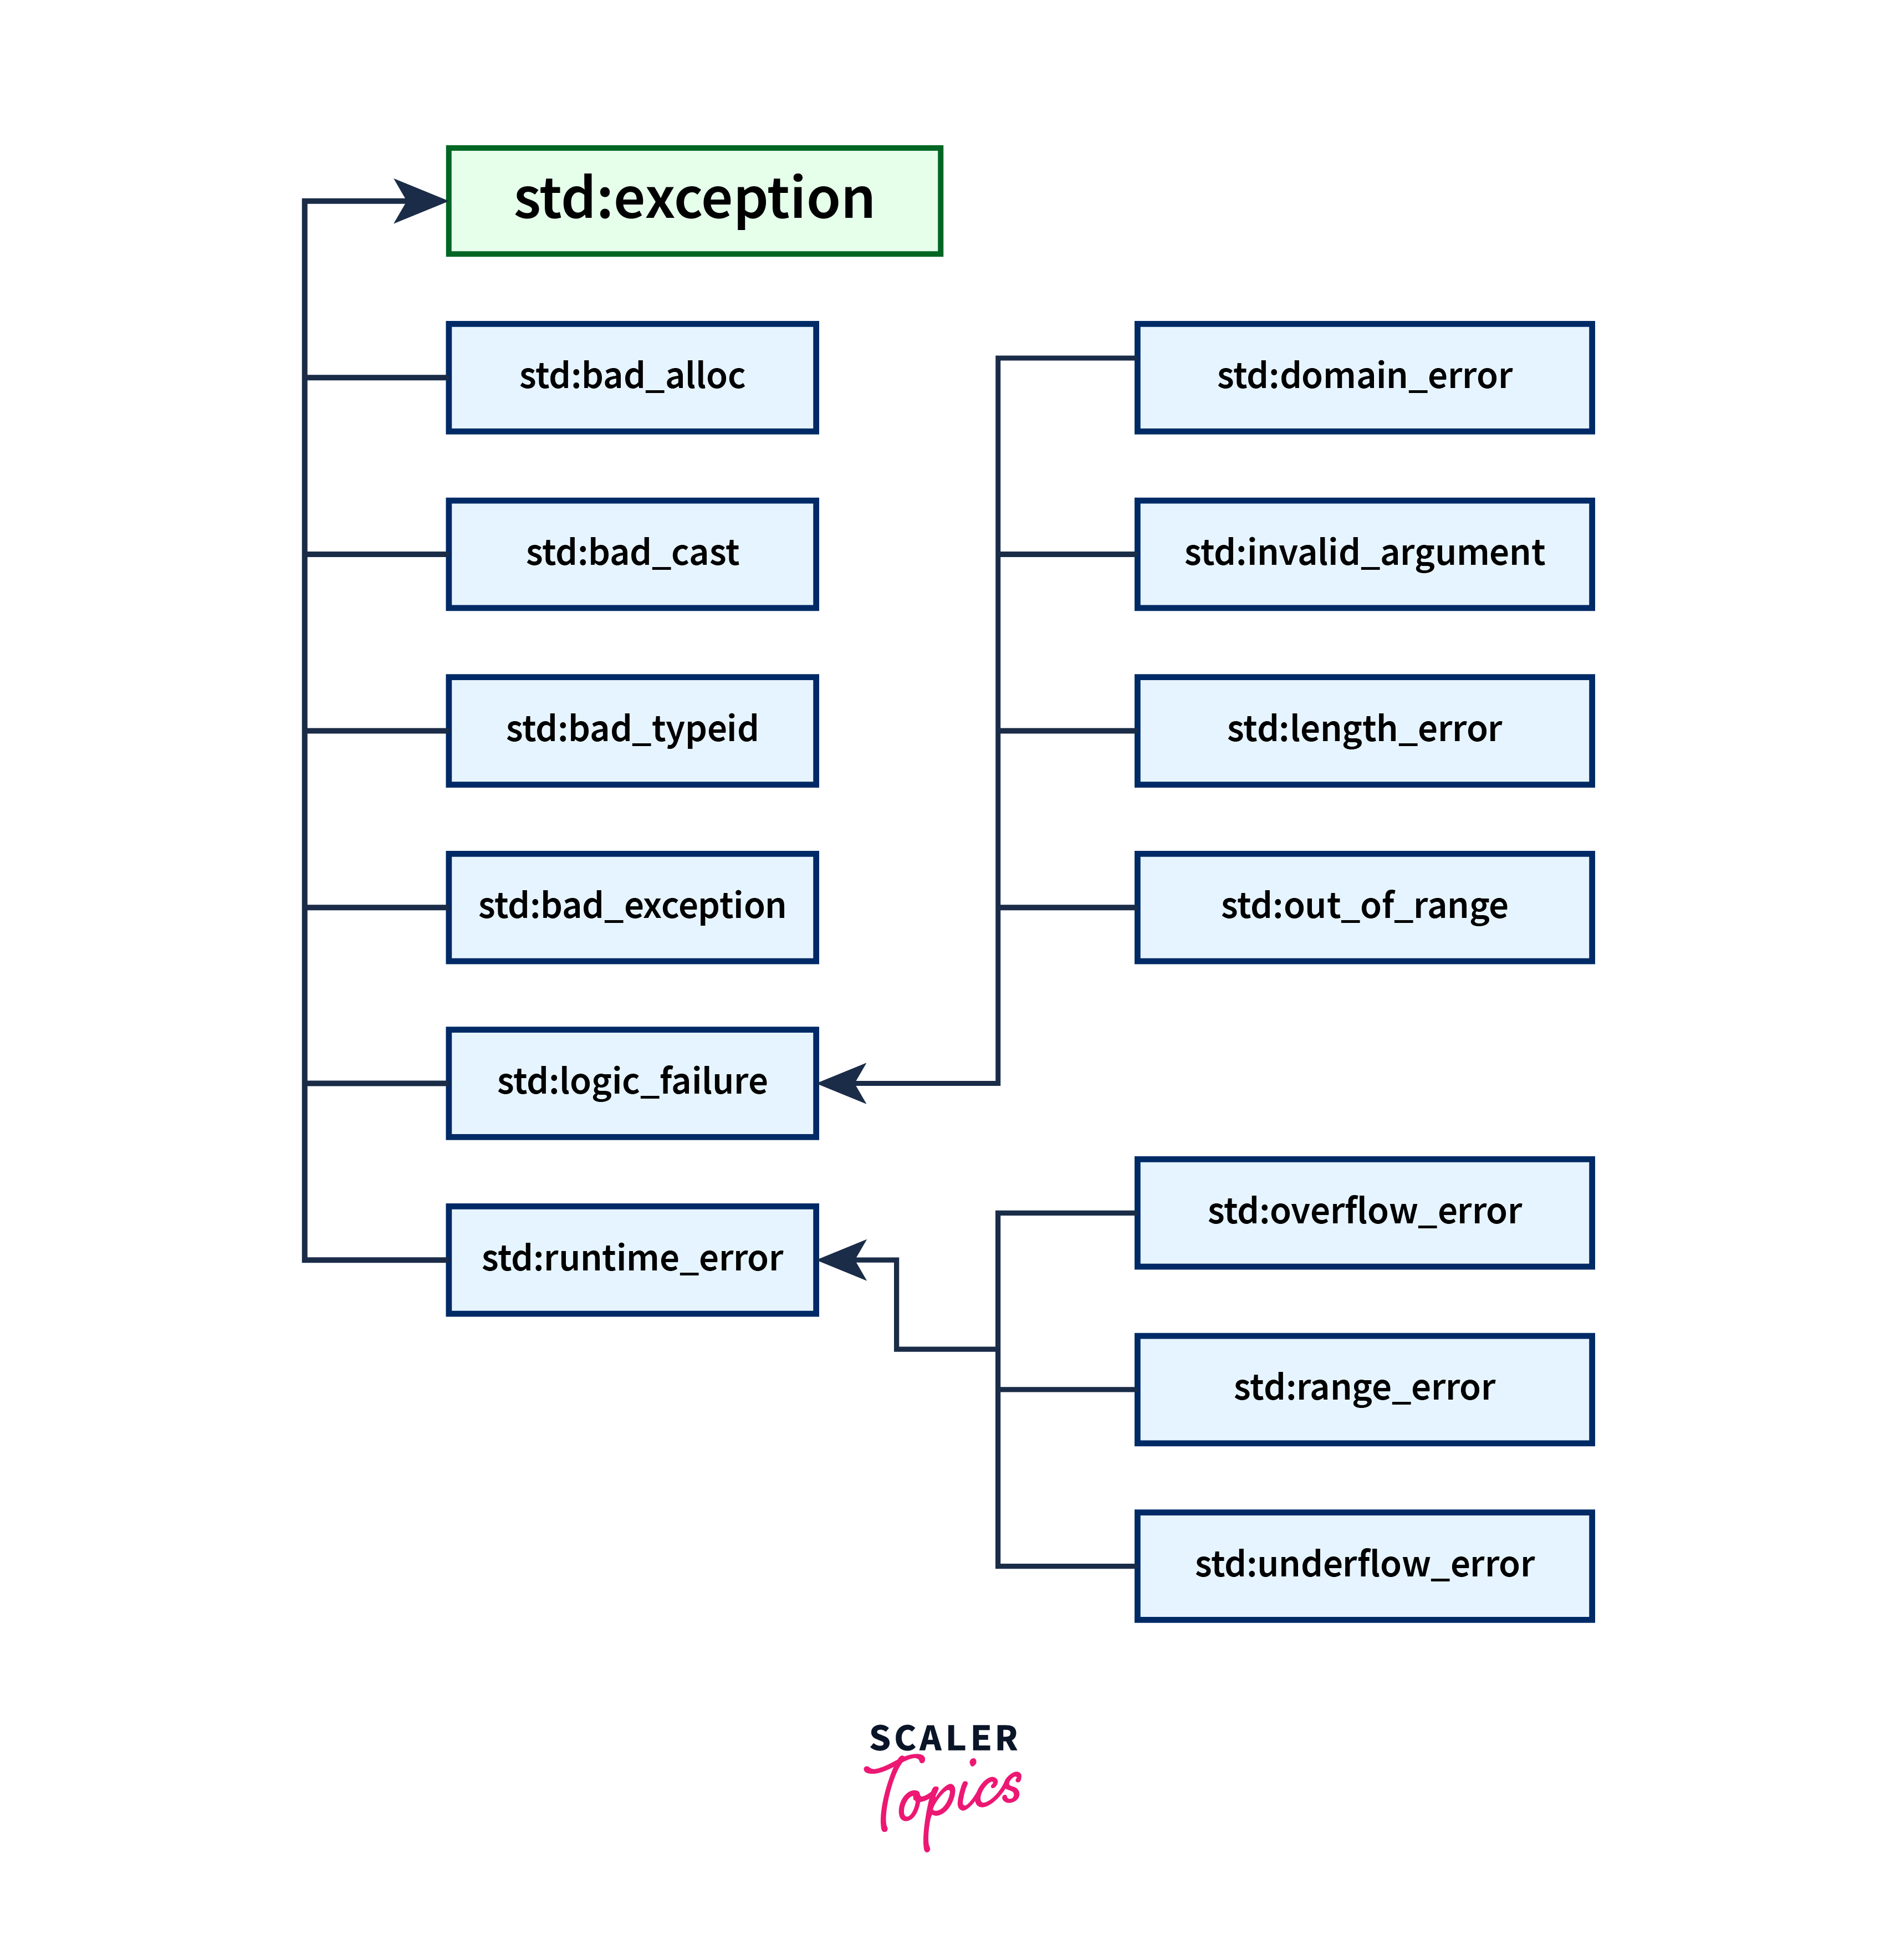

Slide 21
Exception Specification
C++ provides a mechanism to ensure that a given function is limited to throw only a specified list of exceptions.
void translate() throw(unknown_word,bad_grammar) {
/* ... */
}
It will not throw any exception other than unknown _word or bad_grammar

Slide 22
class unknown_word{};
class bad_grammar{};
void translate(int a) throw(unknown_word,bad_grammar) {
if (a==0) throw unknown_word();
else if(a==1) throw bad_grammar();
else throw 10;
}
int main(){
try{ translate(22);}
catch(unknown_word u){cout<<" unknown word";}
catch(bad_grammar g){cout<<" bad grammar";}
catch(...) {cout<<"Default catch";}
}

Slide 23
Output
terminate called after throwing an instance of 'int'
Aborted (core dumped)

