Slide 1
Polymorphism

Slide 2
Contents
Polymorphism
Function Overloading
Default Function Arguments
Ambiguity in Function Overloading

Slide 3
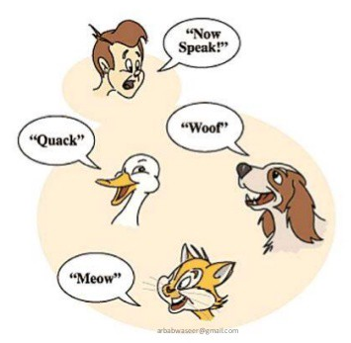
Polymorphism
The word polymorphism means having many forms. In simple words, we can define polymorphism as the ability of a message to be displayed in more than one form.
Real life example of polymorphism, a person at a same time can have different characteristic. Like a man at a same time is a father, a husband, a employee.
So a same person posses have different behavior in different situations. This is called polymorphism.

Slide 4
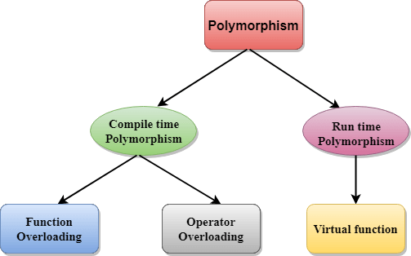
Types of Polymorphism
Compile Time Polymorphism
Run Time Polymorphism

Slide 5
Compile Time Polymorphism
Early binding refers to events that occur at compile time. In essence, early binding occurs when all information needed to call a function is known at compile time. (Put differently, early binding means that an object and a function call are bound during compilation).
Examples of early binding include normal function calls (including standard library functions), overloaded function calls, and overloaded operators.
The main advantage to early binding is efficiency. Because all information necessary to call a function is determined at compile time, these types of function calls are very fast.

Slide 6
Run Time Polymorphism
The opposite of early binding is late binding.
As it relates to C++, late binding refers to function calls that are not resolved until run time.
As function calls are not determined at compile time, the object and the function are not linked until run time.

Slide 7
Run Time Polymorphism
The main advantage to late binding is flexibility.
Unlike early binding, late binding allows you to create programs that can respond to events occurring while the program executes without having to create a large amount of "contingency code."
Keep in mind that because a function call is not resolved until run time, late binding can make for somewhat slower execution times.
Virtual functions are used to achieve late binding.

Slide 8
Function Overloading
Function overloading is the process of using the same name for two or more functions.
The secret to overloading is that each redefinition of the function must use either different types of parameters or a different number of parameters.
It is only through these differences that the compiler knows which function to call in any given situation.

Slide 9
Example
#include <iostream> using namespace std;
int myfunc(int i); // these differ in types of parameters double myfunc(double i);
int main()
{
cout << myfunc(10) << " "; // calls myfunc(int i) cout << myfunc(5.4); // calls myfunc(double i) return 0;
}

Slide 10
double myfunc(double i)
{
return i;
}
int myfunc(int i)
{
return i;
}
Output:
10 5.4

Slide 11
Example 2
#include <iostream>
using namespace std;
int myfunc(int i); // these differ in number of parameters
int myfunc(int i, int j); int main()
{
cout << myfunc(10) << " "; // calls myfunc(int i) cout << myfunc(4, 5); // calls myfunc(int i, int j)
return 0;
}

Slide 12
int myfunc(int i)
{
return i;
}
int myfunc(int i, int j)
{
return i*j;
}
Output:
10 20

Slide 13
Key Points
The key point about function overloading is that the functions must differ in regard to the types and/or number of parameters. Two functions differing only in their return types cannot be overloaded.
For example, this is an invalid attempt to overload myfunc( ):
int myfunc(int i);
float myfunc(int i);
// Error: differing return types are insufficient when overloading.
Sometimes, two function declarations will appear to differ, when in
fact they do not. For example, consider the following declarations.
void f(int *p);
void f(int p[]); // error, *p is same as p[]
Remember, to the compiler *p is the same as p[ ]. Therefore, although the two prototypes appear to differ in the types of their parameter, in actuality they do not.

Slide 14
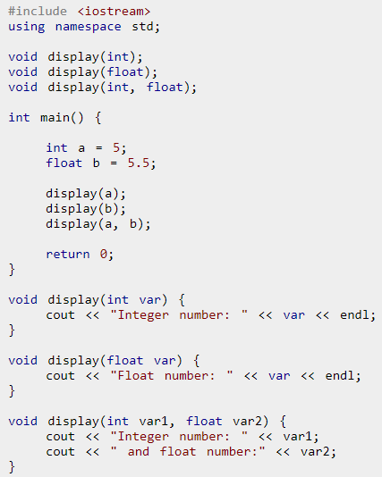
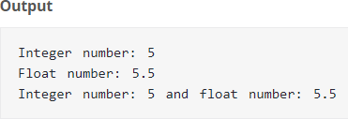
Example 3

Slide 15
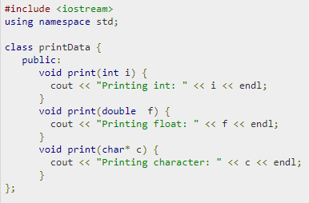
Example 4
(Function overloading in classes)

Slide 16
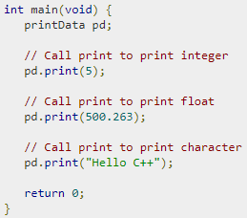


Slide 17
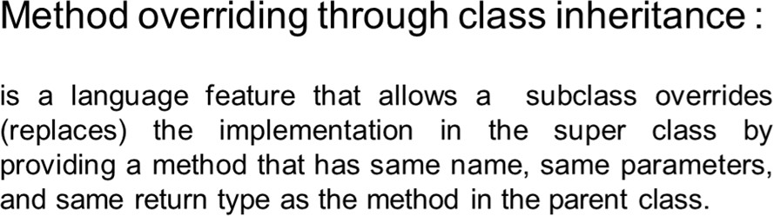
Inheritance based Polymorphism

Slide 18
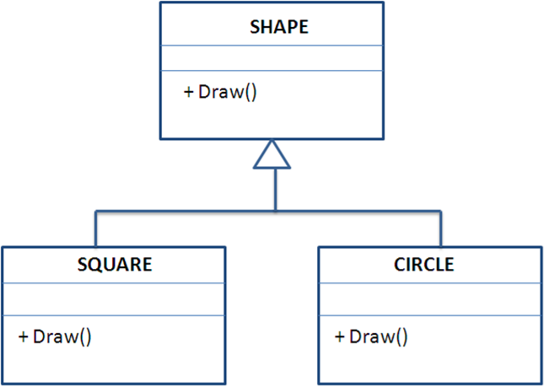
Example

Slide 19
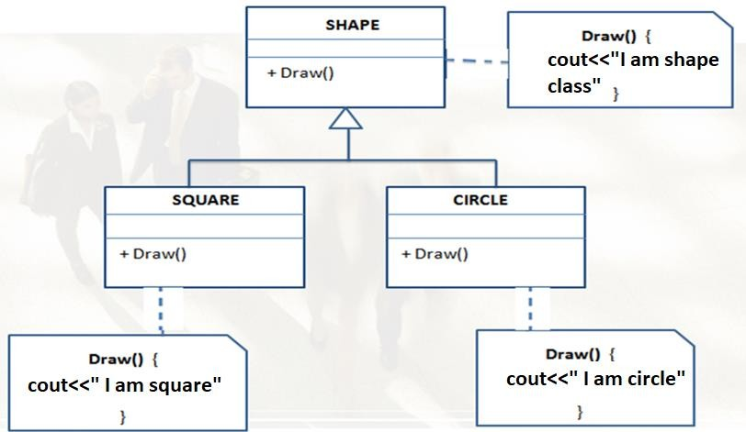

Slide 20
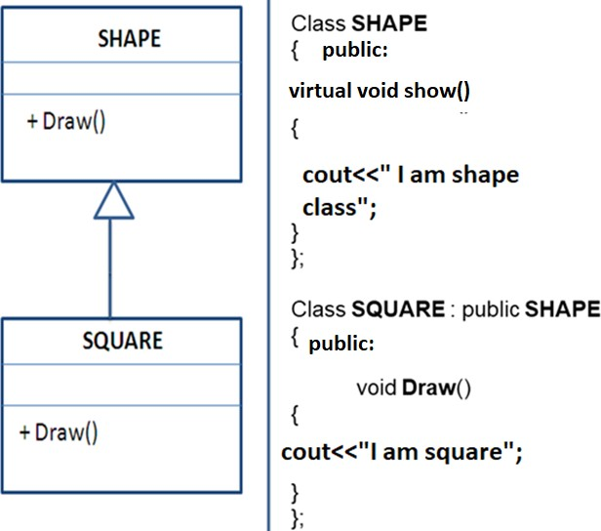

Slide 21
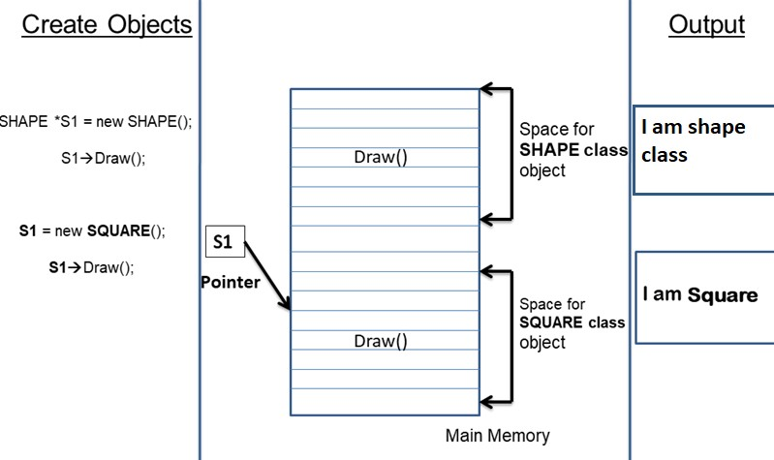

Slide 22
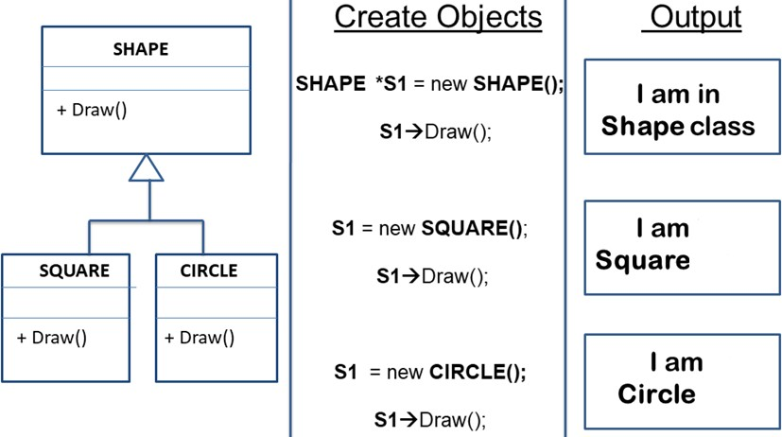
Extend the Logic

Slide 23
Virtual Functions
Be aware that the virtual function mechanism works only with pointers to objects and, with references, not with objects themselves.

Slide 24
Class Activity (15 minutes)
Can you showcase polymorphism (Drive function in various types of automobiles) in context of VEHICLES ?

Slide 25
Overloading vs overriding
Function overloading – same function name but different arguments. Functions are defined in the same class.
Function overriding – same function name and arguments. Defined in different classes.

Slide 26
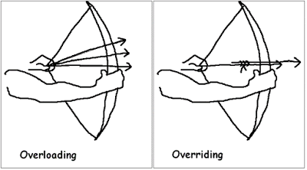

Slide 27
Compile time and Run time Polymorphism
Compile time OR static polymorphism is executed using function overloading.
Run time polymorphism or dynamic/late binding is done using function overriding and virtual functions.

Slide 28
Compile Time Polymorphism | Run-Time Polymorphism
At Compile time, which functions to be called is decided. | At Runtime, which function to be called is decided.
Also known as early or static binding | Also known as late or dynamic binding
It executes faster because the function is resolved at compilation time only. | It executes slower because the function is resolved at Run-time.
It is achieved through function and operator overloading | It is achieved through function overriding and virtual functions

Slide 29
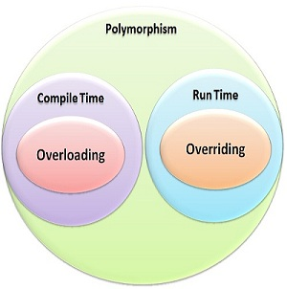

Slide 30
Default Function Arguments
C++ allows a function to assign a parameter a default value when no argument corresponding to that parameter is specified in a call to that function.
For example, this declares myfunc( ) as taking one double argument
with a default value of 0.0:
void myfunc(double d = 0.0)
{
// ...}
myfunc(198.234); // pass an explicit value myfunc(); // let function use default
The first call passes the value 198.234 to d. The second call
automatically gives d the default value zero.

Slide 31
The idea behind default argument is simple. If a function is called by passing argument/s, those arguments are used by the function.
But if the argument/s are not passed while invoking a function then, the default values are used.
Default value/s are passed to argument/s in the function prototype.

Slide 32
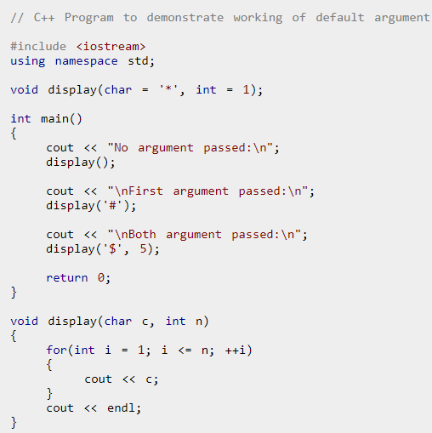
Example

Slide 33
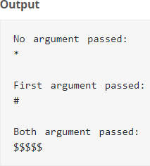

Slide 34
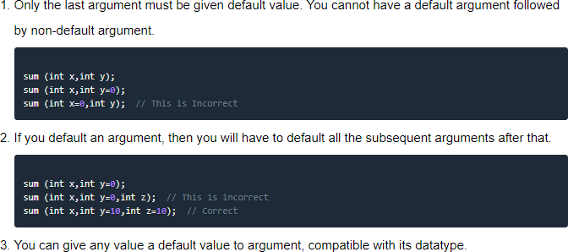
Rules for using Default Arguments

Slide 35
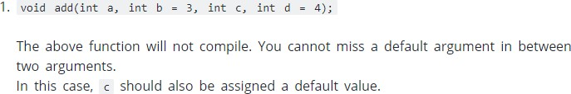
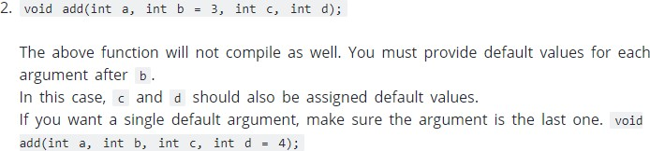
Common Mistakes when using Default Arguments

Slide 36


Slide 37
Ambiguity in Function Overloading
You can create a situation in which the compiler is unable to choose between two (or more) overloaded functions.
When this happens, the situation is said to be
ambiguous.
Ambiguous | statements are errors, | and
programs | containing ambiguity will | not
compile.

Slide 38
Ambiguity in Function Overloading
int myfunc(double d);
// ...
cout << myfunc('c');
// not an error, conversion applied
Although automatic type conversions are convenient, they are also a prime cause of ambiguity.

Slide 39
Example
#include <iostream> using namespace std; float myfunc(float i); double myfunc(double i);
int main()
{
cout << myfunc(10.1) << " "; // unambiguous, calls myfunc(double)
cout << myfunc(10); // ambiguous return 0;
}

Slide 40
Thanks

