Slide 1
UTA018
Inheritance

Slide 2
Copy Constructor
Initializes the member variables of an object when it is created.
Sometimes constructors have parameters so that we can pass arguments to tell the constructor how to initialize the new object.
When the argument is another object of the same type, then we call the constructor a copy constructor.
This is a very important constructor. It is called a lot. Here are four somewhat different times that the copy constructor is used:
  SomeClass a;
  SomeClass b(a);
  SomeClass a;
  SomeClass b = a;
  void someFunc(SomeClass passedByValue) {}
  SomeClass anotherFunc () { SomeClass returnedByValue; return returnedByValue;
Items 1 and 2 above are both creating an object and initializing based on another object of the same type.
In both cases, it is the copy constructor that is called.
Item 3 shows a function with a parameter that is passed by value.
Passing by value uses the copy constructor to initialize the parameter.
Item 4 shows a function with a value that is returned by value.
Returning by value uses the copy constructor to return a copy of the value that is being returned.

Slide 3
Inheritance
Inherit Definition -
Derive quality and characteristics from parents or ancestors. Like you inherit features of your parents.
Example:
"She had inherited the beauty of her mother"
Inheritance in Object Oriented Programming can be described as a process of creating new classes from existing classes.

Slide 4
Inheritance (Cont…)
New classes inherit some of the properties and behaviour of the existing classes.
The existing class that is "parent" of a new class is called a base class.
New class that inherits properties of the base class is called a derived class(“child class”).
Inheritance is a technique of code reuse.

Slide 5
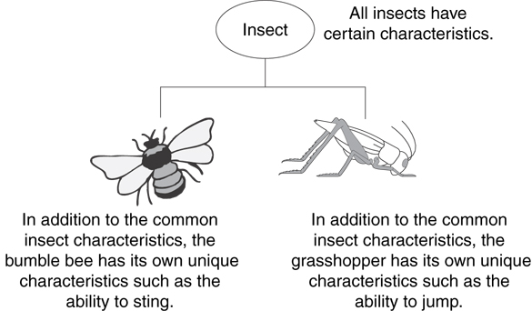
Example: Insect Taxonomy

Slide 6
The "is a" Relationship
Inheritance establishes an "is a" relationship between classes.
  A poodle is a dog
  A car is a vehicle
  A flower is a plant
  A football player is an athlete

Slide 7
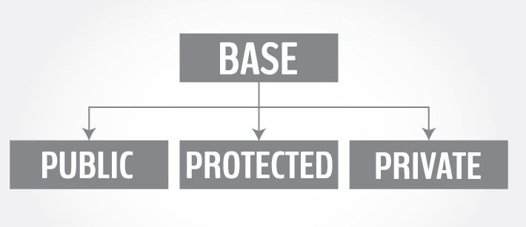
Base Class access control
Derived class can be declared from a base class with different access control, i.e., public inheritance, protected inheritance or private inheritance.

Slide 8
Protected Members and Class Access
Protected member access specification: like private, but accessible by objects of derived class
Class access specification: determines how private, protected, and public members of base class are inherited by the derived class

Slide 9
Class Access Specifiers
public – object of derived class can be treated as object of base class (not vice-versa)
protected – more restrictive than public, but allows derived classes to know details of parents
private – prevents objects of derived class from being treated as objects of base class.

Slide 10
Syntax
1. #include <iostream>
2. using namespace std;
3. class base
4. { .... ... .... };
5. class derived : access_specifier base
6. { .... ... .... };
Either public, protected or private keyword is used in place of access_specifier term used in the syntax code code.

Slide 11
1.class base {
2. public: int x;
3. protected: int y;
4. private: int z; };
5. class publicDerived: public base {
6. // x is public
7. // y is protected
8. // z is not accessible from publicDerived };
class protectedDerived: protected base {
// x is protected
// y is protected
// z is not accessible from protectedDerived };
class privateDerived: private base {
// x is private
// y is private
// z is not accessible from privateDerived }

Slide 12
Observations
base class has three member variables: x, y and z which are public, protected and private member respectively.
publicDerived inherits variables x and y as public and protected. z is not inherited as it is a private member variable of base class.
protectedDerived inherits variables x and y. Both variables become protected. z is not inherited.

Slide 13
Observations (Cont…)
If we derive a class derivedFromProtectedDerived from protectedDerived, variables x and y are also inherited to the derived class.
privateDerived inherits variables x and y. Both variables become private. z is not inherited
If we derive a class derivedFromPrivateDerived from privateDerived, variables x and y are not inherited because they are private variables of privateDerived.

Slide 14
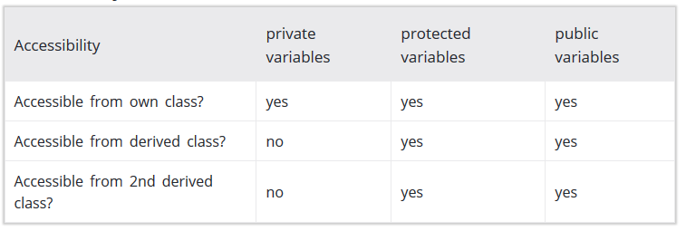
Accessibility in Public Inheritance

Slide 15
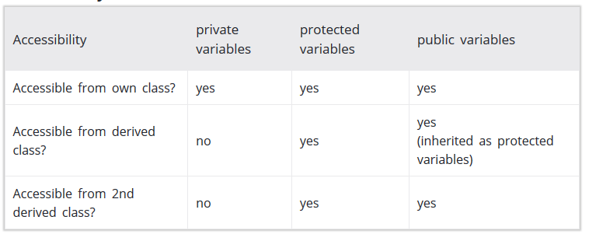
Accessibility in Protected Inheritance

Slide 16
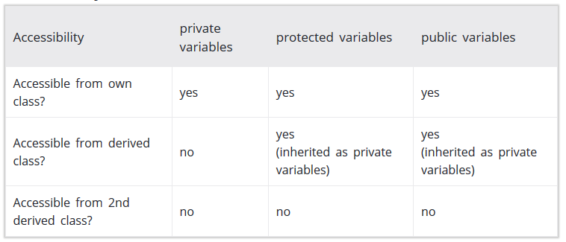
Accessibility in Private Inheritance

Slide 17
Inheritance vs. Access
How inherited base class members
appear in derived class
Base class members
private: x
protected: y
public: z
private
base class
x is inaccessible
private: y
private: z
private: x
protected: y
public: z
protected
base class
x is inaccessible
protected: y
protected: z
private: x
protected: y
public: z
public
base class
x is inaccessible
protected: y
public: z

Slide 18
Inheritance vs. Access
class Grade
class Test : public Grade
private members:
char letter;
float score;
void calcGrade();
public members:
void setScore(float);
float getScore();
char getLetter();
private members:
int numQuestions;
float pointsEach;
int numMissed;
public members:
Test(int, int);
private members:
int numQuestions:
float pointsEach;
int numMissed;
public members:
Test(int, int);
void setScore(float);
float getScore();
char getLetter();
When Test class inherits
from Grade class using
public class access, it looks like this:

Slide 19
Inheritance vs. Access
class Grade
class Test : protected Grade
private members:
char letter;
float score;
void calcGrade();
public members:
void setScore(float);
float getScore();
char getLetter();
private members:
int numQuestions;
float pointsEach;
int numMissed;
public members:
Test(int, int);
private members:
int numQuestions:
float pointsEach;
int numMissed;
public members:
Test(int, int);
protected members:
void setScore(float);
float getScore();
char getLetter();
When Test class inherits
from Grade class using
protected class access, it looks like this:

Slide 20
Inheritance vs. Access
class Grade
class Test : private Grade
private members:
char letter;
float score;
void calcGrade();
public members:
void setScore(float);
float getScore();
char getLetter();
private members:
int numQuestions;
float pointsEach;
int numMissed;
public members:
Test(int, int);
private members:
int numQuestions:
float pointsEach;
int numMissed;
void setScore(float);
float getScore();
float getLetter();
public members:
Test(int, int);
When Test class inherits
from Grade class using
private class access, it looks like this:

Slide 21
What Does a Child Have?
An object of the derived class has:
all members defined in child class
all members declared in parent class
An object of the derived class can use:
all public members defined in child class
all public members defined in parent class

Slide 22
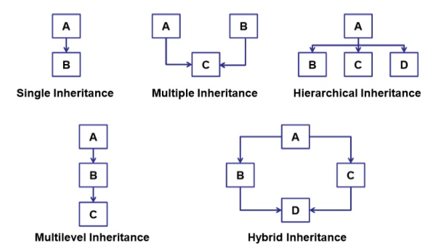
Types of Inheritance

Slide 23
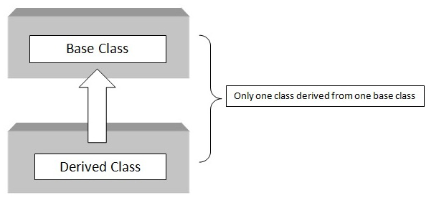
Single Inheritance
Single Inheritance: It is the inheritance hierarchy wherein one derived class inherits from one base class.

Slide 24
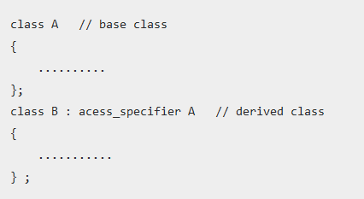
Single Inheritance Syntax

Slide 25
Single Inheritance Example
#include <iostream.h>
using namespace std;
class Shape { Output
protected:
int width;
int height;
public:
void setWidth(int w) {
width = w; }
void setHeight(int h) {
height = h; } } ;
class Rectangle: public Shape {
public:
int getArea() {
return (width * height); } }
int main {
Rectangle Rect;
Rect.setWidth(5);
Rect.setHeight(7);
cout << "Total area: " << Rect.getArea() << endl; // Print the area of the object.
return 0;
}

Slide 26
#include <iostream.h>
using namespace std;
class base {
int i, j;
public:
void set(int a, int b)
{ i=a; j=b; }
void show()
{ cout << i << " " << j << "\n"; }
};
class derived : public base {
int k;
public:
derived(int x) { k=x; }
void showk() { cout << k << "\n"; }
};
int main()
{
derived ob(3);
ob.set(1, 2); // access member of base
ob.show(); // access member of base
ob.showk(); // uses member of derived class
return 0;
}

Slide 27
// This program won't compile.
#include <iostream.h>
using namespace std;
class base {
int i, j;
public:
void set(int a, int b) { i=a; j=b; }
void show() { cout << i << " " << j << "\n";}
};
// Public elements of base are private in derived.
class derived : private base {
int k;
public:
derived(int x) { k=x; }
void showk()
{ cout << k << "\n"; }
};
int main()
{
derived ob(3);
ob.set(1, 2);
// error, can't access set()
ob.show();
// error, can't access show()
return 0;
}

Slide 28
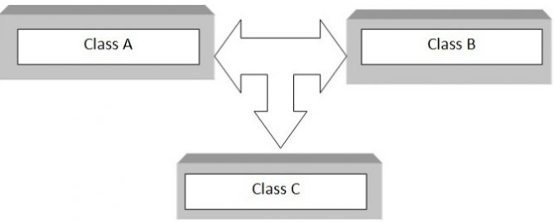
Multiple Inheritance
Multiple Inheritance: It is the inheritance hierarchy wherein one derived class inherits from multiple base class(es).

Slide 29
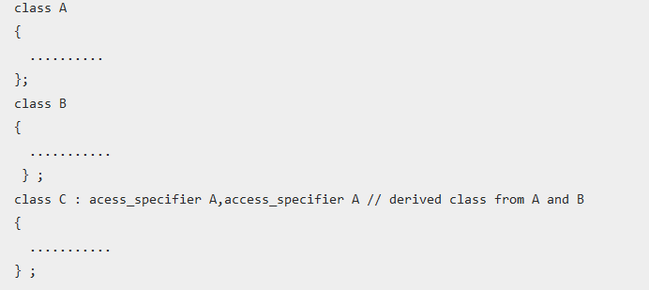
Syntax

Slide 30
Inheriting Multiple Base Classes
#include <iostream>
using namespace std;
class base1 {
protected:
int x;
public:
void showx() { cout << x << "\n"; }
};
class base2 {
protected:
int y;
Public:
void showy() {cout << y << "\n";}
};
// Inherit multiple base classes.
class derived: public base1, public base2 {
public:
void set(int i, int j) { x=i; y=j; }
};
int main()
{
derived ob;
ob.set(10, 20);
// provided by derived
ob.showx(); // from base1
ob.showy(); // from base2
return 0;
}

Slide 31
//EXAMPLE
#include <iostream.h>
using namespace std;
// Base class Shape
class Shape {
public:
void setWidth(int w) {
width = w; }
void setHeight(int h) {
height = h; }
protected:
int width;
int height;
};
// Base class PaintCost
class PaintCost {
public:
int getCost(int area) {
return area * 70;
}};
// Derived class
class Rectangle: public Shape, public PaintCost {
public:
int getArea() {
return (width * height);
} };
int main(void) {
Rectangle Rect;
int area;
Rect.setWidth(5);
Rect.setHeight(7);
area = Rect.getArea();
// Print the total cost of painting
cout << "Total paint cost: $" << Rect.getCost(area) << endl;
return 0; }

Slide 32
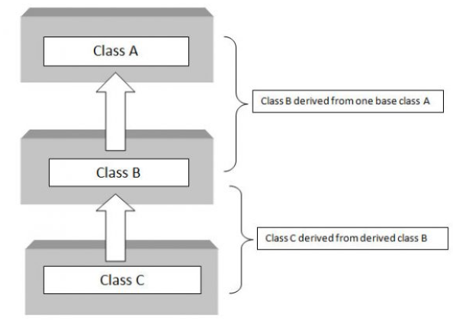
Multilevel Inheritance
Multilevel Inheritance: It is the inheritance hierarchy wherein subclass acts as a base class for other classes.

Slide 33
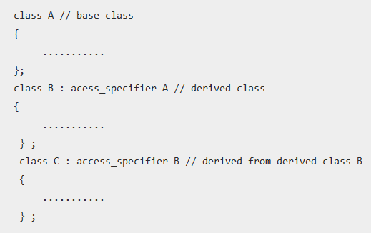
Syntax

Slide 34
Multi-level Inheritance
#include <iostream>
using namespace std;
//Base class
class base {
public:
void display1() {
cout << "\nBase class content."; }
};
//derived class
class derived : public base
{
public:
void display2()
{
cout << "1st derived class content."; } };
//derived2 class
class derived2 : public derived
{ public:
void display3(){
cout << "\n2nd Derived class content.";
} };
int main()
{
derived2 D;
D.display3();
D.display2();
D.display1();
return(0);
}

Slide 35
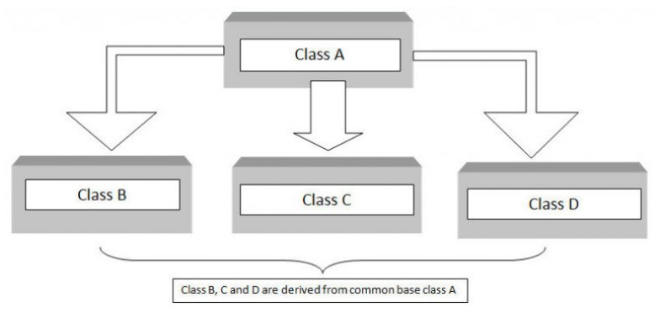
Hierarchical Inheritance
Hierarchical Inheritance: It is the inheritance hierarchy wherein multiple subclasses inherit from one base class.

Slide 36
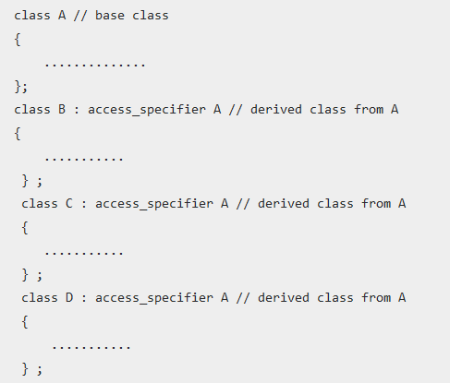
Hierarchical Inheritance

Slide 37
Hierarchical Inheritance
#include <iostream>
#include <string.h>
using namespace std;
//Base Class
class member {
char gender[10];
int age;
public:
void get()
{ cout << "Age: "; cin >> age;
cout << "Gender: "; cin >> gender; }
void disp() {
cout << "Age: " << age << endl; cout << "Gender: " << gender << endl; }
};
//derived from member
class stud : public member
{ char level[20];
public:
void getdata() { member::get();
cout << "Class: ";
cin >> level; }
Continue...

Slide 38
void disp2()
{ member::disp();
cout << "Level: " << level;
} };
//staff class derived from member
class staff : public member
{ float salary;
public:
void getdata() { member::get();
cout << "Salary: Rs.";
cin >> salary; }
void disp3() { member::disp();
cout << "Salary: Rs." << salary << endl;
} };
int main() {
//member M;
staff S;
stud s;
s.getdata();
s.disp();
S.getdata();
S.disp();
return(0); }

Slide 39
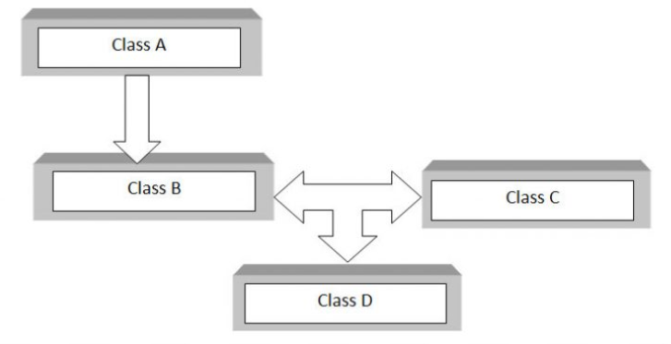
Hybrid Inheritance
Hybrid Inheritance: The inheritance hierarchy that reflects any legal combination of other four types of inheritance.

Slide 40
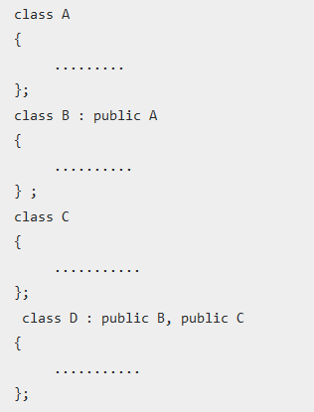
Syntax

Slide 41
#include <iostream>
using namespace std;
class A {
public: int x;
};
class B : public A {
public: B() //constructor to initialize x in base class A
{ x = 10; }
};
class C {
public: int y; C() //constructor to initialize y { y = 4; }
};
class D : public B, public C
//D is derived from class B and class C
{ public:
void sum()
{ cout << "Sum= " << x + y; }
};
int main()
{ D obj1; //object of derived class D
obj1.sum();
return 0; Output
}

Slide 42
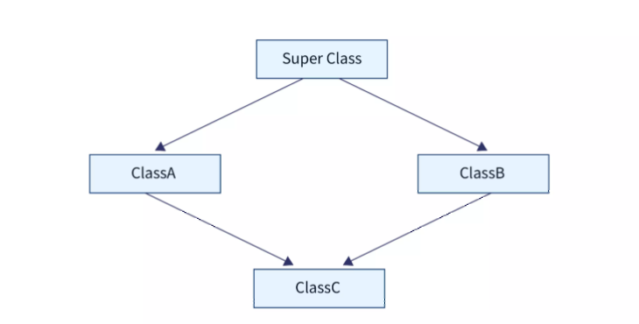
The Diamond Problem

Slide 43
Thanks

