Slide 1
C++ files and streams

Slide 2
Introduction
So far, we have been using the iostream standard library, which provides cin and cout methods for reading from standard input and writing to standard output respectively.
To perform file processing in C++, header files
<iostream> and <fstream> must be included in your C++ source file.

Slide 3
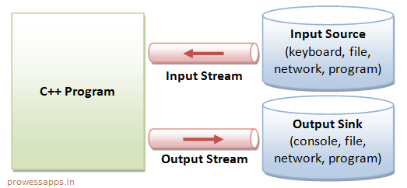
Streams
The stream that supplies data to the program is known as input stream and the one that receives data from the program is known as output stream.
the input stream extracts (or reads) data from the file and the output stream inserts (or writes) data to the file

Slide 4
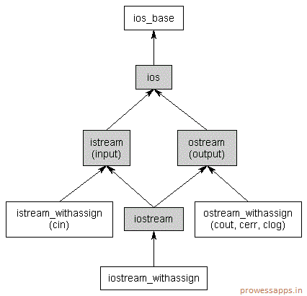

Slide 5
reads
writes
Keyboard
>>
Program
<<
file
Extraction
insertion
Console input stream
File Output stream
reads
File
>>
Program
<<
Monitor
Extraction
insertion
File input stream
Console Output stream

Slide 6
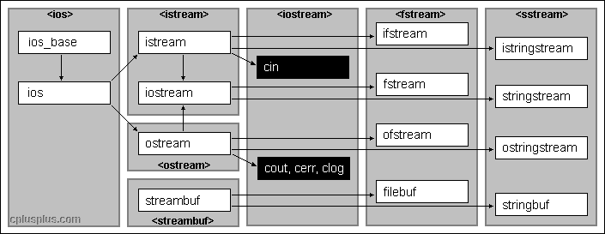
Streams

Slide 7
Files
A file is a collection on information, usually stored on a computer’s disk. Information can be saved to files and then later reused.
All files are assigned a name that is used for identification purposes by the operating system and the user.
File Name and Extension | File Contents
MYPROG.BAS | BASIC program
MENU.BAT | DOS Batch File
INSTALL.DOC | Documentation File
CRUNCH.EXE | Executable File
BOB.HTML | HTML (Hypertext Markup Language) File
3DMODEL.JAVA | Java program or applet
INVENT.OBJ | Object File
PROG1.PRJ | Borland C++ Project File
ANSI.SYS | System Device Driver
README.TXT | Text File
3

Slide 8
Process of Using a File
Using a file in a program is a simple three-step process
The file must be opened. If the file does not yet exits, opening it means creating it.
Information is then saved to the file, read from the file, or both.
When the program is finished using the file, the file must be closed.
4

Slide 9
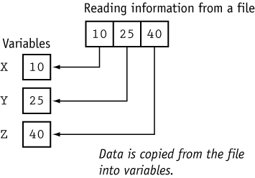
Contd…
5

Slide 10
File stream classes
ios - all I/O operations
istream is for input e.g. as getline()
ostream is for output e.g. write()
ifstream – Input from file
ofstream – write to a file
fstream – I/O with a file

Slide 11

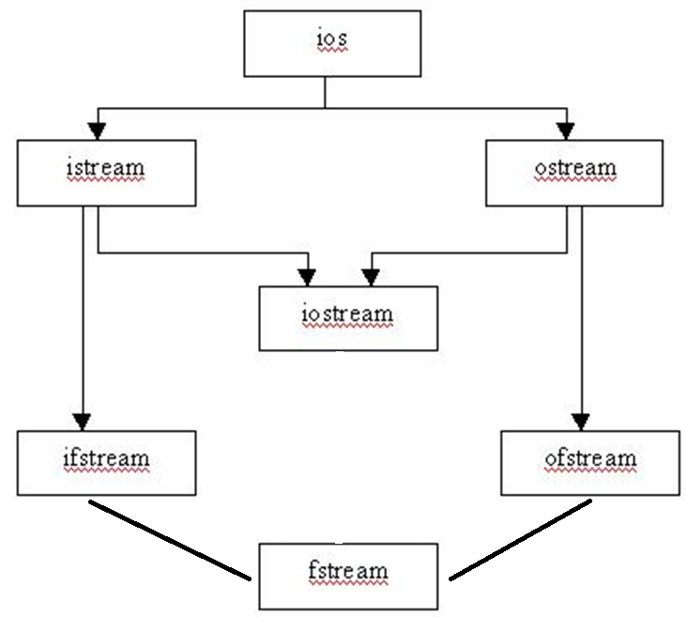

Slide 12
File Input/Output
Before file I/O can be performed, a C++ program must be set up properly.
File access requires the inclusion of fstream
Before data can be written to or read from a file, the file must be opened.
ifstream inputFile; inputFile.open(“customer.dat”);
6

Slide 13
Example
This program demonstrates the declaration of an fstream object and the opening of a file.
#include <iostream>
#include <fstream>
using namespace std;
int main()
5. {
fstream dataFile; // Declare file stream object
char fileName[81];
cout << "Enter the name of a file you wish to open\n";
cout << "or create: ";
cin.getline(fileName, 81);
dataFile.open(fileName, ios::out);
cout << "The file " << fileName << " was opened.\n";
return 0;
14. }
Output:
Enter the name of a file you wish to open
or create: mystuff.dat
The file mystuff.dat was opened.
7

Slide 14
Opening a File at Declaration
fstream dataFile(“names.dat”, ios::in | ios::out);
This program demonstrates the opening of a file at the
time the file stream object is declared.
#include <iostream>
#include <fstream>
using namespace std;
int main() 5. {
fstream dataFile("names.dat", ios::in | ios::out);
cout << "The file names.dat was opened.\n";
return 0; 9. }
Output:
The file names.dat was opened.
8

Slide 15
Testing for Open Errors
dataFile.open(“cust.dat”, ios::in); if (!dataFile)
{ cout << “Error opening file.\n”;
dataFile.open(“cust.dat”, ios::in); if (dataFile.fail())
{ cout << “Error opening file.\n”;
}
}
9

Slide 16
Closing a File
A file should be closed when a program is finished using it.
This program demonstrates the close function.
#include <iostream>
#include <fstream>
using namespace std;
int main()
{ fstream dataFile;
dataFile.open("testfile.txt", ios::out);
if (!dataFile) 8.
Output:
File was created successfully.
Now closing the file.
{ cout << "File open error!" << endl;
}
return 0;
cout << "File was created successfully.\n";
cout << "Now closing the file.\n";
dataFile.close();
return 0; }
10

Slide 17
File Default Open Modes
File Type | Default Open Mode
ofstream | The file is opened for output only. (Information may be written to the file, but not read from the file.) If the file does not exist, it is created. If the file already exists, its contents are deleted (the file is truncated).
ifstream | The file is opened for input only. (Information may be read from the file, but not written to it.) The file’s contents will be read from its beginning. If the file does not exist, the open function fails.
11

Slide 18
File Mode Flags
File Mode Flag | Meaning
ios::app | Append mode. If the file already exists, its contents are preserved and all output is written to the end of the file. By default, this flag causes the file to be created if it does not exist.
ios::ate | If the file already exists, the program goes directly to the end of it. Output may be written anywhere in the file.
ios::binary | Binary mode. When a file is opened in binary mode, information is written to or read from it in pure binary format. (The default mode is text.)
ios::in | Input mode. Information will be read from the file. If the file does not exist, it will not be created and the open function will fail.
ios::nocreate | If the file does not already exist, this flag will cause the open function to fail. (The file will not be created.)
ios::noreplace | If the file already exists, this flag will cause the open function to fail. (The existing file will not be opened.)
ios::out | Output mode. Information will be written to the file. By default, the file’s contents will be deleted if it already exists.
ios::trunc | If the file already exists, its contents will be deleted (truncated). This is the default mode used by ios::out.
12

Slide 19
Write on file
The stream insertion operator (<<) may be used to write information to a file.
outputFile << “I love C++ programming !”

Slide 20
Example
This program uses the << operator to write information to a file.
#include <iostream>
#include <fstream>
using namespace std;
int main()
{ fstream dataFile;
char line[81];
7.
8.
9.
cout << "File opened successfully.\n";
cout << "Now writing information to the file.\n";
dataFile << "Jones\n";
dataFile << "Smith\n";
dataFile.close();
cout << "Done.\n"; return 0; }
Output:
File opened successfully.
Now writing information to the file.
Done.
dataFile.open("demofile.txt", ios::out); if (!dataFile)
{ cout << "File open error!" << endl;
return 0;
}
14

Slide 21
Example
This program writes information to a file, closes the file, then reopens it and appends more information.
#include <iostream>
#include <fstream>
using namespace std;
int main()
5.
6.
7.
8.
9.
{ fstream dataFile; dataFile.open("demofile.txt", ios::out); dataFile << "Jones\n";
dataFile << "Smith\n";
dataFile.close();
dataFile.open("demofile.txt", ios::app);
dataFile << "Willis\n";
dataFile << "Davis\n";
dataFile.close();
return 0; }
15

Slide 22
Read from file
The stream extraction operator (>>) may be used to read information from a file.
16

Slide 23
Example
This program uses the >> operator to read information from a file.
Output:
File opened successfully.
Now reading information from the file. Jones
Smith Willis Davis
Done.
#include <iostream>
#include <fstream>
using namespace std;
int main()
{ fstream dataFile;
6.
7.
8.
9.
cout << "File opened successfully.\n";
cout << "Now reading information from the file.\n";
for (int count = 0; count < 4; count++) 13.
dataFile.close();
cout << "Done.\n";
return 0; }
char name[81];
dataFile.open("demofile.txt", ios::in); if (!dataFile)
{ cout << "File open error!" << endl; return 0;
}
{ dataFile >> name; cout << name << endl; }
17

Slide 24
Detecting the End of a File
The eof() member function reports when the end of a file has been encountered.
if (inFile.eof())
inFile.close();
In C++, “end of file” doesn’t mean the program is at the last piece of information in the file, but beyond it. The eof() function returns true when there is no more information to be read.
18

Slide 25
Example
This program uses the file stream object's eof() member function to detect the end of the file.
#include <iostream>
#include <fstream>
using namespace std;
int main()
{ fstream dataFile;
char name[81];
dataFile.open("demofile.txt", ios::in);
if (!dataFile) 9.
10.
11.
12.
13.
14.
15.
16.
17.
18.
File opened successfully.
Reading information from the file.
Jones Smith Willis Davis
Done.
{ cout << "File open error!" << endl; return 0; }
cout << "File opened successfully.\n";
cout << "Reading information from the file.\n";
dataFile >> name; // Read first name from the file
while (!dataFile.eof())
{ cout << name << endl; dataFile >> name; dataFile.close();
cout << "\nDone.\n";
}
return 0; }
19

Slide 26
Example
This program uses the file stream object's eof() member function to detect the
end of the file.
Output:
#include <iostream>
#include <fstream>
using namespace std;
int main()
{ fstream nameFile;
char input[81]; nameFile.open("demofile.txt", ios::in); if (!nameFile)
Jones
Smith Willis Davis
7.
8.
9.
10.
11.
12.
13.
14. }
{ cout << "File open error!" << endl;
return 0; }
nameFile >> input; while (!nameFile.eof())
{ cout << input << endl; nameFile.close();
return 0;
nameFile >> input; }
21

Slide 27
Member Functions for Reading and Writing Files
File stream objects have member functions for more specialized file reading and writing.
20

Slide 28
The getline Member Function
dataFile.getline(str, 81, ‘\n’);
str – This is the name of a character array, or a pointer to a section of memory. The information read from the file will be stored here.
81 – This number is one greater than the maximum number of characters to be read. In this example, a maximum of 80 characters will be read.
‘\n’ – This is a delimiter character of your choice. If this delimiter is encountered, it will cause the function to stop reading before it has read the maximum number of characters. (This argument is optional. If it’s left our, ‘\n’ is the default.)
22

Slide 29
Example
This program uses the file stream object's getline member function to read a line of
information from the file.
Output:
#include <iostream>
#include <fstream>
using namespace std;
int main()
{ fstream nameFile;
char input[81]; nameFile.open("demofile.txt", ios::in); if (!nameFile)
Jones
Smith Willis Davis
7.
8.
9.
10.
11.
12.
13.
14.
{ cout << "File open error!" << endl; return 0; }
nameFile.getline(input, 81); // use \n as a delimiter while (!nameFile.eof())
{ cout << input << endl;
nameFile.getline(input, 81); // use \n as a delimiter }
nameFile.close(); return 0; }
23

Slide 30
The get Member Function
This program asks the user for a file name. The file is opened and its contents are displayed on the screen.
#include <iostream>
#include <fstream>
using namespace std;
int main()
{ fstream file;
char ch, fileName[51];
cout << "Enter a file name: ";
cin >> fileName;
file.open(fileName, ios::in);
if (!file)
{ cout << fileName << “ could not be opened.\n";
file.get(ch); // Get a character 13.
14.
15.
16.
return 0; }
while (!file.eof())
{ cout << ch; file.close(); return 0; }
file.get(ch); // Get another character }
24

Slide 31
More get() Functions
In addition to the form shown earlier, get function is overloaded in several different ways. The prototype for the three most commonly used overloaded forms are shown here:
istream &get(char *buf, streamsize num);
istream &get(char *buf, streamsize num, char delim);
int get( );
The first form reads characters into the array pointed to by buf until either num-1
characters have been read, a newline is found, or the end of the file has been encountered.
The second form reads characters into the array pointed to by buf until either num-1 characters have been read, the character specified by delim has been found, or the end of the file has been encountered.
The third overloaded form of get( ) returns the next character from the stream. It
returns EOF if the end of the file is encountered.
24

Slide 32
The put Member Function
This program demonstrates the put member function.
#include <iostream>
#include <fstream> using namespace std;
int main()
{ fstream dataFile("sentence.txt", ios::out);
char ch;
cout << "Type a sentence and be sure to end it with a ";
cout << "period.\n";
Output:
6.
7.
8.
9.
10.
11.
12.
13.
14.
while (1)
Type a sentence and be sure to end
it with a period.
I am on my way.
Resulting Contents of the File
SENTENCE.TXT:
I am on my way.
{ cin.get(ch); dataFile.put(ch); if (ch == '.')
break;
}
dataFile.close();
return 0; }
25

Slide 33
Example
1. #include <iostream>
2. #include <fstream>
3. using namespace std;
4. int main()
5. {
6. ifstream in("test");
7. if(!in) {
8. cout << "Cannot open file.\n";
9. return 1;
10. }
11. in.ignore(10, ' ');
12. char c;
13. while(in) {
14. in.get(c);
15. if(in) cout << c;
16. }
17. in.close();
18. return 0;
19. }

Slide 34
File pointers to read/write from binary files
To write n bytes:
write (const char* buffer, int n);
To read n bytes (to a pre-allocated buffer):
read (char* buffer, int num)

Slide 35
Example
#include<iostream>
#include <fstream>
using namespace std;
int main()
5. { int a[] = {10,23,3,7,9,11,25};
fstream fs;
fs.open("myfile.txt", ios::binary | ios::out);
fs.write((char*) &a, sizeof(a));
fs.close();
10. for(int i = 0; i < 7; i++) a[i] = 0;
fs.open("myfile.txt", ios::in | ios::binary);
fs.read((char*) &a, sizeof(a));
13. for(int i = 0; i < 7; i++) cout << a[i] << " ";
14. fs.close(); }

Slide 36
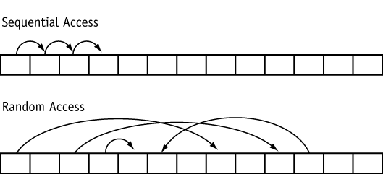
Random Access Files
Random Access means non-sequentially accessing information in a file.
29

Slide 37
Mode Flags
Mode Flag | Description
ios::beg | The offset is calculated from the beginning of the file.
ios::end | The offset is calculated from the end of the file.
ios::cur | The offset is calculated from the current position.
30

Slide 38
Contd…
Statement | How it Affects the Read/Write Position
File.seekp(32L, ios::beg); | Sets the write position to the 33rd byte (byte 32) from the beginning of the file.
file.seekp(-10L, ios::end); | Sets the write position to the 11th byte (byte 10) from the end of the file.
file.seekp(120L, ios::cur); | Sets the write position to the 121st byte (byte 120) from the current position.
file.seekg(2L, ios::beg); | Sets the read position to the 3rd byte (byte 2) from the beginning of the file.
file.seekg(-100L, ios::end); | Sets the read position to the 101st byte (byte 100) from the end of the file.
file.seekg(40L, ios::cur); | Sets the read position to the 41st byte (byte 40) from the current position.
file.seekg(0L, ios::end); | Sets the read position to the end of the file. ³¹

Slide 39
File position pointers
Both istream and ostream provide member functions for
repositioning the file-position pointer. functions are seekg ("seek get") and seekp ("seek put") for ostream.
These
for
member istream
The seek direction can be
ios::beg (the default) for positioning relative to the beginning of
a stream
ios::cur for positioning relative to the current position in a stream
ios::end for positioning relative to the end of a stream.

Slide 40
Continued…
position to the nth byte of fileObject (assumes ios::beg)
fileObject.seekg( n );
position n bytes forward in fileObject
fileObject.seekg( n, ios::cur );
position n bytes back from end of fileObject
fileObject.seekg( n, ios::end );
position at end of fileObject
fileObject.seekg( 0, ios::end );

Slide 41
Example
This program demonstrates the seekg function.
#include <iostream>
#include <fstream>
using namespace std;
int main()
{ fstream file("demofile.txt", ios::in);
char ch;
file.seekg(5L, ios::beg);
file.get(ch);
cout << "Byte 5 from beginning: " << ch << endl;
file.seekg(-10L, ios::end);
file.get(ch);
cout << "Byte 10 from end: " << ch << endl;
file.seekg(3L, ios::cur);
file.get(ch);
cout << "Byte 3 from current: " << ch << endl;
file.close();
return 0;}
34

Slide 42
File pointers – bookmarks in the file
Get Pointer tells the current location during file reading
Put Pointer tells the current position during file writing
A file pointer is not like a C++ pointer but works like a book-mark in a book
These pointers help attain random access in file for faster access in comparison to a sequential access

Slide 43
File pointers – seek and tell
Tell function - just examine the file location
Seek function – actually set the bookmark in a file

Slide 44
G and P in – seekg(), tellg(), seekp(), tellp()
G – (as Get) is for file read operation
P – (as Put) is for file write operation

Slide 45
File pointers – seekg(), tellg(), seekp(), tellp()
seekg() and tellg() functions allow you to set and examine the get_pointer in the given file
seekp() and tellp() functions perform these operations on the put_pointer.

Slide 46
Current, beginning and & end
References for seek and tell functions
ios::beg
ios:cur
ios:end

Slide 47
Command Line Arguments
In C/C++ it is possible to accept arguments from the command line.
We will be passing arguments to the main function, which we have always left empty.
Command line arguments are passed as character arrays, where each parameter is separated by space.
Comes into the program as two arguments
argc – Number of parameters
argv – Parameter list
34

Slide 48
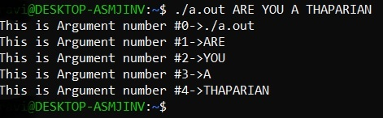
An example program
#include <iostream>
using namespace std;
int main(int argc, char *argv[])
{
for (int i=0; i<argc; i++)
cout << "This is Argument number #"
<< i
<< "->"
<< argv[i] << endl;
return 0;
}
34

Slide 49
Command Line Arguments Conventional rules:
First argument (argv[0]) will always be the name of the calling program.
argc will always be at least 1
The first argument is always argv[0]
The last argument is always argv[argc-1]
argv[argc] will always be a null pointer
34

Slide 50
Command Line Arguments Conventional rules:
Arguments are always passed as character strings.
Numbers must be converted from characters to integers, floats, doubles, etc.
The names argc and argv are traditional but arbitrary.
You may name these two parameters to main( ) anything you like.
34

Slide 51
Command Line Arguments use:
A program that wants its parameters to be set when it is executed would use command line arguments.
One common use is to write a function that takes the name of a file and outputs the entire text of it onto the screen (program on next slide).
34

Slide 52
Command Line Arguments use:
#include <fstream>
#include <iostream>
using namespace std;
int main ( int argc, char *argv[] )
{
if ( argc != 2 ) // argc should be 2 for correct execution
cout<<"You have to run it like: "<< argv[0] <<" <filename>\n";
else {
ifstream the_file ( argv[1] ); // We assume argv[1] is a filename to open
if ( !the_file.is_open() ) // check to see if file opening succeeded
cout<<"Could not open file\n";
else {
char x;
while ( the_file.get ( x ) ) //the_file.get ( x ) returns false if the end of the file
cout<< x; // is reached or an error occurs.
}
}
}
34

Slide 53
Thank You

