Slide 1

Adidas Sales Analytics (2020–2021)
Saif Palnaik

Slide 2




Slide 3
Dashboard
Problem Statement
Insights

Slide 4
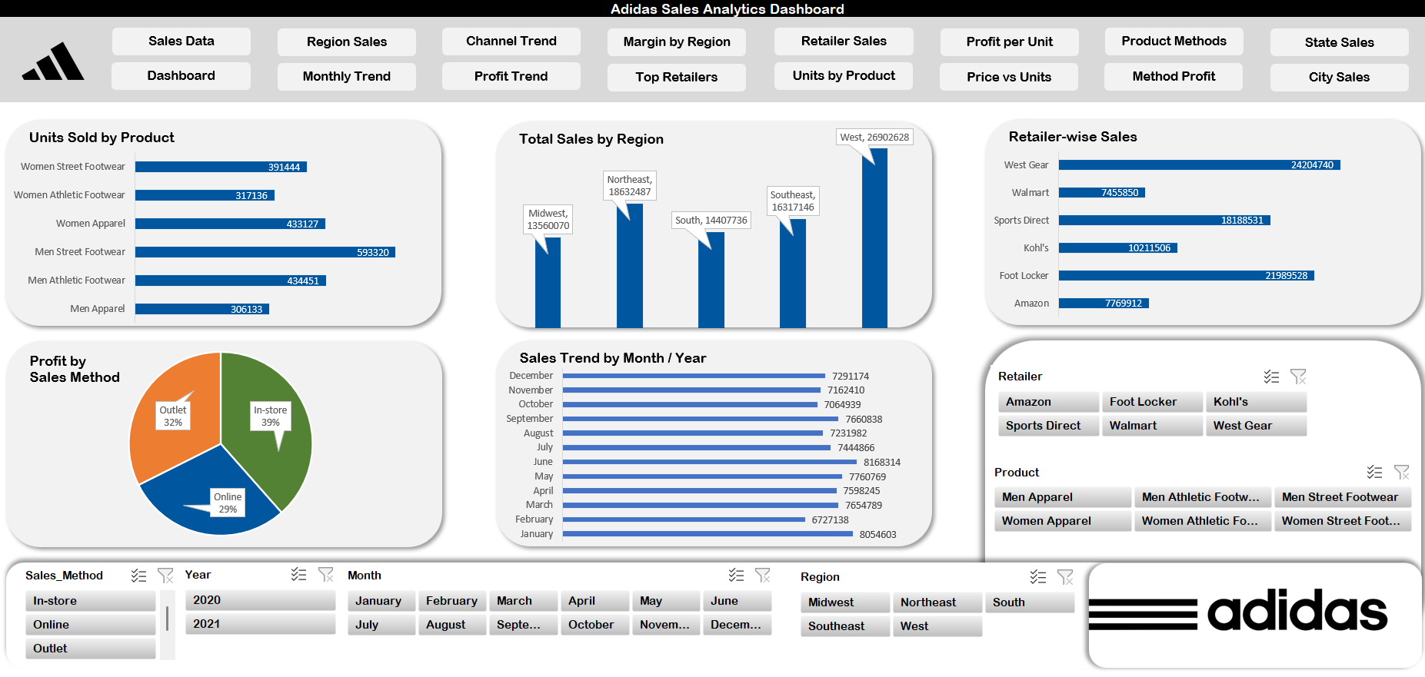
DASHBOARD
Units Sold by Product
Total Sales by Region
Retailer-wise Sales
Sales Trend by Month / Year

Slide 5
Problem Statements
Which regions have the highest/lowest sales? (How to boost underperforming areas)
Which products sell the most units, and which yield highest profit per unit?
How do sales and profit differ by sales channel (online vs outlet vs in-store)?
What are the seasonal sales trends (month/year) and how can we plan inventory?
Which retailers drive the most sales and which need attention?

Slide 6
Which regions have the highest/lowest sales?

Slide 7
Which products sell the most units?

Slide 8
How do sales and profit differ by sales channel ?

Slide 9
Which retailers drive the most sales and which need attention?

Slide 10
Conclusion:
West region contributes the highest overall sales.
Key products dominate total units sold — indicating demand concentration.
High-performing retailers drive a major share of revenue.
Clear monthly and seasonal sales trends observed.
Sales methods (online, in-store, outlet) show significant differences in profitability.
Recommendations:
Focus marketing and inventory on high-performing regions and products.
Optimize pricing strategy for less profitable channels (e.g., outlets).
Prepare seasonal campaigns and stock based on sales peak months.
Promote profitable sales channels like online where applicable.
Strengthen partnerships with top retailers based on performance insights.

