Slide 1

ELK-Retailteck@WalmartLabs,
December 2017

Slide 2
ELK is…
Elasticsearch
Logstash
Kibana
3 different opensource projects found synergy among themselves

Slide 3
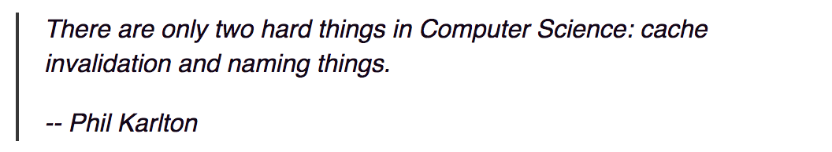
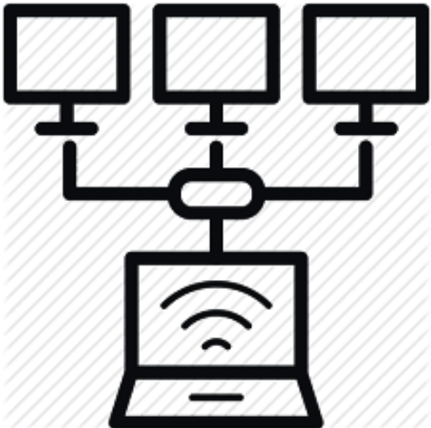
naming
Terminology
node
distributed
cluster

Slide 4

naming
Terminology
Database
Relational
Transactional
ACID
Free form text search
No Schema

Slide 5
naming
Document
Terminology
Index
Lucene Index
Shard
Inverted Index
replica shard

Slide 6
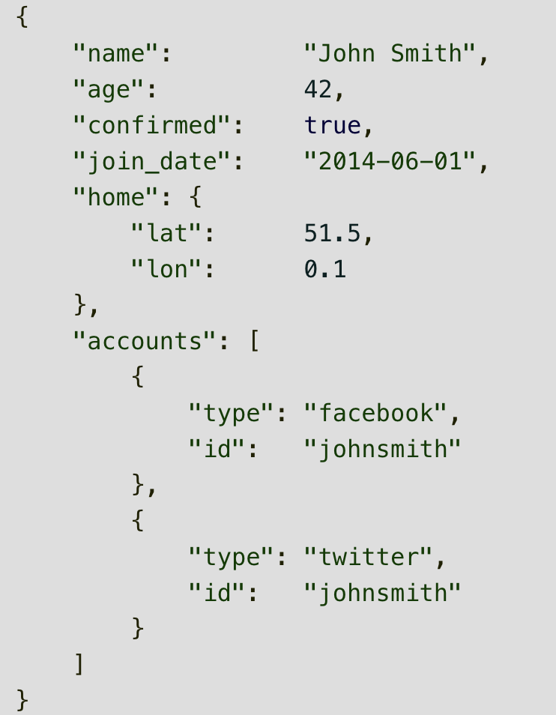
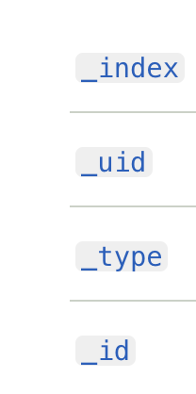
Document
Object
Meta fields

Slide 7
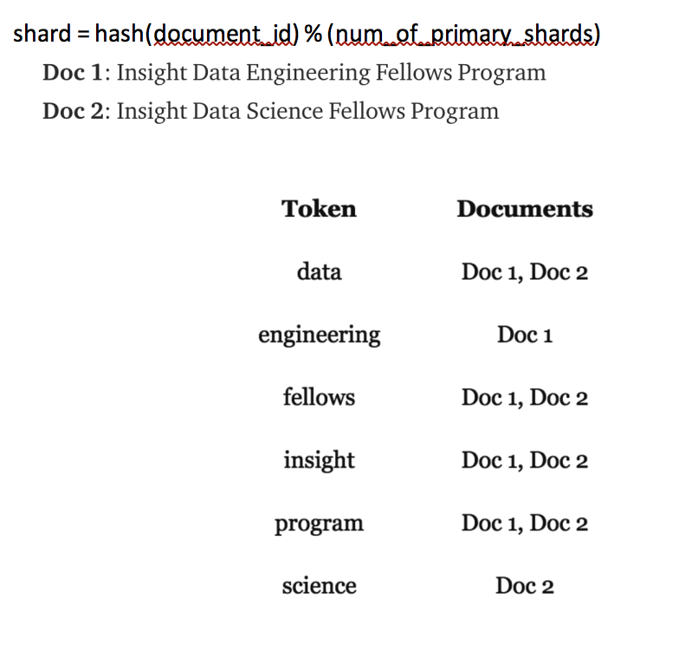
Inverted Index

Slide 8
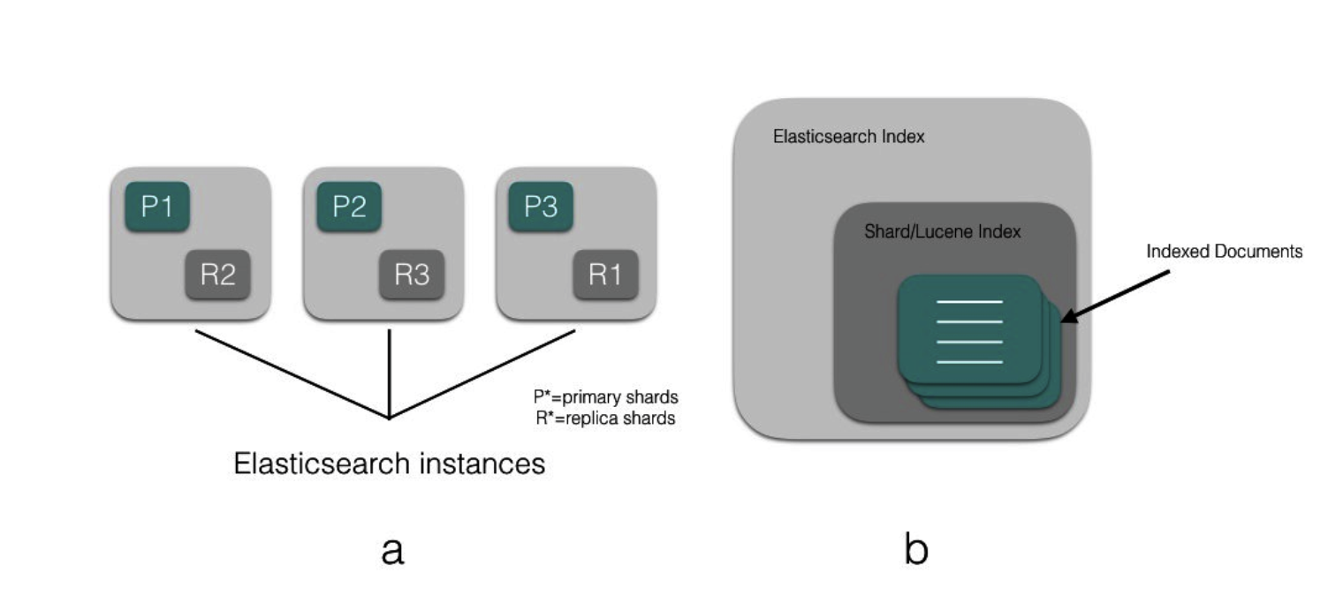
Shard spread
Master Node
Data Node
Client Node

Slide 9
A Cluster consists of Masters eligible nodes, Data nodes and client nodes
cluster
Master node cluster/admin operations like allocation, state maintenance, index/alias creation
Data nodes stores actual indexes, documents

Slide 10
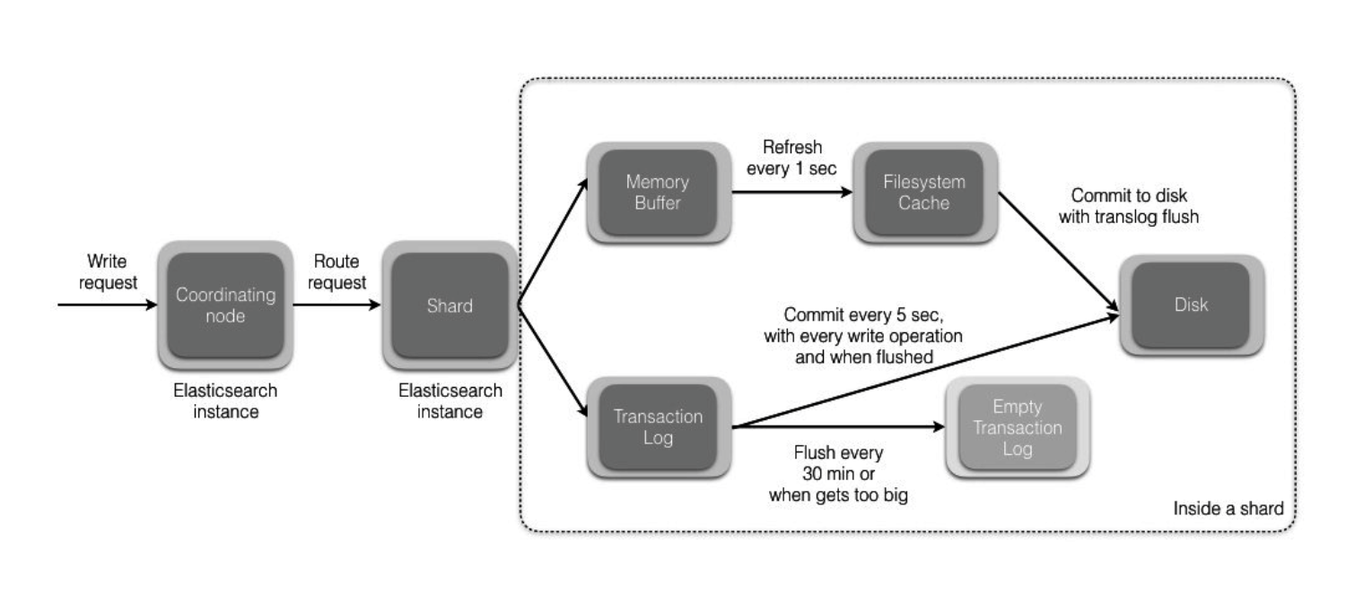
Write Anatomy

Slide 11
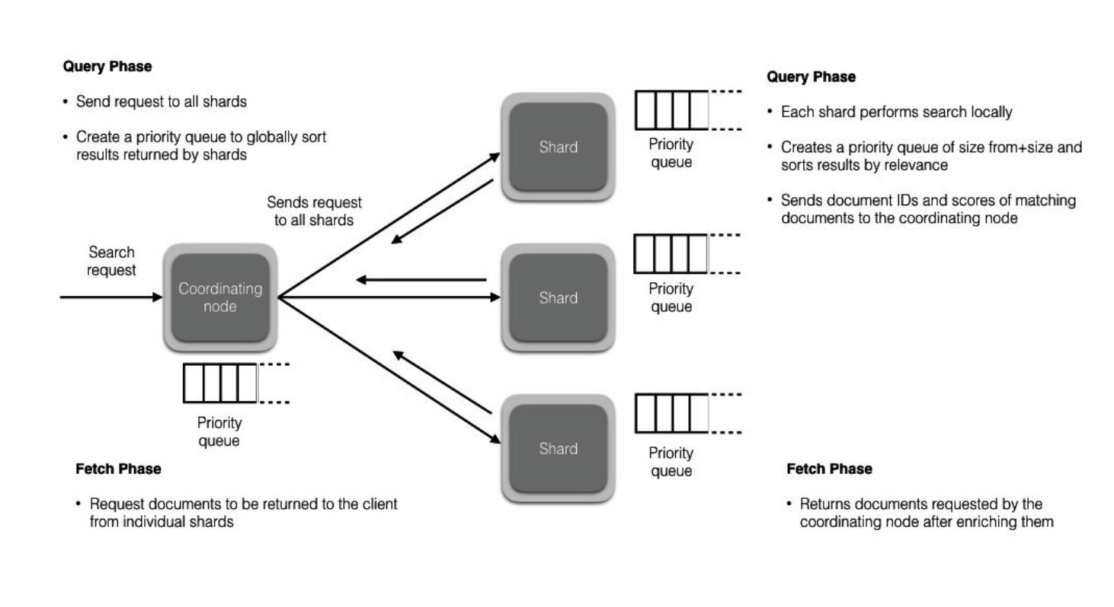
Read Anatomy

Slide 12
Sorting, pagination
Text search
Phrase search , slop
Multi match
Fuzzy
Queries

