Slide 1


GAMIFICATION OF WRITTEN ASSIGNMENTS
GROUP E

Slide 2
Table of Contents
1
Sprint goals
3
Progress overview
2
Deliverables
4
Demo

Slide 3
1
Sprint Goals

Slide 4
Sprint Goals
What we wanted to achieve
Seamless integration with Canvas
Gamification integration
Green coding

Slide 5
2
Deliverables

Slide 6
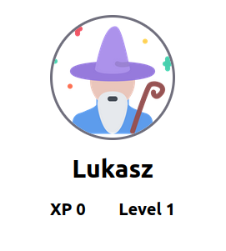
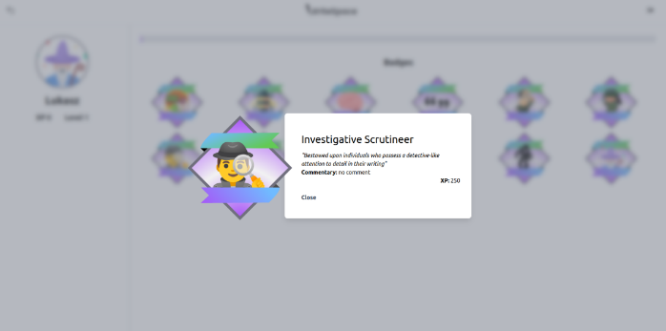
Deliverables
What we build
Gamification integration
Correct spelling reward
Automatic Badges
Progress bar
Green coding
Research
API call minimizations
(Almost) complete Canvas integration
Authentication
Assignment creation

Slide 7
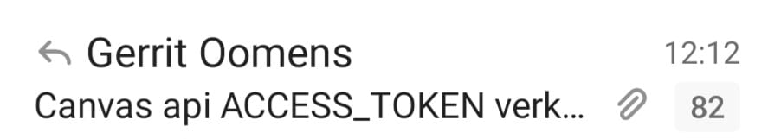
How to integrate Canvas

Slide 8
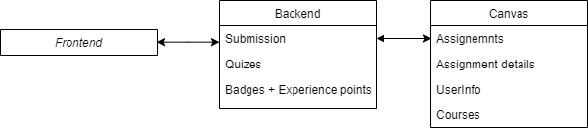
Canvas integration
Store as much info at Canvas
Assignments created in Writespace backpropagated to Canvas
Submissions backpropagated to Canvas
Store as little user info as possible in own db

Slide 9
3
Progress overview

Slide 10

Progress overview
Next Sprint:
Green Coding
MongoDB aggregations
Documentation
API
Components
Hooks

Slide 11
4
Demo

Slide 12
The End
Thanks for listening

