Slide 1

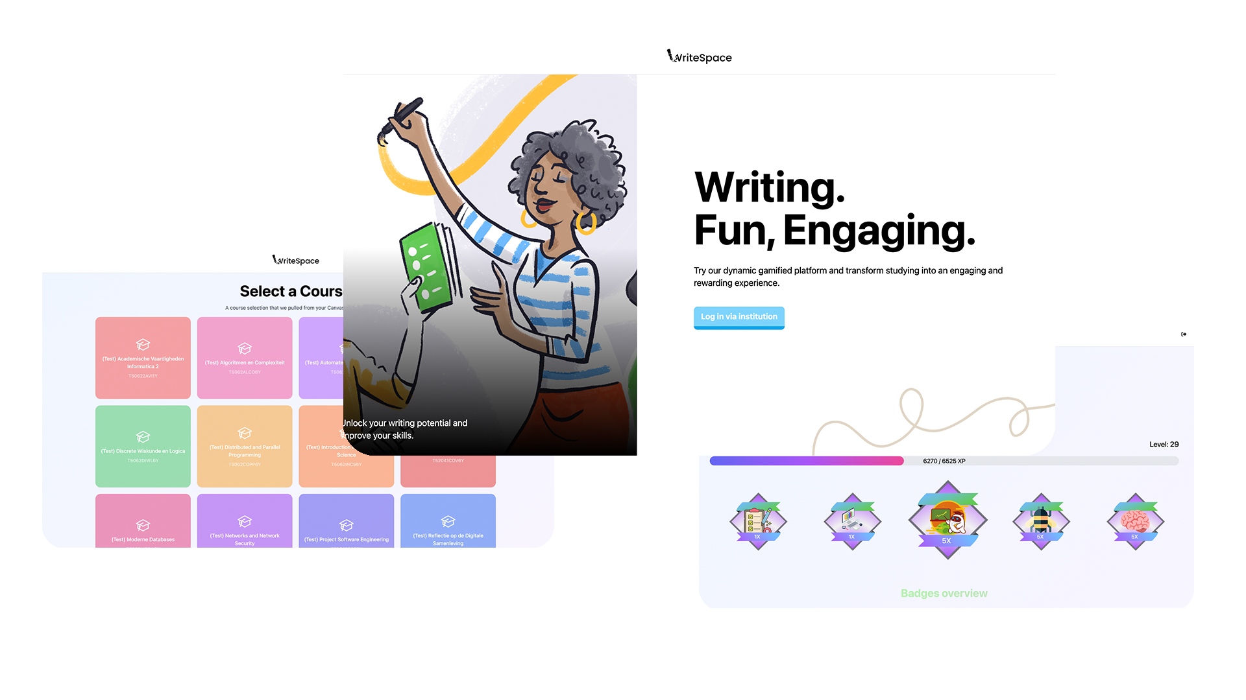

Slide 2

1
The Project

Slide 3
Context
What was the situation
The team
11 driven students
Ambitious goal
The project
Written assignments
Making it exciting again

Slide 4
The objective
What did we want to achieve
Seamless Integration with Canvas
Enhance Student Engagement
Enhance Grading Experience
Improve students' writings skills

Slide 5
2
WriteSpace System

Slide 6






WriteSpace System
Technology stack

Slide 7
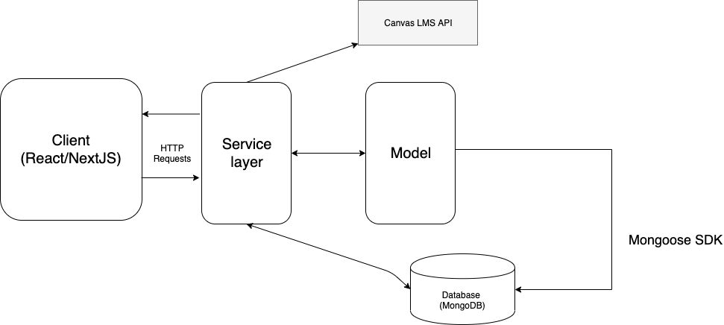
WriteSpace System
The Architecture

Slide 8




WriteSpace System
CI/CD & Testing

Slide 9

WriteSpace System
Green coding
Amsterdam based servers
Minimized API calls
NextJS server-side rendering

Slide 10
4
Demo

Slide 11
Demo
Future enhancements
Learning objectives
LMS Integrations
More badges
Gamifiying writing process

Slide 12

Thank you!

