Slide 1
LinkedIn Post Generator Tool
Name: Mohammed Saif Shaikh
Roll No: 17030924048
Department: Data Science and Technology
Course: MCA
Guide: Mr. Naimesh Tungare
Institute: K J Somaiya Institute of Management

Slide 2
Introduction
Rise of Generative AI in professional content
Need for automating high-quality LinkedIn posts
Lack of personalization in existing tools
Hinglish & tone/length customization missing

Slide 3
Problem Statement & Objective
Problem: Professionals struggle with frequent, structured LinkedIn content.
Goal: Generate personalized posts with topic, tone, language
Objective:
Few-shot prompting
Hinglish support
Streamlit UI
Structured output (intro + bullets + hashtag)

Slide 4


Mental Health
Job Search
Scams
Investment
Minimalism
India

Slide 5
Technical Architecture

Slide 6
Stage 1: Preprocessing

Slide 7
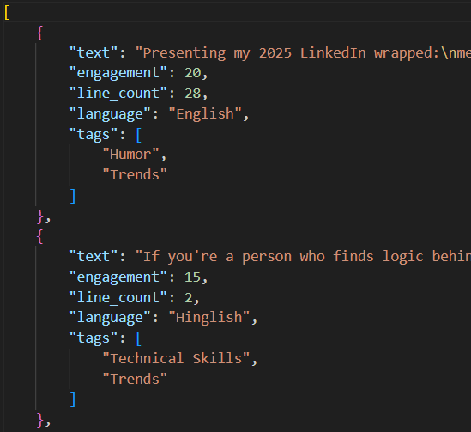
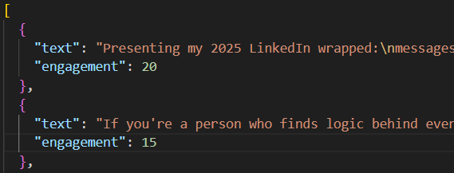
LLM
(Llama 4)

Slide 8
Stage 2: Post Generation

Slide 9
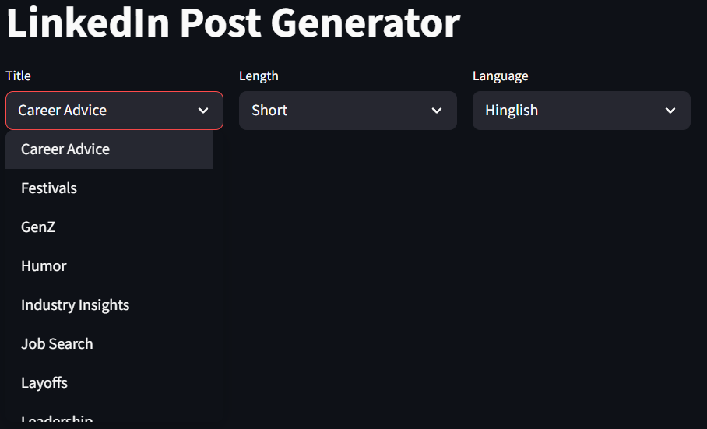

Slide 10
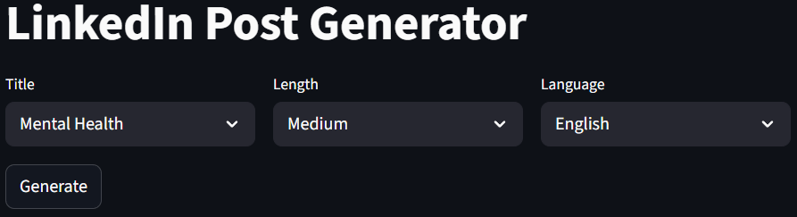
As we navigate our busy lives, it's easy to overlook one of the most important aspects of our overall well-being: mental health.
Taking care of our mental health is just as crucial as maintaining our physical …
If you're struggling or know someone who is, don't hesitate to reach out to a mental health professional or …
#MentalHealthMatters #SelfCare #SupportEachOther
Generate a LinkedIn post using the below information. No preamble.
1) Topic: Mental Health
2) Length: Medium
3) Language: English
4) Use the writing style as per the following examples.
Example 1:
Jobseekers, this one’s for you.
Every application, every interview, every follow-up…
…
Example 2:
To everyone who’s still looking for a job…
I see you. I feel you. 💔
…
LLM
(Llama 4)

Slide 11
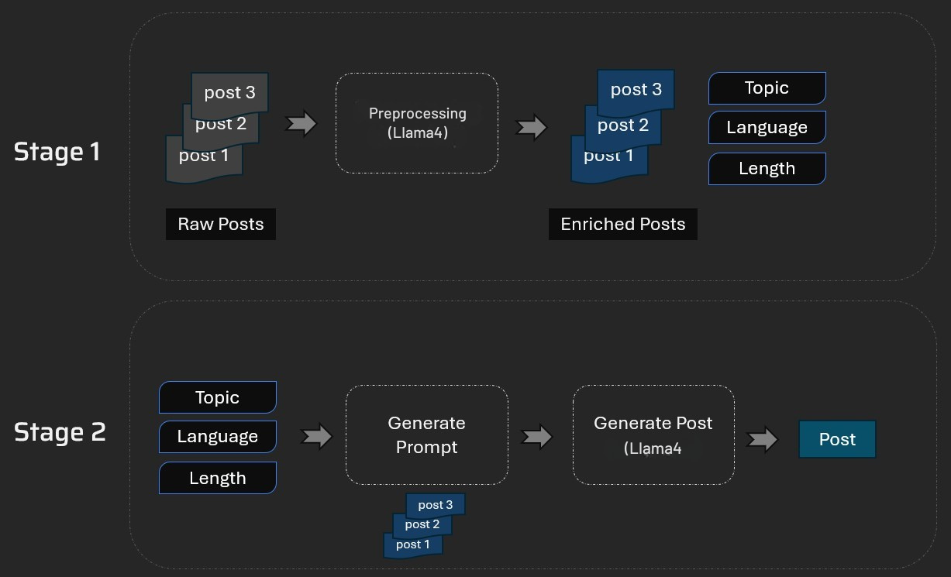

Slide 12
Limitations
No LinkedIn API integration
Requires internet (cloud-hosted LLM)
Limited formal evaluation
Basic UI

Slide 13
Future Work
Add other languages (e.g. Hindi, Spanish)
Integrate with LinkedIn’s posting API
Enhance prompt with tone, emoji control
Fine-tune with LinkedIn-specific data

Slide 14
THANK YOU

