Slide 1

E-Voting System
MD.Saiful Islam(2132105642)
Ariful Alam Abir(2122236642)
Apurba Krishna Dash(2222691642)

Slide 2
Why E-Voting website needs to be used
Push for faster, safer, accessible public services.
Traditional voting = costly, time-consuming, error-prone.
Low trust and participation in manual systems.
E-Voting = efficient, transparent, remote-friendly.
Supports Digital Bangladesh vision.
Builds skills: web security, data handling, user verification.

Slide 3
How we built our E-Voting System
By finding some recent issues regarding election and a fare election system we came up with this idea of E-Voting system . The system is divided into two part
First: National services
In this part a user can get all the national services like NID Card/Birth certificate application , print from this website . Which can save the time of the user and also corrects any mistakes .
Second: Voting part
In this part an eligible voter can cast their vote from home through this website . As they can save time through this. In every developed country they use EVM for voting .

Slide 4
Let’s Talk about our work
We created a home page
Where all the needed toolbars are showed .
Let’s observe it one by one .

Slide 5
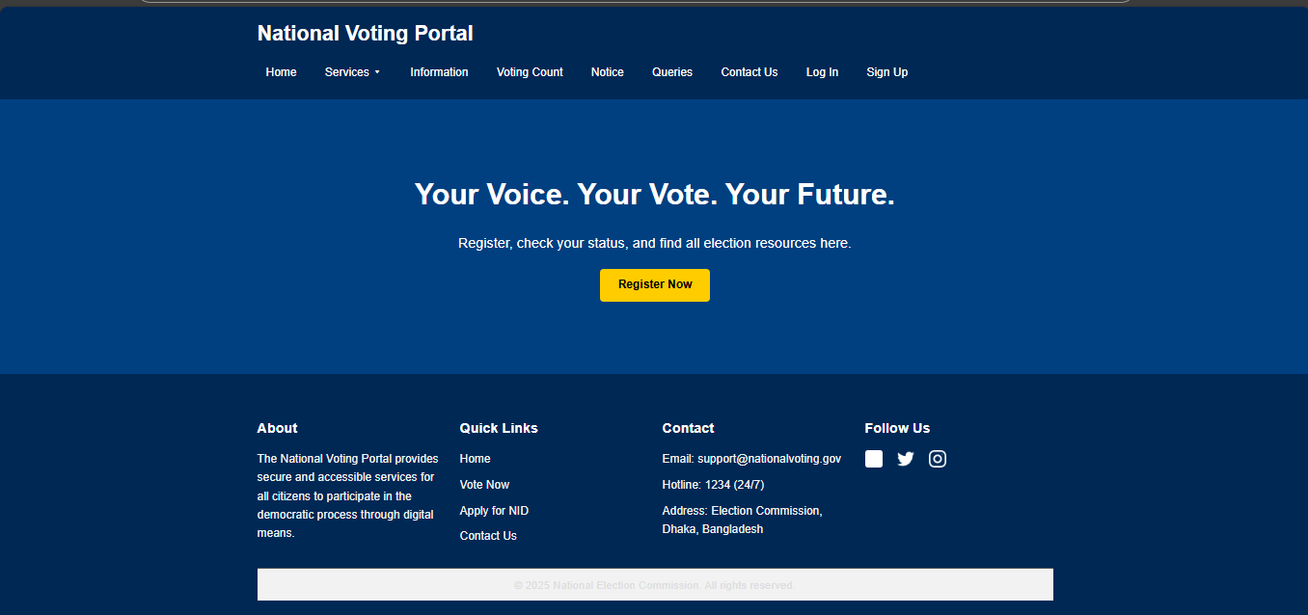
Home Page :

Slide 6
Home page :
This is our home page for this project . In home page there are 9 toolbar.They are:
Services
Information
Voting count
Notice
Queries
Contact us
Log in
Sign up
Let’s talk about all toolbars in details .

Slide 7
Services:
In services there are 6 portal available . They are :
Birth certificate Apply
Birth certificate Log in/Download
Birth certificate correction
NID card Apply
NID card Correction
NID card Download
No we will discuss about Birth certificate Apply first :

Slide 8
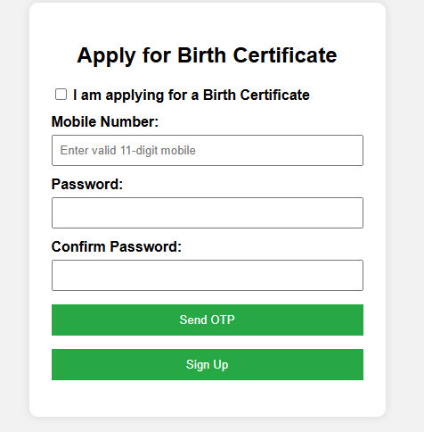
Birth certificate apply
If we enter the birth certificate apply portal firstly this interface will came up . Here user have to give their mobile number and password and an otp will generate and have to put the correct otp .And this will take to next page . At the same time data will store in our database . A sample stored data is showed in picture .

Slide 9
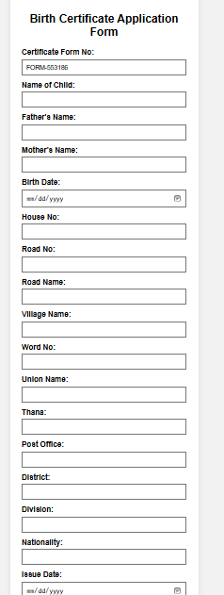
Birth certificate application form :
Ater sing up user will find this page . And here user needs to fill up all information table and his/her data will stored in our data base . A Sample data table showed in picture .

Slide 10
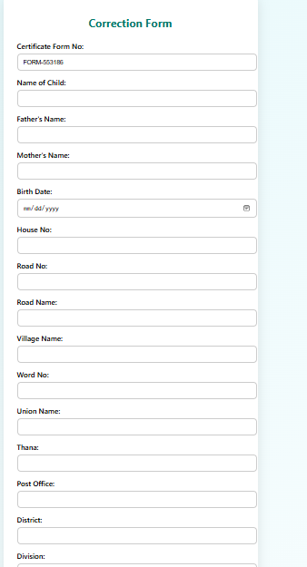
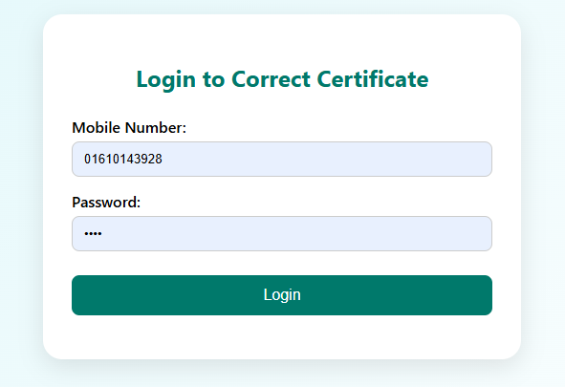
Birth certificate Correction :
For the correction of birth certificate user needs the same mobile number and the password to log in and can correct his birth certificate . Here is the correction page ---→

Slide 11
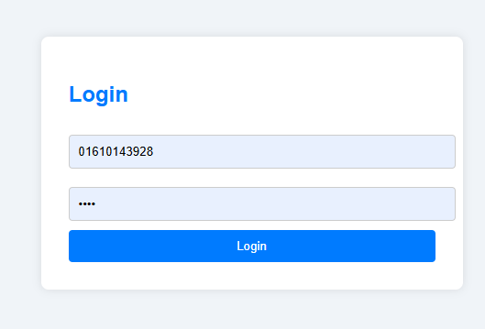
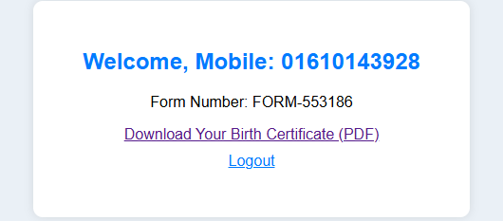
Birth Certificate Download :
For birth certificate download then just simply enter the portal and need to put registered information .And this will take them in pdf download page →

Slide 12
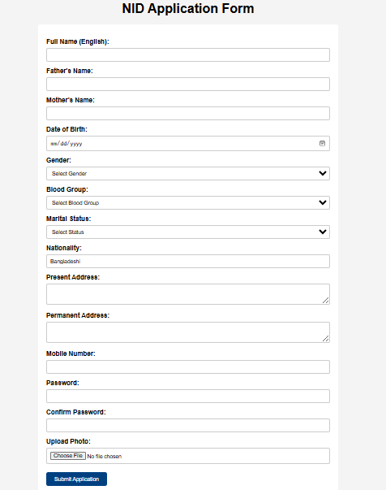
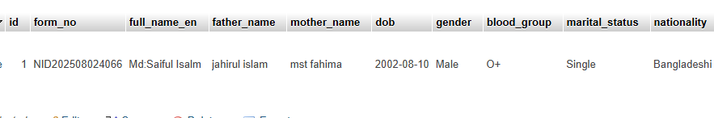
NID Card apply :
This is the nid card apply from . From where user can apply for his nid. The same stored data is showed in picture below :

Slide 13
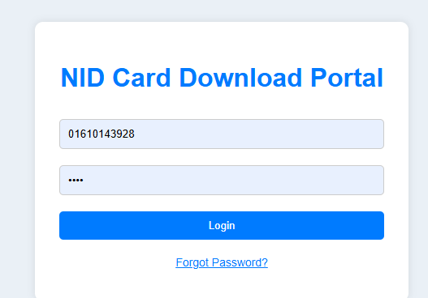
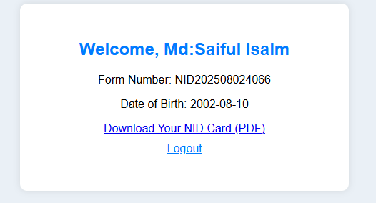
NID card Download :
By entering with valid mobile number and password the page will take user into the page where a ready pad version of his NID is ready -→ From where he can download it .

Slide 14
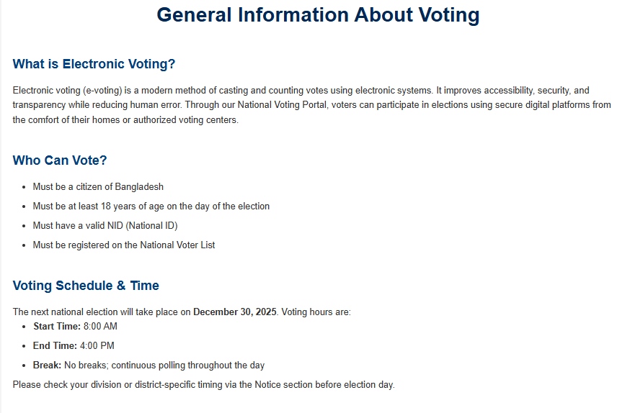
Information Toolbar
This toolbar will give the information about voting ,how to register for vote , how to register for nid,birth certificate , or download etc .

Slide 15
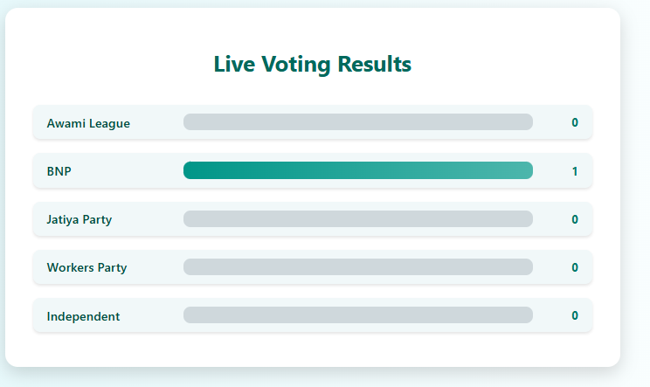
Voting count
The vote user will cast store in our database and also it will show the live counting of voting . As we can see 1 vote is casted for BNP

Slide 16
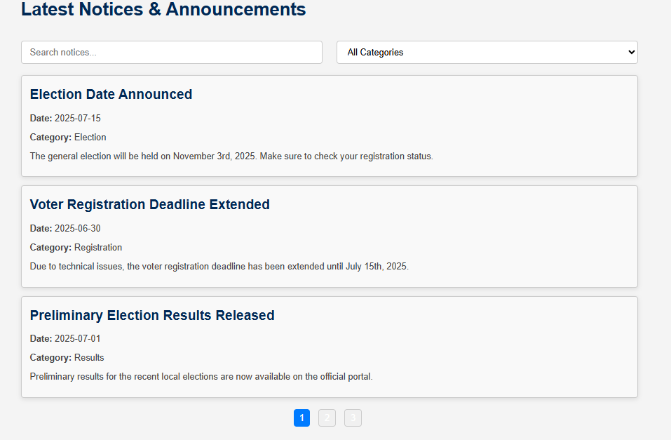
Notice
All the notices given by EC will show here . Voters can see the important dates from this toolbar .

Slide 17
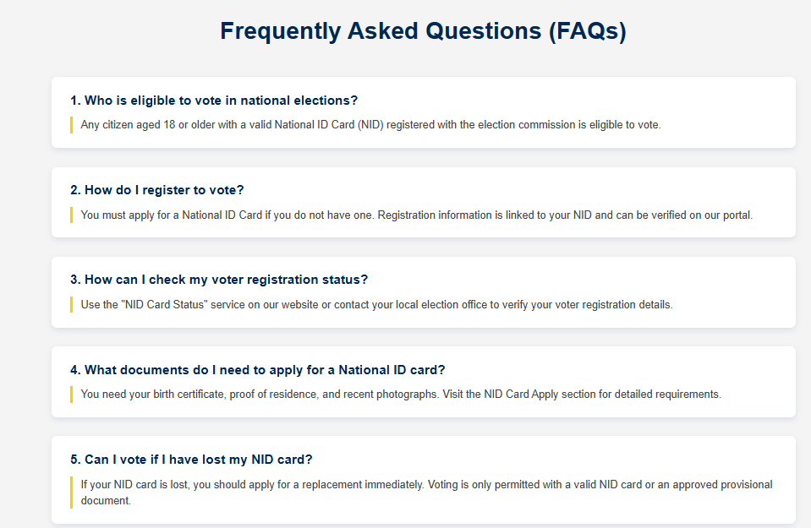
Queries
The question usually an user can asked is given in this section and the will get answer of it .

Slide 18
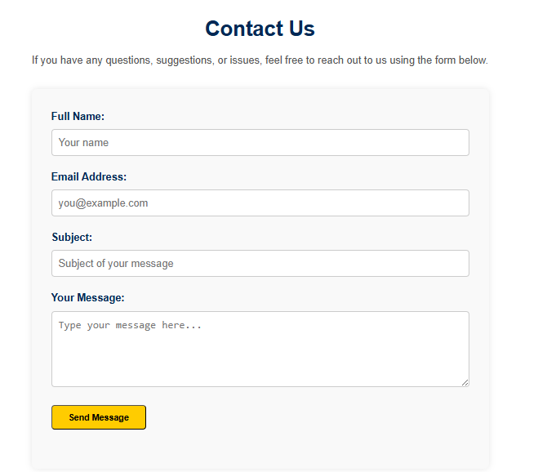
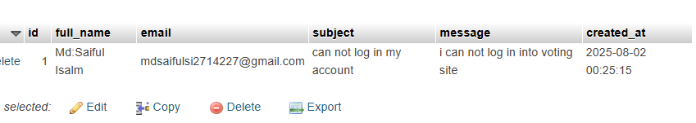
Contact US
An user can contact us through this website by this toolbar . And his asked question or problems will be stored in our database . For example :

Slide 19
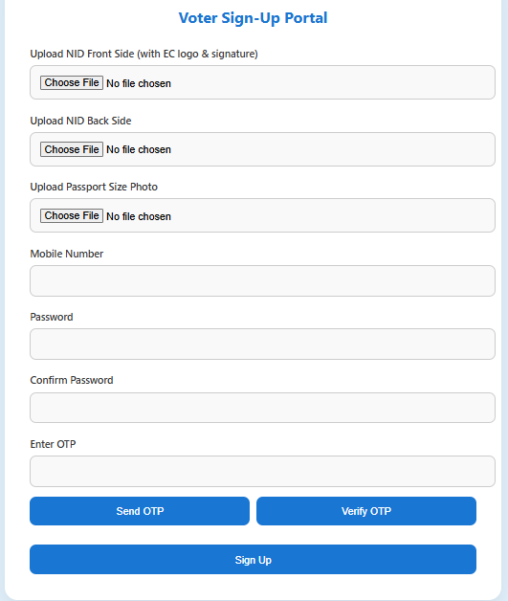
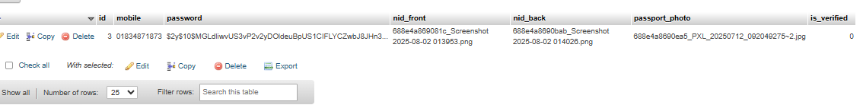
Voter Sign Up
Voter can sign up here to give vote . Without registering no voter can log in . And the data will save in our database . And the pictures will save in our main database folder .

Slide 20
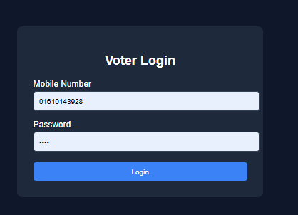
Voter Log in
After sign up voter will log in with valid mobile number and password . It will take him/her into voting dashboard .

Slide 21
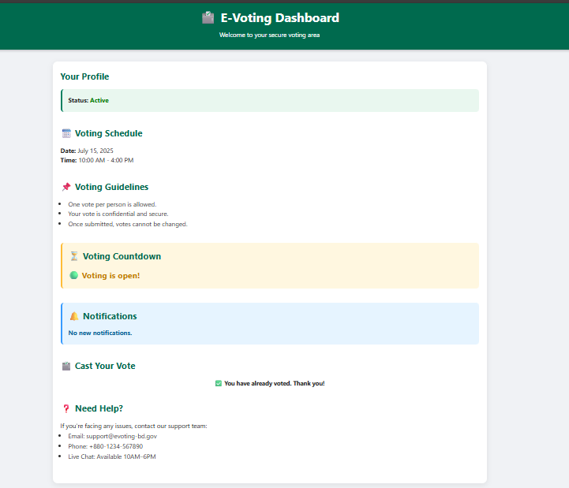
Voting Dashboard
This is the voting dashboard as the user voted for once we can not vote again .

Slide 22
Novelty
Technology-based election: E-Voting offers a modern alternative to manual and faulty EVM systems.
Easy & transparent voting: Fully online system where citizens can vote smoothly and view live results.
Time & cost saving: National documents can be accessed online, reducing hassle for citizens.
Support for citizens abroad: Enables people living overseas to get important documents easily.

Slide 23
Future Improvement
Integrate OTP with real SMS service.
Add stronger security (encryption, multi-factor authentication).
Improve backend for large-scale elections.
Deploy on reliable server/cloud.
Create an admin dashboard for management.
Make the website fully mobile-friendly.

Slide 24
Thank you for Having with Us . Any Question?

