Slide 1
Graphs (Cont.)
graph (many to many)
Notes:
Graphs

Slide 2
Graph Searching
Given: a graph G = (V, E), directed or undirected
Goal: methodically explore every vertex and every edge
Ultimately: build a tree on the graph
  Pick a vertex as the root
  Choose certain edges to produce a tree
  Note: might also build a forest if graph is not connected
There are two standard graph traversal techniques:
  Breadth-First Search (BFS)
  Depth-First Search (DFS)

Slide 3
Breadth-First Search
“Explore” a graph, turning it into a tree
  One vertex at a time
  Expand frontier of explored vertices across the breadth of the frontier
Builds a tree over the graph
  Pick a source vertex to be the root
  Find (“discover”) its children, then their children, etc.

Slide 4
Breadth-First Search
Again will associate vertex “colors” to guide the algorithm
  White vertices have not been discovered
    All vertices start out white
  Grey vertices are discovered but not fully explored
    They may be adjacent to white vertices
  Black vertices are discovered and fully explored
    They are adjacent only to black and grey vertices
Explore vertices by scanning adjacency list of grey vertices

Slide 5
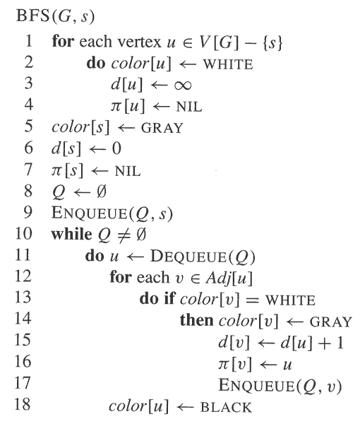
Breadth-First Search

Slide 6
Breadth-First Search: Example
r
s
t
u
∞
∞
∞
∞
∞
∞
∞
∞
v
w
x
y

Slide 7
Breadth-First Search: Example
r
s
t
u
∞
0
∞
∞
∞
∞
∞
∞
v
w
x
y
Q:
s

Slide 8
Breadth-First Search: Example
r
s
t
u
1
0
∞
∞
∞
1
∞
∞
v
w
x
y
Q:
w
r

Slide 9
Breadth-First Search: Example
r
s
t
u
1
0
2
∞
∞
1
2
∞
v
w
x
y
Q:
r
t
x

Slide 10
Breadth-First Search: Example
r
s
t
u
1
0
2
∞
2
1
2
∞
v
w
x
y
Q:
t
x
v

Slide 11
Breadth-First Search: Example
r
s
t
u
1
0
2
3
2
1
2
∞
v
w
x
y
Q:
x
v
u

Slide 12
Breadth-First Search: Example
r
s
t
u
1
0
2
3
2
1
2
3
v
w
x
y
Q:
v
u
y

Slide 13
Breadth-First Search: Example
r
s
t
u
1
0
2
3
2
1
2
3
v
w
x
y
Q:
u
y

Slide 14
Breadth-First Search: Example
r
s
t
u
1
0
2
3
2
1
2
3
v
w
x
y
Q:
y

Slide 15
Breadth-First Search: Example
r
s
t
u
1
0
2
3
2
1
2
3
v
w
x
y
Q:
Ø

Slide 16
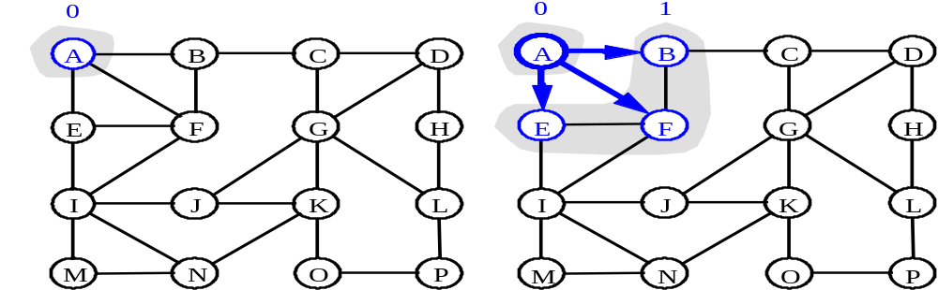
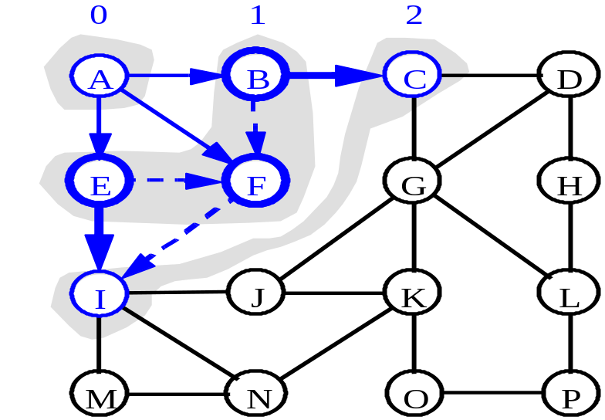
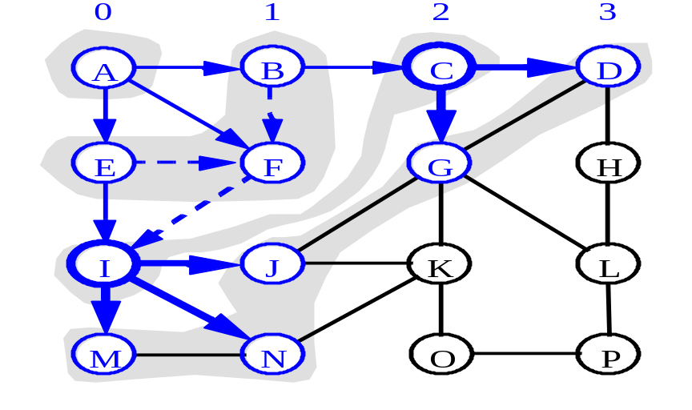
BFS - A Graphical Representation
a)
b)
c)
d)

Slide 17
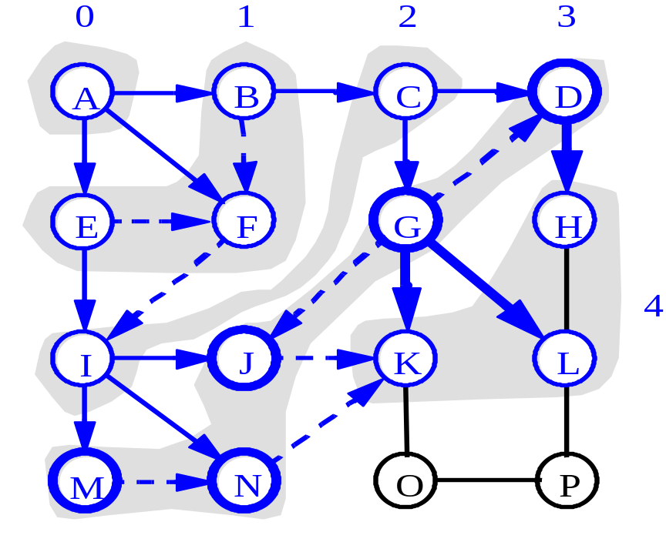
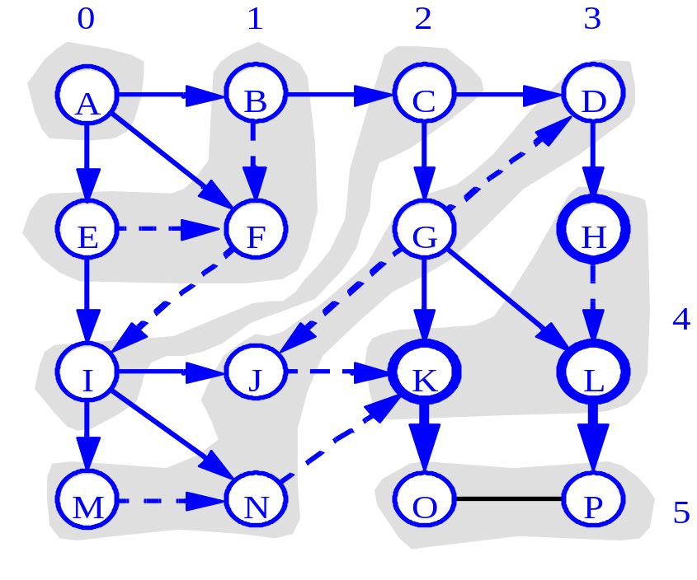
BFS - A Graphical Representation
e)
f)

Slide 18
BFS: The Code Again
BFS(G, s) {
initialize vertices;
Q = {s};
while (Q not empty) {
u = RemoveTop(Q);
for each v ∈ u->adj {
if (v->color == WHITE)
v->color = GREY;
v->d = u->d + 1;
v->p = u;
Enqueue(Q, v);
}
u->color = BLACK;
}
}
Touch every vertex: O(V)
u = every vertex, but only once
(Why?)
So v = every vertex that appears in some other vert’s adjacency list
What will be the running time?
Total running time: O(V+E)

Slide 19
BFS: The Code Again
BFS(G, s) {
initialize vertices;
Q = {s};
while (Q not empty) {
u = RemoveTop(Q);
for each v ∈ u->adj {
if (v->color == WHITE)
v->color = GREY;
v->d = u->d + 1;
v->p = u;
Enqueue(Q, v);
}
u->color = BLACK;
}
}
What will be the storage cost
in addition to storing the tree?
Total space used:
O(V + Σ(degree(v))) = O(V+E)

Slide 20
Breadth-First Search: Properties
BFS calculates the shortest-path distance to the source node
  Shortest-path distance δ(s,v) = minimum number of edges from s to v, or ∞ if v not reachable from s
BFS builds breadth-first tree, in which paths to root represent shortest paths in G
  Thus can use BFS to calculate shortest path from one vertex to another in O(V+E) time in an unweighted tree

Slide 21
Depth-First Search
Depth-first search is another strategy for exploring a graph
  Explore “deeper” in the graph whenever possible
  Edges are explored out of the most recently discovered vertex v that still has unexplored edges
  When all of v’s edges have been explored, backtrack to the vertex from which v was discovered
Vertices initially colored white
Then colored grey when discovered
Then black when finished

Slide 22
Depth-First Search: The Code
DFS(G)
{
for each vertex u ∈ G->V
{
u->color = WHITE;
}
time = 0;
for each vertex u ∈ G->V
{
if (u->color == WHITE)
DFS_Visit(u);
}
}
DFS_Visit(u)
{
u->color = GREY;
time = time+1;
u->d = time;
for each v ∈ u->Adj[]
{
if (v->color == WHITE)
DFS_Visit(v);
}
u->color = BLACK;
time = time+1;
u->f = time;
}

Slide 23
Depth-First Search: The Code
DFS(G)
{
for each vertex u ∈ G->V
{
u->color = WHITE;
}
time = 0;
for each vertex u ∈ G->V
{
if (u->color == WHITE)
DFS_Visit(u);
}
}
DFS_Visit(u)
{
u->color = GREY;
time = time+1;
u->d = time;
for each v ∈ u->Adj[]
{
if (v->color == WHITE)
DFS_Visit(v);
}
u->color = BLACK;
time = time+1;
u->f = time;
}
What does u->d represent?

Slide 24
Depth-First Search: The Code
DFS(G)
{
for each vertex u ∈ G->V
{
u->color = WHITE;
}
time = 0;
for each vertex u ∈ G->V
{
if (u->color == WHITE)
DFS_Visit(u);
}
}
DFS_Visit(u)
{
u->color = GREY;
time = time+1;
u->d = time;
for each v ∈ u->Adj[]
{
if (v->color == WHITE)
DFS_Visit(v);
}
u->color = BLACK;
time = time+1;
u->f = time;
}
What does u->f represent?

Slide 25
Depth-First Search: The Code
DFS(G)
{
for each vertex u ∈ G->V
{
u->color = WHITE;
}
time = 0;
for each vertex u ∈ G->V
{
if (u->color == WHITE)
DFS_Visit(u);
}
}
DFS_Visit(u)
{
u->color = GREY;
time = time+1;
u->d = time;
for each v ∈ u->Adj[]
{
if (v->color == WHITE)
DFS_Visit(v);
}
u->color = BLACK;
time = time+1;
u->f = time;
}
Will all vertices eventually be colored black?

Slide 26
Depth-First Search: The Code
DFS(G)
{
for each vertex u ∈ G->V
{
u->color = WHITE;
}
time = 0;
for each vertex u ∈ G->V
{
if (u->color == WHITE)
DFS_Visit(u);
}
}
DFS_Visit(u)
{
u->color = GREY;
time = time+1;
u->d = time;
for each v ∈ u->Adj[]
{
if (v->color == WHITE)
DFS_Visit(v);
}
u->color = BLACK;
time = time+1;
u->f = time;
}
What will be the running time?

Slide 27
Depth-First Search: The Code
DFS(G)
{
for each vertex u ∈ G->V
{
u->color = WHITE;
}
time = 0;
for each vertex u ∈ G->V
{
if (u->color == WHITE)
DFS_Visit(u);
}
}
DFS_Visit(u)
{
u->color = GREY;
time = time+1;
u->d = time;
for each v ∈ u->Adj[]
{
if (v->color == WHITE)
DFS_Visit(v);
}
u->color = BLACK;
time = time+1;
u->f = time;
}
Running time: O(n²) because call DFS_Visit on each vertex,
and the loop over Adj[] can run as many as |V| times

Slide 28
Depth-First Search: The Code
DFS(G)
{
for each vertex u ∈ G->V
{
u->color = WHITE;
}
time = 0;
for each vertex u ∈ G->V
{
if (u->color == WHITE)
DFS_Visit(u);
}
}
DFS_Visit(u)
{
u->color = GREY;
time = time+1;
u->d = time;
for each v ∈ u->Adj[]
{
if (v->color == WHITE)
DFS_Visit(v);
}
u->color = BLACK;
time = time+1;
u->f = time;
}
BUT, there is actually a tighter bound.
How many times will DFS_Visit() actually be called?

Slide 29
Depth-First Search: The Code
DFS(G)
{
for each vertex u ∈ G->V
{
u->color = WHITE;
}
time = 0;
for each vertex u ∈ G->V
{
if (u->color == WHITE)
DFS_Visit(u);
}
}
DFS_Visit(u)
{
u->color = GREY;
time = time+1;
u->d = time;
for each v ∈ u->Adj[]
{
if (v->color == WHITE)
DFS_Visit(v);
}
u->color = BLACK;
time = time+1;
u->f = time;
}
So, running time of DFS = O(V+E)

Slide 30
Depth-First Search Analysis
This running time argument is an informal example of amortized analysis
  “Charge” the exploration of edge to the edge:
    Each loop in DFS_Visit can be attributed to an edge in the graph
    Runs once/edge if directed graph, twice if undirected
    Thus loop will run in O(E) time, algorithm O(V+E)
  Storage requirement is O(V+E), since adj list requires O(V+E) storage

Slide 31
DFS Example
source
vertex

Slide 32
DFS Example
source
vertex
d f
1 |
|
|
|
|
|
|
|

Slide 33
DFS Example
source
vertex
d f
1 |
|
|
2 |
|
|
|
|

Slide 34
DFS Example
source
vertex
d f
1 |
|
|
2 |
|
3 |
|
|

Slide 35
DFS Example
source
vertex
d f
1 |
|
|
2 |
|
3 | 4
|
|

Slide 36
DFS Example
source
vertex
d f
1 |
|
|
2 |
|
3 | 4
5 |
|

Slide 37
DFS Example
source
vertex
d f
1 |
|
|
2 |
|
3 | 4
5 | 6
|

Slide 38
DFS Example
source
vertex
d f
1 |
8 |
|
2 | 7
|
3 | 4
5 | 6
|

Slide 39
DFS Example
source
vertex
d f
1 |
8 |
|
2 | 7
|
3 | 4
5 | 6
|

Slide 40
DFS Example
source
vertex
d f
1 |
8 |
|
2 | 7
9 |
3 | 4
5 | 6
|

Slide 41
DFS Example
source
vertex
d f
1 |
8 |
|
2 | 7
9 |10
3 | 4
5 | 6
|

Slide 42
DFS Example
source
vertex
d f
1 |
8 |11
|
2 | 7
9 |10
3 | 4
5 | 6
|

Slide 43
DFS Example
source
vertex
d f
1 |12
8 |11
|
2 | 7
9 |10
3 | 4
5 | 6
|

Slide 44
DFS Example
source
vertex
d f
1 |12
8 |11
13|
2 | 7
9 |10
3 | 4
5 | 6
|

Slide 45
DFS Example
source
vertex
d f
1 |12
8 |11
13|
2 | 7
9 |10
3 | 4
5 | 6
14|

Slide 46
DFS Example
source
vertex
d f
1 |12
8 |11
13|
2 | 7
9 |10
3 | 4
5 | 6
14|15

Slide 47
DFS Example
source
vertex
d f
1 |12
8 |11
13|16
2 | 7
9 |10
3 | 4
5 | 6
14|15

Slide 48
DFS: Kinds of edges
DFS introduces an important distinction among edges in the original graph:
  Tree edge: encounter new (white) vertex
    The tree edges form a spanning forest
    Can tree edges form cycles? Why or why not?

Slide 49
DFS: Kinds of edges
source
vertex
d f
1 |12
8 |11
13|16
2 | 7
9 |10
3 | 4
5 | 6
14|15
Tree edges

Slide 50
DFS: Kinds of edges
DFS introduces an important distinction among edges in the original graph:
  Tree edge: encounter new (white) vertex
  Back edge: from descendent to ancestor
    Encounter a grey vertex (grey to grey)

Slide 51
DFS: Kinds of edges
source
vertex
d f
1 |
|
|
2 |
|
3 |
|
|
Tree edges
Back edges

Slide 52
DFS: Kinds of edges
DFS introduces an important distinction among edges in the original graph:
  Tree edge: encounter new (white) vertex
  Back edge: from descendent to ancestor
  Forward edge: from ancestor to descendent
    Not a tree edge, though
    From grey node to black node

Slide 53
DFS: Kinds of edges
source
vertex
d f
1 |
8 |
|
2 | 7
|
3 | 4
5 | 6
|
Tree edges
Back edges
Forward edges

Slide 54
DFS: Kinds of edges
DFS introduces an important distinction among edges in the original graph:
  Tree edge: encounter new (white) vertex
  Back edge: from descendent to ancestor
  Forward edge: from ancestor to descendent
  Cross edge: between a tree or subtrees
    From a grey node to a black node

Slide 55
DFS: Kinds of edges
source
vertex
d f
1 |12
8 |11
13|16
2 | 7
9 |10
3 | 4
5 | 6
14|15
Tree edges
Back edges
Forward edges
Cross edges

Slide 56
DFS: Kinds of edges
DFS introduces an important distinction among edges in the original graph:
  Tree edge: encounter new (white) vertex
  Back edge: from descendent to ancestor
  Forward edge: from ancestor to descendent
  Cross edge: between a tree or subtrees
Note: tree and back edges are very important; some algorithms use forward and cross edges

