Slide 1
Computer Architecture
Memory Organization

Slide 2
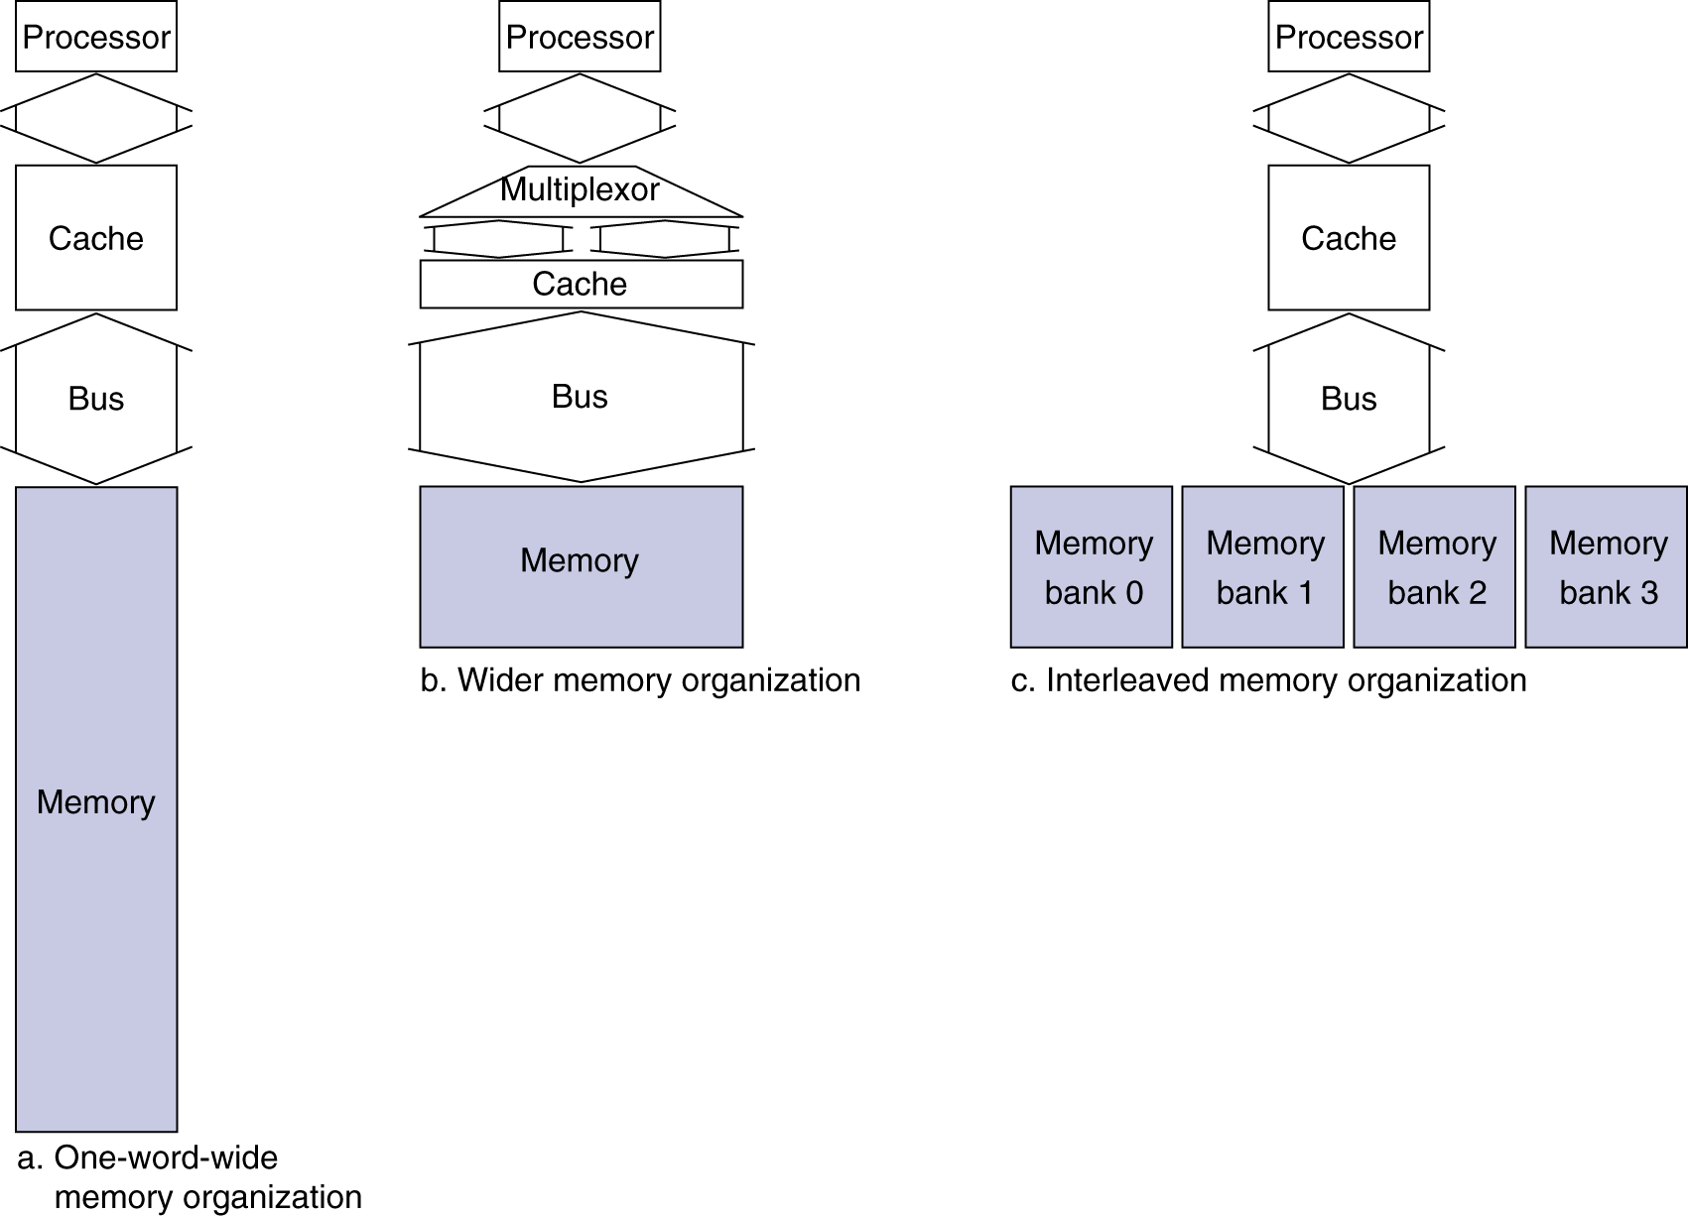
Memory Organization
How about bandwidth for these organizations?
Example cache block read for organization a.
1 bus cycle for address transfer
15 bus cycles per DRAM access
1 bus cycle per data transfer
For 4-word block, 1-word-wide DRAM
Miss penalty = 1 + 4×15 + 4×1 = 65 bus cycles
Bandwidth = 16 bytes / 65 cycles = 0.25 B/cycle

Slide 3
Memory Organization
How about bandwidth for these organizations?
Example cache block read for organization b.
1 bus cycle for address transfer
15 bus cycles per DRAM access
1 bus cycle per data transfer
For 4-word block, 2-word-wide DRAM
Miss penalty = 1 + 2×15 + 2×1 = 33 bus cycles
Bandwidth = 16 bytes / 33 cycles

Slide 4
Memory Organization
How about bandwidth for these organizations?
Example cache block read for organization c.
1 bus cycle for address transfer
15 bus cycles per DRAM access
1 bus cycle per data transfer
For 4-word block, 1nterleaved Memory
Miss penalty = 1 + 1x15 + 4x1 = 20 cycles
Bandwidth = 16 bytes / 20 cycles

Slide 5
Review: The Memory Hierarchy
Take advantage of the principle of locality to present the user with as much memory as is available in the cheapest technology at the speed offered by the fastest technology
Processor
Inclusive– what is in L1 is a subset of what is in L2 is a subset of what is in MM that is a subset of is in SM
Increasing distance from the processor in access time
L1
L2
Main Memory
Secondary Memory
(Relative) size of the memory at each level

Slide 6
Virtual Memory
Use main memory as a “cache” for secondary memory
Allows efficient and safe sharing of memory among multiple programs
Provides the ability to easily run programs larger than the size of physical memory
Simplifies loading a program for execution by providing for code relocation (i.e., the code can be loaded anywhere in main memory)
What makes it work? – again the Principle of Locality
A program is likely to access a relatively small portion of its address space during any period of time

Slide 7
Virtual Memory
Programs share main memory
Each program is compiled into its own address space – a “virtual” address space
During run-time each virtual address must be translated to a physical address (an address in main memory)
CPU and OS translate virtual addresses to physical addresses
VM “block” is called a page
VM translation “miss” is called a page fault

Slide 8
Two Programs Sharing Physical Memory
A program’s address space is divided into pages (all one fixed size) or segments (variable sizes)
Program 1
virtual address space
main memory
Program 2
virtual address space

Slide 9
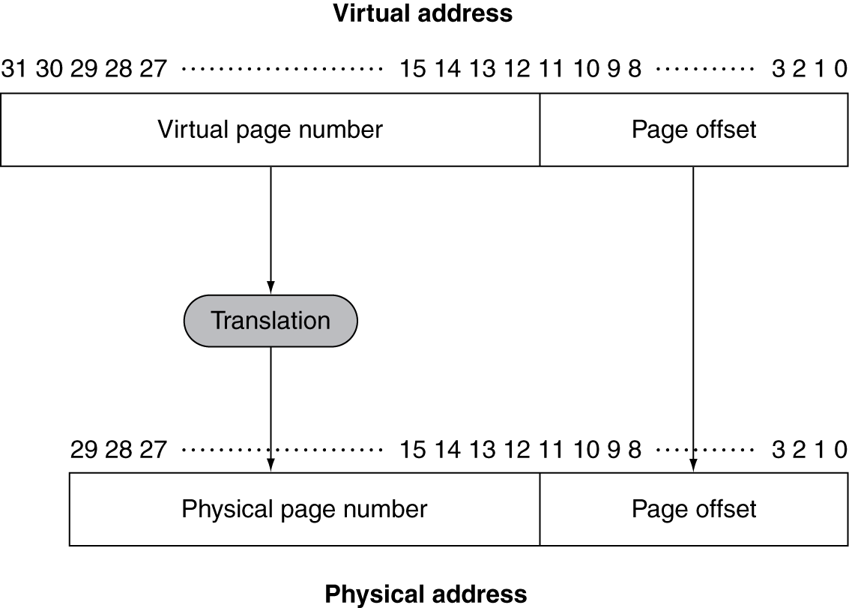
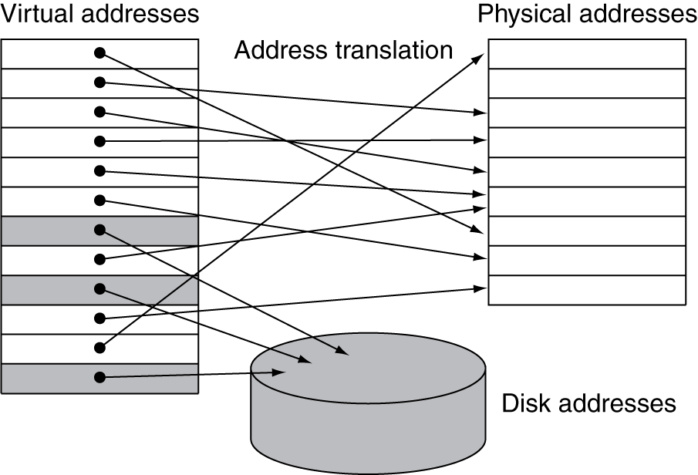
Address Translation
Fixed-size pages (e.g., 4K)
Examples of translation

Slide 10
Address Translation: Concepts
Physical memory
pages
virtual memory pages
(located on disk)
base address
VPN
offset
pages
PPN
offset
Move page and translate address
offset
Address
Translation
Data
Structure
PPN
VPN
Offsets within the virtual page and corresponding physical page are the same
We only need to translate the virtual page number (VPN) to the corresponding physical page number (PPN) also called page frame → effectively a base address

Slide 11
Page Tables
Stores placement information
Array of page table entries, indexed by virtual page number
Page table register in CPU points to page table in physical memory
If page is present in memory
Page table entry (PTE) stores the physical page number
Plus other status bits (referenced, dirty, …)
If page is not present
PTE can refer to location in swap space on disk

Slide 12
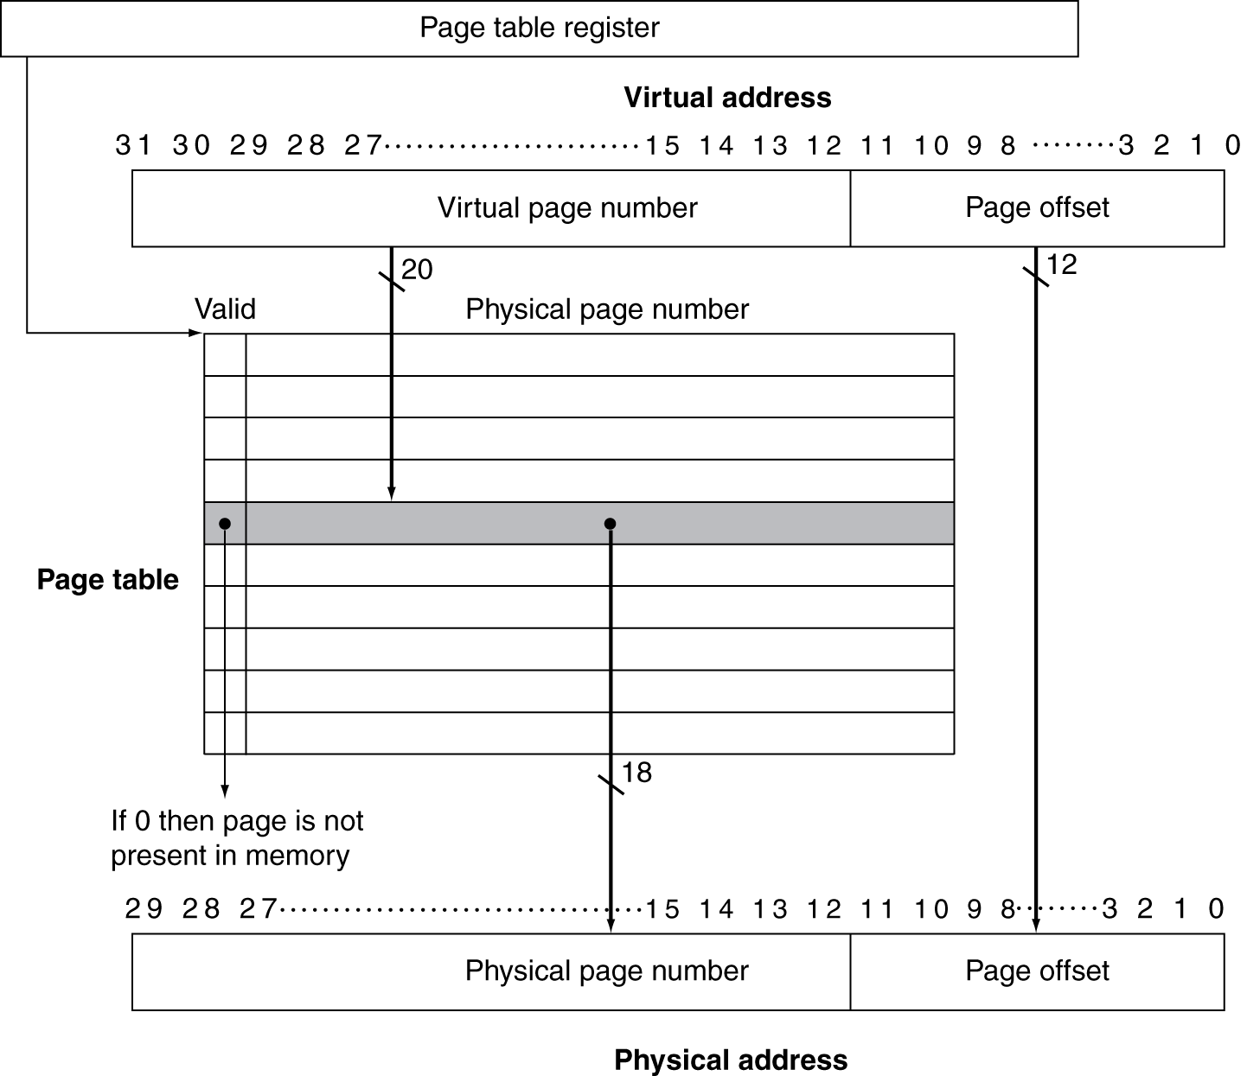
Translation Using a Page Table

Slide 13
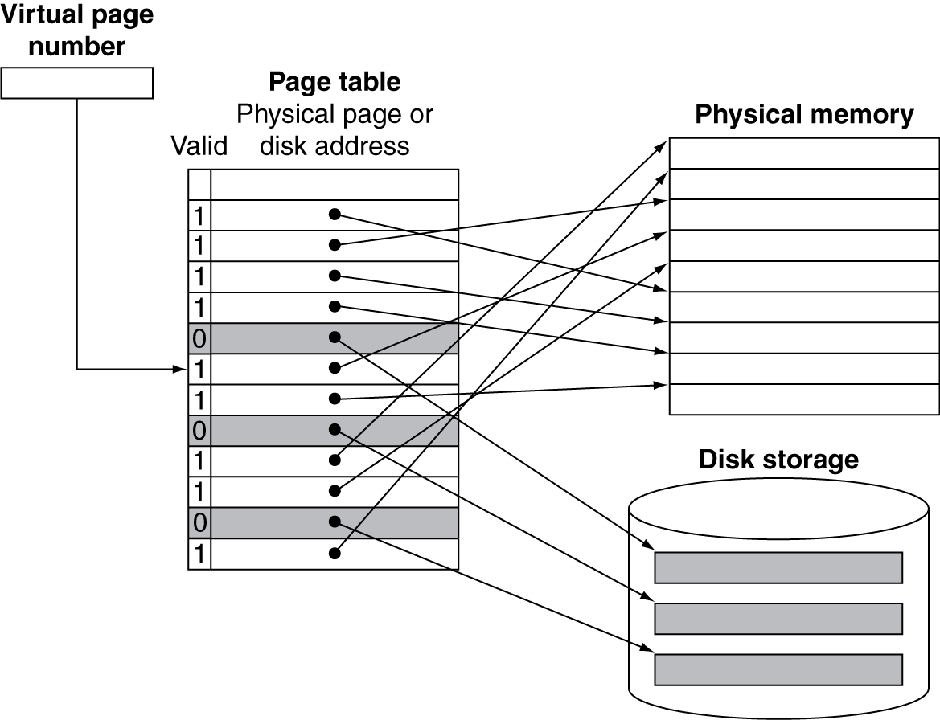
Mapping Pages to Storage

Slide 14
Practice
Virtual Address (bits): 64
Physical DRAM: 16 GB
Page Size 4 KB
PTE Size (byte): 8
How many page table entries (PTE) are needed?
#PTE = 64 – 12 = 52 bits or 2⁵² entries
How much physical memory is needed for storing the page table?
PT physical memory = 2⁵² × 2³= 2⁵⁵ bytes

Slide 15
Page Fault Penalty
On page fault, the page must be fetched from disk
Takes millions of clock cycles
Handled by OS code
Try to minimize page fault rate
Fully associative placement
Smart replacement algorithms

Slide 16
Replacement and Writes
To reduce page fault rate, prefer least-recently used (LRU) replacement
Reference bit (aka use bit) in PTE set to 1 on access to page
Periodically cleared to 0 by OS
A page with reference bit = 0 has not been used recently
Disk writes take millions of cycles
Write through is impractical
Use write-back
Dirty bit in PTE set when page is written

Slide 17
Address Translation
What happens during a memory access?
Map virtual address into physical address using page table
If the page is in memory: access physical memory
If the page is on disk: page fault
Suspend program
Get operating system to load the page from disk

Slide 18
Address Translation
Page table is in memory - this slows down access!
Takes an extra memory access to translate a VA to a PA
Makes memory accesses very expensive (if every access was really two accesses)
VA
PA
miss
Trans-
lation
Cache
Main
Memory
CPU
hit
data

Slide 19
Translation lookaside buffer (TLB)
Translation lookaside buffer (TLB)
Special cache of translated addresses
Keeps track of recently used address mappings to avoid having to do a page table lookup
Just like any other cache, the TLB can be organized as fully associative, set associative, or direct mapped
TLB access time is typically smaller than cache access time (because TLBs are much smaller than caches)
TLBs are typically not more than 128 to 256 entries even on high end machines

Slide 20
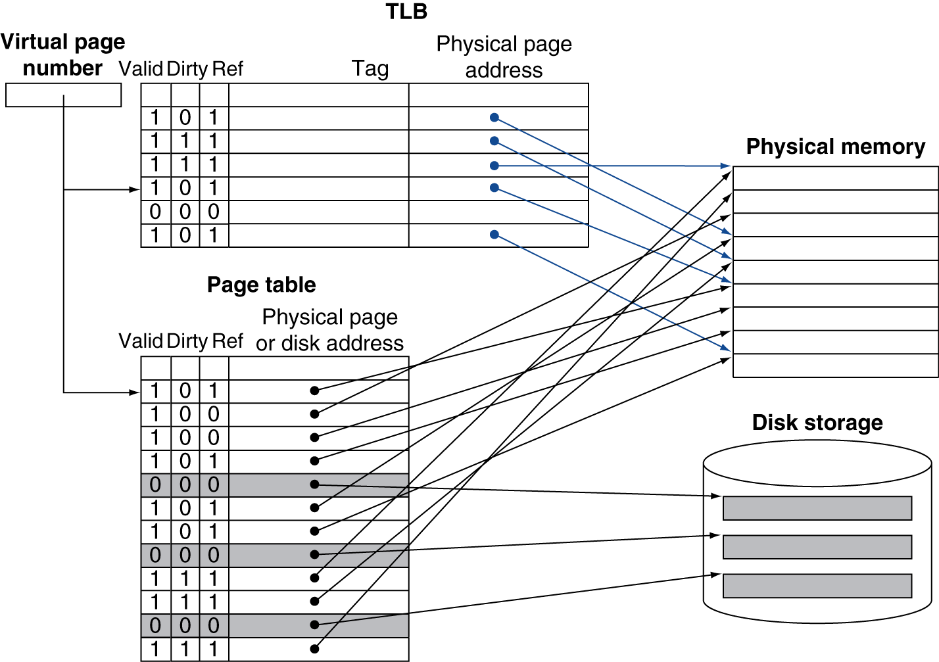
Fast Translation Using a TLB

Slide 21
TLB Miss Handler
TLB miss indicates one of
Page present, but PTE not in TLB
Page not present (page fault)
Handler copies PTE from memory to TLB
Then restarts instruction
If page not present, page fault will occur
TLB misses are much more frequent than page faults

Slide 22
Page Fault Handler
Use faulting virtual address to find PTE
Locate page on disk
Choose page to replace
If dirty, write to disk first
What about copies in the cache?
Read page into memory and update page table
Interaction with the operating system: make process runnable again
Restart from faulting instruction

Slide 23
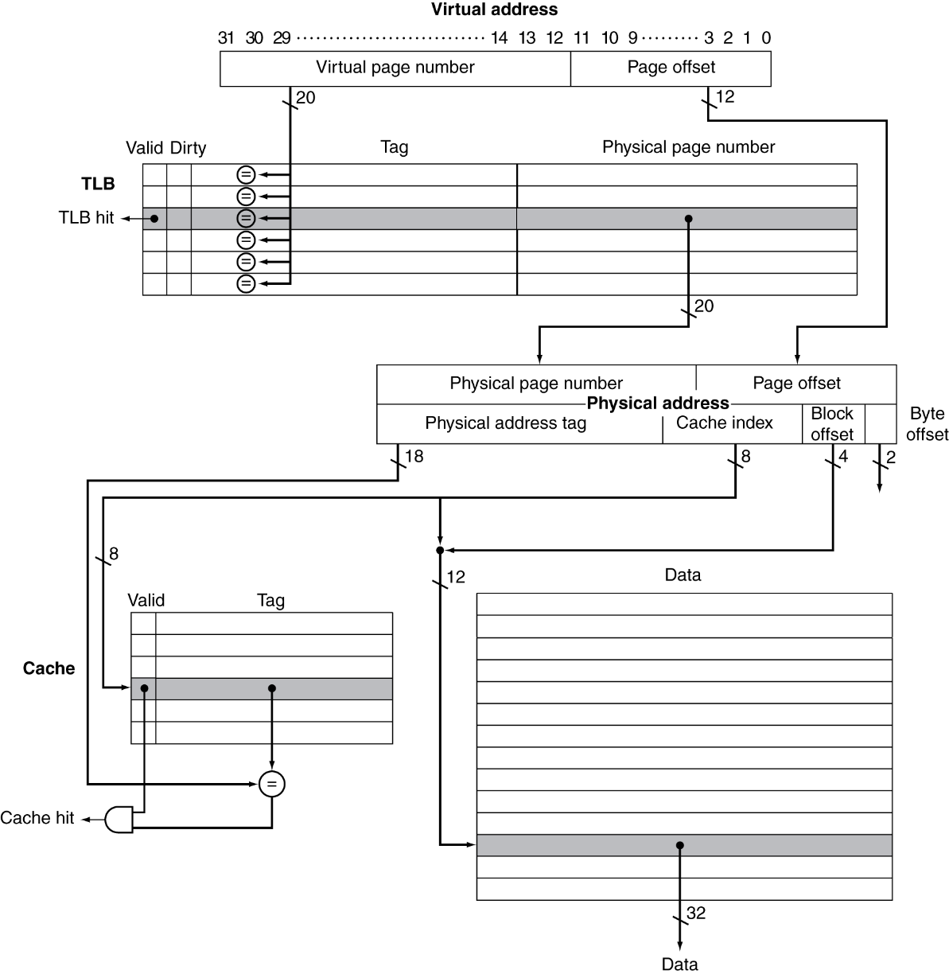
TLB and Cache Interaction
If cache tag uses physical address
Need to translate before cache lookup
Alternative: use virtual address tag
Complications due to aliasing
Different virtual addresses for shared physical address

Slide 24
The Big Picture
Virtual address
TLB access
No
Yes
TLB hit?
try to read from PT
No
Yes
Write?
Yes
try to read from cache
Set in TLB
No
page fault?
No
Yes
cache/buffer mem. write
Cache hit?
replace page from disk
TLB miss stall
Deliver data to CPU
cache miss stall

Slide 25
TLB Event Combinations
TLB | Page Table | Cache | Possible? Under what circumstances?
Hit | Hit | Hit
Hit | Hit | Miss
Miss | Hit | Hit
Miss | Hit | Miss
Miss | Miss | Miss
Hit | Miss | Miss/ Hit
Miss | Miss | Hit
Yes – what we want!
Yes – although the page table is not
checked if the TLB hits
Yes – TLB miss, PA in page table
Yes – TLB miss, PA in page table, but data
not in cache
Yes – page fault
Impossible – TLB translation not possible if
page is not present in memory
Impossible – data not allowed in cache if
page is not in memory

Slide 26
Why Not a Virtually Addressed Cache?
A virtually addressed cache would only require address translation on cache misses
But
Two different virtual addresses can map to the same physical address (when processes are sharing data), i.e., two different cache entries hold data for the same physical address – synonyms
VA
Trans-
lation
PA
Main
Memory
CPU
Cache
hit
data

Slide 27

Sharing
shared page
A’s Page table
B’s Page table
Process A
Main Memory
Process B
Must update all cache entries with the same physical address or the memory becomes inconsistent

Slide 28
Memory Protection
Important function of virtual memory: Protection
Allow sharing of single main memory by multiple processes
Provide each process with its own address space
Protect each process from memory accesses by other processes
Basic mechanism: two modes of operation
User mode - allows access only to user address space
Supervisor (kernel) mode - allows access to OS address space
Page tables and other state information only accessible in supervisor mode
System call - allows processor to change mode

Slide 29
Reading Materials
Class Lectures
Computer Organization and Design (4th Edition)
Sections 5.1 – 5.3, 5.4 (Pages 513-515 are excluded), 5.5, 5.8, 5.12
Related Exercise from 5.14

Slide 30
Acknowledgements
These slides contain material developed and copyright by:
Sudhakar Yalamanchili (GATECH) (Course# ECE3056, Fall 2012)
Hong Jiang (University of Nebraska) (Course# CSCE430, Fall 2012)
Duncan Smeed Jiang (University of Strathclyde) (Course# CS305)

Slide 31
The End

