Slide 1
Multi-Agent LLM Workflow
Md Saiful Islam
AI/HCI PhD Candidate,
University of Rochester

Slide 2
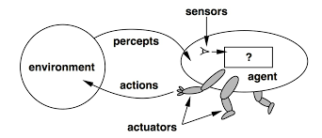
AI Agent
An AI agent is an autonomous software system designed to perceive its environment, reason, make decisions, and take actions to achieve specific goals without direct human instruction.

Slide 3
Multi-Agent Systems in Real Life
Academic Research
Supervise
Collaborate
Delegate
Utilize the best ability of team members

Slide 4
Do We Need Multi-Agent AI Systems
No
If AI reaches true agentic capabilities
A single model can be expert of everything
However, we are not there yet

Slide 5
Do We Need Multi-Agent AI Systems
Yes
As long as AI is unreliable, we cannot rely on delegating a task to a model and hoping that it will figure out how to accomplish the task.
The application domain is sensitive (i.e., health, finance). We may trust a system that mimics a real-life workflow more than an agent that does unexplainable “voodoo” magic to solve a problem.

Slide 6
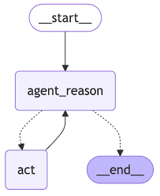
LLM Workflow vs. Agent
An LLM workflow is a fixed sequence of steps where LLMs and tools are called in a pre-defined order, providing deterministic and predictable outcomes.
AI agent is an autonomous system that uses a powerful LLM to make independent decisions, select tools, and dynamically determine its own processes to achieve a goal.

Slide 7
Utilizing a True Agent is Simple
Relies on core abilities, rather than user defined logics and workflows.
Ideally, as long as these components are provided, agent can figure out its own algorithm:
LLM: The "brain" that processes text, reasons, and generates responses.
Tools: The "hands" that allow the agent to interact with the outside world, like searching the web, executing code, or using APIs.
Memory: Provides recall for previous interactions and information. This can be short-term (like a conversation buffer) or long-term (a vector database).

Slide 8
Hybrid Strategies Maybe Better for Now
Maintain a fixed workflow and control over the process.
Define states and their transitions
Allow LLMs to independently figure out a narrow objective.
Provide tools to LLM, and instruct it to accomplish a narrow task
Autonomy vs. Control is a trade-off
How do you define the granularity of states?
Experience & Domain Knowledge

Slide 9
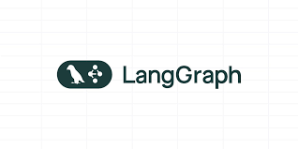

Slide 10
What is LangGraph?
A Python framework that provides fundamentals for implementing and managing LLM workflows.
Basic Components
State Graph
Shared Memory
States (Nodes)
Transitions (Edges)
LLM Calls
Persistent Memory
Human in the loop

Slide 11
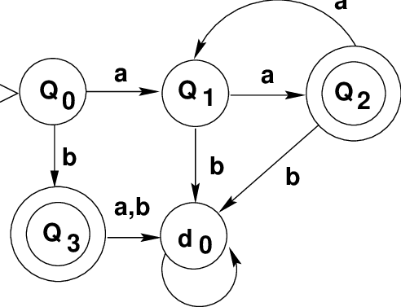
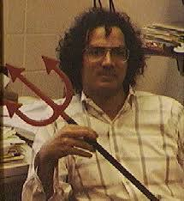
State Graph
Finite State Machines (DFA/NFA)
Defines the Workflow

Slide 12
Shared Memory
Environment
Information available to each state

Slide 13
States
Accomplish a narrow objective
Agent
Algorithmic Step
LLM Call
Tool Call

Slide 14
Transitions
Next step of the agent
Fixed step (go to state B)
Deterministic single step (if x in state A, go to state B)
Nondeterministic steps (randomly select either state A or B)
Parallel steps (delegate sub-tasks across multiple states)

Slide 15
LLM Calls
Each step can make LLM calls
We can use a single LLM for all steps
We can use different LLMs for different steps

Slide 16
Persistent Memory
Keeps a copy of the graph in case we need to resume or recall

Slide 17
Human in the Loop
Pause graph execution and resume with human input

Slide 18
Let’s Build an Investment Agent

Slide 19
Problem Setup
I have 100$ to invest. Which stocks should I buy?
Agent’s Goal: Propose an investment thesis optimizing long-term profit. - Specifically list a set of companies for the user to buy. - Split the total amount mentioned by the user into the suggested companies. - Then provide exact amount of money the user should invest in each company.

Slide 20
Baseline
stock_agent_v0.py

Slide 21
Let’s Add Structured Output
stock_agent_v1.py

Slide 22
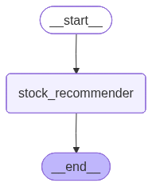
Putting things in LangGraph
Simplest Architecture
stock_agent_v2.py

Slide 23
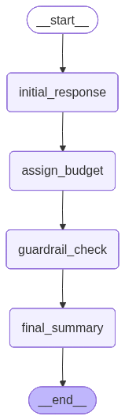
Add Multiple Reasoning Steps
stock_agent_v3.py

Slide 24
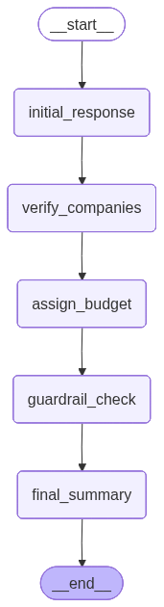
Add Search Tool
stock_agent_v4.py

Slide 25
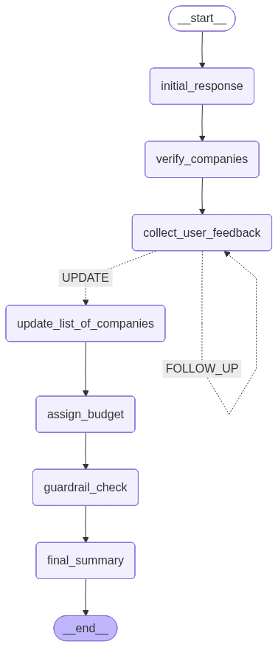
Add Human In the Loop
stock_agent_v5.py

Slide 26
Practice Time!
Abdelrahman Abdelkader
Computer Science,
University of Rochester

