Slide 1

Predicting Vulnerable Road Users Using Stacked LSTM Network
Md Shiful Islam
AI Engineering of Autonomous Systems (M. Eng.) Technische Hochschule Ingolstadt (THI)

Slide 2
Motivation for VRU Protection in Automated Driving
Road Traffic Deaths: A Growing Concern
WHO Report 2013: By 2030, road traffic deaths projected to rise from 8th to 5th leading cause of death.
Urgent Action Needed: Cooperative, automated driving as a key intervention.
Vulnerable Road Users (VRUs)
Statistics:
27% of 1.24 million road traffic deaths are VRUs (pedestrians and cyclists).
In Germany (2013):
101,873 accidents with injuries.
58% of fatalities were pedestrians.
42% of fatalities were cyclists.
69% of fatal accidents occurred in urban areas.

Slide 3

Addressing the Challenge
Dangerous Situations at Intersections
Intersections: High-risk areas due to occlusions and accumulation of VRUs.
Objective: Prevent accidents at urban intersections.
The Need for Cooperative Automated Driving
Challenges:
Sudden movements and direction changes by VRUs.
Need for early and reliable detection of VRU trajectories.

Slide 4

Research Focus and Importance
Research Focus:
Predicting behaviors of pedestrians and other vulnerable road users.
Importance:
Enhances safety and efficiency of driving systems.

Slide 5
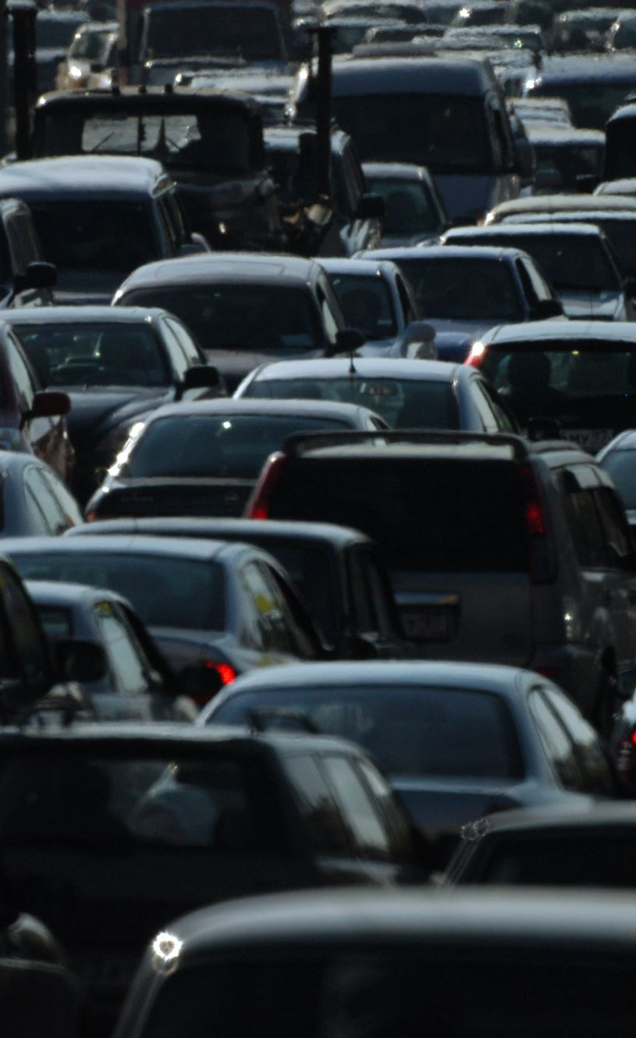
Current Trends and Issues
Popularity and Involvement:
Major car companies (Toyota, Mercedes Benz, GM, Ford, Audi) and tech giants (Google, Uber) are heavily involved.
Challenges in Urban Areas:
AVs struggle with pedestrian interactions in busy city areas.
Human drivers use unspoken signals, like initial movements, to predict intentions.

Slide 6
Existing Research and Limitations:
Focus on specific models not suited for varied movements.
Difficulty in predicting sudden pedestrian stops.
Manual setup requirements limit adaptability in new situations.

Slide 7
Proposed Method and Results
Proposed Method:
Uses Long-Short Term Memory (LSTM) networks.
Observes short sequences of pedestrian movements.
Results:
Accurate predictions up to 4 seconds ahead.
Tested on diverse traffic situations with positive outcomes.

Slide 8
Introduction to Related Work
Growing Interest:
Focus on predicting pedestrian intentions in urban traffic.
Key areas: Dynamical Motion Models, Planning-based Models, Data-Driven Approaches.

Slide 9
Dynamical Motion Models
Main Approach:
Predict pedestrian intentions based on motion trajectories.
Schneider et al.:
Used Bayesian filters (EKF) for short-term predictions (< 2 seconds).
Applied to bending-in, crossing, starting, and stopping motions.
Introduced IMM KF for varied movements: constant velocity, acceleration, and turn.
Kooij et al.:
Used Dynamic Bayesian Network (DBN) for crossing predictions.
Factors: approaching vehicle, pedestrian awareness, and environment layout.
Modeled as a Switching Linear Dynamical System (SLDS).

Slide 10
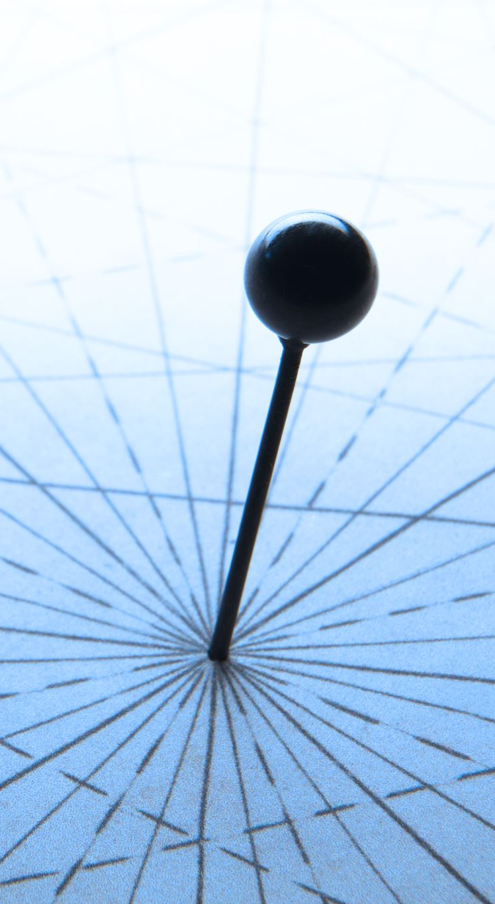
Planning-based Models
General Concept:
Focus on path planning rather than motion dynamics.
Assume pedestrians choose optimal (shortest) path to their goal.
Rehder et al.:
Long-term prediction of pedestrian destination.
Used path planning and grid occupancy maps.
Modeled goal destination as a Gaussian Mixture Model, refined with Particle filter.

Slide 11

Data-Driven Approaches
Overview:
Utilize deep learning techniques like CNNs and RNNs.
Alahi et al.:
RNN-based model for social behavior prediction in crowded environments.
Used surveillance camera data to capture pedestrian interactions.
Volz et al.:
Vehicle-based approach using 3D LiDAR data.
Employed CNNs and RNNs for intention recognition.

Slide 12
Why Proposed LSTM Model is Best
Advantages of LSTM Model:
Captures temporal dependencies in pedestrian motion.
Effective for both short-term and long-term predictions.
Superior performance in predictive accuracy across various scenarios.
Comparison:
Outperforms traditional dynamical models (EKF, IMM).
Better at long-term forecasting due to advanced memory capabilities.

Slide 13
Superior Performance and Flexibility
Performance Metrics:
Consistently lower mean lateral position error.
Significant improvements in "Starting", "Bending In", and "Crossing" scenarios.
Flexibility:
Adapts to different urban traffic environments.
Can handle complex pedestrian behaviors and interactions.
Conclusion:
LSTM-based approach provides robust and accurate long-term pedestrian intent prediction, crucial for enhancing urban traffic safety and efficiency.

Slide 14
Introduction to Methodology
Overview:
Discuss Recurrent Neural Networks (RNNs) and their application to time series prediction.
Explain the problem formulation of pedestrian intent prediction using RNNs.
Introduce our proposed approach and model for long-term intent prediction in urban traffic environments.

Slide 15
Time Series Prediction Using RNNs
Recurrent Neural Networks (RNNs):
Used for tasks like handwriting imitation, analyzing walking patterns, and studying human interactions.
Feature loops (hidden units) to remember previous information.
Struggle with long sequences.
Solution: Long Short-Term Memory (LSTM) Networks:
Contain memory blocks with memory cells and three gates: forget, input, and output.
Gates determine what information to remember, update, or output.

Slide 16
LSTM Network Operations
LSTM Operations:
Forget gate:
decides what to forget from previous memory.
Input gate:
decides what new information to add to the memory.
Memory update:
combines old and new information.
Output gate:
decides what to output based on updated memory.
Final output:
based on updated memory.

Slide 17
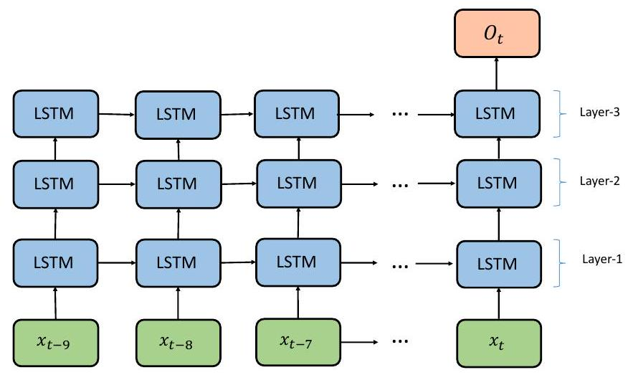
Intent Prediction Using Stacked LSTM Network
Approach:
Predict future movements based on recorded paths.
Network Structure:
Deep network with three layers of LSTM blocks.
Each layer has 100 hidden units.
Final layer has one neuron predicting the next lateral position.
Use linear activation function in the last layer for predicting real numbers.

Slide 18
Application and Flexibility
Training and Testing:
Model learns to predict the next position during training.
Can predict sequences of any length during testing.
Adaptability:
Flexible to different scenarios without needing structural changes.
Suitable for various urban traffic environments.

Slide 19
Summary and Novel Contributions
Novel Approach for Pedestrian Intent Prediction
Objective: Long-term intent prediction of pedestrians from motion trajectories.
Method: Time-series prediction using a stacked LSTM (Long Short-Term Memory) architecture.
Data: Trained on a widely recognized public dataset capturing various urban traffic scenarios.

Slide 20
Key Features of Stacked LSTM Model
Temporal Dependencies: Effectively captures the sequential nature of pedestrian movement.
Short and Long-term Prediction: Accurate predictions over extended horizons.
Improved Performance: Significant improvement over traditional dynamical motion models.

Slide 21
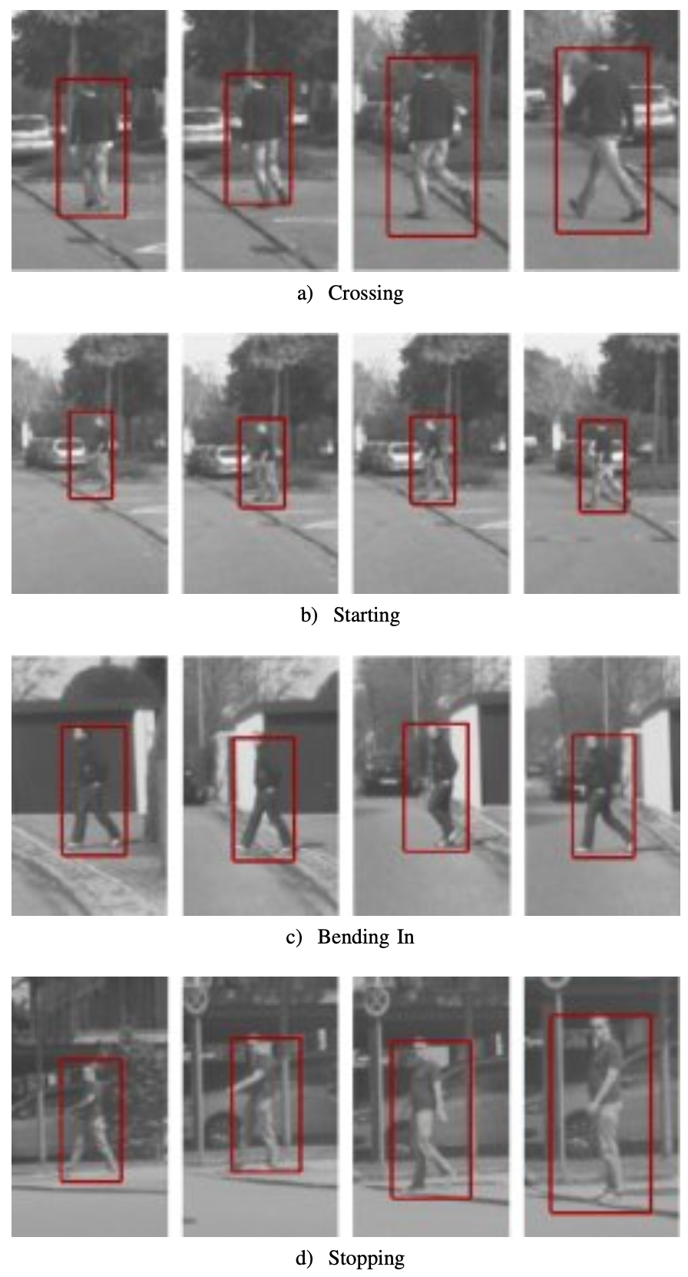
Evaluation and Impact
Comparative Performance
Baseline Models: Extended Kalman Filter (EKF) and Interacting Multiple Model (IMM).
Testing Scenarios: Crossing, stopping, starting to walk, and bending in towards the street.

Slide 22
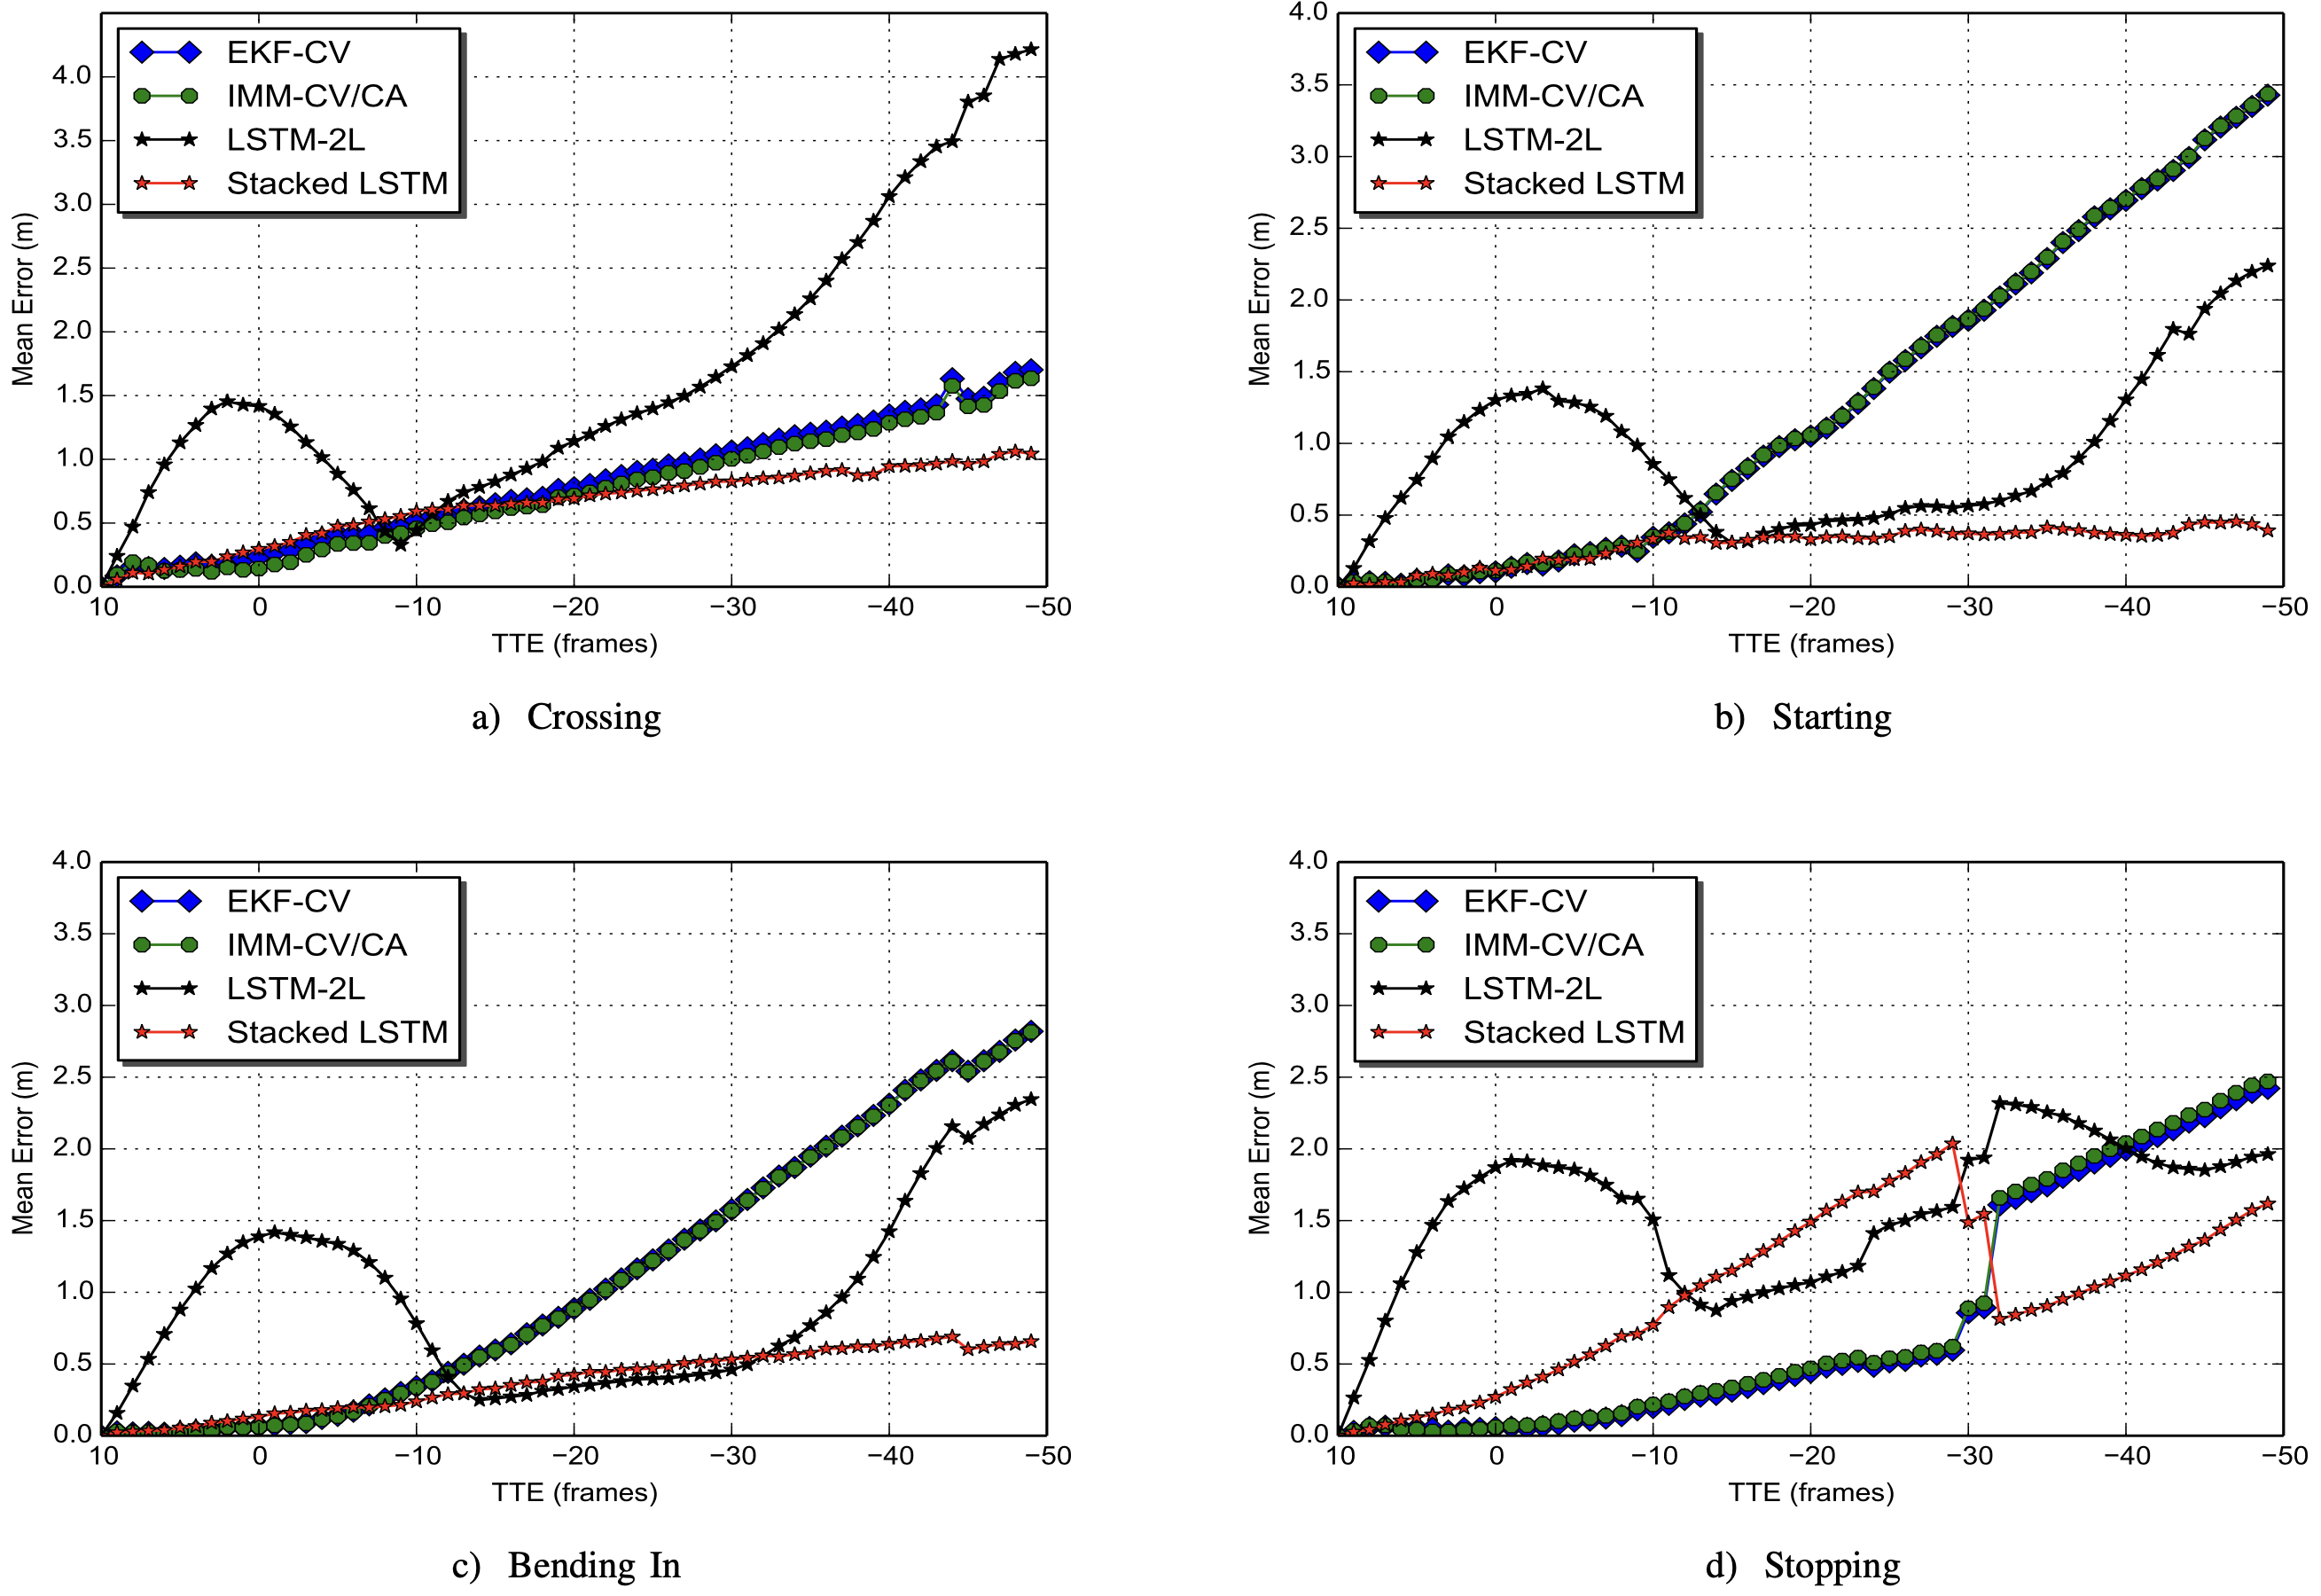
Results
Consistent Outperformance: Stacked LSTM outperforms EKF and IMM in most scenarios.

Slide 23
Implications
Safety and Efficiency: Enhances the safety and efficiency of intelligent transportation systems.
Urban Traffic Management: Valuable tool for understanding and anticipating pedestrian behavior.
Autonomous Vehicle Navigation: Critical for preventing accidents and ensuring smooth traffic flow.

Slide 24
Future Work
Enhancing Model Accuracy:
Integrate More Data Sources: Incorporate additional data such as environmental factors (weather, lighting) and pedestrian attributes (age, gender) to improve prediction accuracy.
Refine LSTM Architecture: Experiment with different configurations and advanced LSTM variants to further enhance model performance.
Real-time Implementation:
Optimize for Real-time Use: Adapt the model for real-time processing in autonomous vehicles and urban traffic systems.
Deploy on Edge Devices: Ensure the model can run efficiently on edge devices with limited computational resources.

Slide 25
Expand to Diverse Scenarios:
Test in Varied Environments: Validate the model in different urban settings and with more complex pedestrian interactions.
Adapt for Mixed Traffic: Extend the model to predict the behavior of other vulnerable road users (VRUs) such as cyclists and scooters.
Collaborative Systems:
Integration with Other Models: Combine the LSTM model with other predictive models for a holistic traffic management system.
Feedback Loop Mechanisms: Implement feedback mechanisms where the predictions can be used to improve model accuracy continuously.

Slide 26
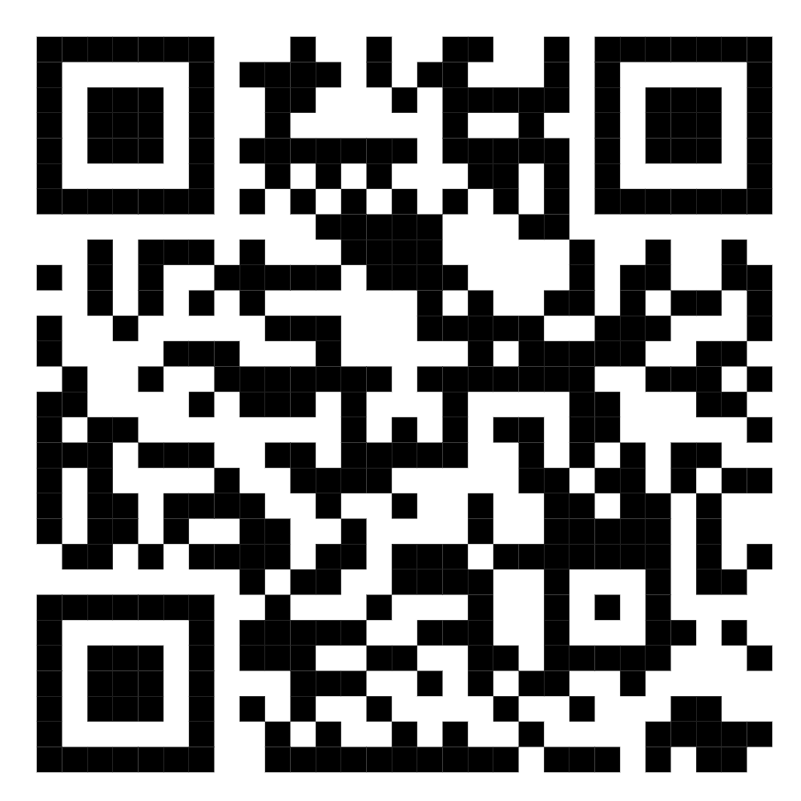
Q & A

