Slide 1
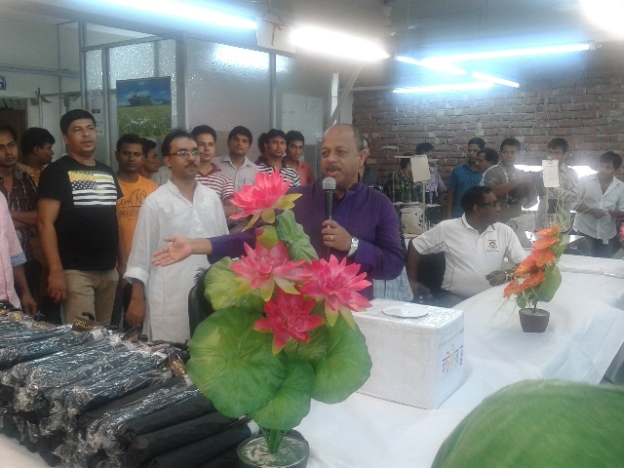

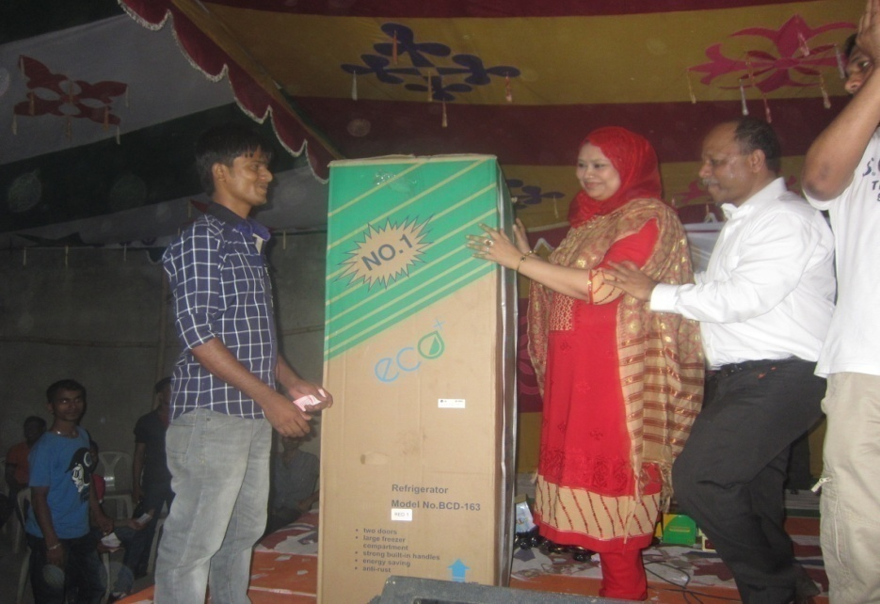
Contents
Company snapshot
Major customers
Business model
Annual Sales
Contacts
Sample
Cutting
Sewing
Washing
Certificates
Corporate Social Responsibility

Slide 2
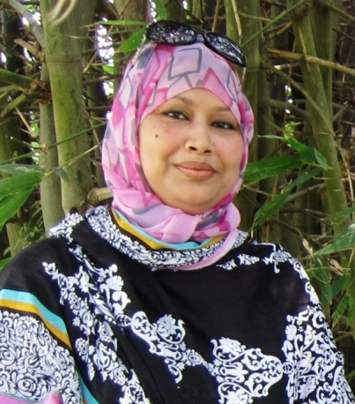
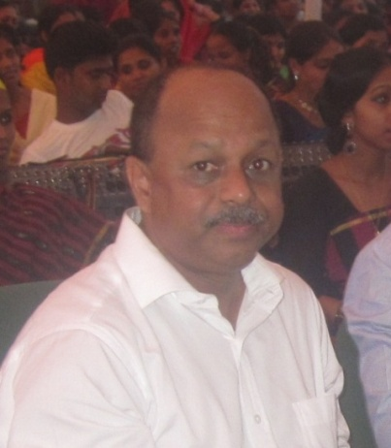
MRS. KAZI MAHJABIN MOMTAZ
CHAIRMAN
A person with wisdom and belief pursuing the best output with available resource. Honesty and affection is her priceless asset of life which is the inspiration for the company staffs. A respected and caring mother of two children is equally mother to all the members of D & S
MR. MD ZAHANGIR ALAM . FCA
MANAGING DIRECTOR
Pacing the momentum of modernization in Garment Manufacturing worldwide , Mr Alam is an icon to the whole business for his education experience wisdom and passion. All the company members are lead to the best result through his experienced management of every affair of business. A widely acceptable visionary character Mr Alam is firmly believed and depended by all his timely decision honesty sincerity discipline and care.

Slide 3
Company Snapshot
Ownership
Design & Source Ltd.
Established
Started its journey in 2014 as Waymart Apparels ltd
_{Core Business}
Manufacturing woven Bottoms (Infant , Children wear, and Menswear ) for export markets. Our items are Denim and non Denim trousers Jacket, Dungaree,

Slide 4
Company Snapshot
Main Operations
Garment factory, 1 Units.
Annual turn over for the Group USD 8.5 Million
Location: Heart of Dhaka
800 employees
6 Production lines
450 machines
150K Pcs per month
Product development facilities
Washing facilities
Management Team
All key Departments of the Factories are managed by an experienced team of Management and a well experienced Support team.

Slide 5
Our Goal
To become a highly reputed Garments Manufacturer in the international market by producing best quality products in a very short lead time, with High ON Time delivery which will confirm and satisfy customer expectation.

Slide 6






Next.co.uk
OUR CORE BUYRES

Slide 7
Business Model
Delivery
Quality
Full service
Lead time:
Original Orders
60-120 days
Re orders
60-90 days
Quick response program
30-60 days
Minimum Order:
10000 pcs /Style
2.5 Accepted Quality level (AQL)
Statistical process control (SPC) for inline Quality inspection
Sample
Cutting
Embroidery – Collaborative Partners
Printing - Collaborative Partners
Sewing
Washing
Finishing

Slide 8
Sample & Design
Capacity 500 pcs per month
Sample lead time 3-5 days
Managed by 2 experienced Manager.
Can handle detailed style Garments

Slide 9
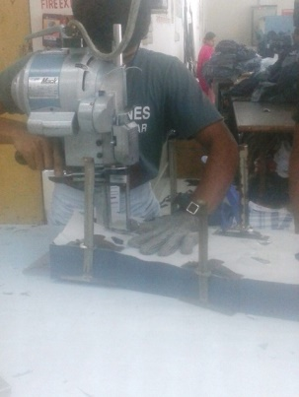
Cutting
Consist with 3 Cutting Tables.
Capacity to cut 5,000 pcs. Per day.
Geared to hold 2 days stock.

Slide 10
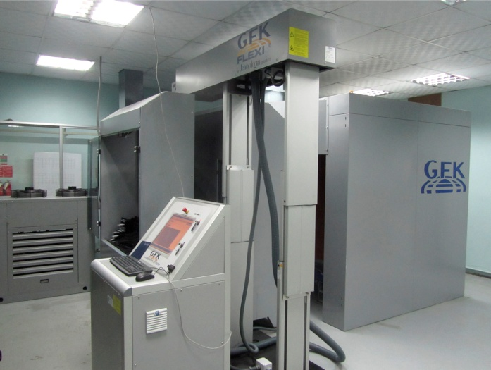
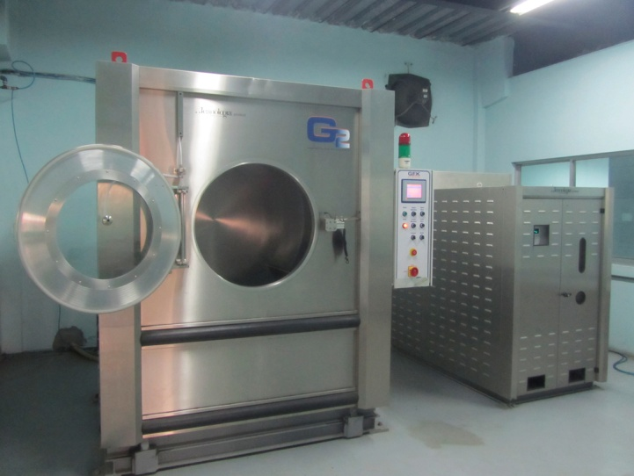
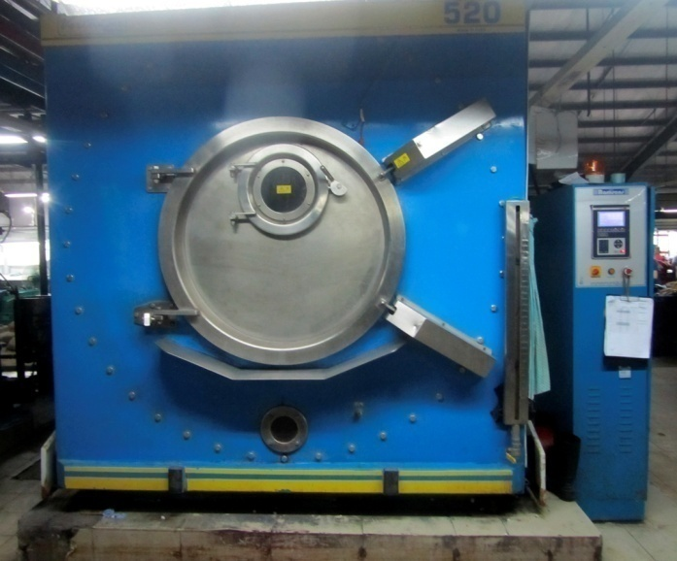
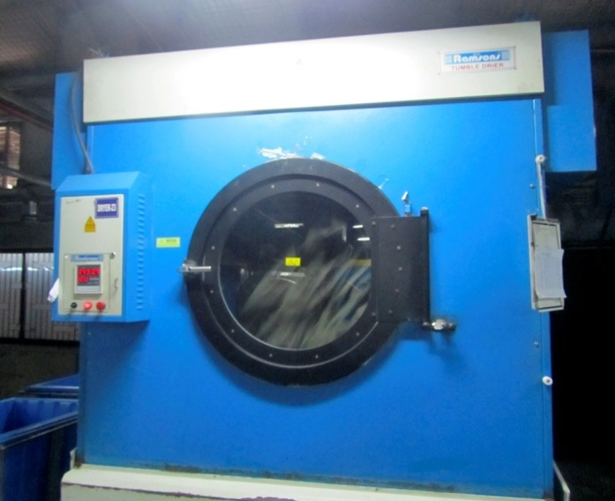
Washing
100 workers headed a Expert Wash Technician.
Capacity of this plant 20,000
pcs. Per day.
Capable of, Hand brushing &
Whiskering, 3D, Chemical Spraying , Grinding , Garment Dye etc. etc.
Equipped with Pre-treatment Water Plant,

Slide 11
Fully Compliant of
Bangladesh Labor Code 2006
BGMEA Instructions
Code of Conduct from each individual buyer
Accord – GREEN Certified
Washing Plant With ETP Set up and other Environment requirement

Slide 12




Certificates

Slide 13
Human Resource Policy
Waymart Apparels Ltd. Has over 800 employees treated according to human resources policy of the company:
Every single employee of WAL is an Asset and one of the key driving forces for the company.
Rewarding for the performance is a regular practice in WAL to motivate the employees.
WAL regularly conducts training to improve the skill level of the employees.
Fire drill and training to safe Guard them from any unwanted fire

Slide 14
Strengths
➔Strong team ( Merchandising /Production/Quality ) with the experience of handling buyers.
➔Quick sample turn around
➔Strong Compliance team
➔Certified fire fighter

Slide 15
Weaknesses
➔Inability to book greige/fabric in advance to meet buyers tight lead time
➔Non-flexibility of production plans to serve fashion trend oriented buyers .( Buyers are changing their styles time to time with the change of trends. This may affect our production plans regularly
➔Small sample room

Slide 16
Opportunities
➔Located Close to buyer s office,
➔Close to the Airport and hotel
➔We can show Our Lead buyer and get new customers

Slide 17
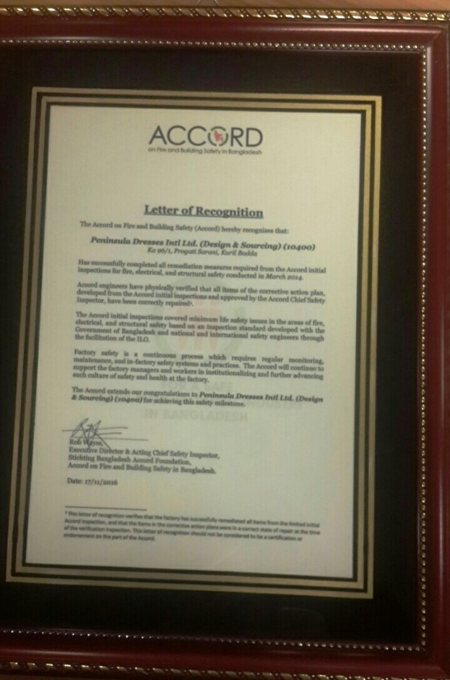
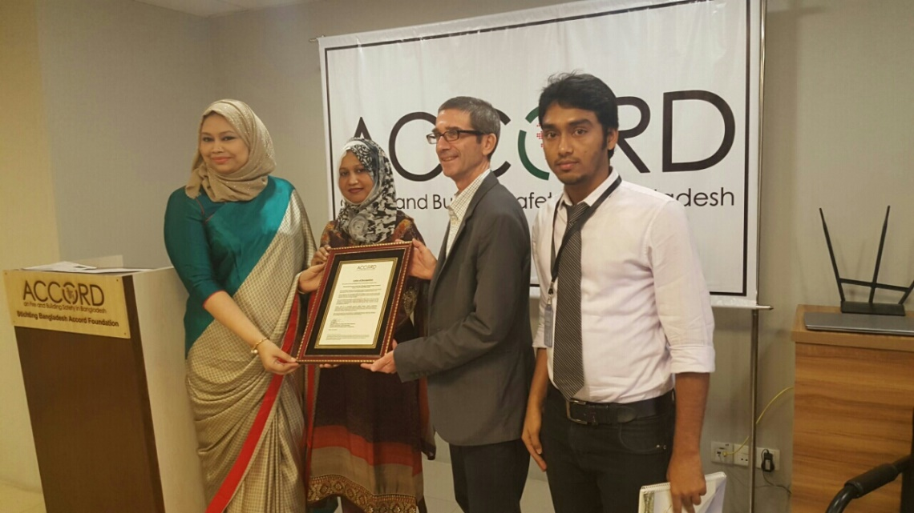
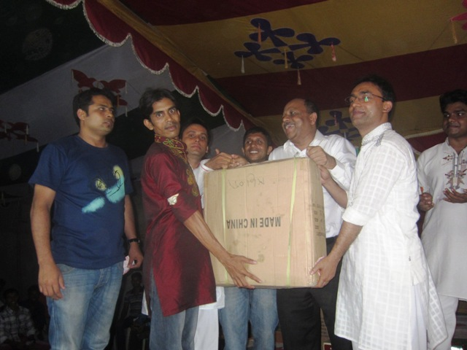
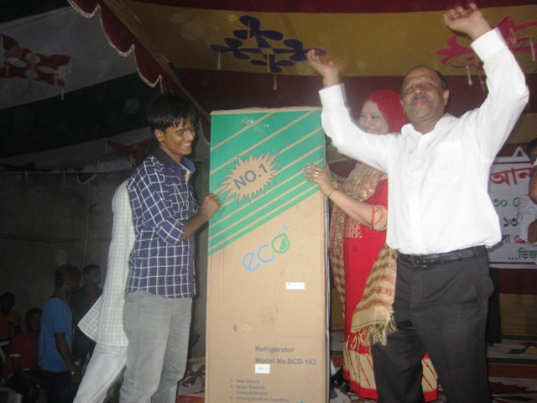
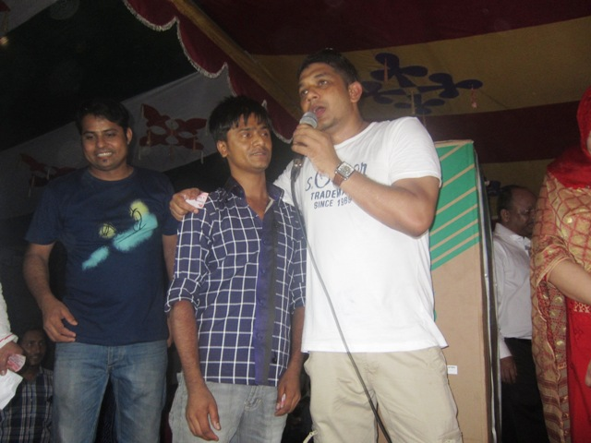
Prize distribution

Slide 18
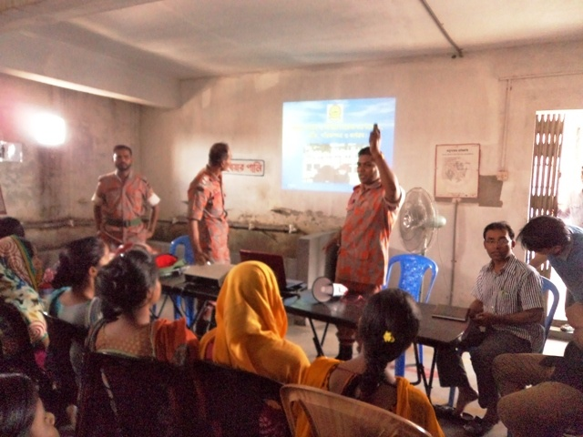
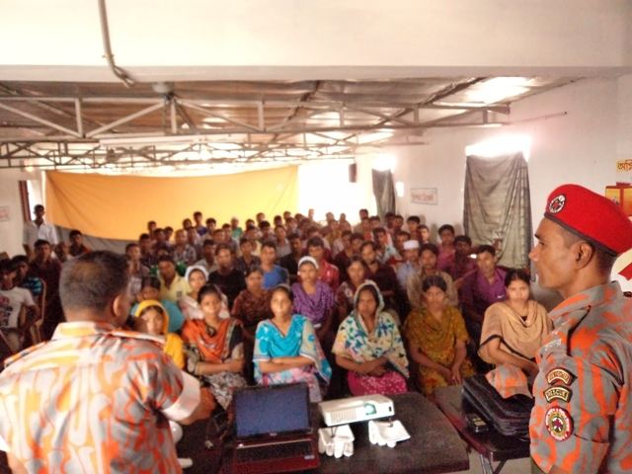
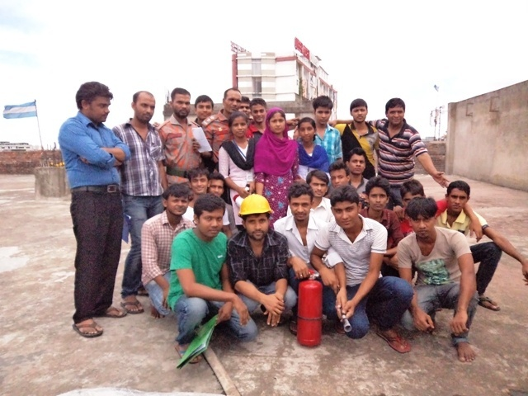
FIRE TRAINING
TRAINING FROM FIRE DEPARTMENT

Slide 19
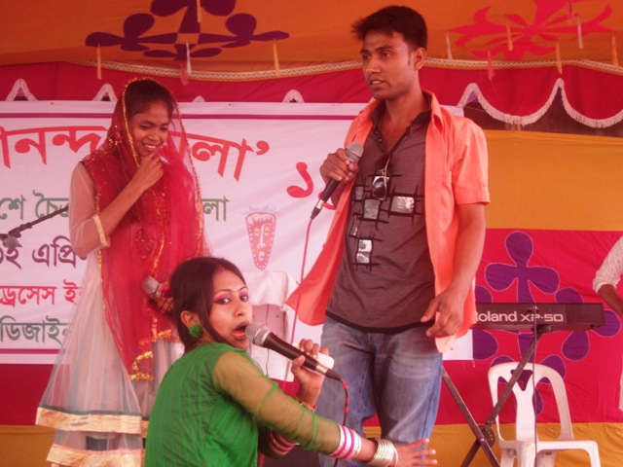
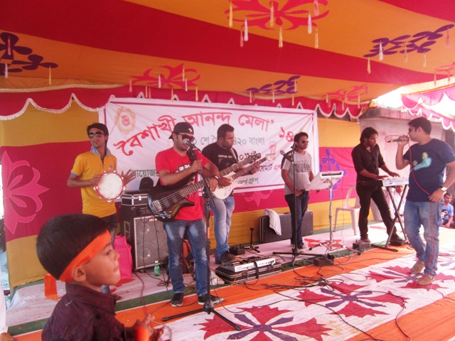
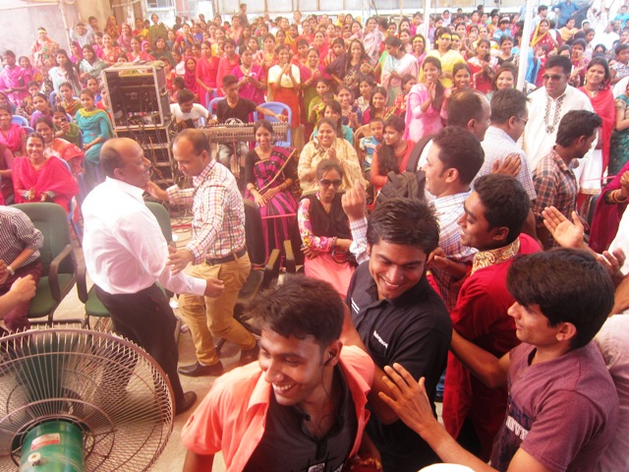
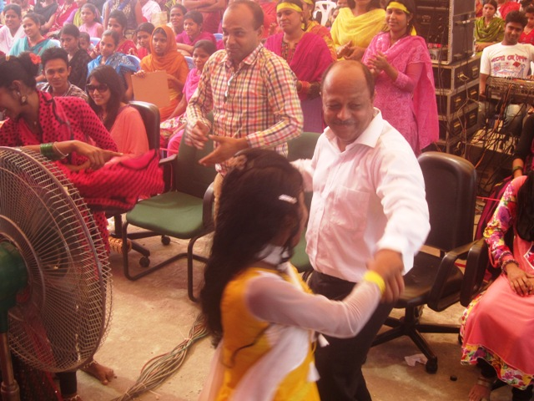
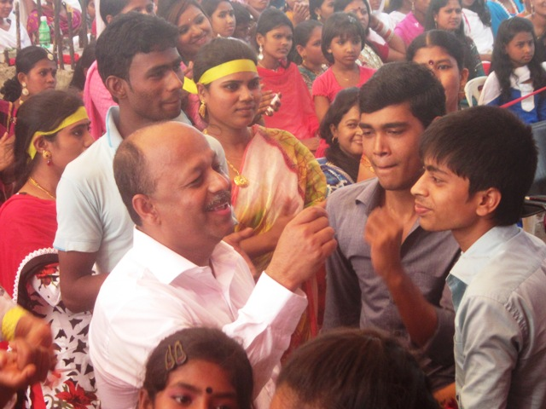
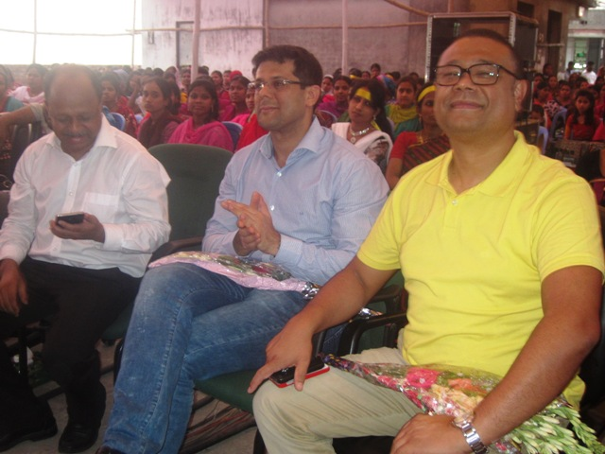
FACTORY DAYS

Slide 20
CONTACT POINTS
Waymart Appareals
96/1 Kazi shopping Center Kuril Kazi bari Badda Dhaka
Adrian Rodriguez
Email: adrian@designsourcebd.com
Cell +88 01955563430
Waymart Appareals
96/1 Kazi shopping Center Kuril Kazi bari Badda Dhaka
Jahid Hossain
Email: jahid@designsourcebd.com
Cell +88 01955563429
Waymart Appareals
96/1 Kazi shopping Center Kuril Kazi bari Badda Dhaka
Rowshan Ara Parvin
Email: parvin@designsourcebd.com
Cell +88 01955563517
Waymart Appareals
96/1 Kazi shopping Center Kuril Kazi bari Badda Dhaka
Rafiqul islam
Email: rafiq@designsourcebd.com
Cell +88 01955563426

