Slide 1
Word Dictionary
MD Jekrul Islam
2019-2-60-046
Nadia Hannan Sharme
2019-2-60-042
Samsun Nahar Zaman
2019-2-60-049
Orpa Noman
2019-2-60-046
Md Saiful
2019-2-60-040

Slide 2
Word Dictionary:
Using binary search tree, we have tried to make a word dictionary where we can insert words with meaning.
Print:
In-order
Pre-order
Post-order
Length:
Minimum
Maximum
Find a word:
Searching
Suggestion word:
Not found word
Remove:
Delete a Word

Slide 3
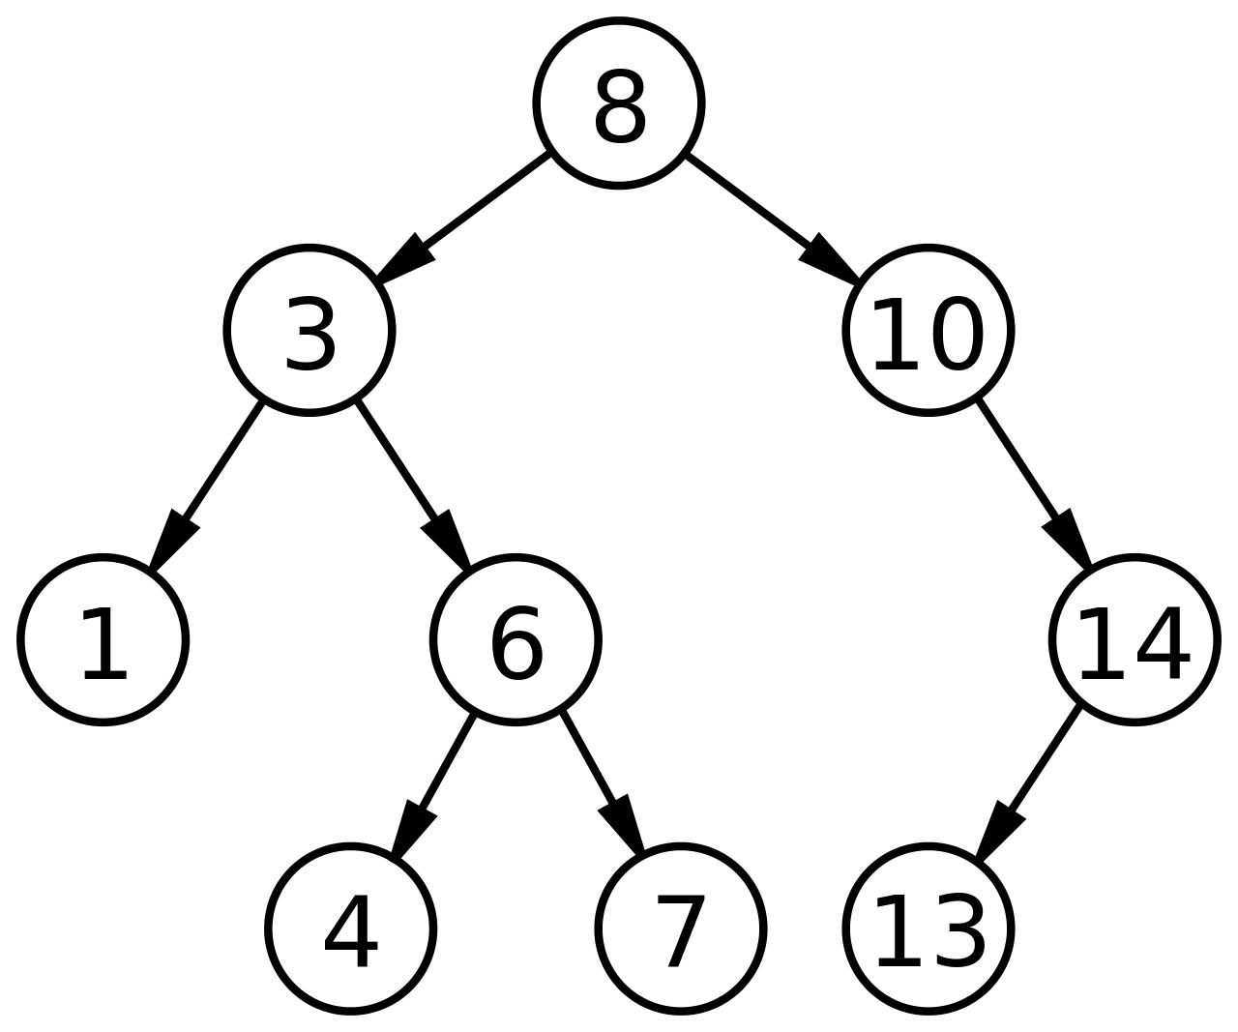
What is Binary Search Tree?
Binary search tree is a node-based binary tree data structure which has the following properties:
The left subtree of a node contains only nodes with keys lesser than the node’s key.
The right subtree of a node contains only nodes with keys greater than the node’s key.
The left and right subtree each must also be a binary search tree.

Slide 4
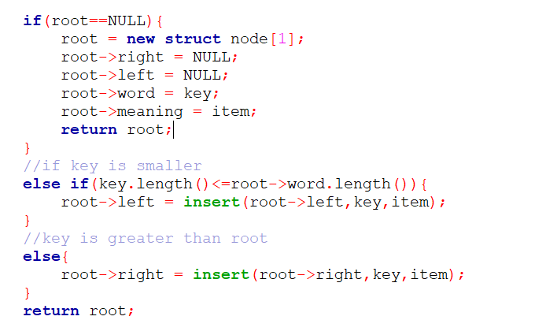
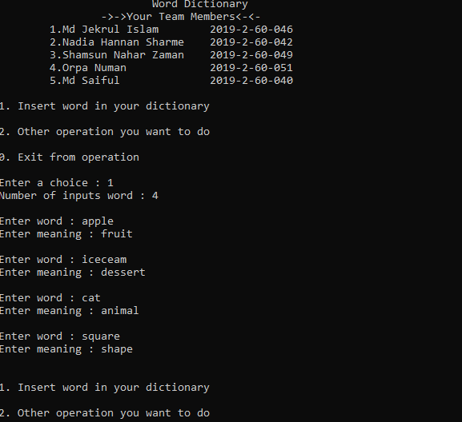
Insert a word

Slide 5
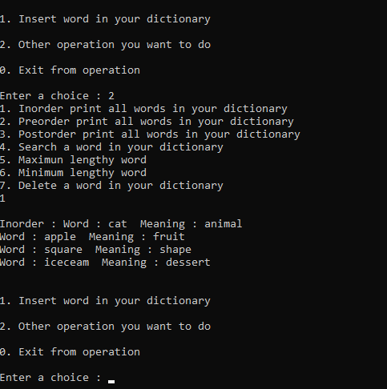
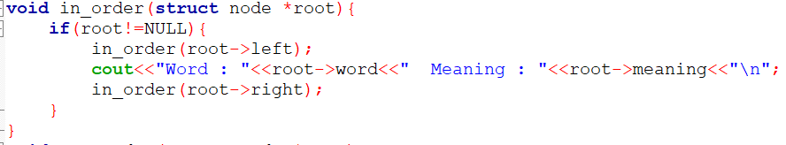
In-order

Slide 6
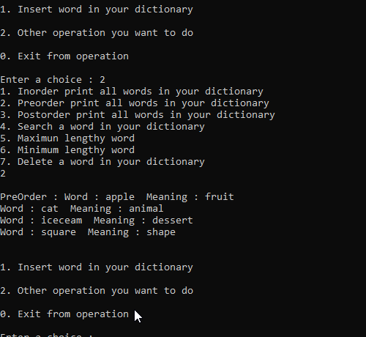
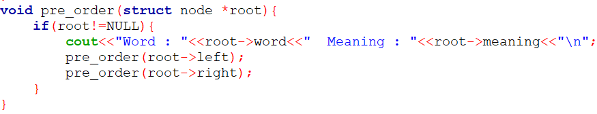
Pre-order

Slide 7
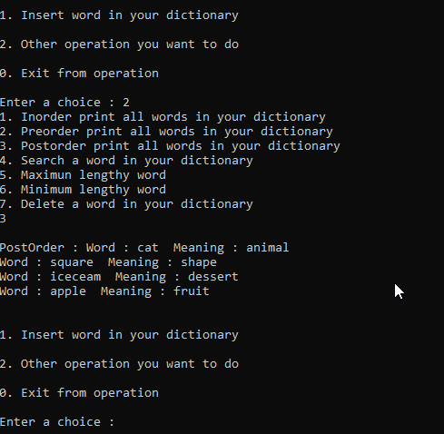
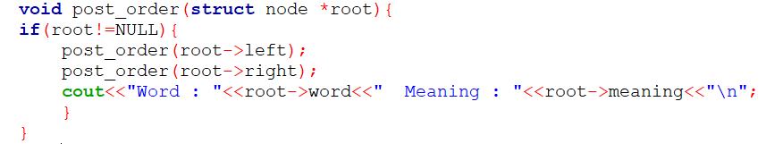
Post-order

Slide 8
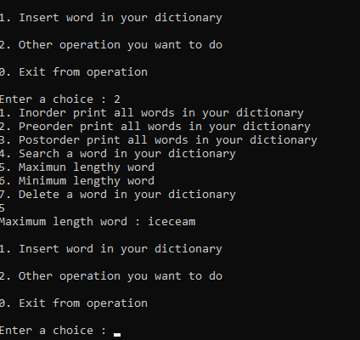
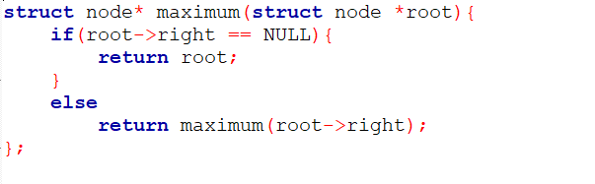
Find Maximum

Slide 9
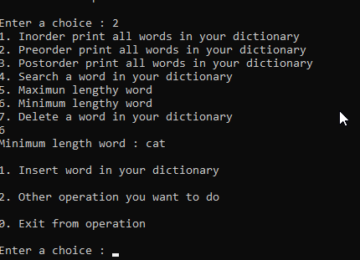
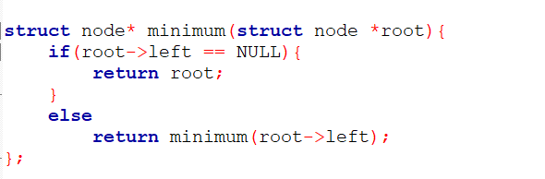
Find Minimum

Slide 10
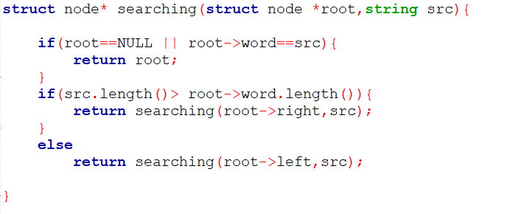
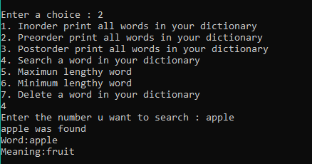
Searching

Slide 11
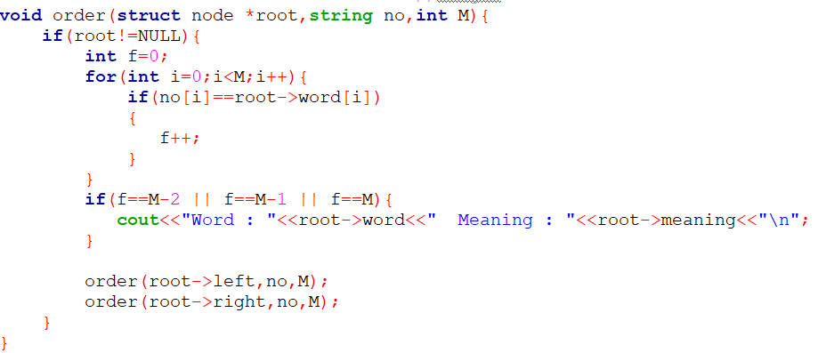
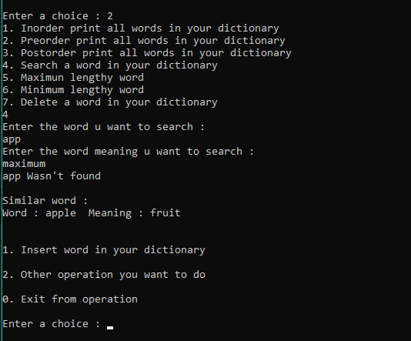
Suggestion word

Slide 12
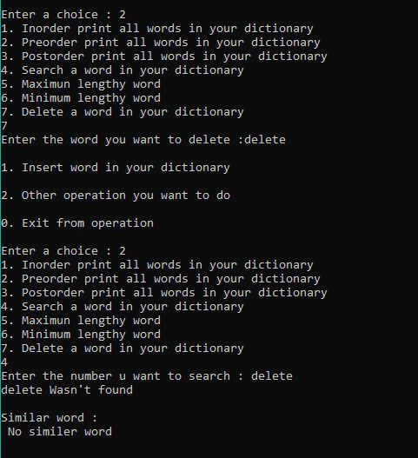
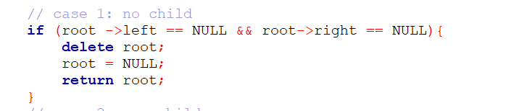
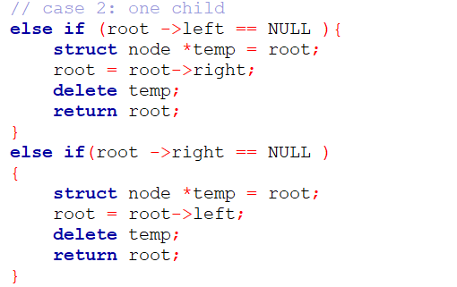
Delete a word

Slide 13
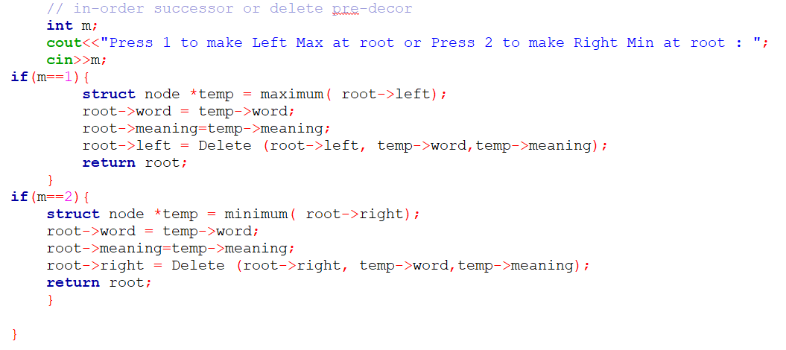
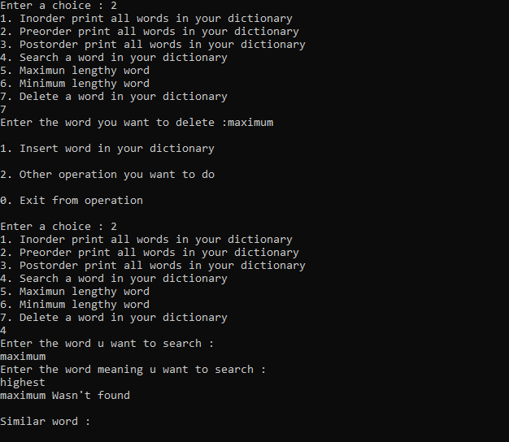
Delete a word

Slide 14
Conclusion
Even though there can be more function and structures which could have added to make it more helpful and a complete, we were still able to construct a simple functional word dictionary by using binary search tree with core basic functions and concepts related to it.

Slide 15
Thank You!

