Slide 1

CA5313 (SOCIALLY RELEVANT PROJECT) Ecommerce Web Project
Team 16 (Deepak Kumar 2019202009, Shubham Kumar 2019202053)
MCA III SEMESTER REGULAR

Slide 2
Abstract
During this lockdown period we’ve faced and noticed too many problems and one of that is taking too much time in delivery of product which we ordered from e-commerce companies or online stores. But main problem isn’t it the main problem is if we don’t like my product which we ordered then we’ve to return it and we’ve to order again for the same product and now it will take 20-30 days to buy us a product so I have found a solution for this problem so now I have to do that is to makes software for a store or E-commerce companies which offers bunch of product to be delivered at once which means a user who can choose more than one items(can add more than one items to cart) of same categories and can order after that a delivery boy will come with all selected items and now user will take items one or more which they like and problem of returning and delivering the same type of product again and again will be solved. And I’m saying this software helps not only in lockdown period but helps tons of people (like Handicapped, Physically disabled, Pregnant Women, An old man or women who can’t walk) who can’t go or don’t want to go to market or mall to buy his favorite product (mainly clothes)

Slide 3
Problem Statement
E-commerce provides an easy way to sell products to a large customer base. However, there is a lot of competition among multiple e-commerce sites. When users land on an e-commerce site, they expect to find what they are looking for quickly and easily. Also, users are not sure about the brands or the actual products they want to purchase. They have a very broad idea about what they want to buy. Many customers nowadays search for their products on Google rather than visiting specific e-commerce sites. They believe that Google will take them to the e-commerce sites that have their product.
The purpose of any e-commerce website is to help customers narrow down their broad ideas and enable them to finalize the products they want to purchase. For example, suppose a customer is interested in purchasing a mobile. His or her search for a mobile should list mobile brands, operating systems on mobiles, screen size of mobiles, and all other features as facets. As the customer selects more and more features or options from the facets provided, the search narrows down to a small list of mobiles that suit his or her choice. If the list is small enough and the customer likes one of the mobiles listed, he or she will make the purchase.
The challenge is also that each category will have a different set of facets to be displayed. For example, searching for books should display their format, as in paper pack or hardcover, author name, book series, language, and other facets related to books. These facets were different for mobiles that we discussed earlier. Similarly, each category will have different facets and it needs to be designed properly so that customers can narrow down to their preferred products, irrespective of the category they are looking into.
The takeaway from this is that categorization and feature listing of products should be taken care of. Misrepresentation of features can lead to incorrect search results. Another takeaway is that we need to provide multiple facets in the search results. For example, while displaying the list of all mobiles, we need to provide facets for a brand. Once a brand is selected, another set of facets for operating systems, network, and mobile phone features has to be provided. As more and more facets are selected, we still need to show facets within the remaining products.

Slide 4
Literature survey
1.AneeshReddy,(April,14,2020) Covid-19 impact: Consumers move towards digital
Aneesh Reddy explained that due to the COVID-19 pandemic, the way we work has totally changed, the way we used to shop and communicate with people. People are only going out only to buy essential items from the retail stores and sill they are worried to go out to buy essential gods because they are constantly worried about getting infected. Reddy said that according to trifecta, due to a cheaper 4G network and constantly increasing consumer wealth, Indian EE-commerce is expected to grow to US$200 billion by 2026. But these projections were based on the pre-covid19. But as COVID-19 hit India, the surging demand of e-commerce for the past few months is so high that the e-commerce industry could hit $200 billion much earlier.

Slide 5
Literature survey
2.Bansal.S,(April 02, 2020) Opinion will consumer behavior see shift post-covid-19
Shuchi Bansal said that, as a consequence of COVID-19 lockdown, there would be a major shift in the supply chain and an increased consumption of e-commerce portals through the internet. It has been estimated that the online stores engaged in sales of groceries and other FMCG products could see amassive shift in demand to avoid going out to crowded shops and market places. After analyzing the consumer buying behaviour from the time India first encountered COVID-19 till the time it went under the lockdown, it could be said that people have become more conscious about health and hygiene and there would be fewer visits to stores and more online shopping for customers.

Slide 6
Literature survey
3.Nath.S,(April 28, 2020) Did the lockdown accelerate the digitization of India Inc.?
Sanstuti Nath threw light on the term 'digital consumption'. Her study on the consumption patterns of consumers post-pandemic lockdown, showed that the e-commerce companies have seen a significant growth of 70-100% for essential commodities. And this sudden adaption of digital platforms can be allocated to mobile advertising. Top companies and brands were already benefiting themselves from these platforms, and also now post lockdown this whole scenario is going to change how consumers buy.

Slide 7
Literature survey
4.Tech desk, (May 19, 2020) Lockdown 4.0 relief: Amazon, Flipkart welcome non Essential deliveries in red zones.
Till lockdown 3.0,the e-commerce companies were allowed to deliver the essential commodities as well as non-essentials to only Orange and green zones but with lockdown 4.0 E-commerce companies have welcomed the guidelines of the government to deliver essentials and non-essentials in all the three zones, however, containment zones will be getting only medicinal deliveries along with the groceries and so. With all this e-commerce companies are trying to meet the ongoing demand for all the categories of goods and are estimating this to be an opportunity for e-commerce platforms.

Slide 8
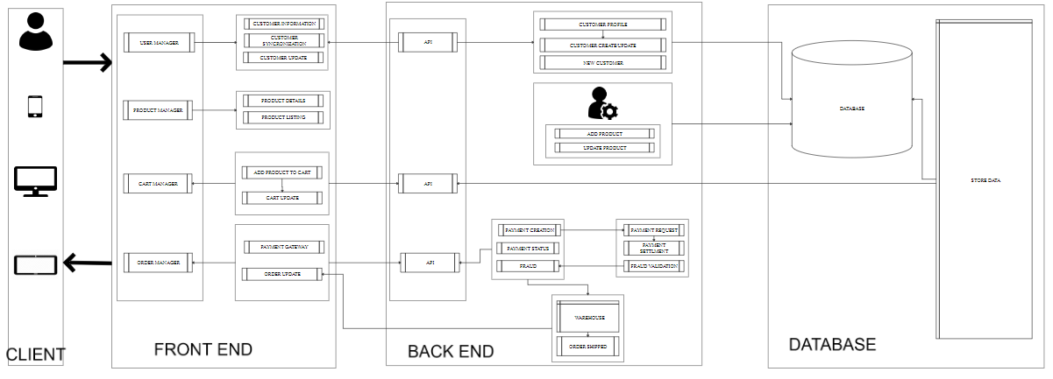
System design

Slide 9
Hardware / software requirements
LANGUAGE AND SOFTWARE TOOL USED:
Front End: HTML, CSS, BOOTSTRAP, JAVASCRIPT
Operating System: Windows
Back End: PHP
Database : MySql
IDE Used: VSCode
MINIMUM HARDWARE REQUIRED:
Intel dual core processor or more
256 MB RAM
40 GB HARD DISK.
MINIMUM SOFTWARE REQUIREMENT:
O/S – WINDOWS XP, Linux Based, Android.
Browser(Chrome, Edge..)

Slide 10
Source code (Index.php)
<?php
$pageTitle = "BaazarOnline : Shopping website.";
$metaPage = 'index';
include_once("includes/header.php");
?>
<?php require_once("includes/components/Comp-hero_slider.php"); ?>
<div class="split-banner-area mb-40 mb-sm-30">
<div class="container">
<div class="row row-5">
<?php
$showcase = $settingsClass->getShowCase();
foreach ( $showcase as $key => $show ) {
?>
<div class="col-md-6 mb-sm-10">
<div class="single-split-banner">
<div class="single-split-banner__image">
<a href="<?php echo $show->link_Url; ?>"></a>
</div>
</div>
</div>

Slide 11
Source code (Index.php)
<?php } ?>
</div>
</div>
</div>
</div>
<div class="product-double-row-slider-area mb-40">
<div class="container">
<div class="row">
<div class="col-lg-12">
<div class="section-title mb-20">
<h2>New Products</h2>
</div>
</div>
</div>
<div class="row">
<div class="col-lg-12">
<div class="product-double-row-slider-wrapper">

Slide 12
Source code (Index.php)
<div class="ht-slick-slider"
data-slick-setting='{
"slidesToShow": 5,
"slidesToScroll": 1,
"dots": false,
"autoplay": false,
"autoplaySpeed": 5000,
"speed": 1000,
"arrows": true,
"rows": 1,
"prevArrow": {"buttonClass": "slick-prev", "iconClass": "ion-ios-arrow-left" },
"nextArrow": {"buttonClass": "slick-next", "iconClass": "ion-ios-arrow-right" }
}'
data-slick-responsive='[
{"breakpoint":1501, "settings": {"slidesToShow": 4} },
{"breakpoint":1199, "settings": {"slidesToShow": 4} },
{"breakpoint":991, "settings": {"slidesToShow": 3} },
{"breakpoint":767, "settings": {"slidesToShow": 2, "arrows": false} },
{"breakpoint":575, "settings": {"slidesToShow": 2, "arrows": false} },
{"breakpoint":479, "settings": {"slidesToShow": 1, "arrows": false} }
]'
>

Slide 13
Source code (Index.php)
<?php
$newProducts = $productClass->newProducts();
if ( $newProducts !== FALSE ) {
foreach ($newProducts as $key => $product) {
?>
<div class="single-slider-product-wrapper">
<div class="single-slider-product">
<div class="single-slider-product__image">
<a href="product.php?id=<?php echo $product->product_id;?>&slug=<?php echo $product->slug;?>">
<img src="<?php echo !empty($product->product_imgUrl) ? $product->product_imgUrl : 'uploads/no_image.jpg'; ?>" class="img-fluid" alt="<?php echo $product->product_name; ?>" width="160">
</a>
<span class="discount-label discount-label--red">
<?php
if(!empty($product->offer_discount)) {
echo percent($product->retail_price , $product->offer_discount). ' %';
}
?>
</span>

Slide 14
Source code (Index.php)
<div class="hover-icons">
<ul>
<li><a href="product.php?id=<?php echo $product->product_id;?>&slug=<?php echo $product->slug;?>"><i class="icon-eye"></i></a></li>
<li><a href="javascript:void(0)"><i class="icon-heart"></i></a></li>
</ul>
</div>
</div>
<div class="single-slider-product__content">
<p class="product-title"><a href="product.php"><?php echo ucfirst($product->product_name);?></a></p>
<div class="rating">
<i class="ion-android-star active"></i>
<i class="ion-android-star active"></i>
<i class="ion-android-star active"></i>
<i class="ion-android-star active"></i>
<i class="ion-android-star"></i>
</div>

Slide 15
Source code (Index.php)
<p class="product-price">
<?php
if(!empty($product->offer_discount)) {
echo "<span class='discounted-price'>Rs $product->offer_discount</span>";
echo "<span class='main-price discounted'>".$product->retail_price."</span></p>";
} else {
echo "<span class='discounted-price'>Rs $product->retail_price</span>";
}
?>
<span class="cart-icon"><a href="<?php echo hash_($product->product_id); ?>" class='icon_addtocart'><i class="icon-shopping-cart" ></i></a></span>
</div>
</div>
</div>
<?php }
} ?>
</div>
</div>
</div>
</div>
</div>
</div>

Slide 16
Source code (Index.php)
<div class="container">
<div class="section-title mb-20">
<h2>Latest Products</h2>
</div>
<div class="card card-body">
<div class="row">
<div class="col-md-3">
<figure class="itemside mb-2">
<div class="aside"><img src="uploads/water.jpg" class="border img-sm"></div>
<figcaption class="info align-self-center">
<a href="#" class="title">Water Purifier</a><br>
<strong class="price">₹ 4000</strong>
</figcaption>
</figure>
</div>
<div class="col-md-3">
<figure class="itemside mb-2">
<div class="aside"><img src="uploads/chimney.jpg" class="border img-sm"></div>
<figcaption class="info align-self-center">
<a href="#" class="title">Chimney</a><br>
<strong class="price">₹ 7000</strong>
</figcaption>
</figure>
</div>

Slide 17
Source code (Index.php)
<div class="col-md-3">
<figure class="itemside mb-2">
<div class="aside"><img src="uploads/dome.jpg" class="border img-sm"></div>
<figcaption class="info align-self-center">
<a href="#" class="title">CCTv Camera</a><br>
<strong class="price">₹ 2000</strong>
</figcaption>
</figure>
</div> <div class="col-md-3">
<figure class="itemside mb-2">
<div class="aside"><img src="uploads/table-fan.jpg" class="border img-sm"></div>
<figcaption class="info align-self-center">
<a href="#" class="title">Table Fan </a><br>
<strong class="price">₹ 1500</strong>
</figcaption>
</figure>
</div> </div>
</div>
</div>

Slide 18
Source code (Index.php)
<div class="container paddingtopbottom">
<div class="row">
<div class="col-sm-4"><a href=""><img src="http://htmldemo.themessoft.com/organ/version1/images/speakers.png" class="img-responsive"></a>
</div><div class="col-sm-4"><a href=""><img src="http://htmldemo.themessoft.com/organ/version1/images/schedule.png"></a>
</div><div class="col-sm-4"><a href=""><img src="http://htmldemo.themessoft.com/organ/version1/images/details.png"></a>
</div>
</div>
</div></div>
<div class="container-fulid backgroundfixed">
<div class="container">
<div class="card card-body">
<div class="row">
<div class="col-md-4">
<div class="section-title mb-20">
<h2>CCTv Camera</h2>
</div>

Slide 19
Source code (Index.php)
<figure class="itemside mb-2">
<div class="aside"><img src="uploads/bullet.jpg" class="border img-sm"></div>
<figcaption class="info align-self-center">
<a href="#" class="title">Bullet Camera</a><br>
<strong class="price">₹ 2000</strong>
</figcaption>
</figure>
<figure class="itemside mb-2">
<div class="aside"><img src="uploads/robot.jpg" class="border img-sm"></div>
<figcaption class="info align-self-center">
<a href="#" class="title">Robot Camera</a><br>
<strong class="price">₹ 2500</strong>
</figcaption>
</figure><figure class="itemside mb-2">
<div class="aside"><img src="uploads/dome.jpg" class="border img-sm"></div>
<figcaption class="info align-self-center">
<a href="#" class="title">Dome Camera</a><br>
<strong class="price">₹ 2800</strong>
</figcaption>
</figure>
</div>

Slide 20
Source code (Index.php)
<div class="col-md-4">
<div class="section-title mb-20">
<h2>Grocery</h2>
</div>
<figure class="itemside mb-2">
<div class="aside"><img src="uploads/hide-seek.webp" class="border img-sm"></div>
<figcaption class="info align-self-center">
<a href="#" class="title">Hide & Seek</a><br>
<strong class="price">₹ 50</strong>
</figcaption>
</figure>
<figure class="itemside mb-2">
<div class="aside"><img src="uploads/kitkat.webp" class="border img-sm"></div>
<figcaption class="info align-self-center">
<a href="#" class="title">KitKat</a><br>
<strong class="price">₹ 999</strong>
</figcaption>
</figure>

Slide 21
Source code (Index.php)
<figure class="itemside mb-2">
<div class="aside"><img src="uploads/mushrooms.webp" class="border img-sm"></div>
<figcaption class="info align-self-center">
<a href="#" class="title">Fresho Mushrooms - Button, 200 g</a><br>
<strong class="price">₹ 69</strong>
</figcaption>
</figure>
</div>
<div class="col-md-4">
<div class="section-title mb-20">
<h2>Mobile</h2>
</div>
<figure class="itemside mb-2">
<div class="aside"><img src="uploads/mobiles/nord.jpg" class="border img-sm"></div>
<figcaption class="info align-self-center">
<a href="#" class="title">One Plus Nord 5G</a><br>
<strong class="price">₹ 27000</strong>
</figcaption>
</figure>

Slide 22
Source code (Index.php)
<figure class="itemside mb-2">
<div class="aside"><img src="uploads/mobiles/iphone-se.jpg" class="border img-sm"></div>
<figcaption class="info align-self-center">
<a href="#" class="title">Apple Iphone SE</a><br>
<strong class="price">₹ 37000</strong>
</figcaption>
</figure> <figure class="itemside mb-2">
<div class="aside"><img src="uploads/mobiles/pixel.jpg" class="border img-sm"></div>
<figcaption class="info align-self-center">
<a href="#" class="title">Google Pixel 4a</a><br>
<strong class="price">₹ 55000</strong>
</figcaption>
</figure>
</div>
</div> </div>
</div>
</div>
<div class="container paddingtopbottom">
<div class="row">
<div class="col-md-3">
<article class="card card-body border" style="
background: #79b103;
">

Slide 23
Source code (Index.php)
<figure class="text-center">
<figcaption class="pt-4">
<h5 class="title" style="
color: #fff;
font-size: 18px;
">Creative Strategy &amp; solution</h5>
</figcaption>
</figure>
</article>
</div>
<div class="col-md-3">
<article class="card card-body border" style="
background: #685c88;
">
<figure class="text-center">
<figcaption class="pt-4">
<h5 style="
color: #fff;
font-size: 18px;
">Creative Strategy &amp; solution</h5>
</figcaption>
</figure> <!-- iconbox // -->
</article>
</div>

Slide 24
Source code (Index.php)
<div class="col-md-3">
<article class="card card-body border" style="
background: #dc4720;
">
<figure class="text-center">
<figcaption class="pt-4">
<h5 style="
color: #fff;
font-size: 18px;
">Creative Strategy &amp; solution</h5>
</figcaption>
</figure>
</article>
</div>
<div class="col-md-3">
<article class="card card-body border" style="
background: #fc9cc4;
">

Slide 25
Source code (Index.php)
<figure class="text-center">
<figcaption class="pt-4">
<h5 style="
color: #fff;
font-size: 18px;
">Creative Strategy &amp; solution</h5>
</figcaption>
</figure>
</article>
</div>
</div>
</div>
<?php include_once("includes/components/Comp-news_letter.php"); ?>
<?php include_once("includes/footer.php"); ?>

Slide 26
Source code
Init.php
<?php
ob_start();
session_start();
$_SESSION['curr'] = 'USD';
include "config/Config.php";
include dirname(__DIR__)."/vendor/autoload.php";
include "database/Database.php";
include "function/function.php";
spl_autoload_register(function( $classname ) {
require __DIR__.DIRECTORY_SEPARATOR."class".DIRECTORY_SEPARATOR.$classname.".php";});
$productClass = new Product; // Product class
$couponClass = new Coupons; // Tag class
$smsClass = new Sms; // SMS class
$cartClass = new Cart(
[// Can add unlimited number of item to cart
'cartMaxItem' => 0,
// Set maximum quantity allowed per item to 99
'itemMaxQuantity' => 100,
// Do not use cookie, cart data will lost when browser is closed
'useCookie' => false,]);

Slide 27
Source code
Init.php
$settingsClass = new Settings;
$addToCartClass = new Addtocart;
$mailchimpClass = new Mailc;
$emailerClass = new Emailer;
$navClass = new Nav;
$accountClass = new Accountclass;
$emailVclass = new Emailverification;
$pusher = new Pusher\Pusher( APPKEY, APPSEC, APPSEC, array('cluster' => APPCLST) );
$pay = new Pay;
?>

Slide 28
Source code
Config.php
<?php
define("HOSTNAME","localhost");
define("DBNAME","bkyrprod_dev");
define("DBUSER","root");
define("DBPWD","");
date_default_timezone_set("Asia/Kolkata");
define("APPROOT" , dirname(__DIR__));
define("URLROOT" , "localhost/Ecommerce");
define("SITENAME" , "E-com Dashboard");
define("APPNAME" , "Team16");
define("UPLOAD_FOLDER" , "uploads");
define('APPID' , '952085');
define('APPKEY' , 'a0d09e0f5d4762138c84');
define('APPSEC' , '4fff511b30adcbc96300');
define('APPCLST' , 'ap2');
?>

Slide 29
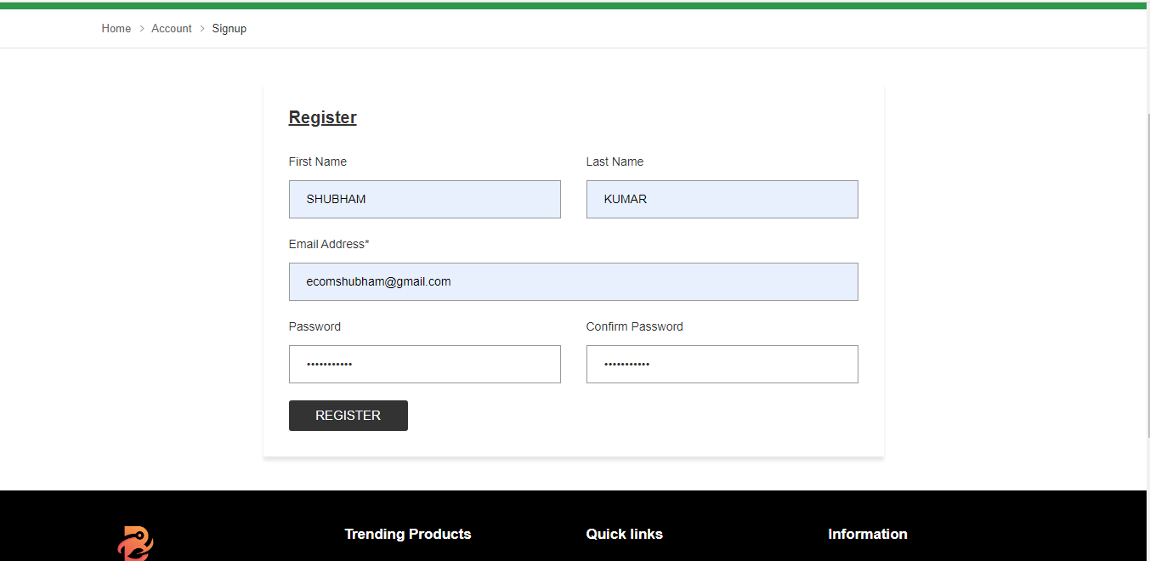
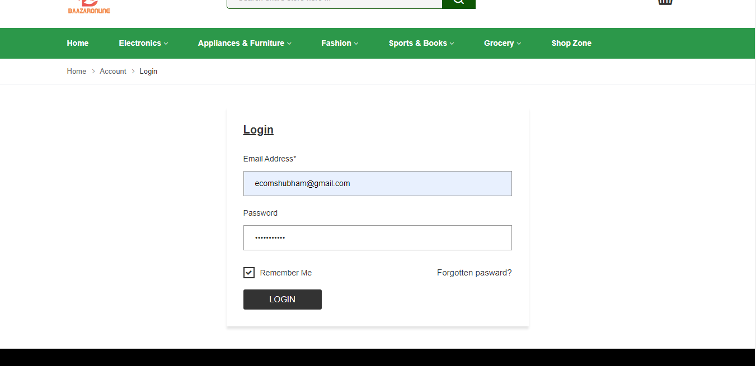
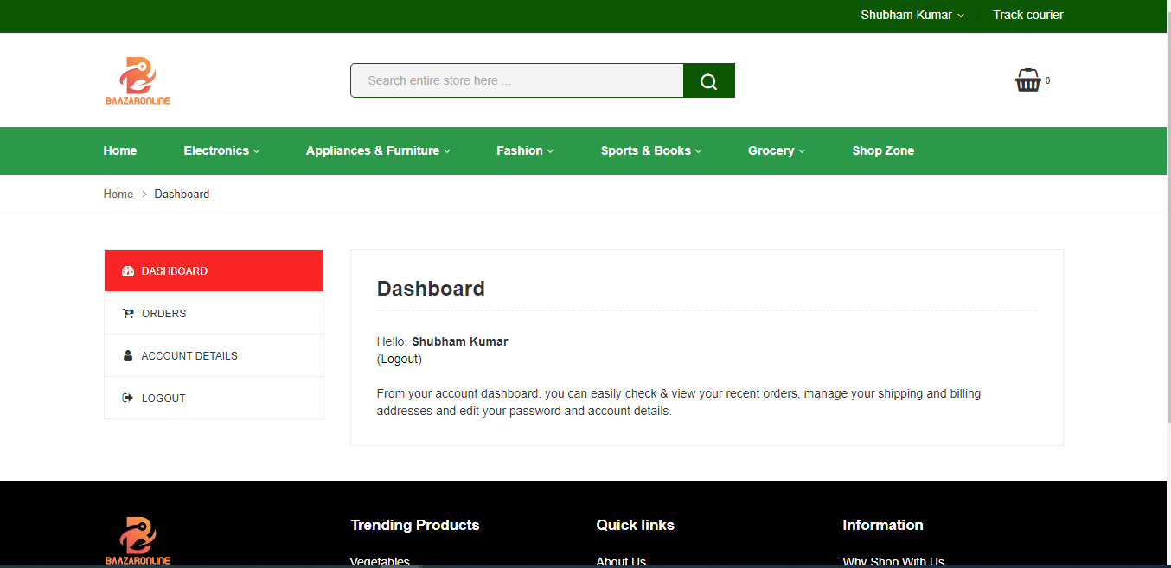
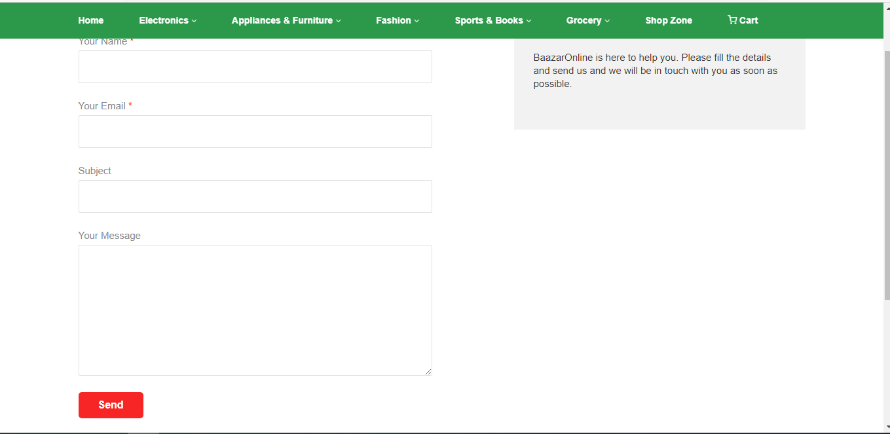
Screenshot

Slide 30
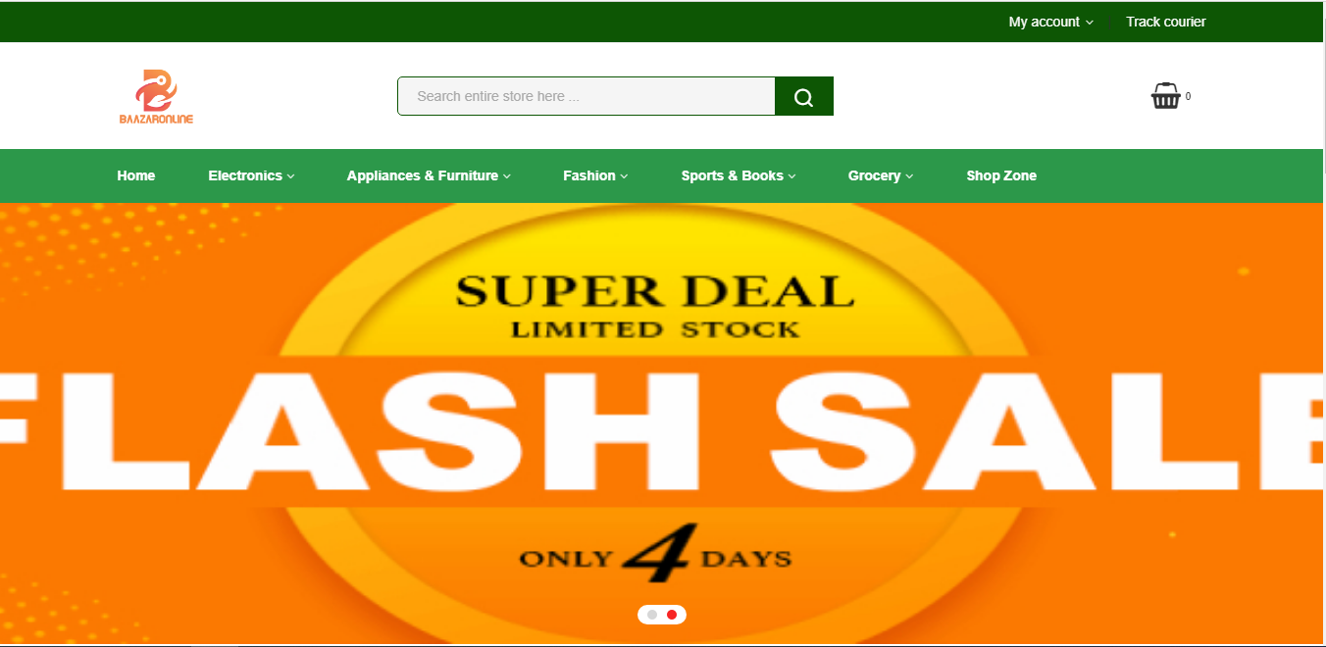
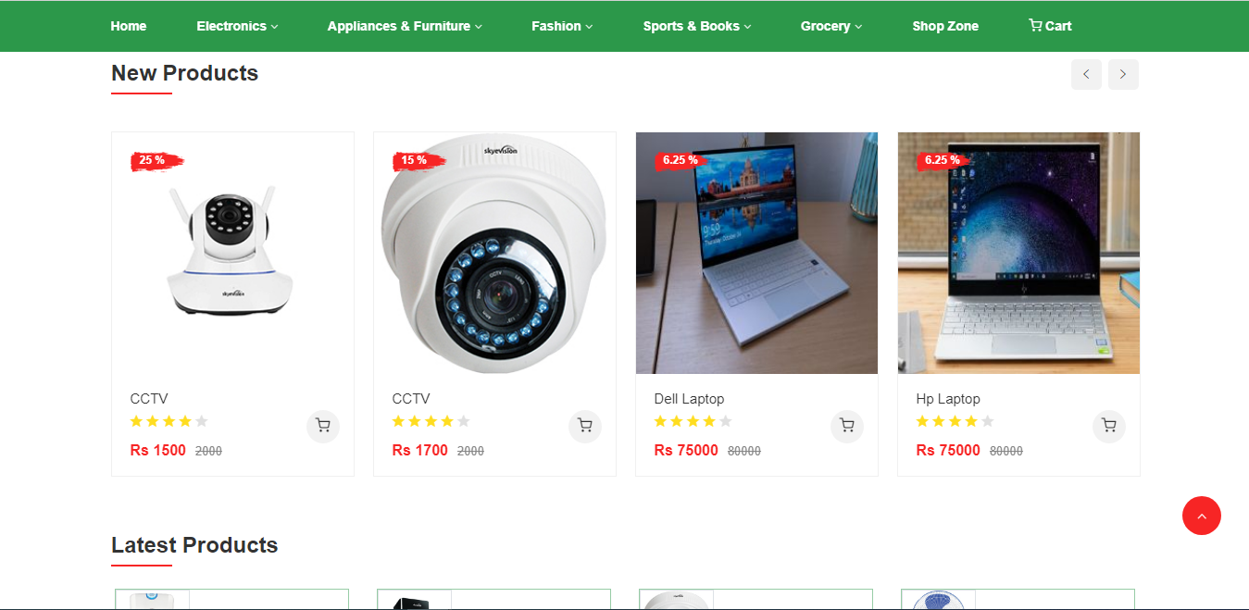
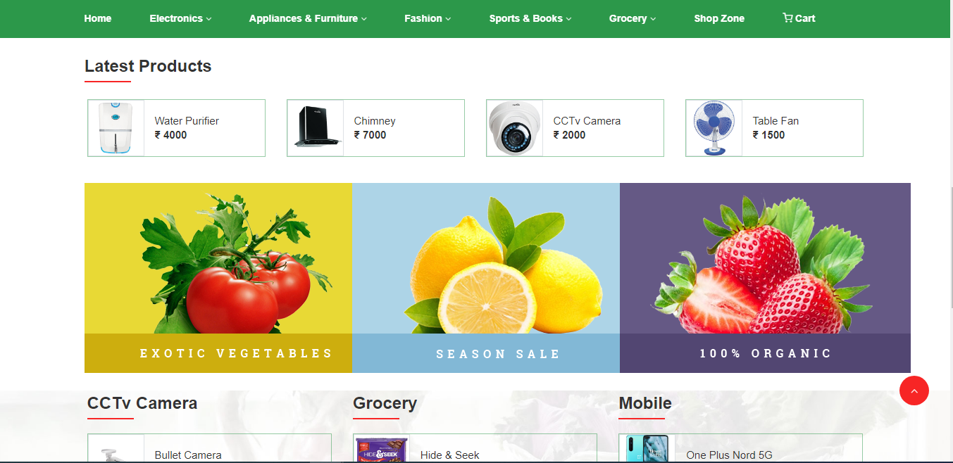
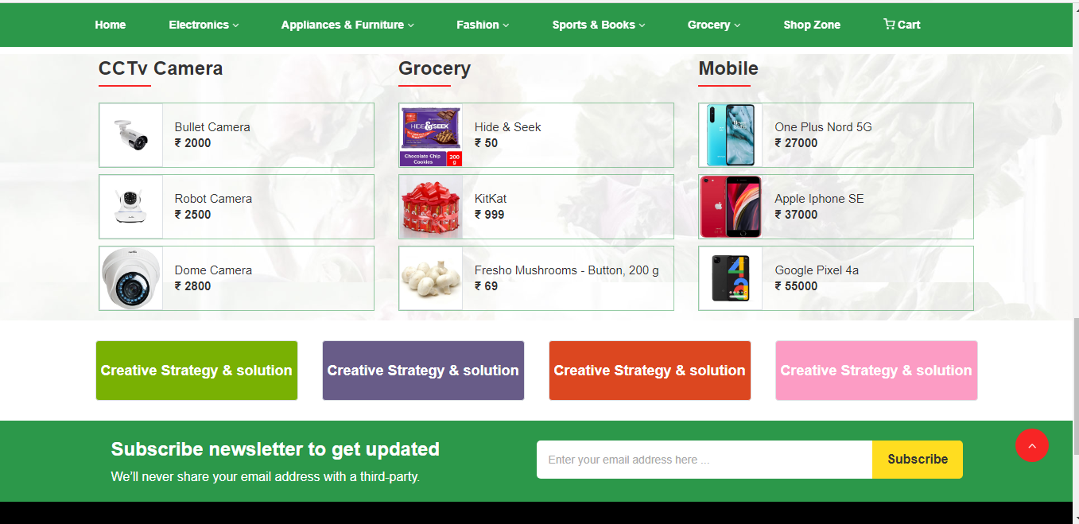
Screenshot

Slide 31
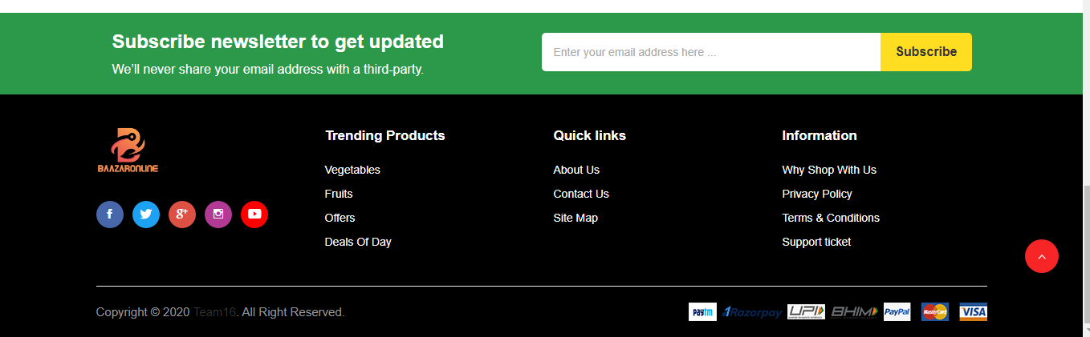
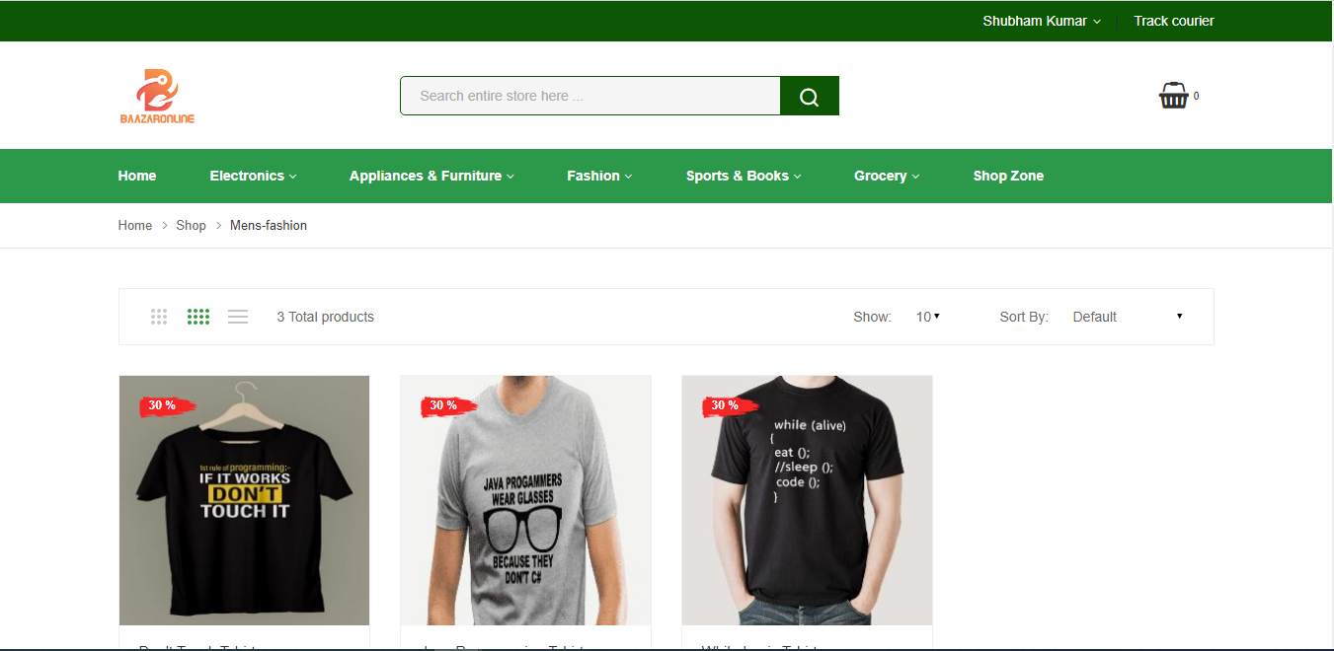
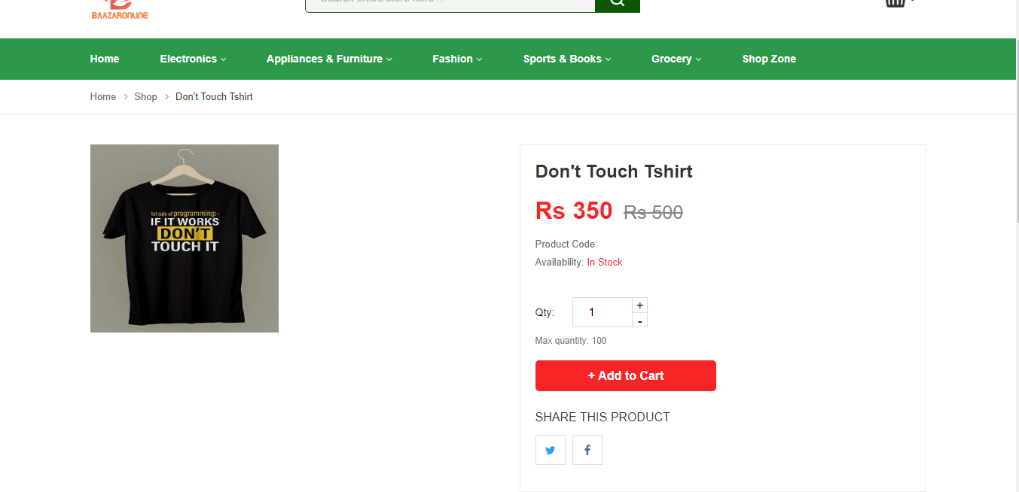
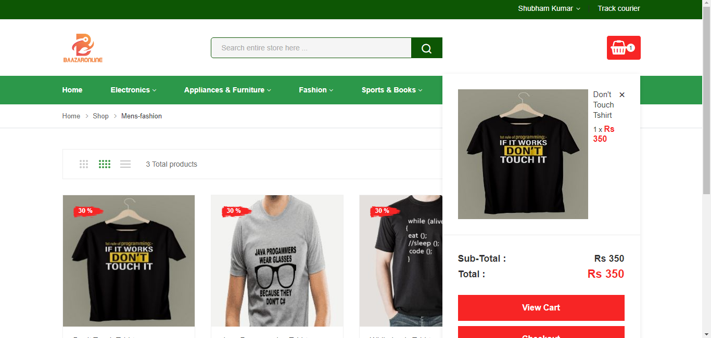
Screenshot

Slide 32
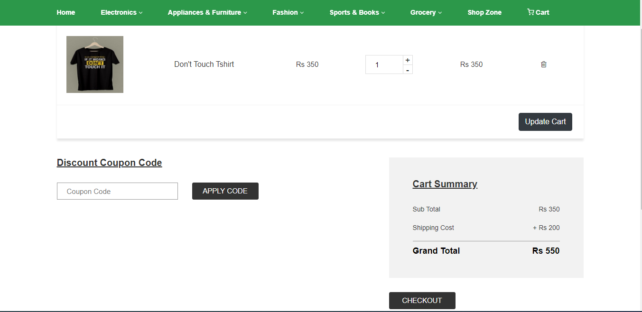
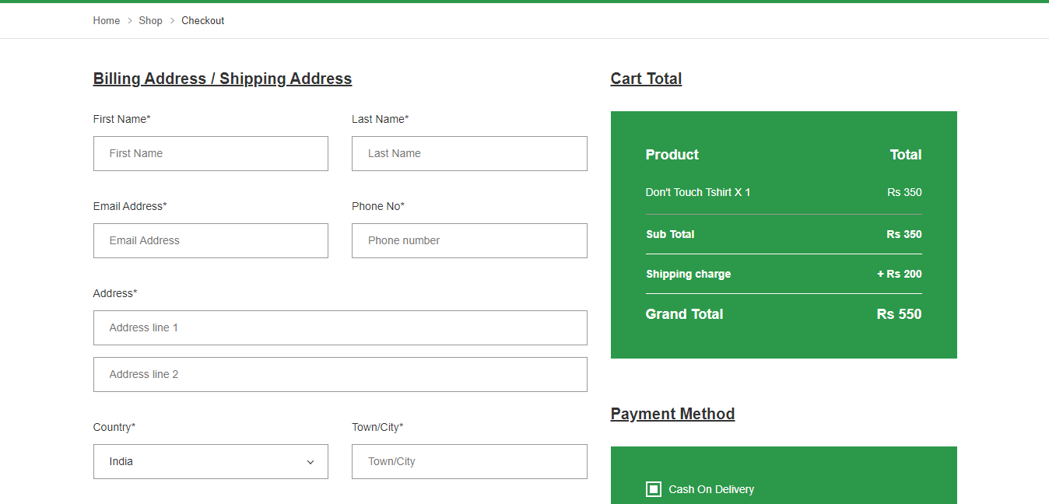
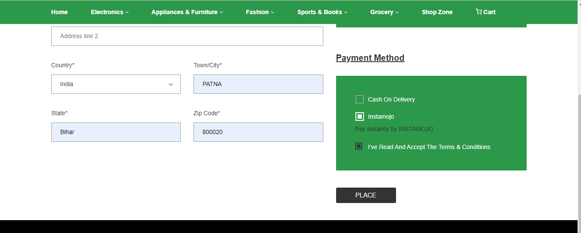
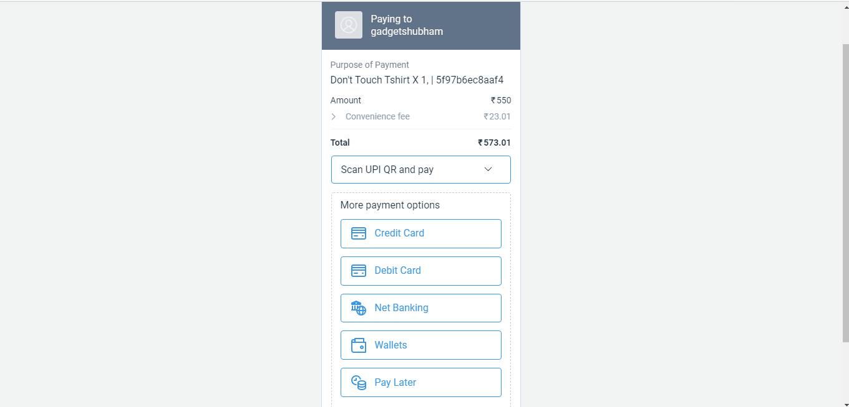
Screenshot

Slide 33
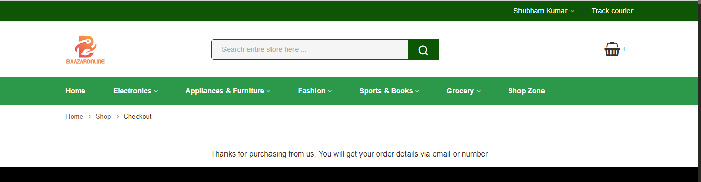
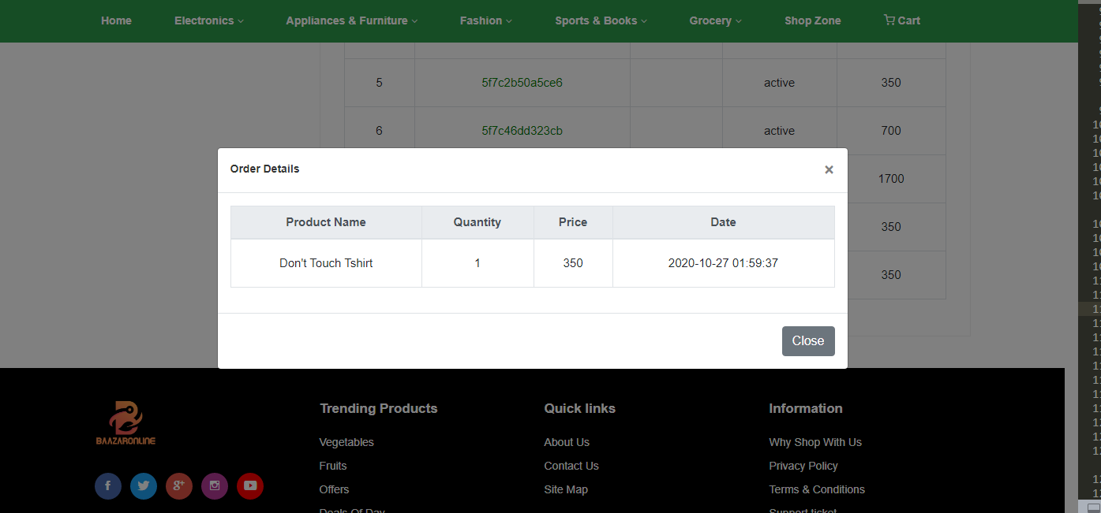
Screenshot

Slide 34
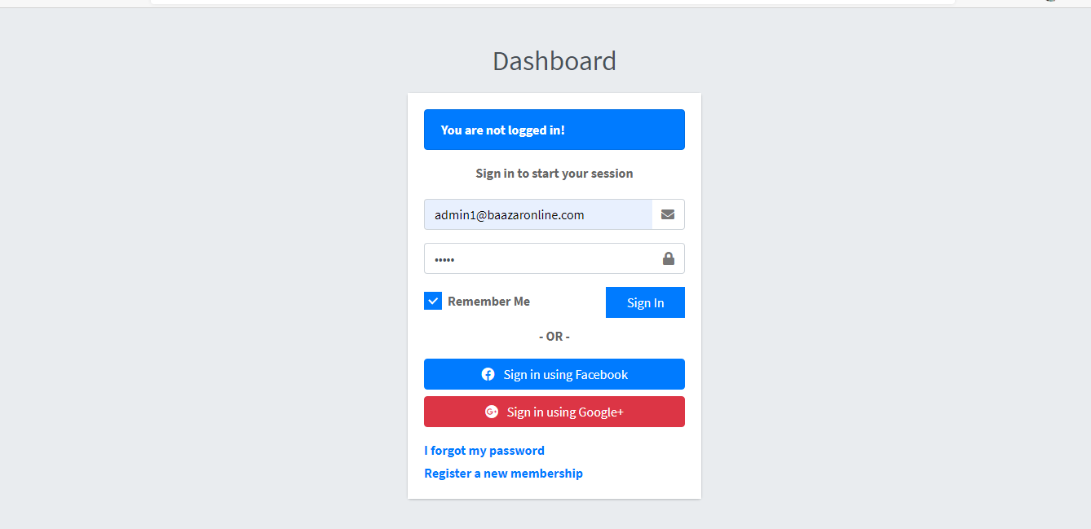
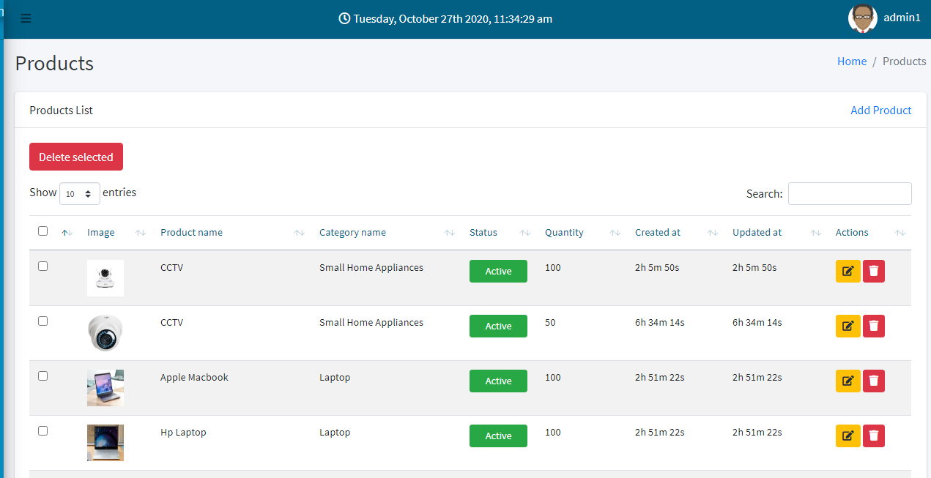
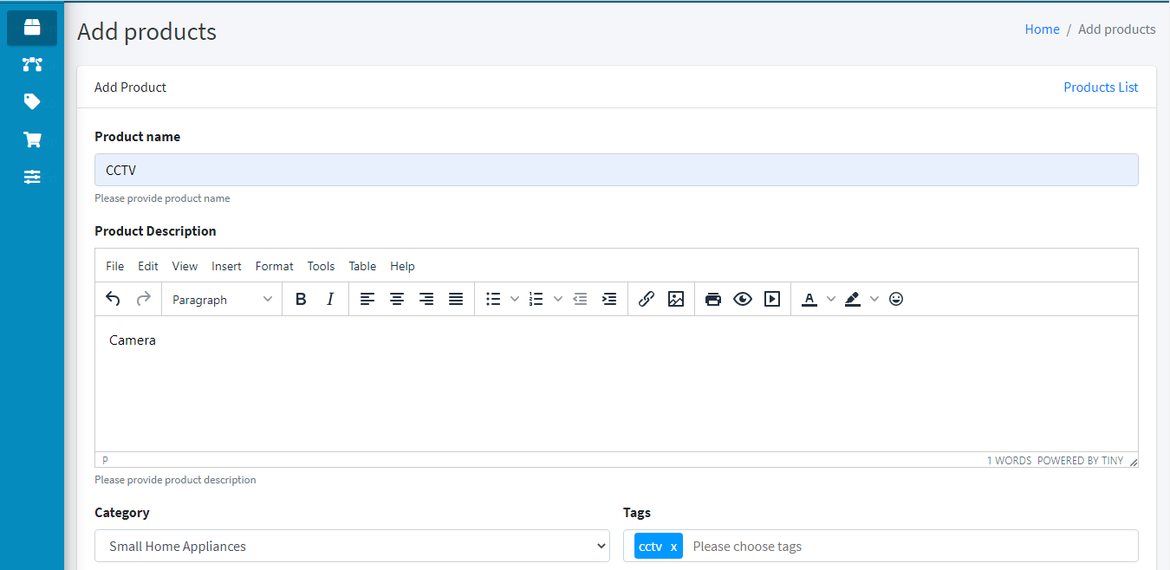
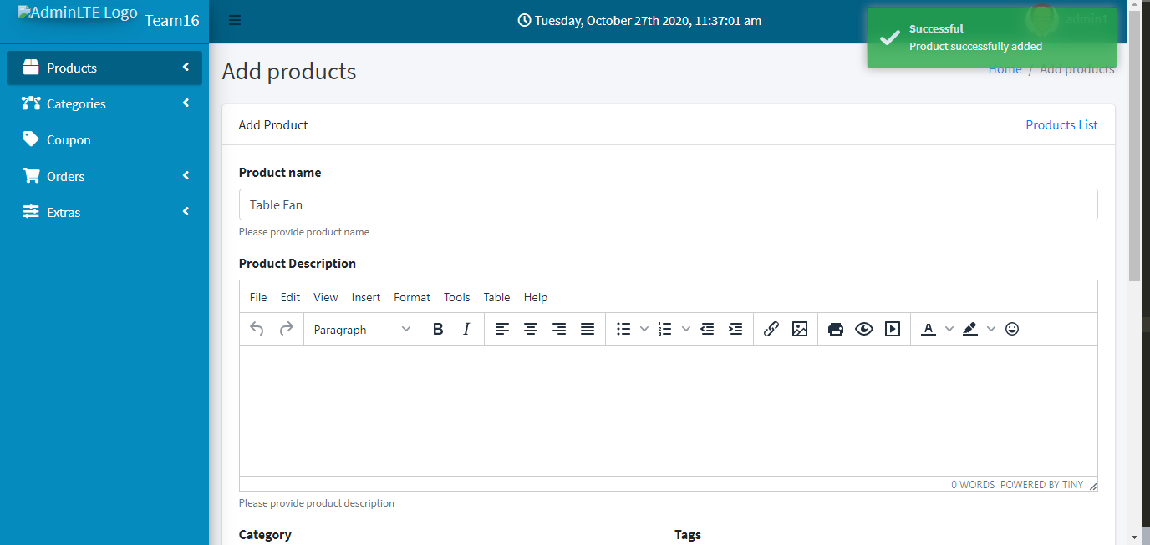
Screenshot

Slide 35
result and conclusion
E-commerce is continuously progressing and is becoming more and more important to businesses as technology continue.
Conclusion.
Every day more people connect to the Internet and grow increasingly comfortable with digital transactions. I always recommend concluding a website’s landing page with a strong call to action.

