Slide 1

Fun with Wikipedia
Saifun Naveh, Maria Tseytlin
Project Presentation

Slide 2


Background
Wikipedia is a free, multilingual online encyclopedia written and maintained by a community of volunteer contributors through a model of open collaboration
Wikidata is a collaboratively edited multilingual knowledge graph. It is a common source of open data that Wikipedia uses (and also others)

Slide 3
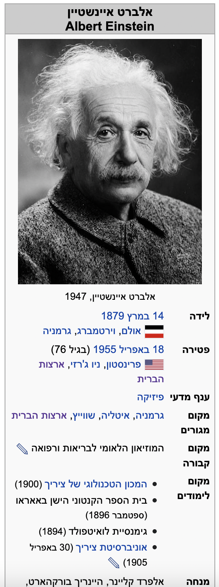
Background

Slide 4

Research Goal
The project has two main goals:
Extract information from a text in order to construct a Wikipedia info-box
Create a short Wikipedia article using information from Wikidata

Slide 5

Goal 1
Information Extraction

Slide 6
Attempt 1 - QA
We wanted to use a QA aproach in order to extract the information – AlephBERT finetuning.
״אלברט איינשטיין נולד בגרמניה וגר בשוויץ״
ב- גרמניה
בגרמניה
איפה הוא נולד?
אלברט איינשטיין
מי נולד?

Slide 7
And… Surprise
We didn’t find Hebrew QA data ☹

Slide 8
Attempt 2 – Using NER
We can try extracting information using NER.
O^S-GPE
O^O
O^S-GPE
O
E-PER
B-PER
״אלברט איינשטיין נולד בגרמניה וגר בשוויץ״
PER -אלברט איינשטיין
במי מדובר?
GPE - בגרמניה, בשוויץ
מה המדינות שהוא היה בהן?

Slide 9
And… Surprise no. 2
We couldn’t find a way to run NEMO² because of CUDA problems ☹

Slide 10
Finally - SUCCESS!
We used the NEMO corpus to finetune AlephBERT for NER.

Slide 11
Data
NEMO corpus – to fine tune AlephBERT for NER
Articles and social media – get information about the subject of the article.

Slide 12


Pipeline
Morphological and Syntactic Analysis
Stanza
AlephBERT + NER
Open
Information Extraction
Datetime extraction
Evaluation
Notes:
Evaluation

Slide 13
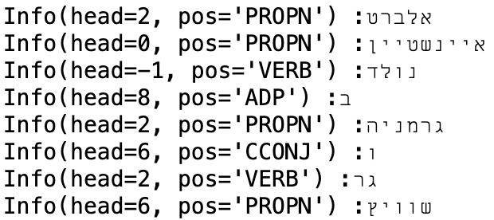
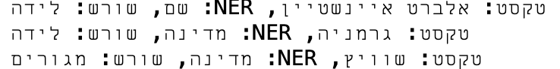
Running Example
Input:
אלברט איינשטיין נולד בגרמניה וגר בשוויץ
Stanza
NER
Information Extraction

Slide 14
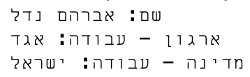
Another example
אברהם נדל עבד בחברת אגד כנהג אוטובוס בישראל

Slide 15
What went as expected
AlephBERT is very convenient and easy to train for many tasks
The NER part had pretty good results, we got an F-score of 83.3%
Finding data was not hard

Slide 16
Insights so far
There are some more difficult cases – for example משפטים שמניים
"אלברט איינשטיין הוא מדען גרמני”
There is some information that couldn’t be extracted using the pipeline, ex. occupation
Contextual understanding – איינשטיין לא נולד בגרמניה

Slide 17
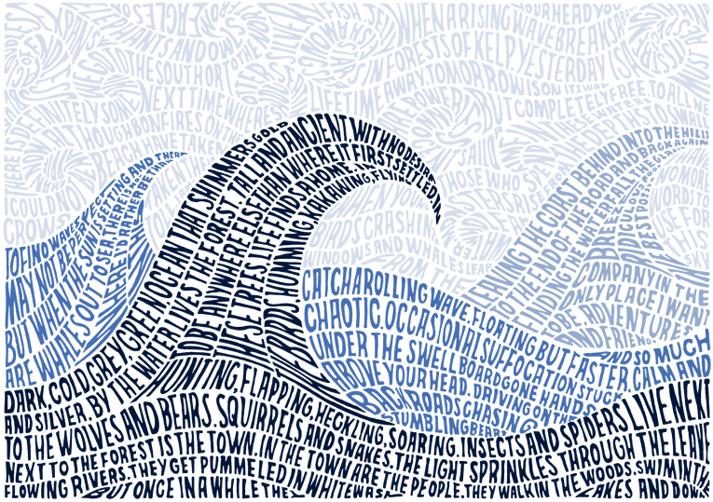
Goal 2
Article Generation

Slide 18
Data
Wikidata RDF JSONs – the input of the process
Articles from Wikipedia – to learn the structure of Wikipedia articles.

Slide 19
Further work
Goal 1 improvements
Goal 2 implementation
Combining text generation using Wikidata information and text summary
Expanding the created short Wikipedia article using text generation

Slide 20
Summary
We managed to successfully extract some information from sentences
We plan to improve the model and deal with special cases
The second part – generating text – is going to be super interesting

Slide 21

Thanks!

Slide 22
Labels
['B-ANG^I-ANG', 'B-DUC', 'B-EVE', 'B-EVE^E-EVE', 'B-EVE^I-EVE', 'B-FAC', 'B-FAC^E-FAC', 'B-FAC^I-FAC', 'B-GPE', 'B-GPE^E-GPE', 'B-GPE^I-GPE', 'B-LOC', 'B-LOC^E-LOC', 'B-LOC^I-LOC', 'B-ORG', 'B-ORG^E-ORG', 'B-ORG^I-ORG', 'B-PER', 'B-PER^E-PER', 'B-PER^I-PER', 'B-WOA', 'B-WOA^E-WOA', 'B-WOA^I-WOA', 'B-WOA^I-WOA^E-WOA', 'E-DUC', 'E-EVE', 'E-FAC', 'E-GPE', 'E-LOC', 'E-ORG', 'E-PER', 'E-WOA', 'I-ANG^E-ANG', 'I-DUC', 'I-DUC^E-DUC', 'I-DUC^I-DUC', 'I-EVE', 'I-EVE^E-EVE', 'I-EVE^I-EVE', 'I-FAC', 'I-FAC^E-FAC', 'I-FAC^I-FAC', 'I-FAC^I-FAC^E-FAC', 'I-FAC^I-FAC^I-FAC', 'I-GPE', 'I-GPE^E-GPE', 'I-GPE^I-GPE', 'I-LOC', 'I-LOC^E-LOC', 'I-LOC^I-LOC', 'I-ORG', 'I-ORG^E-ORG', 'I-ORG^I-ORG', 'I-ORG^I-ORG^E-ORG', 'I-ORG^I-ORG^I-ORG', 'I-PER', 'I-PER^E-PER', 'I-WOA', 'I-WOA^E-WOA', 'I-WOA^I-WOA', 'I-WOA^I-WOA^E-WOA', 'O', 'O^B-ANG^I-ANG', 'O^B-DUC', 'O^B-EVE', 'O^B-EVE^E-EVE', 'O^B-EVE^I-EVE', 'O^B-FAC', 'O^B-FAC^E-FAC', 'O^B-FAC^I-FAC', 'O^B-GPE', 'O^B-GPE^E-GPE', 'O^B-GPE^I-GPE', 'O^B-LOC', 'O^B-LOC^E-LOC', 'O^B-LOC^I-LOC', 'O^B-ORG', 'O^B-ORG^E-ORG', 'O^B-ORG^I-ORG', 'O^B-PER', 'O^B-PER^E-PER', 'O^B-WOA', 'O^B-WOA^E-WOA', 'O^B-WOA^I-WOA', 'O^O', 'O^O^B-EVE', 'O^O^B-FAC', 'O^O^B-FAC^E-FAC', 'O^O^B-GPE', 'O^O^B-GPE^I-GPE', 'O^O^B-LOC', 'O^O^B-LOC^E-LOC', 'O^O^B-LOC^I-LOC', 'O^O^B-ORG', 'O^O^B-ORG^E-ORG', 'O^O^B-ORG^I-ORG', 'O^O^B-PER', 'O^O^B-WOA', 'O^O^B-WOA^E-WOA', 'O^O^B-WOA^I-WOA', 'O^O^B-WOA^I-WOA^E-WOA', 'O^O^O', 'O^O^O^O', 'O^O^O^S-ORG', 'O^O^S-ANG', 'O^O^S-DUC', 'O^O^S-FAC', 'O^O^S-GPE', 'O^O^S-LOC', 'O^O^S-ORG', 'O^O^S-PER', 'O^O^S-WOA', 'O^S-ANG', 'O^S-DUC', 'O^S-EVE', 'O^S-FAC', 'O^S-GPE', 'O^S-LOC', 'O^S-ORG', 'O^S-PER', 'O^S-WOA', 'S-ANG', 'S-DUC', 'S-EVE', 'S-FAC', 'S-GPE', 'S-LOC', 'S-ORG', 'S-PER', 'S-WOA', 'ה']

