Slide 1
Internet of Things
Dr. Raihan Ul Islam
Associate Professor
Department of Computer Science & Engineering
Room No# AB3-1003
Email: raihan.islam@ewubd.edu
Mobile: +8801992392611

Slide 2
Course Outline
Assessment Area | CO
 | CO1 | CO2 | CO3 | CO4 | Assessment Area Mark
Class Participation | 2 | 2 | 1 |  | 5
Class Test/Quiz | 2 | 3 | 4 |  | 10
Midterm Assessment | 20 | 10 |  |  | 30
Final Exam |  | 10 | 20 |  | 30
Laboratory Performance and Lab Exam |  |  |  | 10 | 10
Mini Project |  |  |  | 15 | 15
Assignment/Presentation/Viva |  |  |  |  | 0
Total | 25 | 25 | 25 | 25 | 100

Slide 3
Course Topic
Introduction to IoT Basic Concepts and Definitions Historical Context Key Characteristics Applications by Industry Evolution of Devices Modern IoT Applications
Sensing and Actuation Fundamentals of Sensing and Actuation Types of Sensors Types of Actuators Sensor and Actuator Interface Applications in IoT
Connectivity Technologies in IoT Short-Range Wireless Technologies (Wi-Fi, Bluetooth, ZigBee, Z-Wave) Medium to Long-Range Wireless Technologies (LoRa and Lora WAN, NB-IoT, Sigfox) Others (6LOWPAN, RFID, NFC)
IoT Networking Components of IoT Architecture IoT Messaging Protocols (MQTT, CoAP, AMQP)
Interoperability in IoT Importance of Interoperability in IoT Types of Interoperability User Interoperability Challenges Syntactic Interoperability Semantic Interoperability
Cloud Computing Definition & Basics of Cloud Computing Cloud Service Models Cloud Deployment Models Cloud Computing in IoT
Connected Vehicles: Smart Grid
Data Handling and Analytics
Industrial IoT: Agriculture, Healthcare, Activity Monitoring and related case studies

Slide 4
Internet of things
Internet Of Things is Fully Networked and Connected Devices sending analytics data back to cloud or data center.
The definition of Internet of things is that it is the network in which every object or thing is provided unique identifier and data is transferred through a network without any verbal communication.
Scope of IoT is not just limited to just connecting things to the internet, but it allows these things to communicate and exchange data, process them as well as control them while executing applications.

Slide 5
Formal Definition of IoT
A dynamic global network infrastructure with self- configuring capabilities
based on standard and interoperable communication protocols, where physical and virtual “things” have identities, physical attributes, and use intelligent interfaces, and are seamlessly integrated into information network that communicate data with users and environments.

Slide 6
Characteristics of IoT
Dynamic Global network & Self-Adapting : Adapt the changes w.r.t changing contexts
Self Configuring : E.g. Fetching latest s/w updates without manual intervention.
Interoperable Communication Protocols : Communicate through various protocols
Unique Identity : Such as Unique IP Address or a URI
Integrated into Information Network : This allows to communicate and exchange data with other devices to perform certain analysis.

Slide 7
Physical Design of IoT
Things in IoT
IoT Protocols

Slide 8
Things in IoT
Refers to IoT devices which have unique identities that can perform sensing, actuating and monitoring capabilities.
IoT devices can exchange data with other connected devices or collect data from other devices and process the data either locally or send the data to centralized servers or cloud – based application back-ends for processing the data.

Slide 9
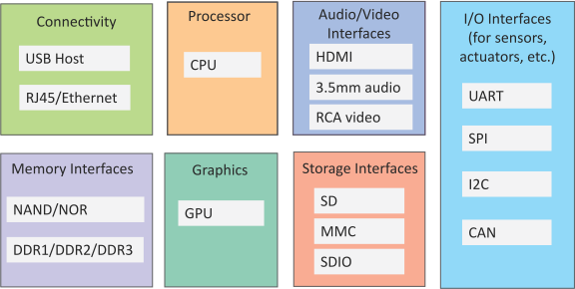
Generic Block Diagram of an IoT Device
An IoT device may consist of several interfaces for connections to other devices, both wired and wireless.
  I/O interfaces for sensors
  Interfaces for internet connectivity
  Memory and storage interfaces
  Audio/video interfaces

Slide 10
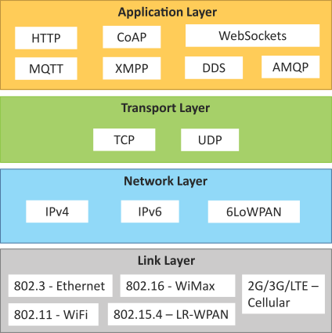
IoT Protocols
Link Layer
  802.3 – Ethernet
  802.11 – WiFi
  802.16 – WiMax
  802.15.4 – LR-WPAN
  2G/3G/4G
Network/Internet Layer
  IPv4
  IPv6
  6LoWPAN
Transport Layer
  TCP
  UDP
Application Layer
  HTTP
  CoAP
  WebSocket
  MQTT
  XMPP
  DDS
  AMQP

Slide 11
IoT Protocols…Link Layer…Ethernet
Sr.No | Standard | Shared medium
1 | 802.3 | Coaxial Cable…10BASE5
2 | 802.3.i | Copper Twisted pair …..10BASE-T
3 | 802.3.j | Fiber Optic……10BASE-F
4 | 802.3.ae | Fiber…..10Gbits/s
Data Rates are provided from 10Gbit/s to 40Gb/s and higher

Slide 12
IoT Protocols…Link Layer…WiFi
Sr.No | Standard | Operates in
1 | 802.11a | 5 GHz band
2 | 802.11b and 802.11g | 2.4GHz band
3 | 802.11.n | 2.4/5 GHz bands
4 | 802.11.ac | 5GHz band
5 | 802.11.ad | 60Hz band
Collection of Wireless LAN
Data Rates from 1Mb/s to 6.75 Gb/s

Slide 13
IoT Protocols…Link Layer…WiMax
Sr.No | Standard | Data Rate
1 | 802.16m | 100Mb/s for mobile stations 1Gb/s for fixed stations
Collection of Wireless Broadband standards
Data Rates from 1.5Mb/s to 1 Gb/s

Slide 14
IoT Protocols…Link Layer…LR-WPAN
Collection of standards for low-rate wireless personal area networks
Basis for high level communication protocols such as Zigbee
Data Rates from 40Kb/s to 250Kb/s
Provide low-cost and low-speed communication for power constrained devices

Slide 15
IoT Protocols…Link Layer…2G/3G/4G/5G –Mobile Communication
Sr.No | Standard | Operates in
1 | 2G | GSM-CDMA
2 | 3G | UMTS and CDMA 2000
3 | 4G | LTE
4 | 5G | NR (New Radio), supports NB-IoT & LTE-M
Data Rates from 9.6Kb/s (for 2G) to up to 100Mb/s (for 4G)

Slide 16
IoT Protocols…Network/Internet Layer
Responsible for sending of IP datagrams from source to destination network
Performs the host addressing and packet routing
Host identification is done using hierarchical IP addressing schemes such as IPV4 or IPV6

Slide 17
IoT Protocols…Network Layer
IPV4
  Used to identify the devices on a network using hierarchical addressing scheme
  Uses 32-bit address scheme
IPV6
  Uses 128-bit address scheme
6LoWPAN (IPV6 over Low power Wireless Personal Area Network)
  Used for devices with limited processing capacity
  Operates in 2.4 Ghz
  Data Rates of 250Kb/s

Slide 18
IoT Protocols…Transport Layer
Provide end-to-end message transfer capability independent of the underlying network
It provides functions such as error control, segmentation, flow- control and congestion control

Slide 19
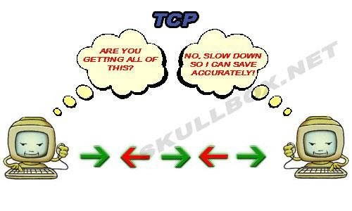
IoT Protocols…TCP
Transmission Control Protocol
Connection Oriented
Ensures Reliable transmission
Provides Error Detection Capability to ensure no delicacy of packets and retransmit lost packets
Flow Control capability to ensure the sending data rate is not too high for the receiver process
Congestion control capability helps in avoiding congestion which leads to degradation
of n/w performance

Slide 20
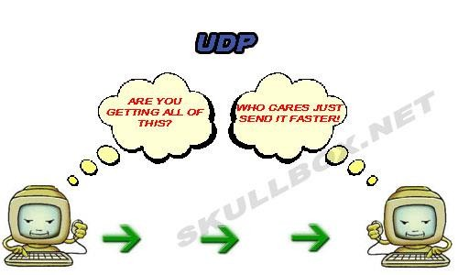
IoT Protocols…UDP
User Datagram Protocol
Connectionless
Does not ensures Reliable transmission
Does not do connection before transmitting
Does not provide proper ordering of messages
Transaction oriented and stateless

Slide 21

IoT Protocols…Application Layer…Hyper Transfer Protocol
Forms foundation of World Wide Web(WWW)
Includes commands such as GET,PUT, POST, HEAD, OPTIONS, TRACE..etc
Follows a request-response model
Uses Universal Resource Identifiers(URIs) to identify HTTP resources

Slide 22
IoT Protocols…Application Layer…CoAP
Constrained Application Protocol
Used for Machine to machine (M2M) applications meant for constrained devices and n/w’s
Web transfer protocol for IoT and uses request-response model
Uses client –server architecture
Supports methods such as GET,POST, PUT and DELETE

Slide 23
IoT Protocols…Application Layer
WebSocket
Allows full-duplex communication over single socket
Based on TCP
Client can be a browser, IoT device or mobile application
MQTT
Message Queue Telemetry Transport , light-weight messaging protocol
Based on publish-subscribe model
Well suited for constrained environments where devices have limited processing, low
memory and n/w bandwith requirement

Slide 24
IoT Protocols…Application Layer…XMPP
Extensible messaging and presence protocol
For Real time communication and streaming XML data between n/w entities
Used for Applications such as Multi-party chat and voice/video calls.
Decentralized protocol and uses client server architecture.

Slide 25
IoT Protocols…Application Layer…DDS
Data Distribution service is a data-centric middleware standard for device-to-device or machine-to-machine communication.
Publish subscribe model where publishers create topics to which subscribers can use.
Provides Quality-of-service control and configurable reliability.

Slide 26
IoT Protocols…Application Layer…AMQP
Advanced Messaging Queuing Protocol used for business messaging.
Supports both point-to-point and publisher/subscriber models, routing and queuing
Broker here receives messages from publishers and route them over connections to consumers through messaging queues.

Slide 27
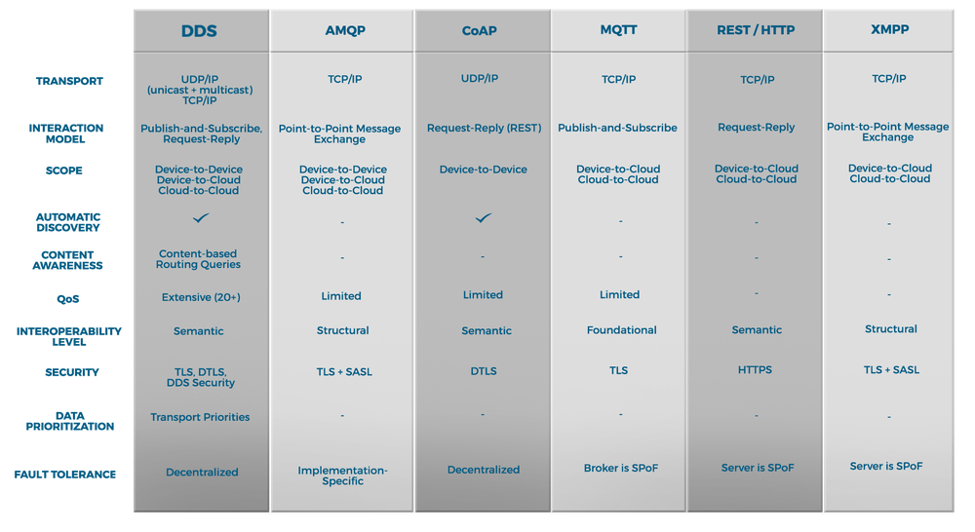
Comparisons of IoT Protocols

Slide 28
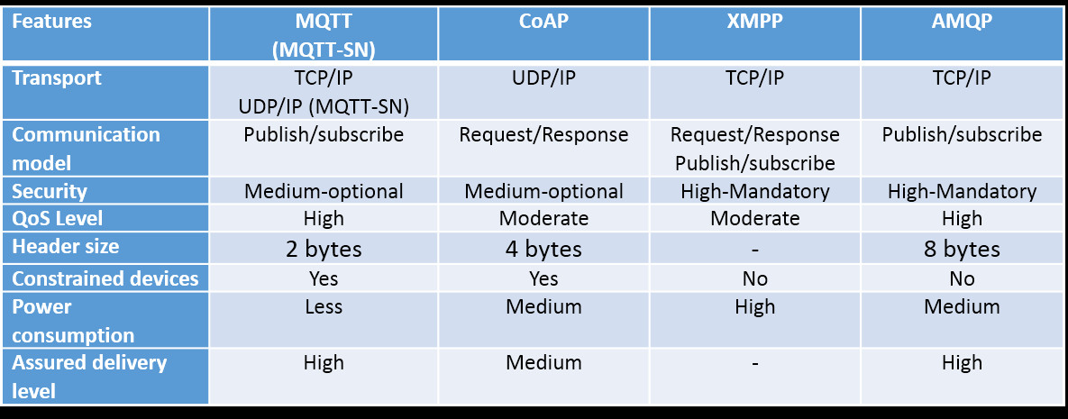
Comparisons of IoT Protocols

Slide 29
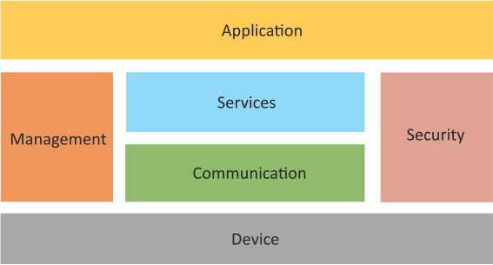
Logical Design of IoT
Device : Devices such as sensing, actuation, monitoring and control functions.
Communication : IoT Protocols
Services like device monitoring, device control services, data publishing services and device discovery
Management : Functions to govern the system
Security : Functions as authentication, authorization, message and content integrity, and data security
Applications

Slide 30
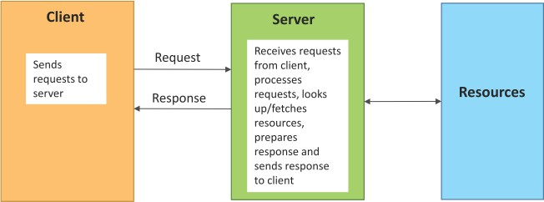
Request–Response Communication Model
Request–Response is a communication model in which the client sends requests to the server and the server responds to the requests.
When the server receives a request, it decides how to respond, fetches the data, retrieves resource representations, prepares the response and then sends the response to the client.
Stateless communication model
Book website: http://www.internet-of-things-book.com
Bahga & Madisetti, © 2015

Slide 31
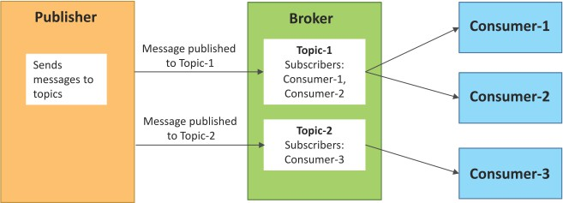
Publish–Subscribe Communication Model
Publish–Subscribe is a communication model that involves publishers, brokers and consumers.
Publishers are the source of data. Publishers send the data to the topics which are managed by the broker. Publishers are not aware of the consumers.
Consumers subscribe to the topics
which are managed by the broker.
When the broker receives data for a topic from the publisher, it sends the data to all the subscribed consumers.

Slide 32
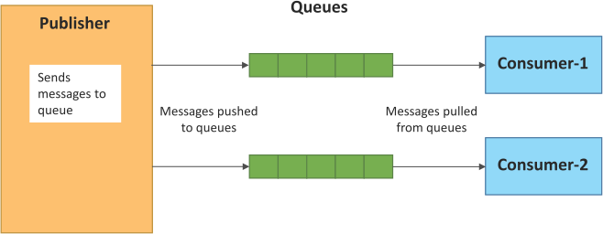
Push–Pull Communication Model
Push–Pull is a communication model in which the data producers push the data to queues and the consumers pull the data from the queues. Producers do not need to be aware of the consumers.
Queues help in decoupling the messaging between the producers and consumers.
Queues also act as a buffer which helps in situations when there is a mismatch between the rate at which the producers push data and the rate at which the consumers pull data.

Slide 33
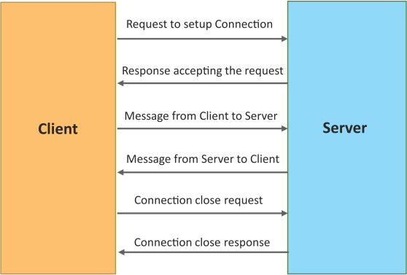
Exclusive Pair Communication Model
Exclusive
Pair
is
a
bidirectional,
fully
duplex
communication model that
uses a persistent connection between the client and the server.
Once the connection is set up it, remains open until the client sends a request to close the connection.
Client and server can send messages to each other after connection setup.

Slide 34
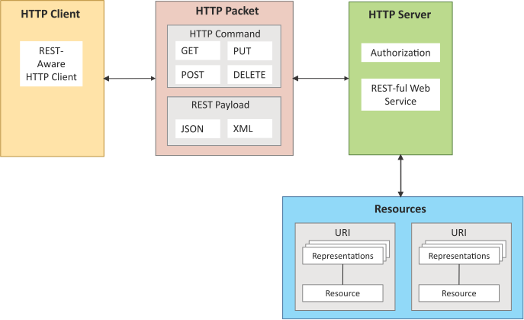
REST-based Communication APIs
Representational State Transfer (REST) is a set of architectural principles by which you can design web services and web APIs that focus on a system’s resources and how resource
states are addressed and
transferred.
REST APIs follow the request–
response communication model.
REST architectural constraints apply to the components, connectors and data elements within a distributed

Slide 35
REST-based Communication APIs Constraints
Client – Server
Stateless
Cacheable
Layered System
Uniform Interface
Code on demand
Client
Server
Request
Response
Request
Response

Slide 36
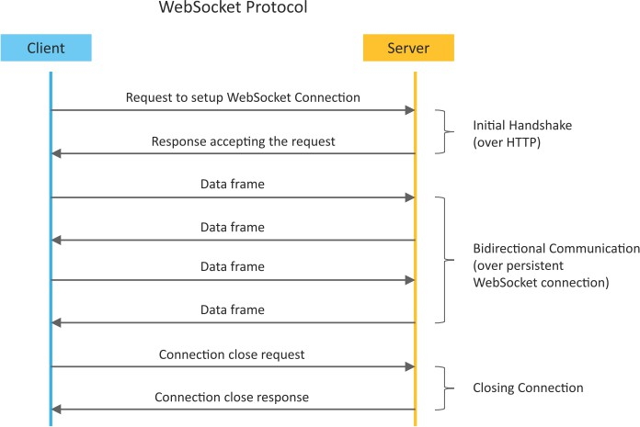
WebSocket-based Communication APIs
WebSocket APIs allow bi- directional, full duplex communication between clients and servers.
WebSocket APIs follow the exclusive pair communication model.

Slide 37
Difference between REST and WebSocket-based Communication APIs
Comparison Based on | REST | Websocket
State | Stateless | Stateful
Directional | Unidirectional | Bidirectional
Req-Res/Full Duplex | Follow Request Response Model | Exclusive Pair Model
TCP Connections | Each HTTP request involves setting up a new TCP Connection | Involves a single TCP Connection for all requests
Header Overhead | Each request carries HTTP Headers, hence not suitable for real-time | Does not involve overhead of headers.
Scalability | Both horizontal and vertical are easier | Only Vertical is easier

Slide 38
IoT Levels and Deployment Templates
Database: Database can be either local or in the cloud and stores the data generated by the IoT device.
Web Service: Web services serve as a link between the IoT device, application, database and analysis components. Web service can be implemented using HTTP and REST principles (REST service) or using the WebSocket protocol (WebSocket service).
Analysis Component: This is responsible for analyzing the IoT data and generating results in a form that is easy for the user to understand.
Application: IoT applications provide an interface that the users can use to control and monitor various aspects of the IoT system. Applications also allow users to view the system status and the processed data.

Slide 39
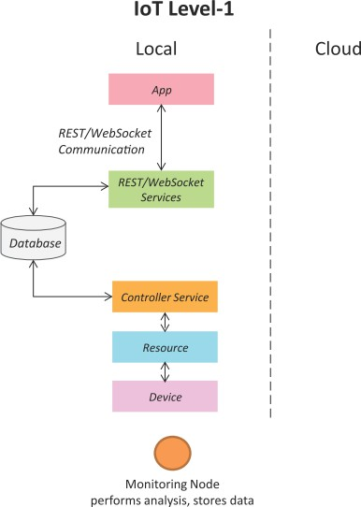
IoT Level-1
A level-1 IoT system has a
single node/device
that and/or
performs
sensing
actuation,
stores data,
performs analysis and hosts the application.
Level-1
IoT systems are
suitable for modelling low-
cost and low-complexity
solutions where the data
involved is not big and the
analysis requirements are
not intensive.
computationally

Slide 40
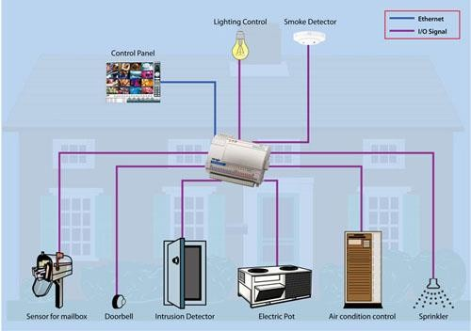
IoT – Level 1 Example …Home Automation System

Slide 41
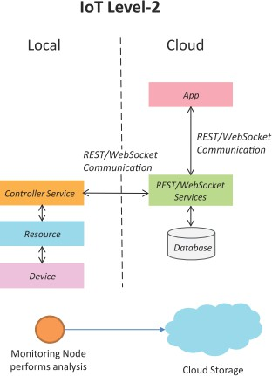
IoT Level-2
A level-2 IoT system has a single node that performs sensing and/or actuation and local analysis.
Data is stored in the cloud and the application is usually cloud-based.
Level-2 IoT systems are suitable for solutions where the data involved is big; however, the primary analysis requirement is not computationally intensive and can be done locally.

Slide 42
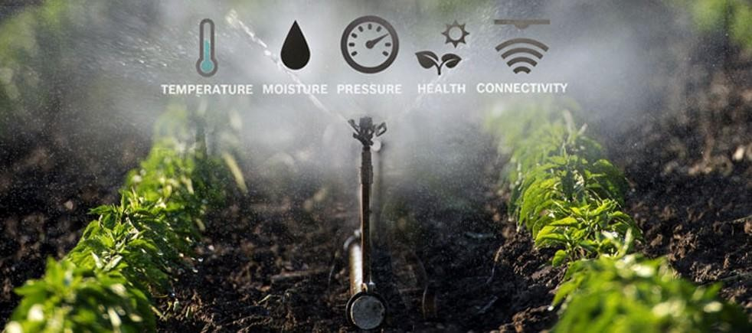
IoT – Level 2 Example …Smart Irrigation

Slide 43
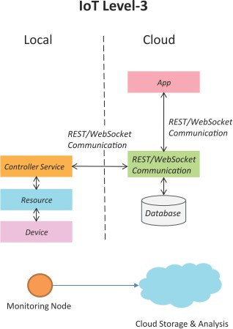
IoT Level-3
A level-3 IoT system has a single node. Data is stored and analyzed in the cloud and the application is cloud-based.
Level-3 IoT systems are suitable for solutions where the data involved is
big and the analysis
are
requirements
computationally intensive.

Slide 44
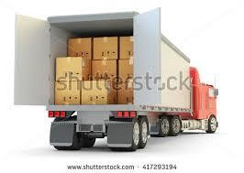
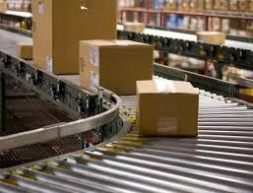
IoT – Level 3 Example …Tracking Package Handling
Sensors used accelrometer and gyroscope

Slide 45
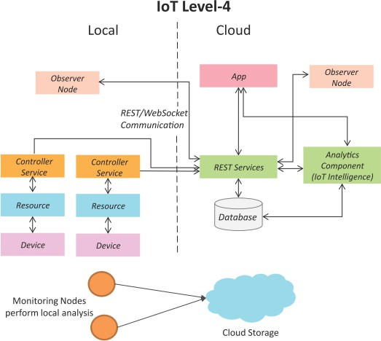
IoT Level-4
A level-4 IoT system has multiple nodes that perform local analysis. Data is stored in the cloud and the application is cloud-based.
Level-4 contains local and cloud- based observer nodes which can subscribe to and receive information collected in the cloud from IoT devices.
Level-4 IoT systems are suitable for solutions where multiple nodes are required, the data involved is big and the analysis requirements are computationally intensive.

Slide 46
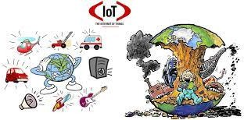
IoT – Level 4 Example …Noise Monitoring
Sound Sensors are used

Slide 47
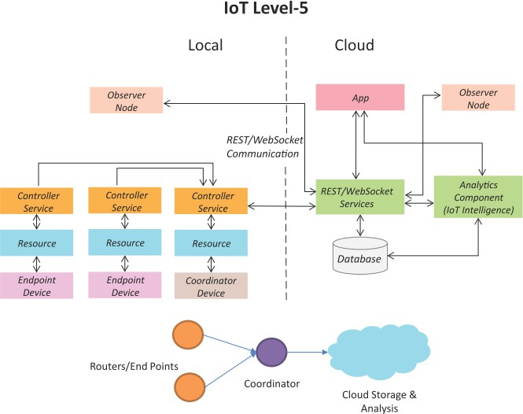
IoT Level-5
A level-5 IoT system has multiple end nodes and one coordinator node.
The end nodes perform sensing
and/or actuation.
The coordinator node collects data from the end nodes and sends it to the cloud.
Data is stored and analyzed in the cloud and the application is cloud- based.
Level-5 IoT systems are suitable for solutions based on wireless sensor networks, in which the data involved is big and the analysis requirements are computationally intensive.

Slide 48
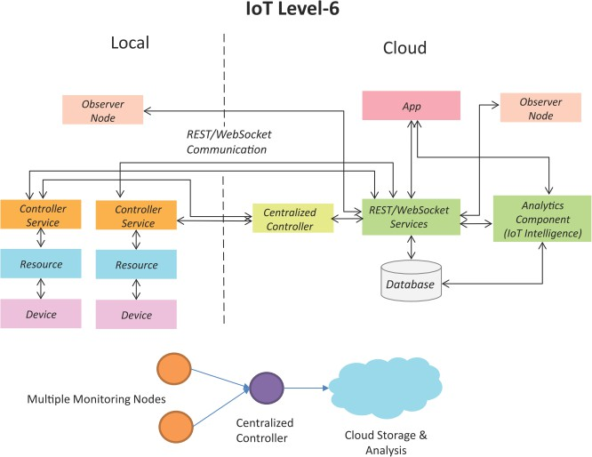
IoT Level-6
A level-6 IoT system has multiple independent end nodes that perform sensing and/or actuation and send data to the cloud.
Data is stored in the cloud and the application is cloud-based.
The analytics component analyzes the data and stores the results in the cloud database.
The results are visualized with the
cloud-based application.
The centralized controller is aware of the status of all the end nodes and sends control commands to the nodes.
Book website: http://www.internet-of-things-book.com
Bahga & Madisetti, © 2015

Slide 49
Thank you

