Slide 1
Internet of Things
Dr. Raihan Ul Islam
Associate Professor
Department of Computer Science & Engineering
Room No# AB3-1003
Email: raihan.islam@ewubd.edu
Mobile: +8801992392611

Slide 2
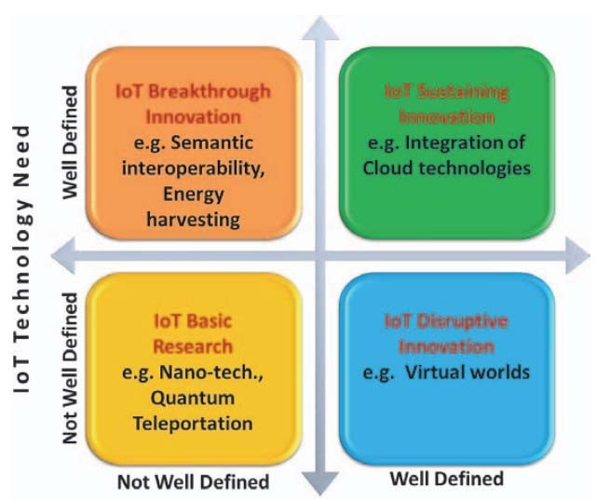
Convergence of Domains
Source: O. Vermesan, P. Friess, “Internet of Things – Converging Technologies for Smart Environments and Integrated Ecosystems”, River Publishers, Series in Communications, 2013

Slide 3
IoT Components
Device (The Thing)
Local Network
Internet
Backend Services
Applications

Slide 4
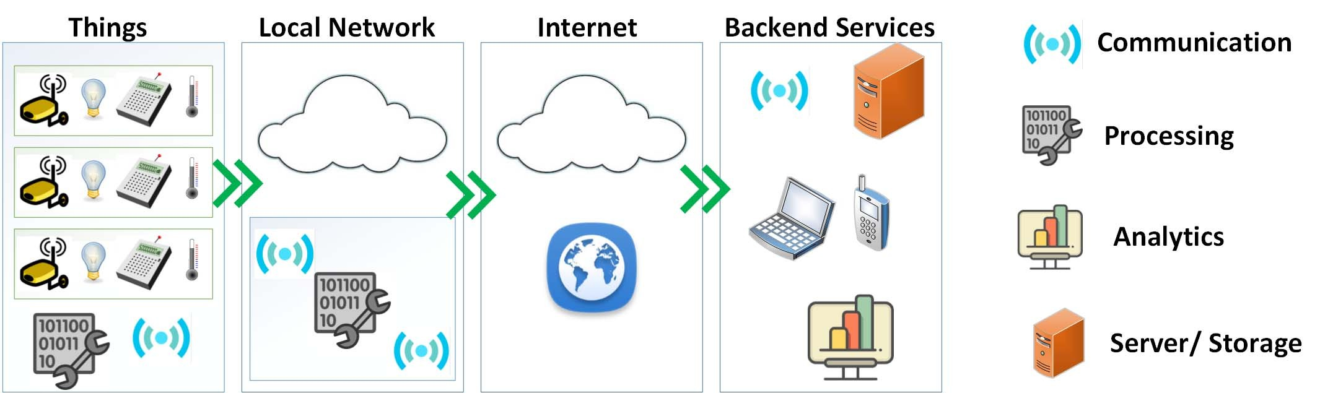

Slide 5
Functional Components of IoT
Component for interaction and communication with other IoT devices
Component for processing and analysis of operations
Component for Internet interaction
Components for handling Web services of applications
Component to integrate application services
User interface to access IoT
Source: O Vermesan, P. Friess, “Internet of Things – Converging Technologies for Smart Environments and Integrated Ecosystems”, River Publishers, Series in Communications, 2013

Slide 6


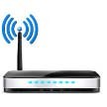

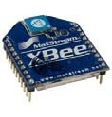
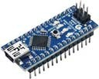

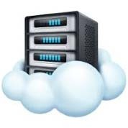


An Example IoT Implementation
Analytics
Proxy Server
Radio
Gateway
Actuation
Processor
Sensor
Websocket
Cloud‐server
Internet
Sensor Mote

Slide 7
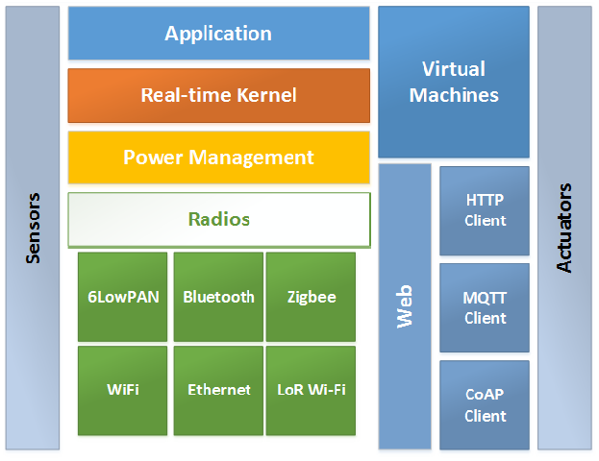
IoT Interdependencies

Slide 8
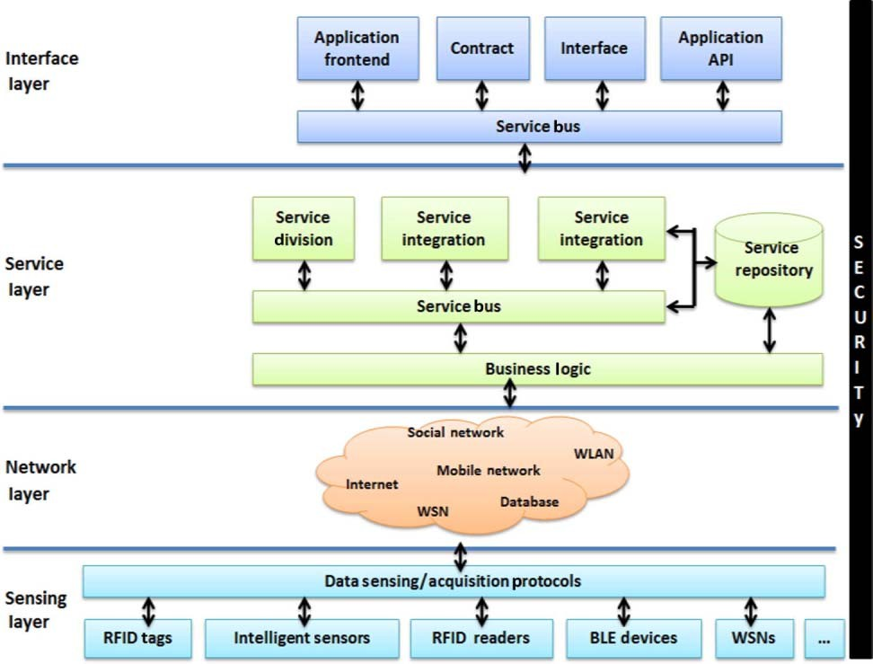
IoT Service Oriented Architecture
Source: Li Da Xu, Wu He, and Shancang Li, “Internet of Things in Industries: A Survey “, IEEE Transactions on Industrial Informatics, Vol. 10, No. 4, Nov. 2014.

Slide 9
IoT Categories
Industrial IoT
  IoT device connects to an IP network and the global Internet.
  Communication between the nodes done using regular as well as industry specific technologies.
Consumer IoT
  IoT device communicates within the locally networked devices.
  Local communication is done mainly via Bluetooth, Zigbee or WiFi.
  Generally limited to local communication by a Gateway

Slide 10
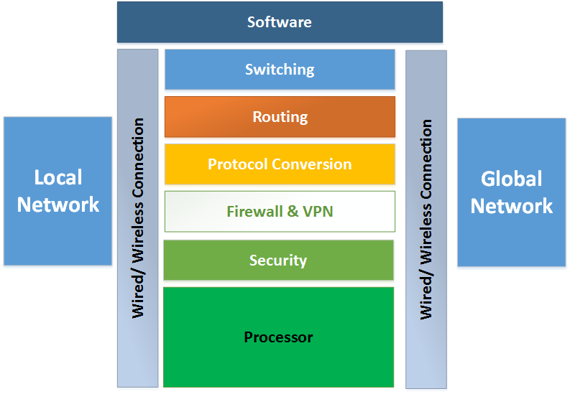
IoT Gateways

Slide 11










IoT and Associated Technologies
Big Data
SDN
Cloud
IoT
3G/4G/5G
Smart Grid
CPS
IoV
Tele‐ medicine
M2M

Slide 12
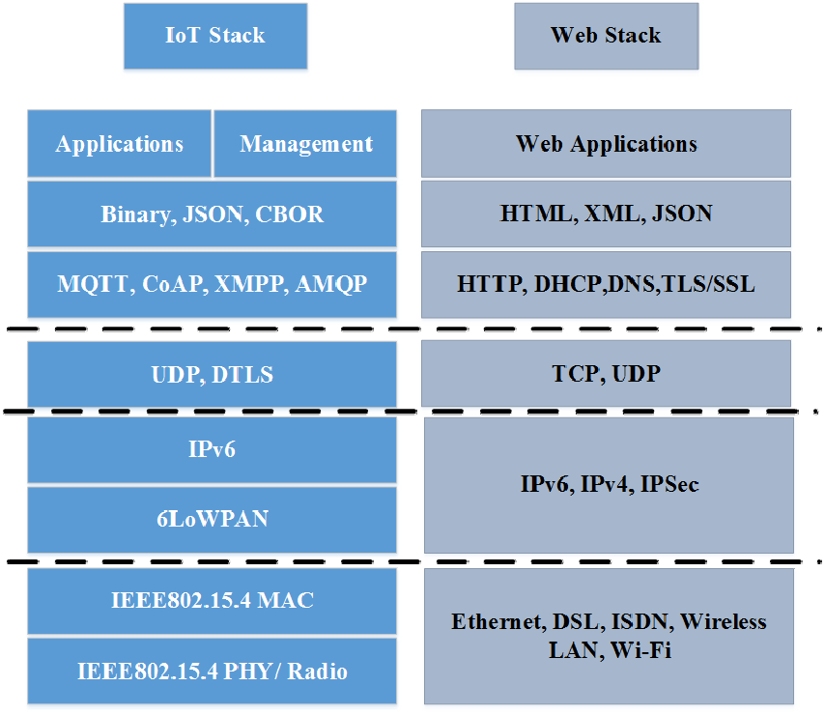
Technical Deviations from Regular Web

Slide 13
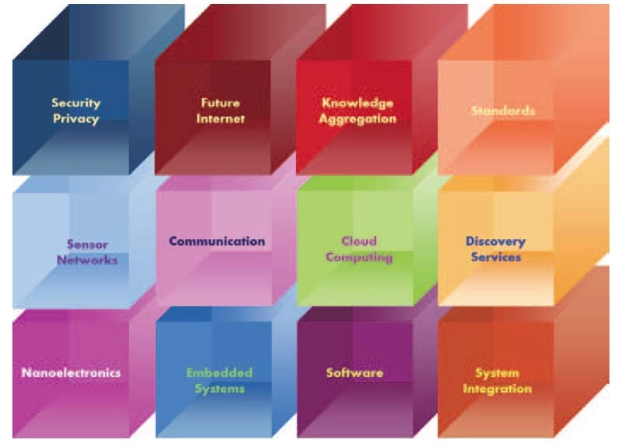
Key Technologies for IoT
Source: O Vermesan, P. Friess, “Internet of Things – Converging Technologies for Smart Environments and Integrated Ecosystems”, River Publishers, Series in Communications, 2013

Slide 14
IoT Challenges
Security
Scalability
Energy efficiency
Bandwidth management
Modeling and Analysis
Interfacing
Interoperability
Data storage
Data Analytics
Complexity management (e.g., SDN)

Slide 15
Considerations
Communication between the IoT device(s) and the outside world dictates the network architecture.
Choice of communication technology dictates the IoT device hardware requirements and costs.
Due to the presence of numerous applications of IoT enabled devices, a single networking paradigm not sufficient to address all the needs of the consumer or the IoT device.

Slide 16
Complexity of Networks
Growth of networks
Interference among devices
Network management
Heterogeneity in networks
Protocol standardization within networks
Source: O Vermesan, P. Friess, “Internet of Things – Converging Technologies for Smart Environments and Integrated Ecosystems”, River Publishers, Series in Communications, 2013

Slide 17
Wireless Networks
Traffic and load management
Variations in wireless networks – Wireless Body Area Networks and other Personal Area Networks
Interoperability
Network management
Overlay networks
Source: O. Vermesan, P. Friess, “Internet of Things – Converging Technologies for Smart Environments and Integrated Ecosystems”, River Publishers, Series in Communications, 2013

Slide 18
Scalability
Flexibility within Internet
IoT integration
Large scale deployment
Real‐time connectivity of billions of devices

Slide 19
Introduction
RFID is an acronym for “radio‐frequency identification”
Data digitally encoded in RFID tags, which can be read by a reader.
Somewhat similar to barcodes.
Data read from tags are stored in a database by the reader.
As compared to traditional barcodes and QR codes, RFID tag data can be read outside the line‐of‐sight.
Source: “How does RFID work?” AB&R (Online)

Slide 20
RFID Features
RFID tag consists of an integrated circuit and an antenna.
The tag is covered by a protective material which also acts as a shield against various environmental effects.
Tags may be passive or active.
Passive RFID tags are the most widely used.
Passive tags have to be powered by a reader inductively before they can transmit information, whereas active tags have their own power supply.
Source: “How does RFID work?” AB&R (Online)

Slide 21
Working Principle
Derived from Automatic Identification and Data Capture (AIDC) technology.
AIDC performs object identification, object data collection and mapping of the collected data to computer systems with little or no human intervention.
AIDC uses wired communication
RFID uses radio waves to perform AIDC functions.
The main components of an RFID system include an RFID tag or smart label, an RFID reader, and an antenna.
Source: “How does RFID work?” AB&R (Online)

Slide 22
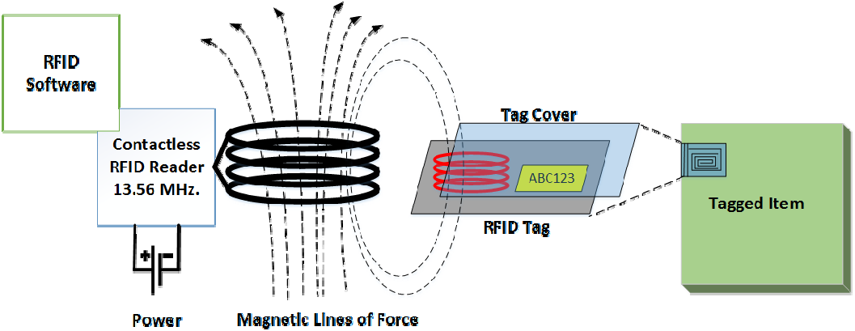

Slide 23
Applications
Inventory management
Asset tracking
Personnel tracking
Controlling access to restricted areas
ID badging
Supply chain management
Counterfeit prevention (e.g. in the pharmaceutical industry)
Source: “How does RFID work?” AB&R (Online)

Slide 24
ZigBee
ZigBee communication protocol :
ZigBee is newly developed technology that works on IEEE standard 802.15.4, which can be used in the wireless sensor network (WSN).
The low data rates, low power consumption, low cost are main features of ZigBee.
The ZigBee technology is designed to carry small amounts of data over a short distance while consuming very little power.
It is a short-range communication standard like Bluetooth and Wi-Fi, covering range of 10 to 100 meters.

Slide 25
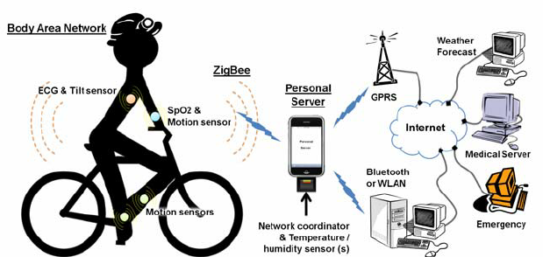

Slide 26

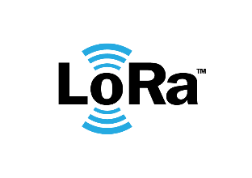


Bluetooth Low Energy (BLE)
Battery Lifetime
Years
RFID
Months
BLE
IEEE 802.15.4
Communication Range
Days
Few Meters
Tens-Hundreds of Meters
Kiliometers

Slide 27
How much Energy does Traditional Bluetooth Use?
Traditional Bluetooth is connection oriented. When a device is connected, a link is maintained, even if there is no data flowing.
Sniff modes allow devices to sleep, reducing power consumption to give months of battery life
Peak transmit current is typically around 25mA
Even though it has been independently shown to be lower power than other radio standards, it is still not low enough power for coin cells and energy harvesting applications

Slide 28
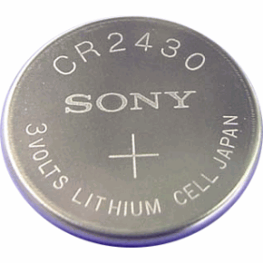
What is Bluetooth Low Energy?
Bluetooth low energy is a NEW, open, short range radio technology
  Blank sheet of paper design
  Different to Bluetooth classic (BR/EDR)
  Optimized for ultra low power
  Enable coin cell battery use cases
    < 20mA peak current
    < 5 uA average current

Slide 29
Basic Concepts of Bluetooth 4.0
Everything is optimized for lowest power consumption
  Short packets reduce TX peak current
  Short packets reduce RX time
  Less RF channels to improve discovery and connection time
  Simple state machine
  Single protocol
  Etc.

Slide 30
Bluetooth Low Energy Factsheet
Range: | ~ 150 meters open field
Output Power: | ~ 10 mW (10dBm)
Max Current: | ~ 15 mA
Latency: | 3 ms
Topology: | Star
Connections: | > 2 billion
Modulation: | GFSK @ 2.4 GHz
Robustness: | Adaptive Frequency Hopping, 24 bit CRC
Security: | 128bit AES CCM
Sleep current: | ~ 1μA
Modes: | Broadcast, Connection, Event Data Models, Reads, Writes

Slide 31
Bluetooth Low Energy Factsheet (2)
Data Throughput
  For Bluetooth low energy, data throughput is not a meaningful parameter. It does not support streaming.
  It has a data rate of 1Mbps, but is not optimized for file transfer.
  It is designed for sending small chunks of data (exposing state)

Slide 32
Designed for Exposing State
23.2˚C
60.5 km/h
12:23 pm
Gate 10 BOARDING
3.2 kWh
PLAY >>
Network Available
It’s good at small, discrete data transfers.
Data can triggered by local events.
Data can be read at any time by a client.

Slide 33
6LoWPAN

Slide 34
Introduction
Low‐power Wireless Personal Area Networks over IPv6.
Allows for the smallest devices with limited processing ability to transmit information wirelessly using an Internet protocol.
Allows low‐power devices to connect to the Internet.
Created by the Internet Engineering Task Force (IETF) ‐ RFC 5933 and RFC 4919.
Source: T. Winter, P. Thubert, A. Brandt, J. Hui, R. Kelsey, P. Levis, K. Pister, R. Struik , JP. Vasseur, R. Alexander, “RPL: IPv6 Routing Protocol for Low‐Power and Lossy Networks”, IETF, Standards Track, Mar. 2012

Slide 35
Features of 6LoWPANs
Allows IEEE 802.15.4 radios to carry 128‐bit addresses of Internet Protocol version 6 (IPv6).
Header compression and address translation techniques allow the IEEE 802.15.4 radios to access the Internet.
IPv6 packets compressed and reformatted to fit the IEEE
802.15.4 packet format.
Uses include IoT, Smart grid, and M2M applications.

Slide 36


Addressing in 6LoWPAN
64‐bit addresses: globally unique
16 bit addresses: PAN specific; assigned by PAN coordinator
IPv6 multicast not supported by 802.15.4
IPv6 packets carried as link layer broadcast frames
Addressing
64‐bit Extended
16‐bit Short

Slide 37
6LowPAN Packet Format
1 | 2 | 3 | 4 | 5 | 6 | 7 | 8 | 1 | 2 | 3 | 4 | 5 | 6 | 7 | 8 | 1 |  | 2 | 3 | 4 | 5 | 6 | 7 | 8 | 1 | 2 | 3 | 4 | 5 | 6 | 7 | 8 | IEEE 802.15.4
Length |  |  |  |  |  |  |  | Flags |  |  |  |  |  |  |  |  |  |  |  |  |  |  |  |  | DSN
PAN ID
Destination (64 bit)
Source (64 bit)
Ver |  |  | Traffic Class |  |  |  |  |  |  |  |  | Flow Label |  |  |  |  |  |  |  |  |  |  |  |  |  |  |  |  |  |  |  |  | IPv6
Payload Length |  |  |  |  |  |  |  |  |  |  |  |  |  |  |  |  |  |  | Next Header |  |  |  |  |  |  |  |  | Hop Limit
Source Address (128 bit)
Destination Length (128 bit)

Slide 38
Header Type: Dispatch Header
1 | 2 | 3 | 4 | 5 | 6 | 7 | 8 | 1 | 2 | 3 | 4 | 5 | 6 | 7 | 8 | 1 | 2 | 3 | 4 | 5 | 6 | 7 | 8 | 1 | 2 | 3 | 4 | 5 | 6 | 7 | 8
0 1 |  | Dispatch |  |  |  |  |  | Type Specific Header
Dispatch: Initiates communication
0,1: Identifier for Dispatch Type
Dispatch:
  6 bits
  Identifies the next header type
Type Specific Header:
  Determined by Dispatch header

Slide 39
Header Type: Mesh Addressing Header
1 | 2 | 3 |  | 4 | 5 | 6 | 7 | 8 | 1 | 2 | 3 | 4 | 5 | 6 | 7 | 8 | 1 | 2 | 3 | 4 | 5 | 6 | 7 | 8 | 1 | 2 | 3 | 4 | 5 | 6 | 7 | 8
1 0 |  | V | F |  | Hops Left |  |  |  | Originator Address |  |  |  |  |  |  |  |  |  |  |  | Final Address
1,0: ID for Mesh Addressing Header
V: ‘0’ if originator is 64‐bit extended address, ‘1’ if 16‐bit address
F: ‘0’ if destination is 64‐bit addr., ‘1’ if 16‐bit addr.
Hops Left: decremented by each node before sending to next hop

Slide 40
Header Type: Fragmentation Header
1 | 2 | 3 | 4 | 5 | 6 | 7 | 8 | 1 | 2 | 3 | 4 | 5 | 6 | 7 | 8 | 1 | 2 |  | 3 | 4 | 5 | 6 | 7 | 8 | 1 | 2 | 3 | 4 | 5 | 6 | 7 | 8
1 1 0 0 |  |  |  | Datagram Size |  |  |  |  |  |  |  |  |  |  |  |  |  | Datagram Tag
(a) First Fragment
1 | 2 | 3 | 4 | 5 | 6 | 7 | 8 |  | 1 | 2 | 3 | 4 | 5 | 6 | 7 | 8 | 1 | 2 |  | 3 | 4 | 5 | 6 | 7 | 8 | 1 | 2 | 3 | 4 | 5 | 6 | 7 | 8
1 1 0 0 |  |  |  | Datagram Size |  |  |  |  |  |  |  |  |  |  |  |  |  |  | Datagram Tag
Datagram Offset
(b) Subsequent Fragment

Slide 41
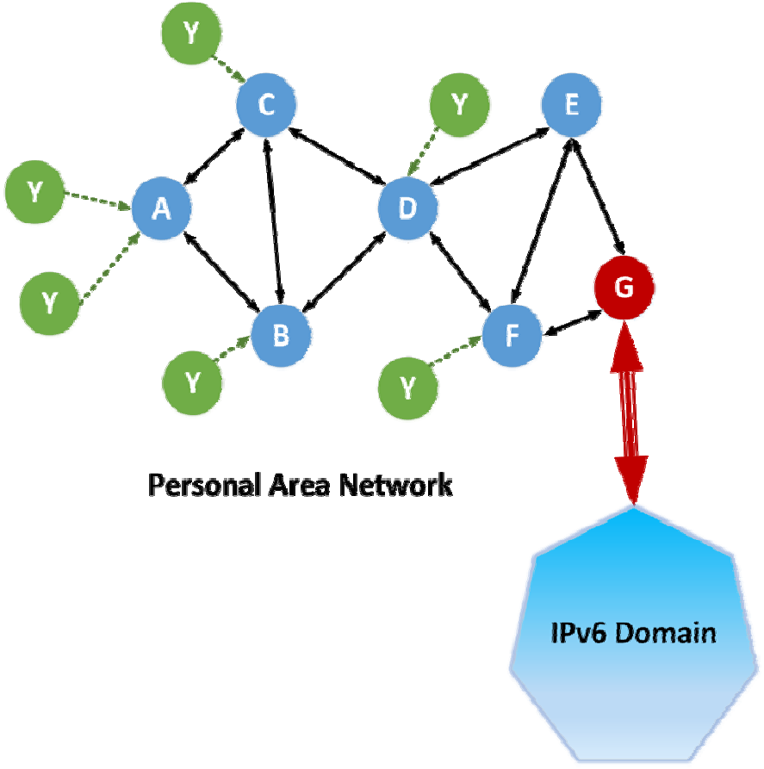
6LoWPAN Routing Considerations
Mesh routing within the PAN space.
Routing between IPv6 and the PAN domain
Routing protocols in use:
  LOADng
  RPL

Slide 42
LOADng Routing
Derived from AODV and extended for use in IoT.
Basic operations of LOADng include:
  Generation of Route Requests (RREQs) by a LOADng Router (originator) for discovering a route to a destination,
  Forwarding of such RREQs until they reach the destination LOADng Router,
  Generation of Route Replies (RREPs) upon receipt of an RREQ by the indicated destination, and unicast hop‐by‐hop forwarding of these RREPs towards the originator.
Source: Clausen, T.; Colin de Verdiere, A.; Yi, J.; Niktash, A.; Igarashi, Y.; Satoh, H.; Herberg, U.; Lavenu, C. et al. (January 2016). The Lightweight On‐demand Ad hoc Distance‐vector Routing Protocol ‐ Next Generation (LOADng). IETF. I‐D draft‐clausen‐lln‐loadng‐14

Slide 43
LOADng Routing
If a route is detected to be broken, a Route Error (RERR) message is returned to the originator of that data packet to inform the originator about the route breakage.
Optimized flooding is supported, reducing the overhead incurred by RREQ generation and flooding.
Only the destination is permitted to respond to an RREQ.
Intermediate LOADng Routers are explicitly prohibited from responding to RREQs, even if they may have active routes to the sought destination.
RREQ/RREP messages generated by a given LOADng Router share a single unique, monotonically increasing sequence number.
Source: Clausen, T.; Colin de Verdiere, A.; Yi, J.; Niktash, A.; Igarashi, Y.; Satoh, H.; Herberg, U.; Lavenu, C. et al. (January 2016). The Lightweight On‐demand Ad hoc Distance‐vector Routing Protocol ‐ Next Generation (LOADng). IETF. I‐D draft‐clausen‐lln‐loadng‐14

Slide 44
Routing Protocol for Low Power and Lossy Networks
(RPL Routing)
Distance Vector IPv6 routing protocol for lossy and low power networks.
Maintains routing topology using low rate beaconing.
Beaconing rate increases on detecting inconsistencies (e.g. node/link in a route is down).
Routing information included in the datagram itself.
Proactive: Maintaining routing topology.
Reactive: Resolving routing inconsistencies.
Source: T. Winter, P. Thubert, A. Brandt, J. Hui, R. Kelsey, P. Levis, K. Pister, R. Struik , JP. Vasseur, R. Alexander,
“RPL: IPv6 Routing Protocol for Low‐Power and Lossy Networks”, IETF, Standards Track, Mar. 2012

Slide 45
RPL Routing
RPL separates packet processing and forwarding from the routing optimization objective, which helps in Low power Lossy Networks (LLN).
RPL supports message confidentiality and integrity.
Supports Data‐Path Validation and Loop Detection
Routing optimization objectives include
  minimizing energy
  minimizing latency
  satisfying constraints (w.r.t node power, bandwidth, etc.)
RPL operations require bidirectional links.
In some LLN scenarios, those links may exhibit asymmetric properties.
It is required that the reachability of a router be verified before the router can be used as a parent.
Source: T. Winter, P. Thubert, A. Brandt, J. Hui, R. Kelsey, P. Levis, K. Pister, R. Struik , JP. Vasseur, R. Alexander, “RPL: IPv6 Routing Protocol for Low‐Power and Lossy Networks”, IETF, Standards Track, Mar. 2012

Slide 46
RFID

Slide 47
Functionality-based IoT Protocol Organization
Connectivity (6LowPAN, RPL)
Identification (EPC, uCode, IPv6, URIs)
Communication / Transport (WiFi, Bluetooth, LPWAN)
Discovery (Physical Web, mDNS, DNS‐SD)
Data Protocols (MQTT, CoAP, AMQP, Websocket, Node)
Device Management (TR‐069, OMA‐DM)
Semantic (JSON‐LD, Web Thing Model)
Multi‐layer Frameworks (Alljoyn, IoTivity, Weave, Homekit)
Source: Internet of Things Protocols (Online)

Slide 48
MQTT

Slide 49
Introduction
Message Queue Telemetry Transport.
ISO standard (ISO/IEC PRF 20922).
It is a publish‐subscribe‐based lightweight messaging protocol for use in conjunction with the TCP/IP protocol.
MQTT was introduced by IBM in 1999 and standardized by OASIS in 2013.
Designed to provide connectivity (mostly embedded) between applications and middle‐wares on one side and networks and communications on the other side.
Source: “MQTT”, Wikipedia (Online)

Slide 50
A message broker controls the publish‐subscribe messaging pattern.
A topic to which a client is subscribed is updated in the form of messages and distributed by the message broker.
Designed for:
  Remote connections
  Limited bandwidth
  Small‐code footprint
Source: “MQTT”, Wikipedia (Online)

Slide 51






MQTT Components
Publishers Subscribers Brokers
Lightweight sensors
• Lightweight sensors
Applications interested in sensor data
• Applications interested in sensor data
Connect publishers and subscribers
Classify sensor data into topics
• Connect publishers and subscribers
• Classify sensor data into topics
Source: “MQTT”, Wikipedia (Online)

Slide 52
MQTT Methods
Connect
Disconnect Subscribe Unsubscribe Publish
Source: “MQTT”, Wikipedia (Online)

Slide 53
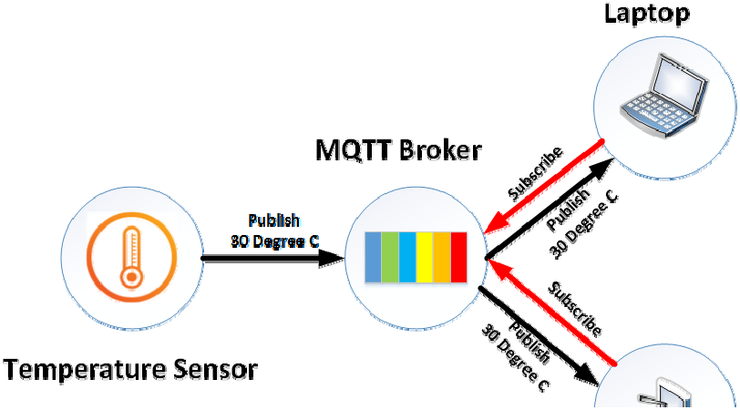

Source: “MQTT 101 – How to Get Started with the lightweight IoT Protocol”, HiveMQ (Online)

Slide 54
Communication
The protocol uses a publish/subscribe architecture (HTTP uses a request/response paradigm).
Publish/subscribe is event‐driven and enables messages to be pushed to clients.
The central communication point is the MQTT broker, which is in charge of dispatching all messages between the senders and the rightful receivers.
Each client that publishes a message to the broker, includes a topic into the message. The topic is the routing information for the broker.
Source: “MQTT 101 – How to Get Started with the lightweight IoT Protocol”, HiveMQ (Online)

Slide 55
Each client that wants to receive messages subscribes to a certain topic and the broker delivers all messages with the matching topic to the client.
Therefore the clients don’t have to know each other. They only communicate over the topic.
This architecture enables highly scalable solutions without dependencies between the data producers and the data consumers.
Source: “MQTT 101 – How to Get Started with the lightweight IoT Protocol”, HiveMQ (Online)

Slide 56
MQTT Topics
A topic is a simple string that can have more hierarchy levels, which are separated by a slash.
A sample topic for sending temperature data of the living room could be house/living‐room/temperature.
On one hand the client (e.g. mobile device) can subscribe to the exact topic or on the other hand, it can use a wildcard.
Source: “MQTT 101 – How to Get Started with the lightweight IoT Protocol”, HiveMQ (Online)

Slide 57
The subscription to house/+/temperature would result in all messages sent to the previously mentioned topic house/living‐ room/temperature, as well as any topic with an arbitrary value in the place of living room, such as house/kitchen/temperature.
The plus sign is a single level wild card and only allows arbitrary values for one hierarchy.
If more than one level needs to be subscribed, such as, the entire sub‐tree, there is also a multilevel wildcard (#).
It allows to subscribe to all underlying hierarchy levels.
For example house/# is subscribing to all topics beginning with
house.
Source: “MQTT 101 – How to Get Started with the lightweight IoT Protocol”, HiveMQ (Online)

Slide 58
Applications
Facebook Messenger uses MQTT for online chat.
Amazon Web Services use Amazon IoT with MQTT.
Microsoft Azure IoT Hub uses MQTT as its main protocol for telemetry messages.
The EVRYTHNG IoT platform uses MQTT as an M2M protocol for millions of connected products.
Adafruit launched a free MQTT cloud service for IoT experimenters called Adafruit IO.

Slide 59
SMQTT
Secure MQTT is an extension of MQTT which uses encryption based on lightweight attribute based encryption.
The main advantage of using such encryption is the broadcast encryption feature, in which one message is encrypted and delivered to multiple other nodes, which is quite common in IoT applications.
In general, the algorithm consists of four main stages: setup, encryption, publish and decryption.
Source: M. Singh, M. Rajan, V. Shivraj, and P. Balamuralidhar, "Secure MQTT for Internet of Things (IoT)," in Fifth International Conference on Communication Systems and Network Technologies (CSNT 2015), April 2015, pp. 746‐751

Slide 60
In the setup phase, the subscribers and publishers register themselves to the broker and get a master secret key according to their developer’s choice of key generation algorithm.
When the data is published, it is encrypted and published by the broker which sends it to the subscribers, which is finally decrypted at the subscriber end having the same master secret key.
The key generation and encryption algorithms are not standardized.
SMQTT is proposed only to enhance MQTT security features.
Source: M. Singh, M. Rajan, V. Shivraj, and P. Balamuralidhar, "Secure MQTT for Internet of Things (IoT)," in Fifth International Conference on Communication Systems and Network Technologies (CSNT 2015), April 2015, pp. 746‐751

Slide 61
Thank you

