Slide 1
Online Shopping
E-shop
28-09-2021

Slide 2
Presented To
Tasniya Ahmed
Lecturer
IIT, NSTU
Presented By
Akash Chandra Debnath (37)
Saifur Rahman (31)
28-09-2021

Slide 3
Content
Problem scenario
Solution
System environment
Language and Tools
Use case diagram
System requirements
Features
ER-diagram
Limitations
Future work
28-09-2021

Slide 4

Problem Scenario
Mr. X need to buy some accessories so he goes to nearest shopping mall transported by a rickshaw. After reach out to shop he noticed that there are so crowd and he felt risky to buy through shop manually because of COVID pandemic. By Ignoring it he started to choose his desired things and for these things he had to wandered to many shops because of different types of accessories sell by different shops. Besides, it was truly time consuming and he had an urgent work, so he aborted shopping in the middle of the way and felt tired of the whole tasks.
28-09-2021

Slide 5
Drawbacks in the existing systems
Transport problem
Time Consuming
Have to go out
Needed agent
Expensive
28-09-2021

Slide 6
Solutions
Online shopping system solved all the problems mentioned in problem scenario. These are :-
No transportation burden (Home delivery module).
The convenience of shopping at home.
Saves time and efforts.
Wide variety of products are available.
Good discounts/lower prices.
Get detailed information about the product.
No need extra agent.
28-09-2021

Slide 7
system environments
Hardware Interface:
Processor: - Pentium I or above
RAM: 128 MB or above
HD: 20 GB or above
NIC: For each party
Software Interface:
Operating System: Windows XP/vista/7
JAVA development tool kit
28-09-2021

Slide 8
system environments
Performance Requirements:
In order to maintain an acceptable speed at maximum number of uploads allowed from a particular customer will be any number of users can access the system at any time. Also connections to the servers will be based on the criteria of attributes of the user like his location, and server will be working whole 24X7 times.
28-09-2021

Slide 9
System Environments
Following Non-functional requirements will be there in the Insurance on internet:
i).Secure access of confidential data (customer's details).
ii). 24 X 7 availability.
iii). Better component design to get better performance At peak time.
iv). Flexible service based architecture will be highly desirable for future extension Non functional requirements define system properties and constraints.
It arise through user needs, because of budget constraints or organizational policies, or due to the external factors such as safety regulations, privacy registration and so on.
Various other Non-functional requirements are
1. Security
2. Reliability
3. Maintainability
4. Portability
5. Extensibility
6. Reusability
7. Application Affinity/Compatibility
8. Resource Utilization
28-09-2021

Slide 10

Language & Tools
Language and tools
PHP
MySQL
This languages and tools used for the e-shopping project.
JavaScript
Languages
& Tools
Visual studio code
For writing languages (PHP, JS, html)
Phpmy-admin
Used for creating databases
Photo-shop
For editing products image
HTML 5
CSS 3
Bootstrap
Bootstrap
28-09-2021

Slide 11
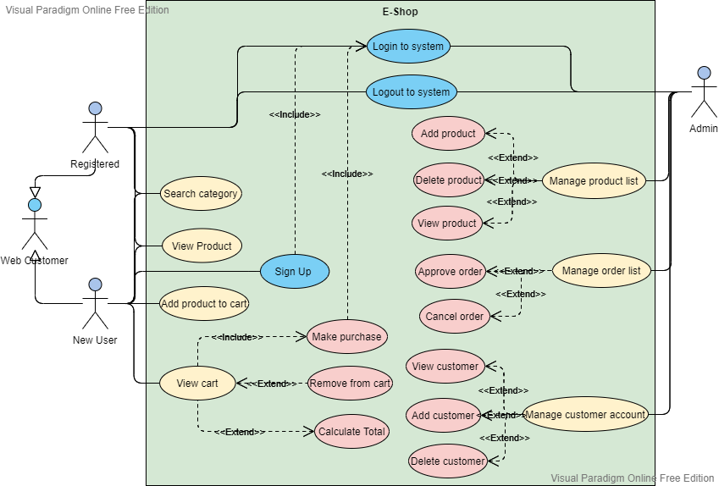
Use case diagram
28-09-2021

Slide 12

System Functional Requirements
The System must provide following functionalities
Keeping records of admission of customers and access control.
Registration, login, logout
Keeping the records of products.
Stock report, product master
Transaction, payment, price master
Keeping the daily sell.
28-09-2021

Slide 13
System Functional Requirements
Keeping details about the product it is delivered or not.
Maintainence
Storing the items selected by the customer in the temporary storage.
Cart manage, order report, delivery report
Reporting
Storing the feedback given by the customer.
28-09-2021

Slide 14

1. Usability
01
How much our website to be intuitive and easy-to-use
02
How easily a user can achieve their goal in a single page visit
03
How quickly a user select product and add to the cart
04
Number and time of errors users make
28-09-2021

Slide 15
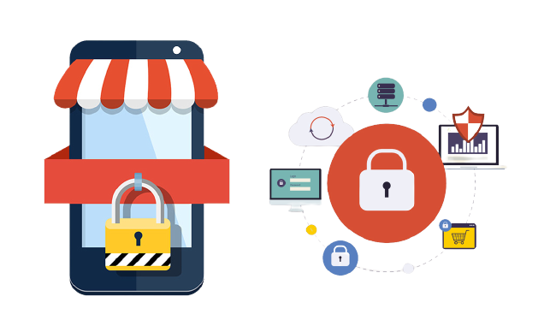
2. security
Our system dealing with monetary transactions and sensitive data.
Only the system administrator can access data permissions for change to the system.
The website must be resilient to any kind of attacks, including SQL injection and XSS attacks etc.
28-09-2021

Slide 16
Non-Functional Requirements
3. Performance:
Our website’s homepage load in less than 3 seconds
Performance give the greater priority in our project
4. Scalability:
How the website can grow and expand its functionality without affecting its performance
How much a website can growth
6. Privacy:
Use MD5 encryption in database for storing password of users
Payment module or transactions not monitored by the system
28-09-2021

Slide 17


The process of E-commerce
Buyer
1. Search and Identification
5. After Sales Service
Delivery
2. Selection and Negotiation
4. Product and Service Delivery
3. Purchasing
28-09-2021

Slide 18
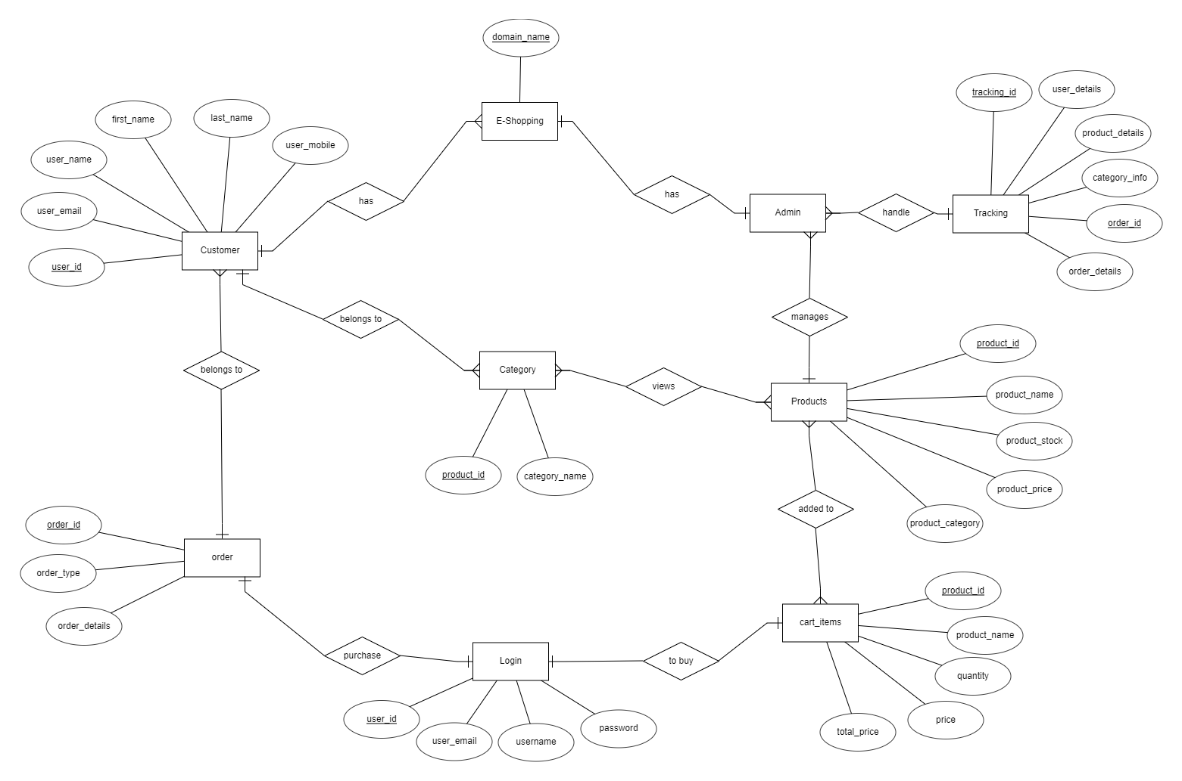
ER Diagram
28-09-2021

Slide 19
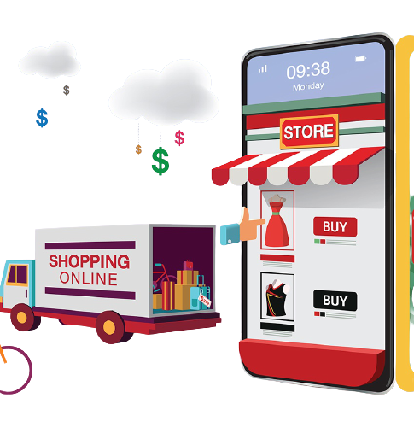
features
Menu
Catalog Browsing
Category List
Product List
Catalog Management
Product Browsing
Product Reviews
Related Products
Shopping Cart
Checkout
Auto generated bill
Administration
28-09-2021

Slide 20
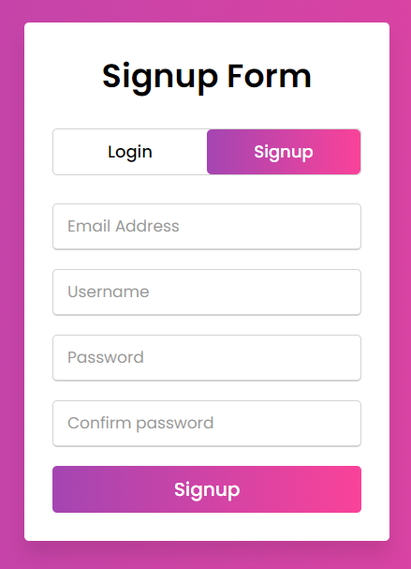
features
User registration
28-09-2021

Slide 21
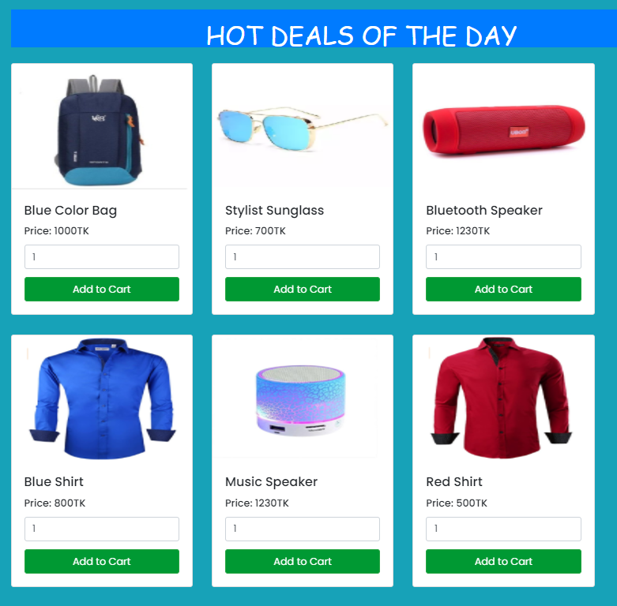
Features
Product list
28-09-2021

Slide 22
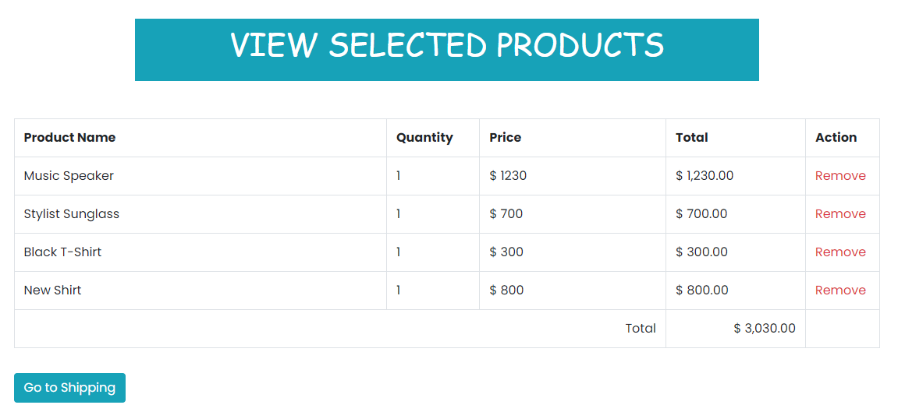
Features- cart items
28-09-2021

Slide 23
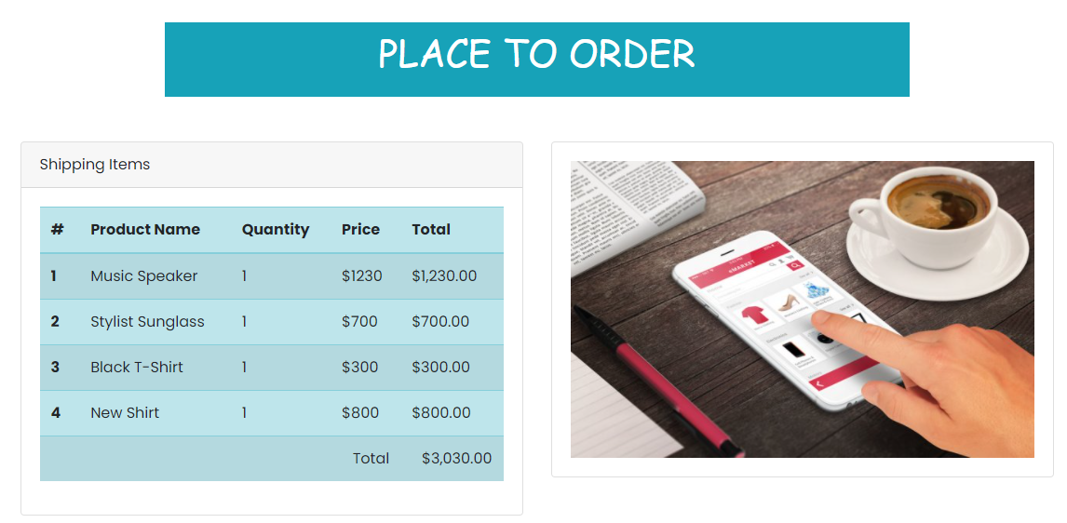
Features- checkout
28-09-2021

Slide 24
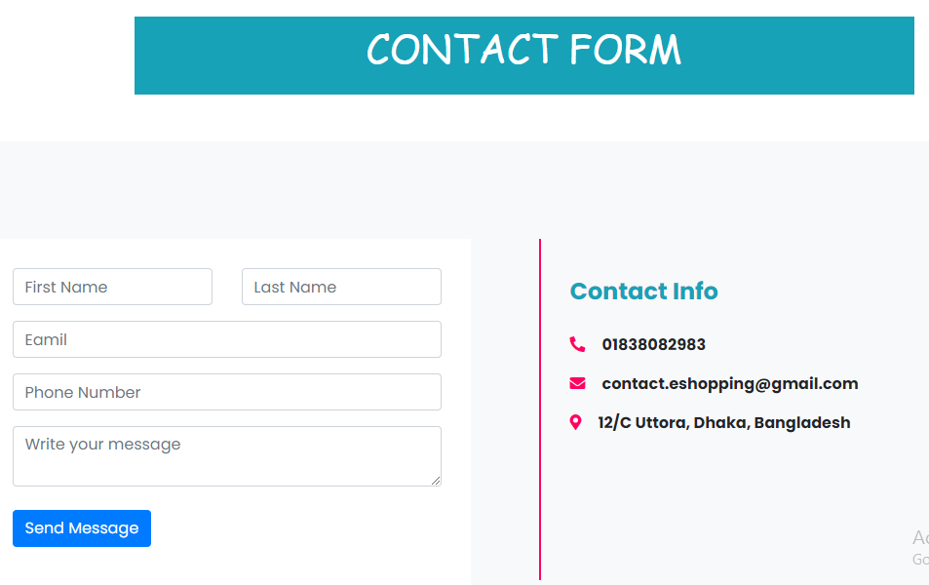
Features
28-09-2021

Slide 25
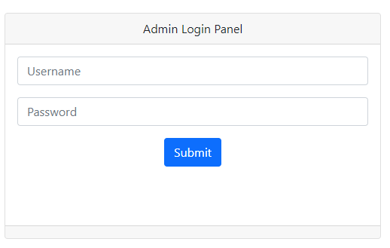
Features- Admin PAnel
28-09-2021

Slide 26
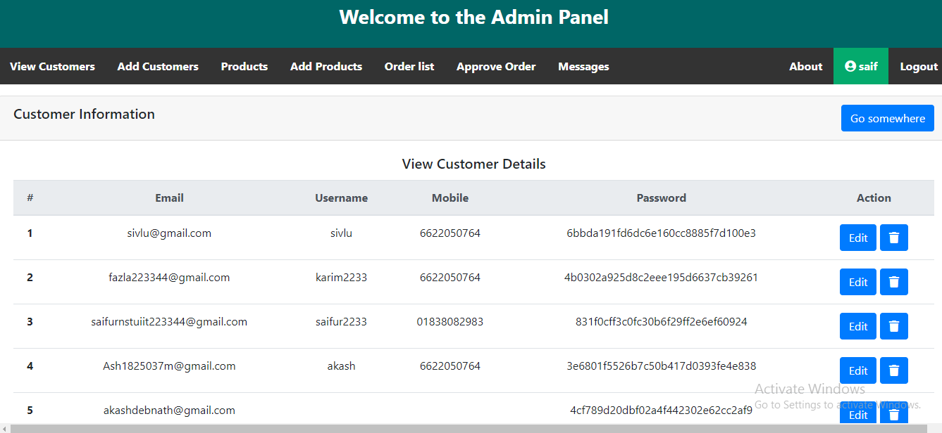
Features
28-09-2021

Slide 27
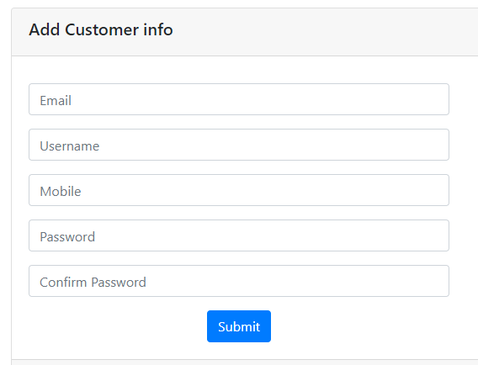
Features

Slide 28
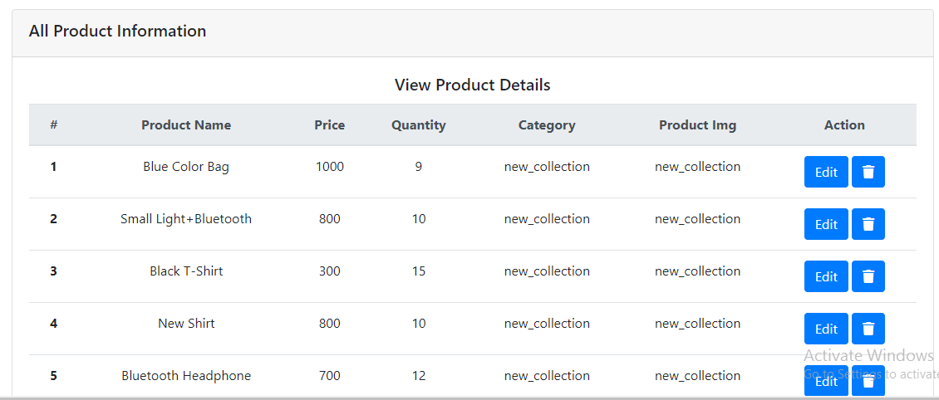
Features

Slide 29
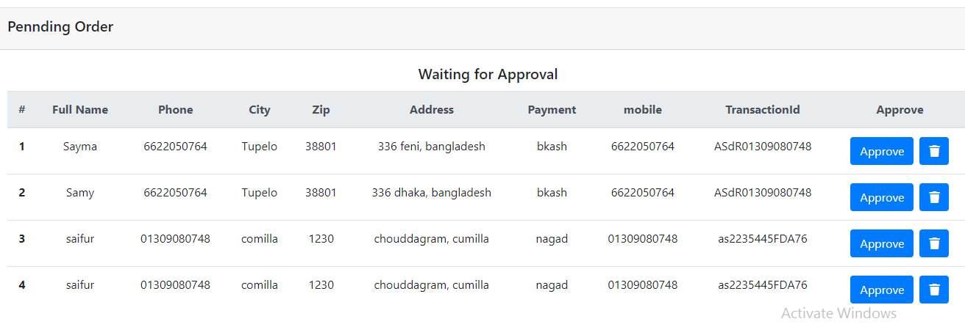
Features

Slide 30
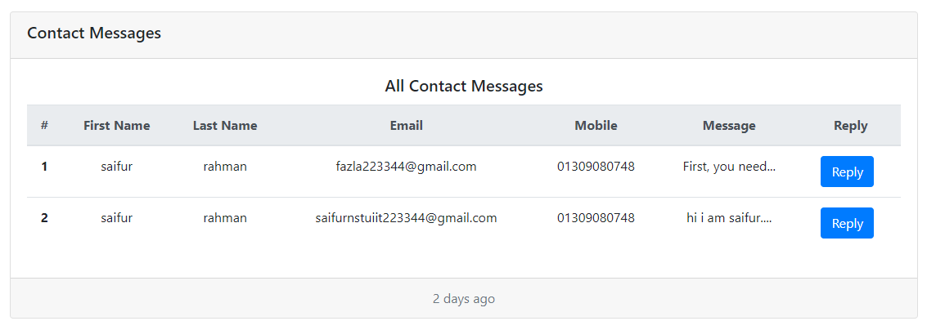
Features

Slide 31
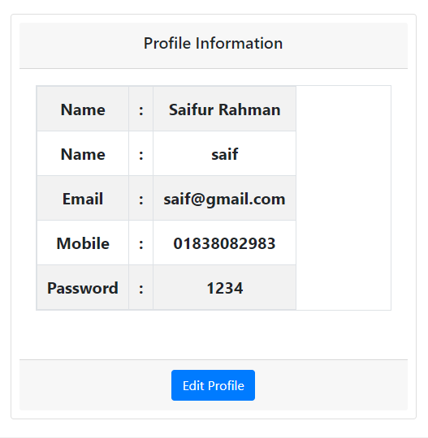
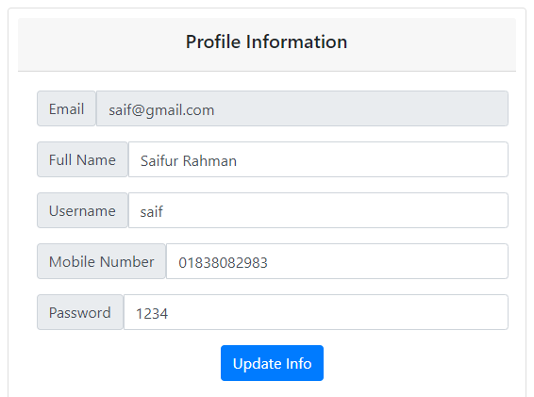
Features
28-09-2021

Slide 32






Limitations
A
Payment system not yet built on.
D
Short Message Services alert not built yet.
There is no SSL security protection.
Our system has no out-of-stock items alert
B
E
C
Our system has no review section.
F
There is no discount offer for products.
28-09-2021

Slide 33
Future plans
01
Payment system will be added.
02
Review section will be added.
03
Strong security features will included in the system.
04
Discount offers and details information will be added.
05
Validation and verification will be added.
06
Out-of-stock items will be allowed to cart for future availability.
28-09-2021

Slide 34
Thank YOU!!
For your attentions…
28-09-2021

