Slide 1

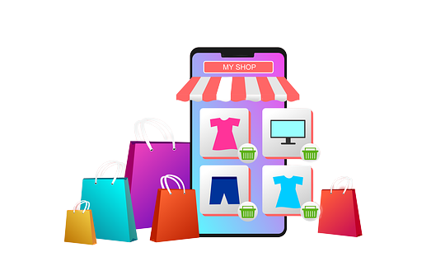
E-Shop
E-Shop

Slide 2


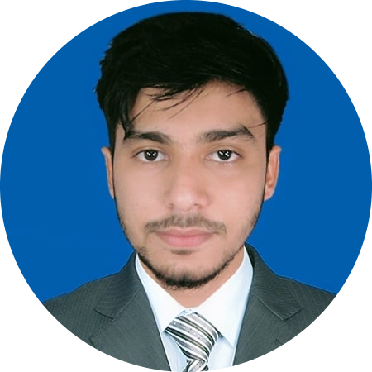
Tester & Mentor
Tasniya Ahmed
Lecturer (IIT, NSTU)
Md. Saifur Rahman
Roll: ASH1825031M
Akash Chandra Debnath
Roll: ASH1825037M

Slide 3
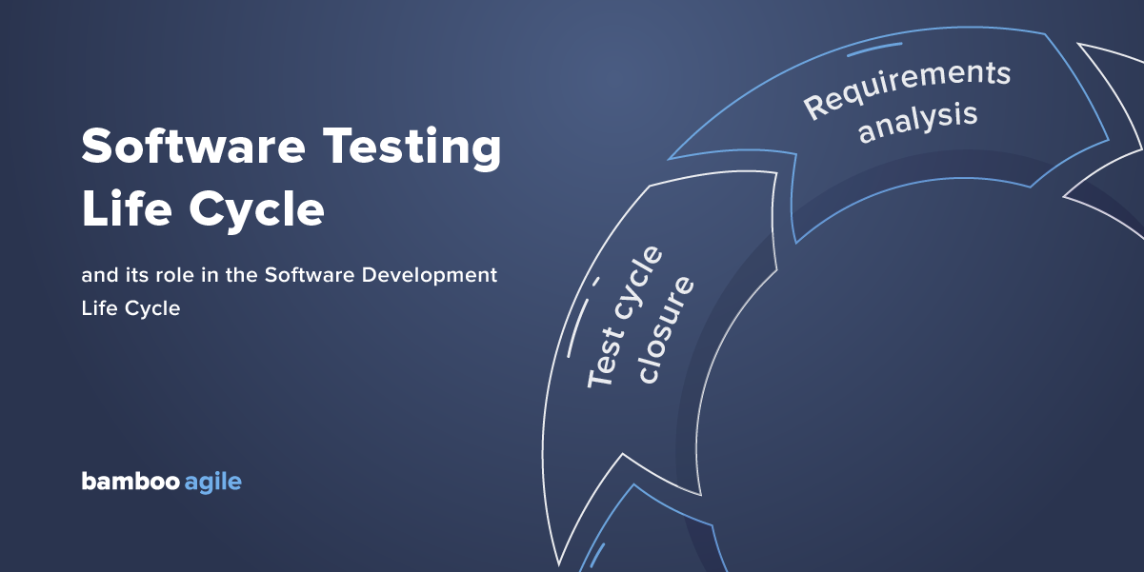
Software Testing Life cycle
The Software Testing Life Cycle (STLC) is a sequence of specific actions performed during the testing process to ensure that the software quality objectives are met.
The STLC includes both verification and validation.
The STLC is a high-quality strategy directly associated with and part of the Software Development Life Cycle (SDLC).
STLC has 6 phases.

Slide 4






Requirement
Analysis
Test Closure
1
6
Test planning
STLC Phrase
Test Execution
2
5
3
4
Environment setup
Test Case Development

Slide 5
Introduction
E-Shop is an e-commerce platform built for buying materials through online.
Any people with a valid email/phone can register themselves by providing email and a new username and a password.
They’ll be able to search any product by category or product name, and they can add to cart of their preferred items.
They can change quantity or remove any item from the cart.
Then, they proceed their purchase by online payment (Bkash, Rocket, Nagad).
Admin will check whether the purchase request is valid or not and if the request is valid, admin will approve the purchase request.

Slide 6
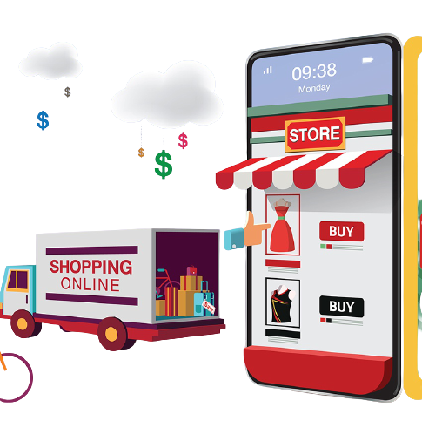
Solutions
Online shopping system solved all the problems mentioned in problem scenario. These are :-
No transportation burden (Home delivery module).
The convenience of shopping at home.
Saves time and efforts.
Wide variety of products are available.
Good discounts/lower prices.
Get detailed information about the product.
No need extra agent.

Slide 7
Phase 01: Requirement Analysis
Requirement Phase Testing also known as Requirement Analysis in which test team studies the requirements from a testing point of view to identify testable requirements and the QA team may interact with various stakeholders to understand requirements in detail. Requirements could be either functional or non-functional.
Functional requirement
FR-01: Keeping the records of products.
FR-02: Keeping records of admission of customers and access control.
FR-03: Keeping the daily sell.
FR-04: Keeping details about the product it is delivered or not.
FR-05: Storing the items selected by the customer in the temporary storage.
FR-06: Storing the feedback given by the customer.
FR-07: Registration to the system
FR-08: Minimum steps to make a purchase
FR-09: Product Attributes
FR-10: Mobile-friendliness
FR-11: Unique, recognizable design
FR-12: Relevant, useful content
FR-13: Email newsletter tools
FR-14: Shipping & payment systems integration

Slide 8

Phase 01: Requirement Analysis
Non-Functional requirement
01
Security
02
Performance
03
Reliability
04
03
Scalability
How quickly a user select product and add to the cart
05
Maintainability
04
Number and time of errors users make
06
Extensibility
07
Reusability

Slide 9
Phase 01: Requirement Analysis
FR - 01 | Keeping records of products
Description | The products which are launched for selling in the system Eshop will be kept details about quality, quantity, brand, price, seller information and location.
Priority | High
FR - 02 | Keeping record of admission of customer and access control
Description | There are three types of stakeholders - user, seller and admin. They are not priviledges same, so access components are based on stakholder roles.
Priority | High
FR – 03 | Keeping the daily sell
Description | About the daily purchases, payments and products launching information.
Priority | Medium
FR - 04 | Keeping the details of product it is delivered or not
Description | After approving purchase by admin checking whether the products are delivered by particular agent.
Priority | Medium

Slide 10
Phase 02: Test Planning
Test Factors of E-Shop
User cannot login to the system with invalid credentials.
User won’t able to see database files or other user’s information.
User won’t able to modify product item attributes.
Price of products in cart should calculate accurately.
User won’t be able to interrupt or access on any part in admin panel.
System will portable to almost every hardware.
Test Phase
Requirements gathering
Requirements specification
Functional design(HLD)
internal design (LLD)
Coding

Slide 11
Phase 02: Test Planning
Test Factors | Test Phase
Factor id | Requirements | Design | Code | Unit test | Integration Test | System Test
I | User registered to the system? |  | Allow sql query in username and password field? | Prohibit invalid query?
II |  | Is system exploits the private files? | Is encryption used for database files?
III |  | Is prduct item is editable by user? |  | Is user module has connection to products add/edit class? |  | Is only admin able to change attributes?
IV |  | Is indexing in cart done properly? | Has sum and multiplication method inconsistency?
Test Strategy Matrix

Slide 12
Testing Techniques | Testing Type | Perform on
Dynamic Testing (Black Box) | Boundary Value Analysis Equivalence Class Partitioning Cause-effect Graph | Functional requirements, code
Dynamic Testing (White Box) | Logic Coverage Criteria Basic Path Testing Control Flow Graph Graph Matrix Connection Matrix | Structure, deign , code
Static Testing | Inspection | Whole system without execute code
Validation Testing | Unit Testing Integration Testing Function Testing System Testing Acceptance Testing Installing Testing | Code Module Merged code Functional design SRS Conformance to gathered requirements Adaptability with operating machine
Regression Testing | Test Prioritization | Testing requirements
Phase 02: Test Planning
Testing techniques and testing types

Slide 13
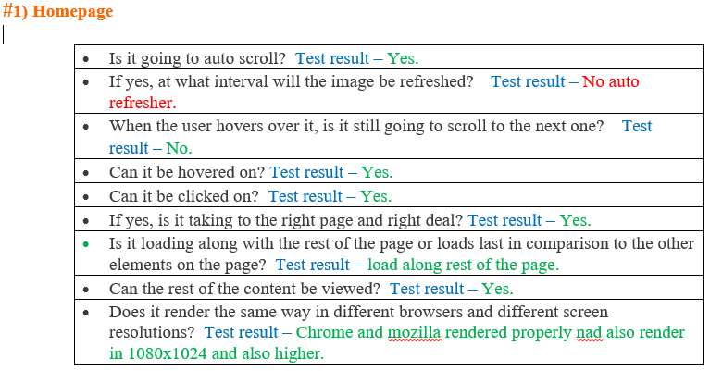
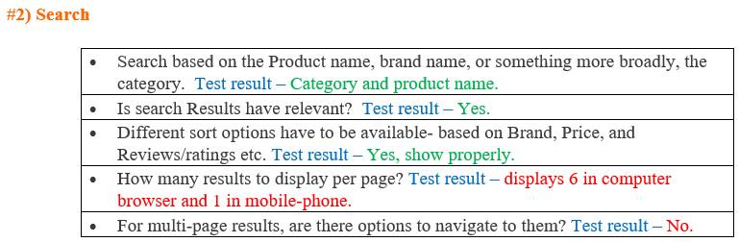
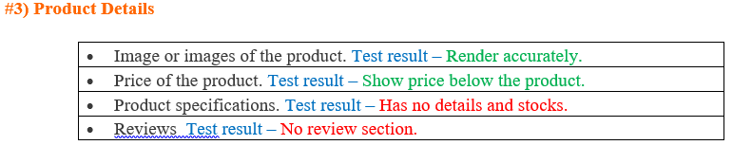
Phase 02: Test Planning
Test Planning Checklist

Slide 14
Phase 03: Test case development
Test Case ID | Test Scenario | Test Steps | Test Data | Expected Results | Actual Results | Pass/Fail
TC03 | Check Customer Login with valid Data | Go to site http://localhost/eshop/login.php Enter Username Enter Password Click Submit | Username = saif99 Password = pass99 | User should Login into an application | As Expected | Pass
TC04 | Check Customer Login with invalid Data | Go to site http://localhost/eshop/login.php Enter Username Enter Password Click Submit | Username = saif99 Password = pass99 | User should not Login into an application | As Expected | Pass

Slide 15
Phase 04: Environment setup
This phase includes the setup or installation process of software and hardware which is required for testing the application.
Hardware (Desktop / Laptop)
RAM: 512 MB or more
Hard drive: 1 GB or above
Processor: 1.80 GHz or above
Software
Operating System : Windows 7 or above / Linux / Mac
Browser: Chrome / Mozilla / opera / Brave latest versions
Code editor: Visual Studio Code, Sublime
We installed OS - window 10 Home, 4GB RAM and 1TB hard-disk, processor - Intel(R) Core(TM) i3-3110M CPU @2.40GHz, chrome browser and Visual studio code as editor.

Slide 16
Phase 05: Test Execution
ID | Test Scenario | Test Steps | Test Data | Expected Results | Actual Results | Pass/ Fail
TC01 | Check Customer Registration with valid Email | Go to site http://localhost/eshop/login.php Click SignUp button Enter valid email and others data Click SignUp | Email: saif@gmail.com username: saifur Phone number: 0182637623 Pass: saif1234 | User should Registration into an application | As Expected | Pass
TC02 | Check Customer Registration with invalid Email | Go to site http://localhost/eshop/login.php Click SignUp button Enter valid email and others data Click SignUp | Email: hello….. username: saifur Phone number: 0182637623 Pass: saif1234 | User should not Registration into an application | As Expected | Pass
TC03 | Check Customer Login with valid Data | Go to site http://localhost/eshop/login.php Enter Username Enter Password Click Submit | Username = saif99 Password = pass99 | User should Login into an application | As Expected | Pass
TC04 | Check Customer Login with invalid Data | Go to site http://localhost/eshop/login.php Enter Username Enter Password Click Submit | Username = saif99 Password = pass99 | User should not Login into an application | As Expected | Pass

Slide 17
Phase 05: Test Execution
TC07 | check customer feedback successfully send to the system | Go to site http://localhost/eshop/login.php |  | User should send feedback | Not Expected | Fail
TC08 | Check daily sell record store in the system | Go to site http://localhost/eshop/login.php |  | Admin should see daily sell record in the system | As Expected | Pass
TC09 | Check the search using a product name. | Go to site http://localhost/eshop/login.php Enter product name in the search box Click Search | Product name= t-shirt | User should see the product available | Not Expected | Fail
TC10 | Check the search using a category name. | Go to site http://localhost/eshop/login.php Enter category name in the search box Click Search | Category name= shirt | User should see the product available | Not Expected | Fail
TC11 | Check website users can easily add/remove products to/from a shopping cart. | Go to site http://localhost/eshop/login.php Click remove button |  | User should see the product remove from the shopping cart | As Expected | Pass

Slide 18
Phase 05: Test Execution
ID | Test Scenario | Test Steps | Test Data | Expected Results | Actual Results | Pass/ Fail
TC20 | Check it takes the expected time for a user to log in with the correct credentials. | Go to site http://localhost/eshop/login.php Enter username Enter password | Username= saif Password=1234 | User should login within 2-3 seconds | As Expected | Pass
TC21 | Check page loading speed is acceptable. | Go to site http://localhost/eshop/login.php |  | User should see that home page load within 2-3 seconds | As Expected | Pass
TC22 | Check the carousel auto scrolls and the scrolling interval. | Go to site http://localhost/eshop/login.php |  | User should see that carousel slider are auto scrolled | As Expected | Pass
TC23 | Check an application should be available at different battery conditions, including charging. | Go to site http://localhost/eshop/login.php |  | User should see that application should be available at different battery conditions. | As Expected | Pass
TC24 | Check a user should be able to log in from different devices simultaneously. | Go to site http://localhost/eshop/login.php Enter username Enter password | Username= saif Password=1234 | User should able to log in from different devices simultaneously. | As Expected | Pass

Slide 19
Phase 05: Test Execution
Bug Report
Scenarios | Complexity | Responsible Tester | Date of Execution | Status (Pass/Fail) | BugID | Severity | Status
Verify if a user will be able to register with a valid information. | Medium | Saifur | 18-02-2022 | Fail | 101 | High | Regist- ration Error
Check if user will be able to add product to shopping cart | Complex | Akash | 18-02-2022 | Pass
Check if admin will be able to change his password | Complex | Saifur | 18-02-2022 | Fail | 102 | High | Update Fail
Check if user will be able to input product quantity | Medium | Akash | 18-02-2022 | Pass
Verify if user will be able to checkout product and order confirm | Complex | Saifur | 18-02-2022 | Pass
Verify that user will be able confirm order and then cart will be empty | Complex | Saifur | 18-02-2022 | Fail | 103 | High | After order confirmed Cart not empty
Verify that user will not able to checkout without add to cart minimum one product | Complex | Akash | 18-02-2022 | Fail | 104 | High | View cart condition failure

Slide 20
Phase 05: Test Execution
Bug Report
Bug Name: Verify if a user will be able to register with a valid information.
Bug Id: 101
Expect Result: Registration Successfully
OS: Windows 10
Severity: High
Priority: High
Bug Name: Check if admin will be able to change his password
Bug Id: 102
Expect Result: Updating Successfully
OS: Windows 10
Severity: High
Priority: High
Bug Name: Verify that user will be able confirm order and then cart will be empty
Bug Id: 103
Expect Result: Cart Updating Successfully
OS: Windows 10
Severity: High
Priority: High
Bug Name: Verify that user will not able to checkout without add to cart minimum one product
Bug Id: 104
Expect Result: Successfully
OS: Windows 10
Severity: High
Priority: High
1
3
2
4

Slide 21
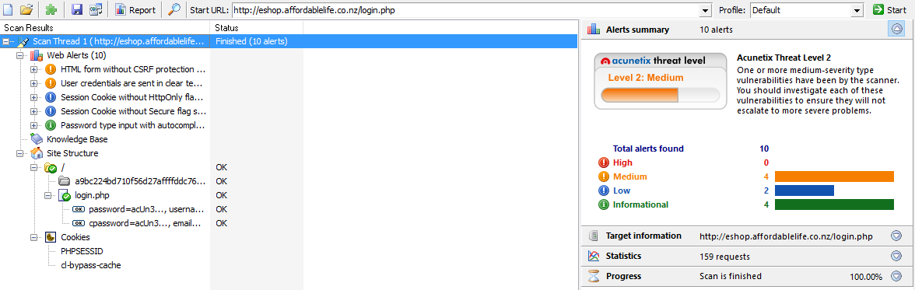
Phase 05: Test Execution
Acunetix WVS 8

Slide 22
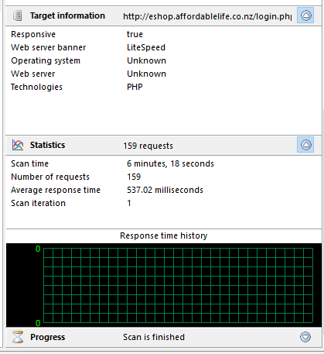
Phase 05: Test Execution
Acunetix WVS 8

Slide 23
Phase 06: Test closure
Test Closure is a document that gives a summary of all the tests conducted during the software development life cycle, it also gives a detailed analysis of the bugs removed and errors found. It evaluate the test completion on the basis of Test Coverage and Software Quality.
Test Closure Report
Test Cycle | Number of test cases | Test case execute | Test case not execute | Test Case pass | Test case fail
Cycle 01 | 19 | 19 | 0 | 12 | 7
Cycle 02 | 7 | 7 | 0 | 7 | 0
Total | 26 | 26 | 0 | 19 | 7

Slide 24
THANKS!
For your attention…

