Slide 1

A.10(A)
add and subtract polynomials of degree one and degree two

Slide 2
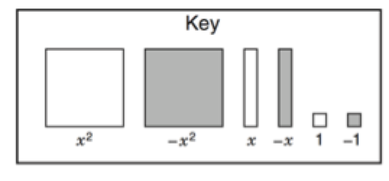
Fluency Practice
Calculate 7-(-5)
Explain what “like terms” means.
What expression is represented by the algebra tiles below.

Slide 3
Problem Solving Strategies
Intervene’s Problem Solving Strategies:
Step 1: Show what you know
Step 2: Solve and Check
Step 3: Eliminate and Justify

Slide 4
Lesson
Key Vocabulary
Polynomial
Like terms
Exponent
Coefficient
Like Terms: add coefficients (NOT EXPONENTS)
2x²+5x²=7x²

Slide 5
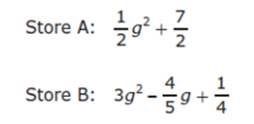
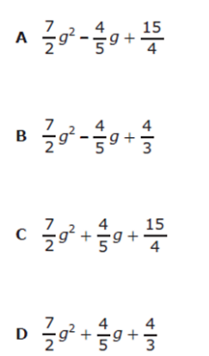
I Do

Slide 6
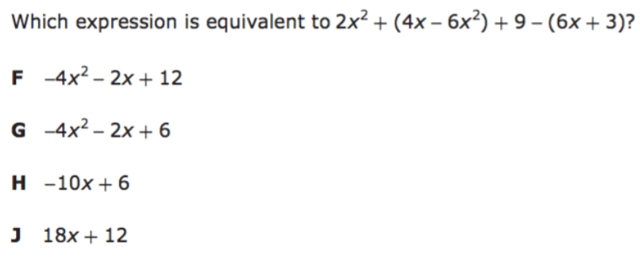
We Do – Student 1

Slide 7
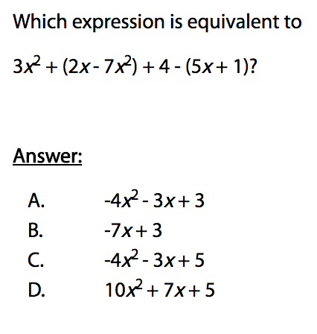
We Do – Student 2

Slide 8
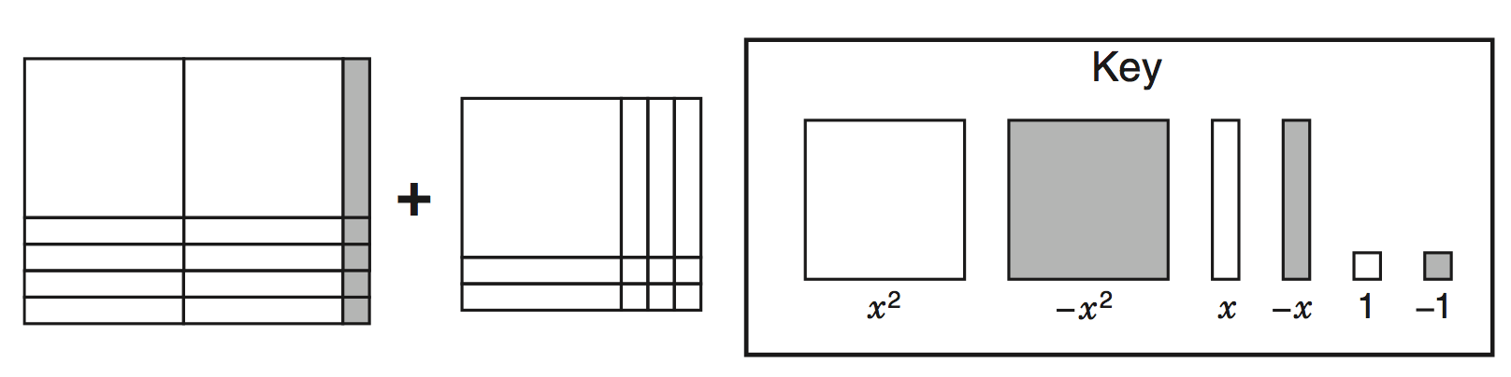
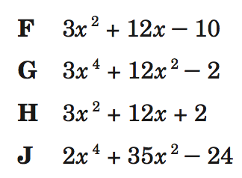
We do – Student 3

Slide 9
We Do

Slide 10
Debrief
Like terms Unlike terms
3x + 5x 2x + 2x²
4x⁴ + 4x⁴ 3x² + 2x³

