Slide 1

A.10(B)
multiply polynomials of degree one and degree two

Slide 2
Fluency Practice
How do you find the area of a rectangle?
What does the word distribute mean?
Underline the like terms. Then simplify the expression
2x³+5y²+9-3y²

Slide 3
Problem Solving Strategies
Intervene’s Problem Solving Strategies:
Step 1: Show what you know
Step 2: Solve and Check
Step 3: Eliminate and Justify

Slide 4
Lesson
Key Vocabulary
Polynomial
Binomial
Trinomial
Like terms
Distribute

Slide 5
F O I L
First Outside Inside Last
( ) ( )

Slide 6
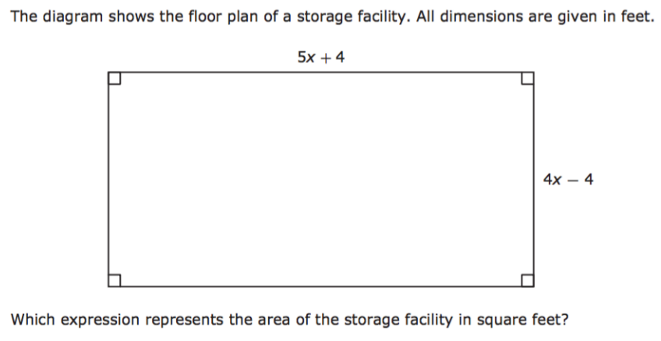
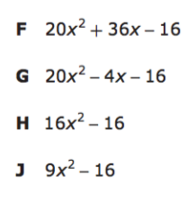
I Do

Slide 7
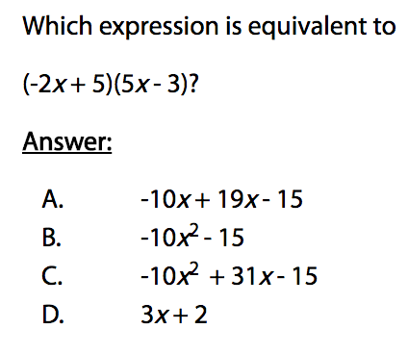
We Do – Student 1

Slide 8
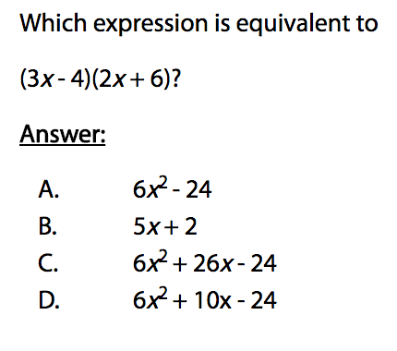
We do - Student 2 [5 minutes]

Slide 9
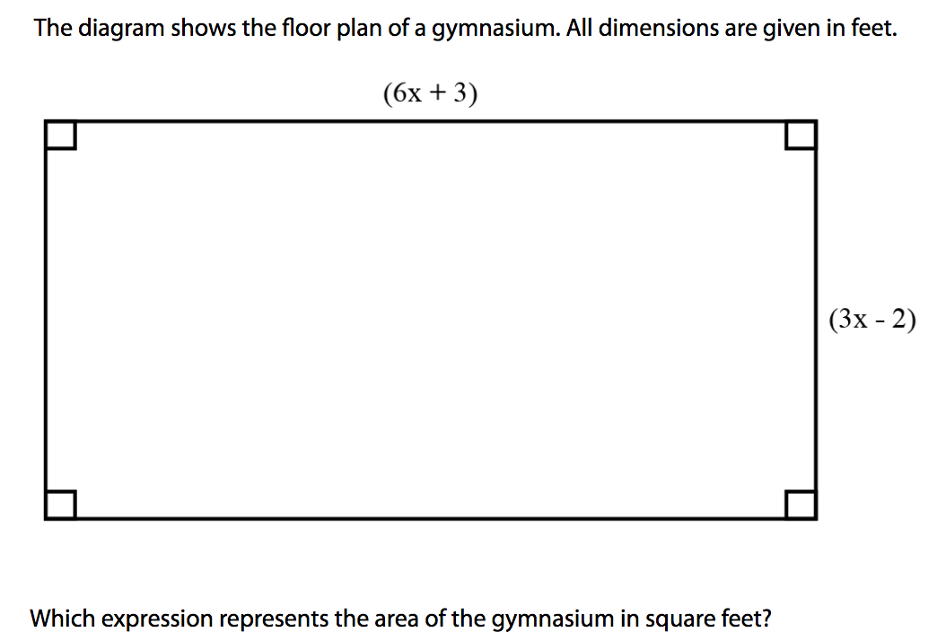
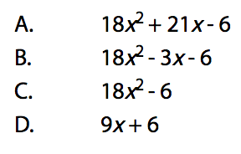
We do - Student 3 [5 minutes]

Slide 10
I Do [5 minutes]

Slide 11
Debrief
F O I L
First Outside Inside Last
( ) ( )

