Slide 1

A.10(D)
rewrite polynomial expressions of degree one and degree two in equivalent forms using the distributive property

Slide 2
Fluency Practice
Distribute -2x(x-5)
Which of the following are like terms? Simplify the expression.
2y³-7y+5y³
Multiply (2x-3)²

Slide 3
Problem Solving Strategies
Intervene’s Problem Solving Strategies:
Step 1: Show what you know
Step 2: Solve and Check
Step 3: Eliminate and Justify

Slide 4
Lesson
Key Vocabulary
Polynomial
Distribute
Like terms
Exponent
Coefficient
Examples of like terms:
.
Examples of unlike terms

Slide 5
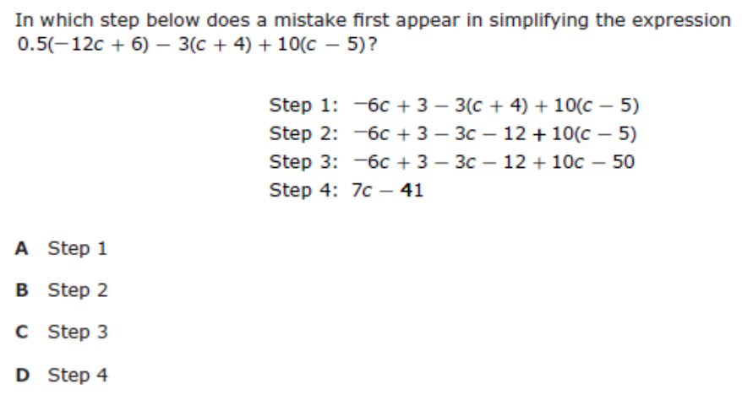
I Do

Slide 6
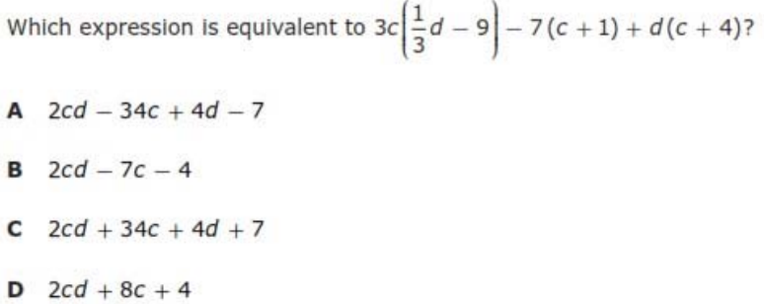
We Do – Student 1

Slide 7
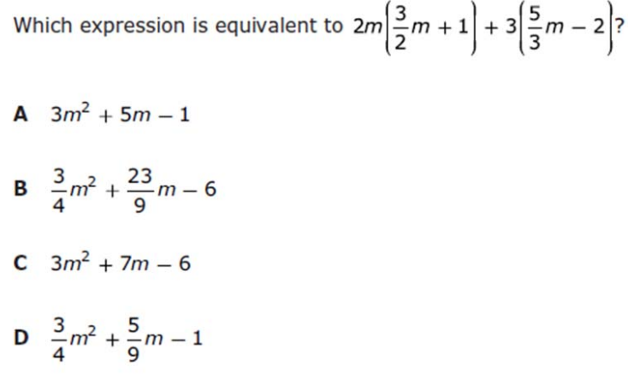
We do - Student 2

Slide 8
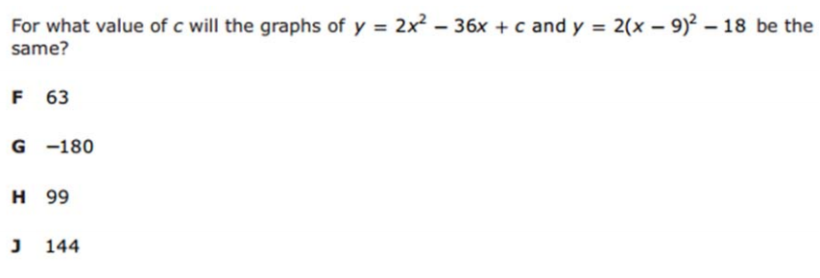
We do - Student 3

Slide 9
We Do

Slide 10
Debrief

Slide 11
Debrief
Like terms Unlike terms
3x + 5x 2x + 2x²
4x⁴ + 4x⁴ 3x² + 2x³

