Slide 1

A.10(E)
factor, if possible, trinomials with real factors in the form
ax² + bx + c,
including perfect square trinomials of degree two

Slide 2
Fluency Practice [5 min]
What numbers multiply to give you 35 but add to give you 12?
Multiply (2x-3)(x+4)?
What is a trinomial?

Slide 3
Problem Solving Strategies
Intervene’s Problem Solving Strategies:
Step 1: Show what you know
Step 2: Solve and Check
Step 3: Eliminate and Justify

Slide 4
Lesson
Key Vocabulary
Quadratic function
Coefficient
Distribute
Standard form
Binomial
Trinomial

Slide 5
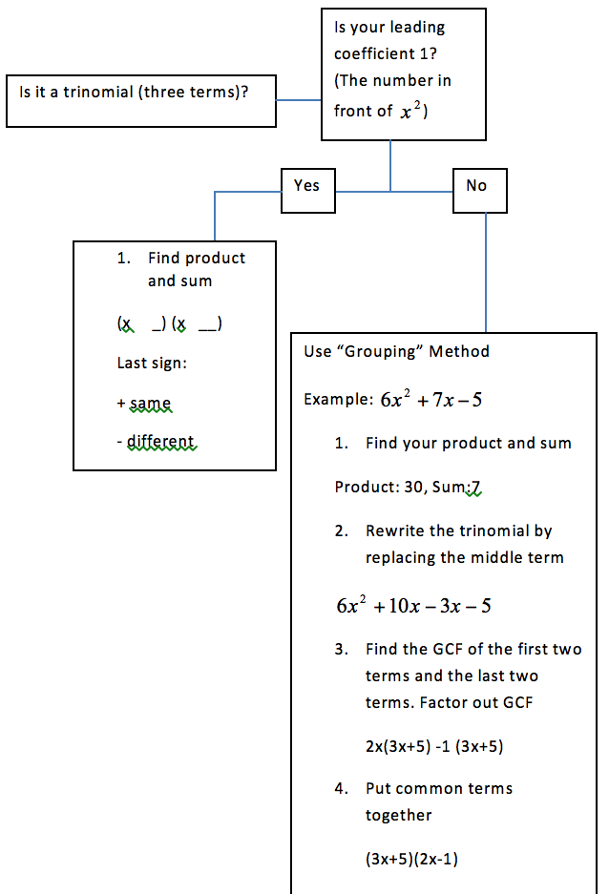

Slide 6
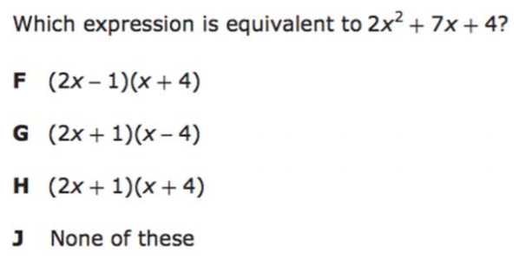
I Do [5 minutes]

Slide 7
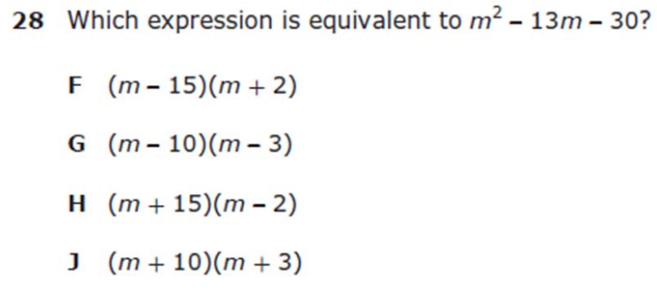
We Do – Student 1 [5 minutes]

Slide 8
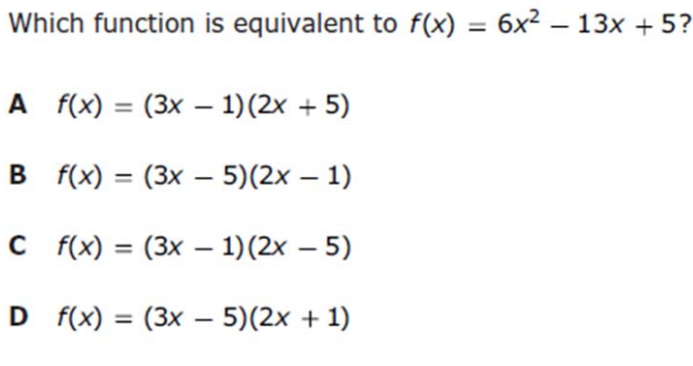
We do - Student 2 [5 minutes]

Slide 9
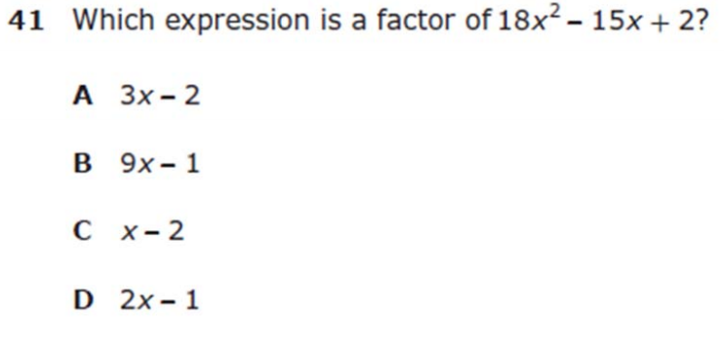
We do - Student 3 [5 minutes]

Slide 10
We Do [5 minutes]

Slide 11
Debrief [2 minutes]

Slide 12
You Do [1 minute to explain]
Instructions for Content Dev:
Nothing to do here
Instructions for Tutor:
Have students click on the Quiz tab above (on their screen)
Instruct students to take the quiz on this objective, and remind to use their problem solving strategies

