Slide 1

A.10(F)
decide if a binomial can be written as the difference of two squares and, if possible, use the structure of a difference of two squares to rewrite the binomial

Slide 2
Fluency Practice
If the area of a square is 16, what would be the measure of each side?
How did you calculate the side above?
What is the square root of the following numbers?
16 25 36 49 64 81 100

Slide 3
Problem Solving Strategies
Intervene’s Problem Solving Strategies:
Step 1: Show what you know
Step 2: Solve and Check
Step 3: Eliminate and Justify

Slide 4
Lesson
Key Vocabulary
Binomial
Square root
Factor
Difference of squares
100x²-9
a=10x b=3
(10x-3)(10x+3)
How to find the difference of squares:
Label a and b as the square root of each term
Plug into formula (a-b)(a+b)
**MUST BE SUBTRACTION

Slide 5



Slide 6
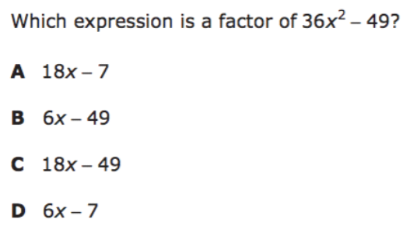
I Do

Slide 7
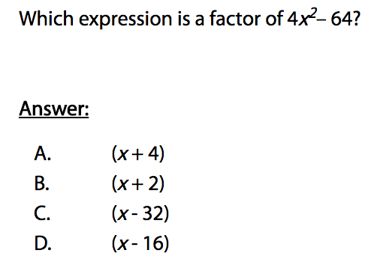
We Do – Student 1

Slide 8
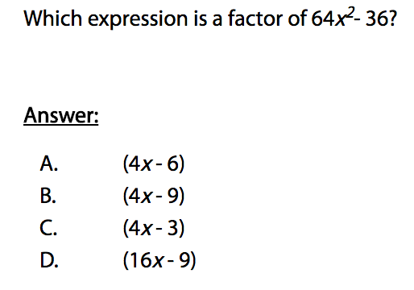
We do - Student 2

Slide 9
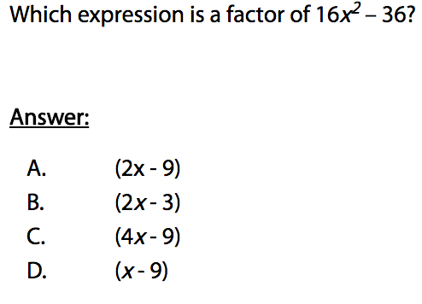
We do - Student 3

Slide 10
We Do

Slide 11
Debrief
In order to use the difference of squares formula:
**MUST BE SUBTRACTION
**MUST BE BINOMIAL
**MUST BE PERFECT SQUARES

