Slide 1

A.11(B)
simplify numeric and algebraic expressions using the laws of
exponents, including integral and rational exponents

Slide 2
Fluency Practice [5 min]
What is the first term in the polynomial after multiplying (x-5)(x+3)?
What is a base? What is an exponent?
What is the formula for area of a rectangle?
What is the formula for volume of a rectangular prism?

Slide 3
Problem Solving Strategies
Intervene’s Problem Solving Strategies:
Step 1: Show what you know
Step 2: Solve and Check
Step 3: Eliminate and Justify

Slide 4
Lesson
Key Vocabulary
Exponent
Coefficient
Base
Exponent Laws
When you multiply→add exponents
When you divide→subtract exponents
When you have a power of a power→multiply exponents
TREAT NUMBERS NORMALLY

Slide 5
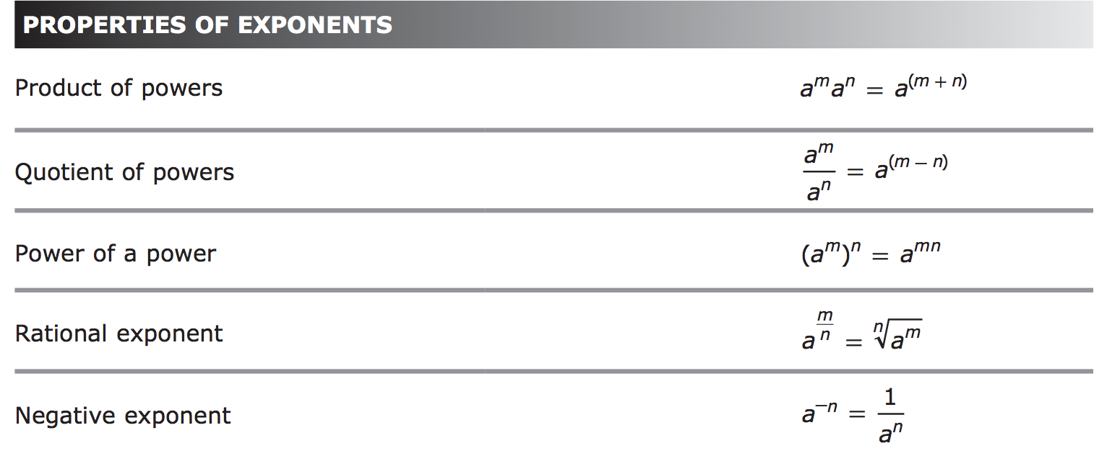

Slide 6
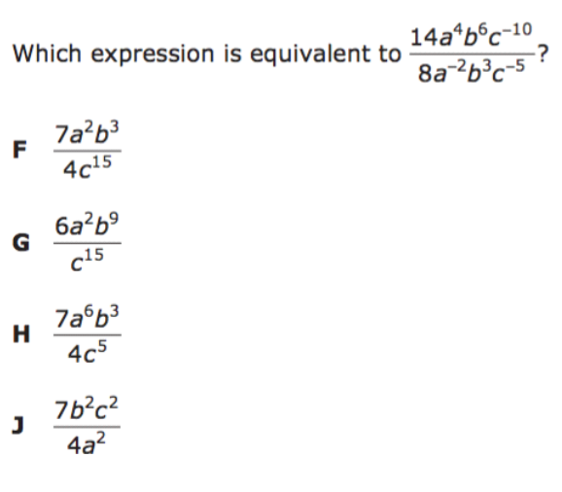
I Do [5 minutes]

Slide 7
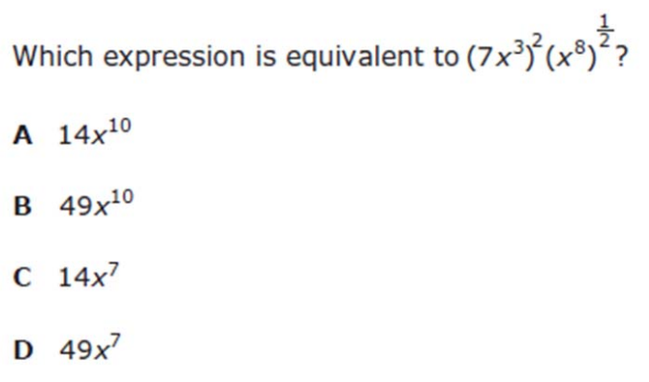
We Do – Student 1 [5 minutes]

Slide 8
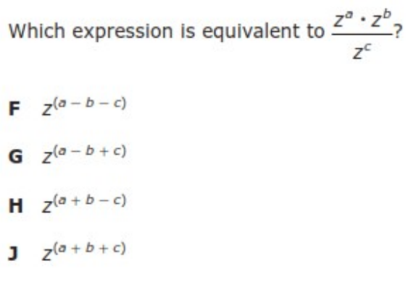
We do - Student 2 [5 minutes]

Slide 9
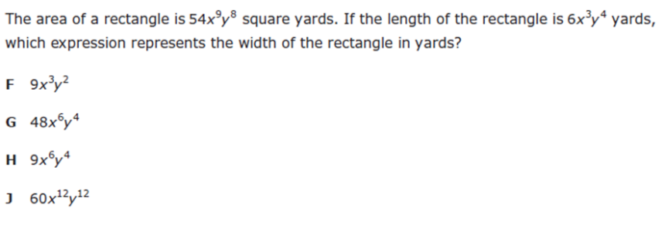
We do - Student 3 [5 minutes]

Slide 10
We Do [5 minutes]

Slide 11
Debrief [2 minutes]

Slide 12
You Do [1 minute to explain]
Instructions for Content Dev:
Nothing to do here
Instructions for Tutor:
Have students click on the Quiz tab above (on their screen)
Instruct students to take the quiz on this objective, and remind to use their problem solving strategies

