Slide 1

A.12(A)
decide whether relations represented verbally, tabularly, graphically, and symbolically define a function

Slide 2
Fluency Practice
x | y
-3 | 6
3 | 2
-5 | -2
9 | -6
What are the x values in the table to the right?
Do any of the values repeat?
What does the term “vertical line” mean?
Which variable is the independent variable? Which is the dependent variable?

Slide 3
Problem Solving Strategies
Intervene’s Problem Solving Strategies:
Step 1: Show what you know
Step 2: Solve and Check
Step 3: Eliminate and Justify

Slide 4
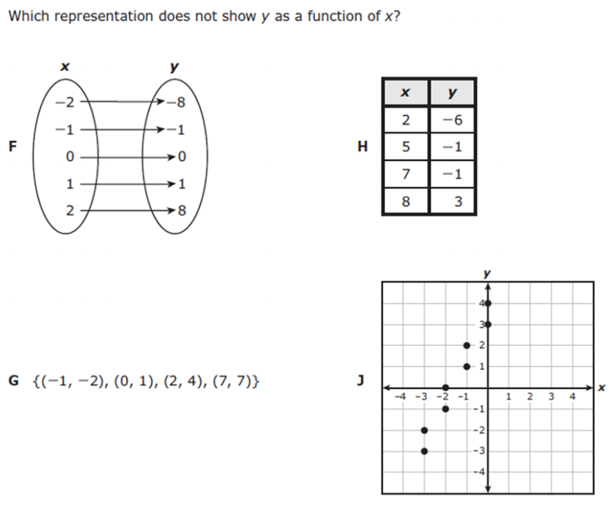
Lesson
Key Vocabulary Types of Relations
Function
Relation
Domain
Range
Vertical line test

Slide 5
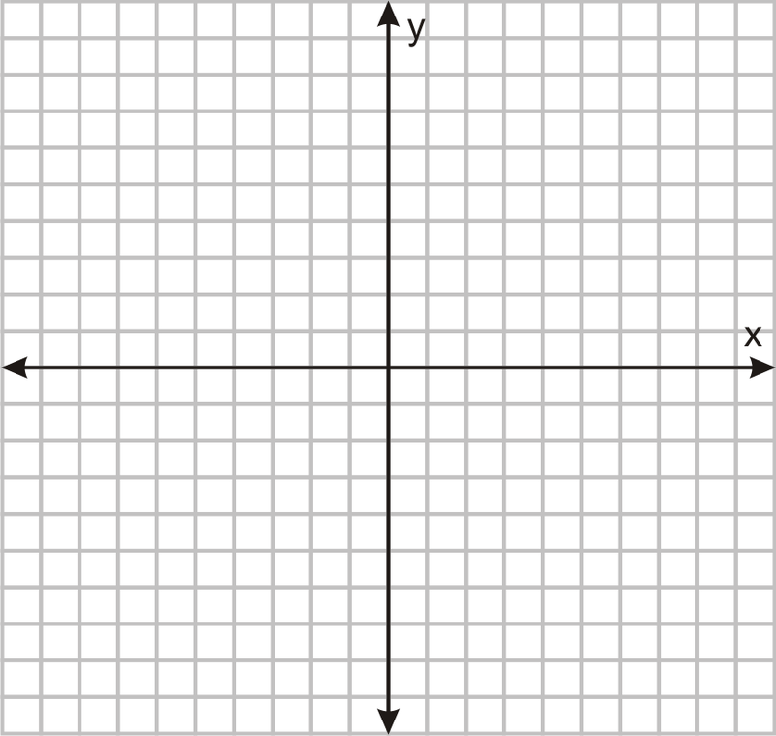

Slide 6
I Do

Slide 7
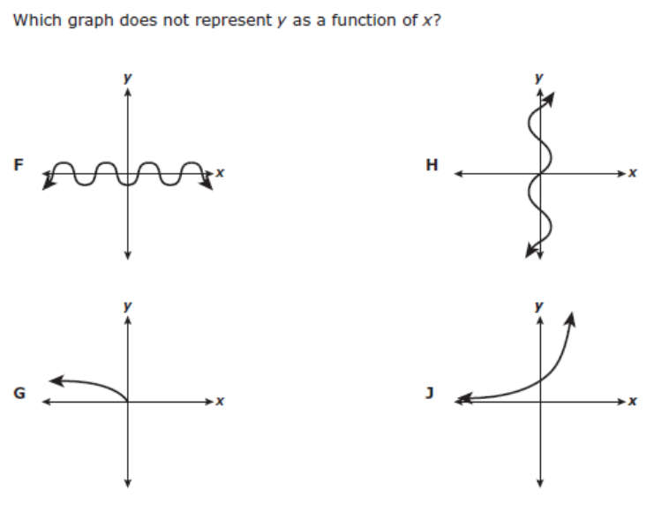
We Do – Student 1

Slide 8
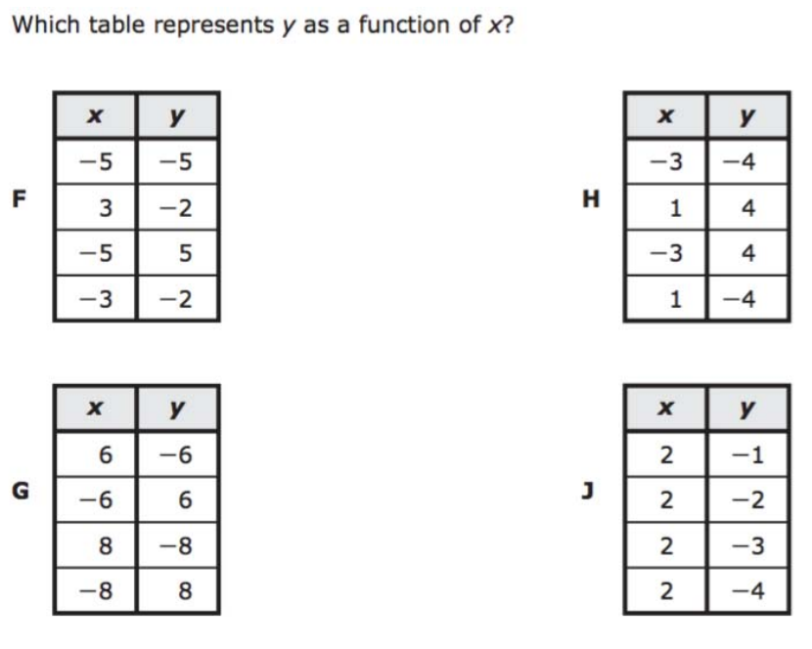
We do - Student 2

Slide 9
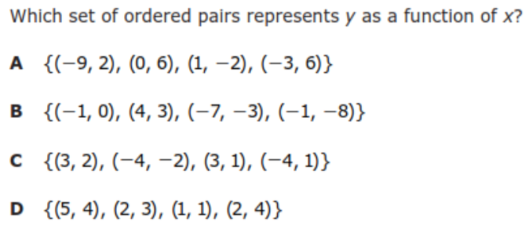
We do - Student 3

Slide 10
We Do

Slide 11
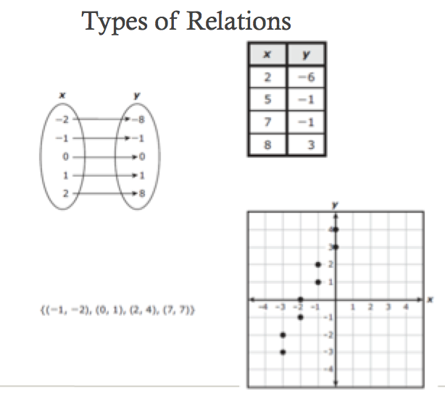
Debrief
Function—X values
do NOT repeat

