Slide 1

A.12(B)
evaluate functions, expressed in function notation, given one or more elements in their domains

Slide 2
Fluency Practice
x | f(x)
-3 | 6
1 | 2
5 | -2
9 | -6
What is the domain of the table to the right?
What is the range of the table to the right?
If your x value is 5, what is the corresponding y value in the table?
Simplify 2(3-5)²+7

Slide 3
Problem Solving Strategies
Intervene’s Problem Solving Strategies:
Step 1: Show what you know
Step 2: Solve and Check
Step 3: Eliminate and Justify

Slide 4
Lesson
Key Vocabulary
Function
Equation
Domain
Range
Function notation

Slide 5
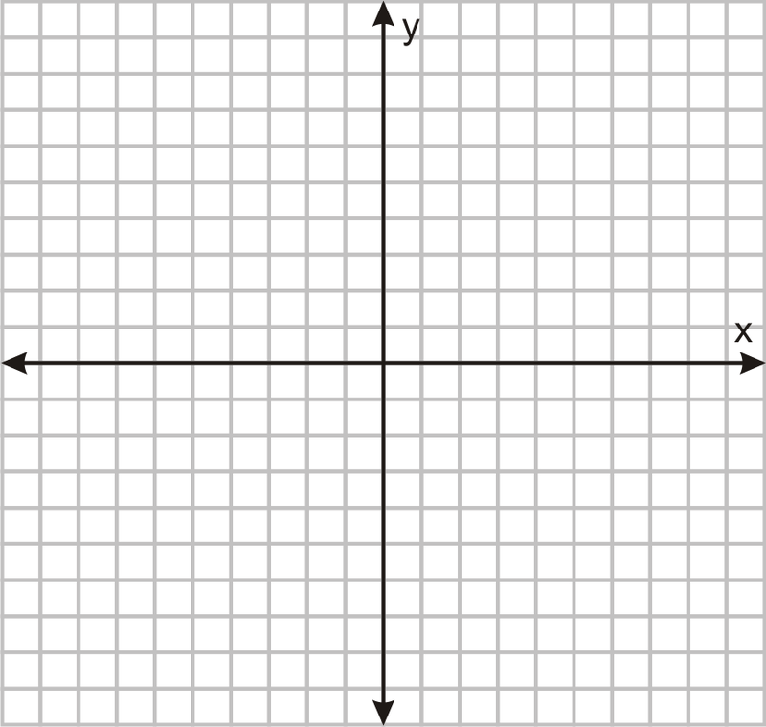
PEMDAS

Slide 6
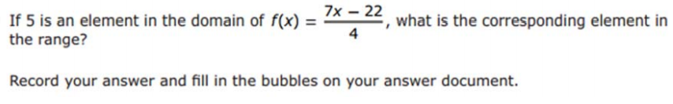
I Do

Slide 7
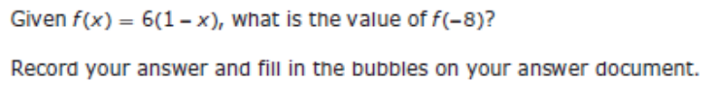
We Do – Student 1

Slide 8
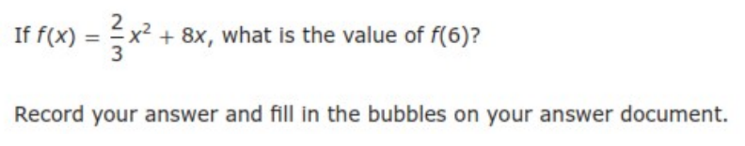
We do - Student 2

Slide 9
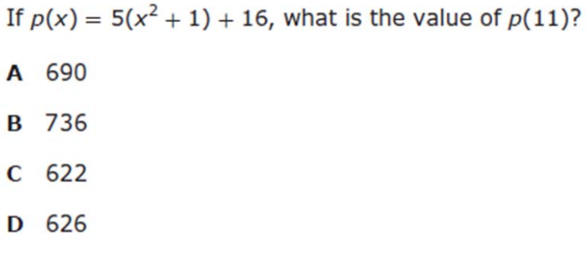
We do - Student 3

Slide 10
We Do

Slide 11
Debrief
Domain-x values
Range- y-values
PEMDAS

