Slide 1

A.12(D)
write a formula for the nth term of arithmetic and geometric sequences, given the value of several of their terms

Slide 2
Fluency Practice
Fill in the table to the right with the corresponding y values for the following equation: y=4x-3
Continue the pattern by listing the next 3 terms:
-5, -3, -1, 1, 3, …
Is the table to the left a linear or quadratic function?
How do you know?
x | y
0
1
2
3
x | y
0 | 1
1 | 2
2 | 5
3 | 10

Slide 3
Problem Solving Strategies
Intervene’s Problem Solving Strategies:
Step 1: Show what you know
Step 2: Solve and Check
Step 3: Eliminate and Justify

Slide 4
Lesson
Key Vocabulary
Linear function
Quadratic function
n^{th} term
Sequence

Slide 5
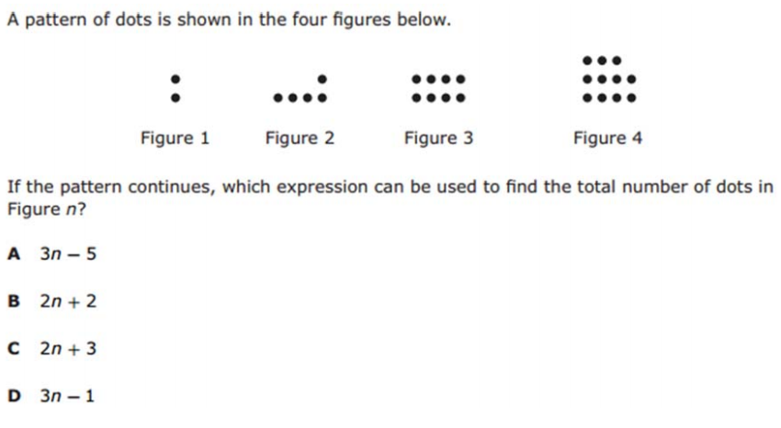
I Do

Slide 6
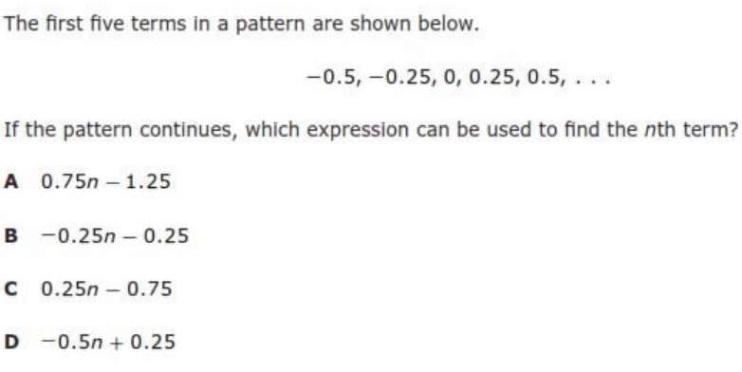
We Do – Student 1

Slide 7
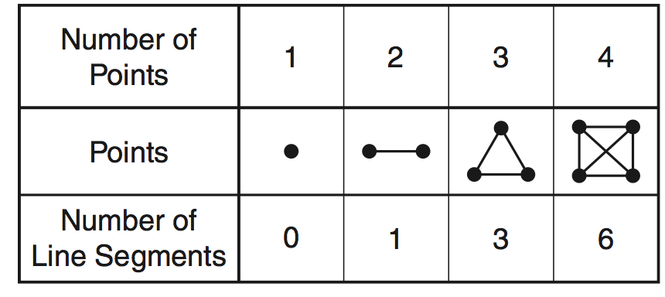
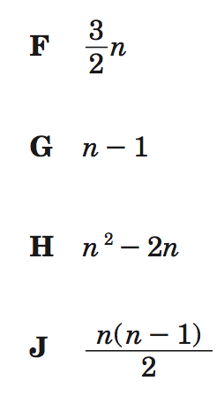
We do - Student 2

Slide 8
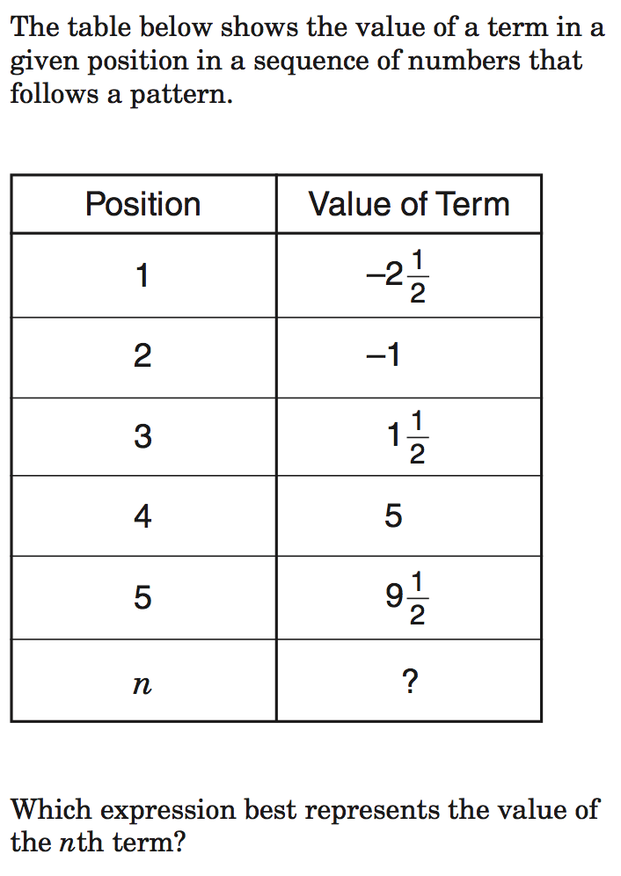
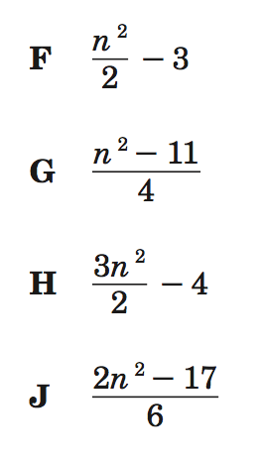
We do - Student 3

Slide 9
We Do

Slide 10
Debrief
Arithmetic Sequence—linear function
Geometric Sequence—quadratic function

