Slide 1

A.12(E)
solve mathematic and scientific formulas, and other literal equations, for a specified variable

Slide 2
Fluency Practice
Solve the following equation:
2 3 x-5=13
What does PEMDAS stand for?
Why would it be helpful to be able to rearrange a formula for a specific letter?
For example: Why would you want the area of a rectangle formula (A=l*w) to be solved for l instead?

Slide 3
Problem Solving Strategies
Intervene’s Problem Solving Strategies:
Step 1: Show what you know
Step 2: Solve and Check
Step 3: Eliminate and Justify

Slide 4
Lesson
Solving for a specific variable works the
Same way as solving an equation.
Solve for x:
Key Vocabulary
Linear function
Variable
Coefficient
2 3 x-5=13
+5 +5
2
3 x =18
*3 *3
2x= 52
2 2
x=26
2 3 x-y=13
+y +y
2
3 x= 13+y
*3 *3
2x=3(13+y)
2 2
x= 3(13+y)
2

Slide 5
Balance the equation

Slide 6
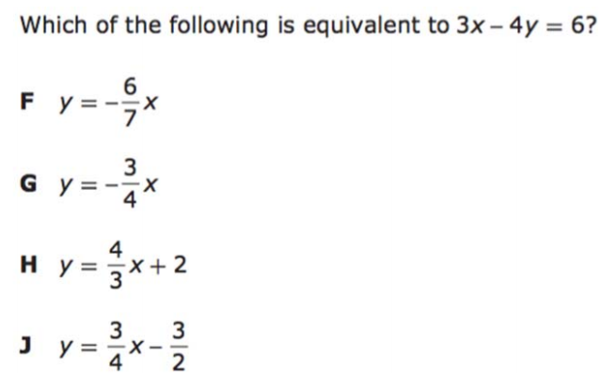
I Do

Slide 7
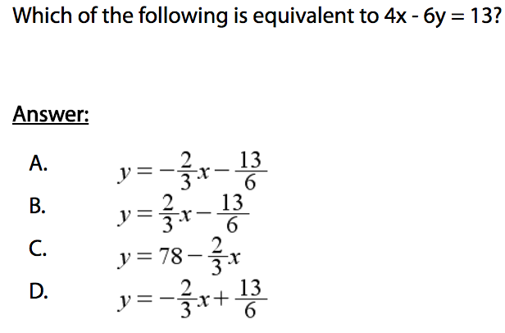
We Do – Student 1

Slide 8
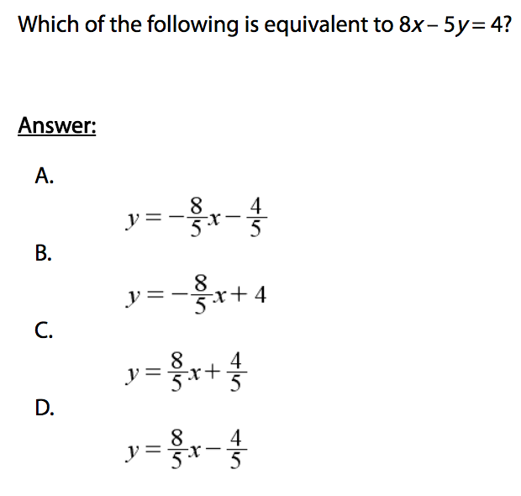
We do - Student 2

Slide 9
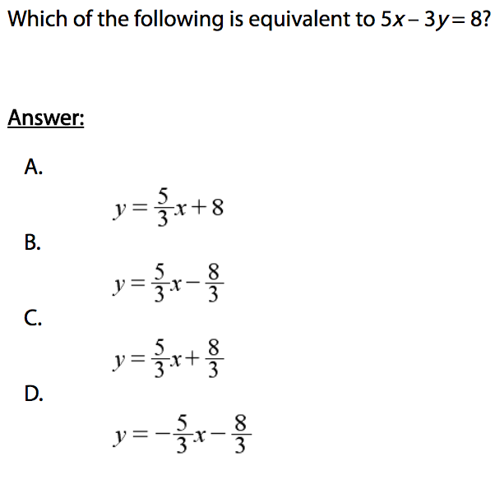
We do - Student 3

Slide 10
We Do

Slide 11
Debrief
Balance the equation

