Slide 1

A.2(A)
determine the domain and range of a linear function in
mathematical problems; determine reasonable domain and range values for real-world situations, both continuous and discrete; and represent domain and range using inequalities

Slide 2
Fluency Practice [5 min]
x | y
-3 | 6
1 | 2
5 | -2
9 | -6
What are the x values in the table to the right?
If your x value is 5, what is the y value for the equation y=4x-3
Which variable is the independent variable? Which is the dependent variable?
What do the following symbols mean:
< < > >

Slide 3
Problem Solving Strategies
Intervene’s Problem Solving Strategies:
Step 1: Show what you know
Step 2: Solve and Check
Step 3: Eliminate and Justify

Slide 4
Lesson
Key Vocabulary
Linear function
Domain
Range
Inequality

Slide 5
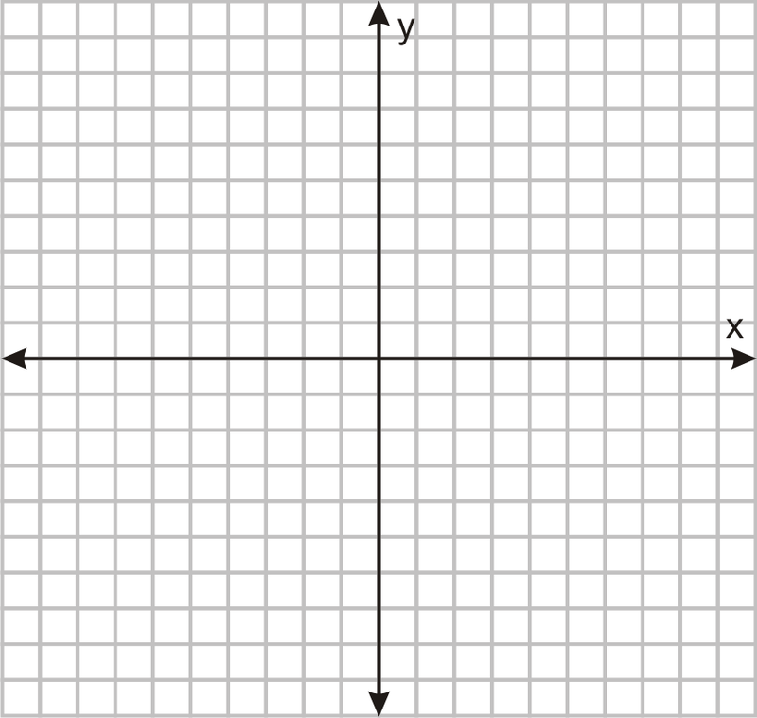

Slide 6
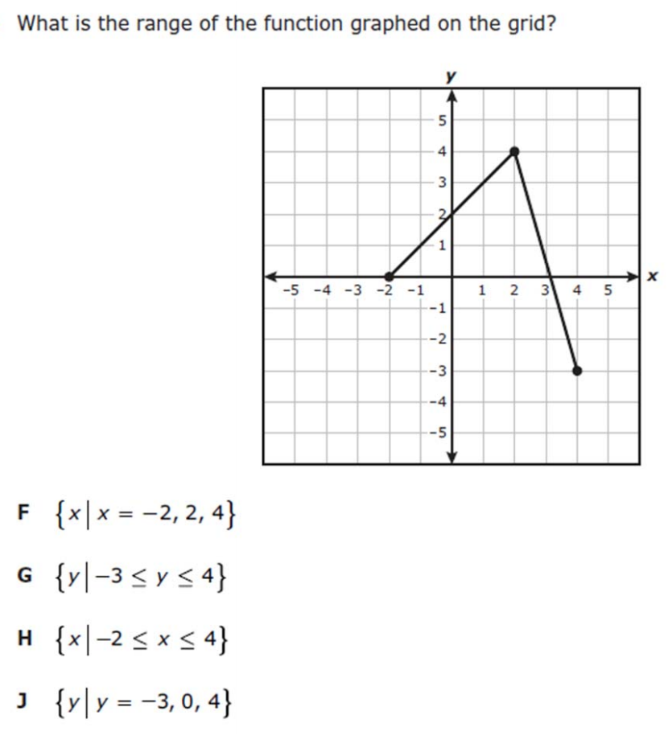
I Do [5 minutes]

Slide 7
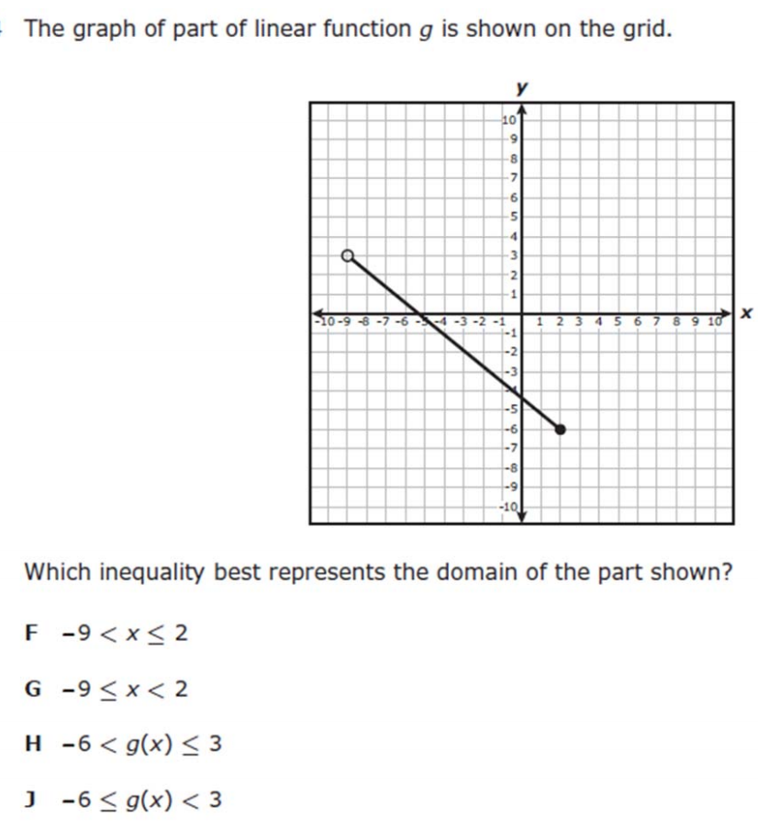
We Do – Student 1 [5 minutes]

Slide 8
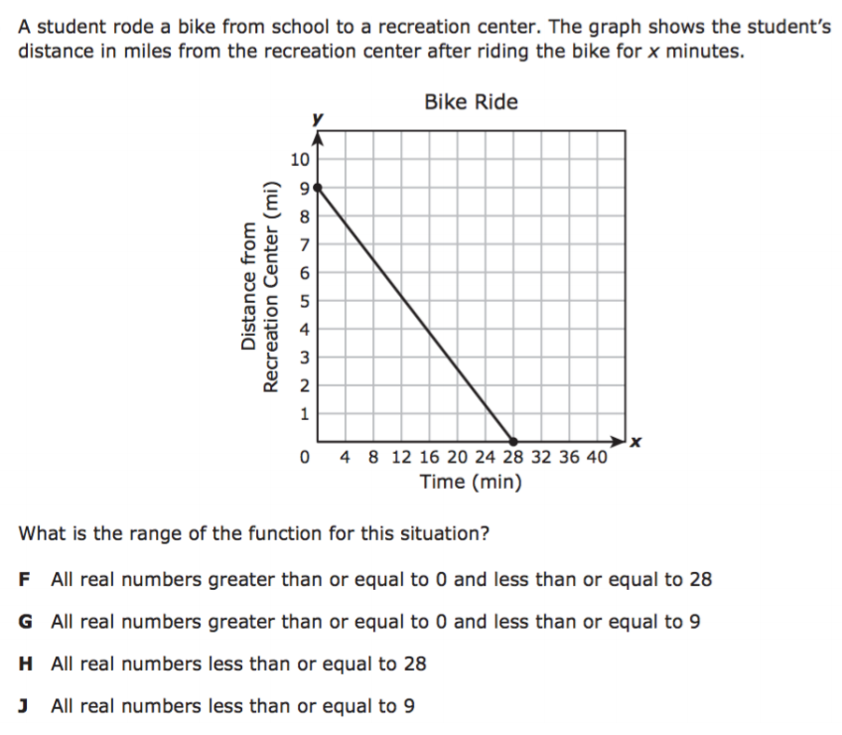
We do - Student 2 [5 minutes]

Slide 9
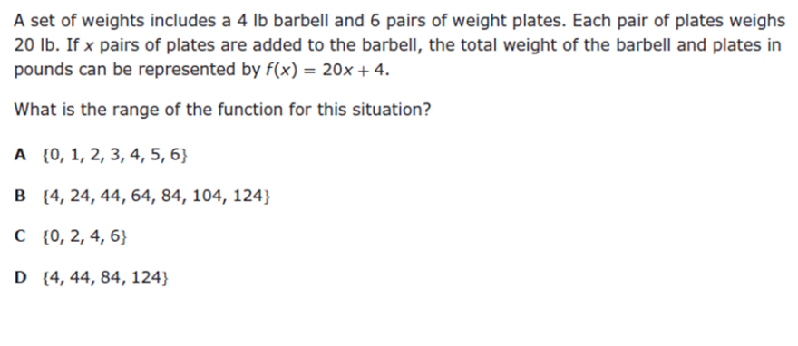
We do - Student 3 [5 minutes]

Slide 10
We Do [5 minutes]

Slide 11
Debrief [2 minutes]
Domain-x values
Range- y-values
< open circle
< closed circle

Slide 12
You Do [1 minute to explain]
Instructions for Content Dev:
Nothing to do here
Instructions for Tutor:
Have students click on the Quiz tab above (on their screen)
Instruct students to take the quiz on this objective, and remind to use their problem solving strategies

