Slide 1

A.2(B)
write linear equations in two variables in various forms, including y = mx + b, Ax + By = C, and y – y₁ = m(x – x₁), given one point and the slope and given two points

Slide 2
Fluency Practice
x | y
-3 | 6
1 | 2
5 | -2
9 | -6
Find the slope in the table to the right?
Explain how to find the slope from a graph.
Distribute: -5(x-3)

Slide 3
Problem Solving Strategies
Intervene’s Problem Solving Strategies:
Step 1: Show what you know
Step 2: Solve and Check
Step 3: Eliminate and Justify

Slide 4
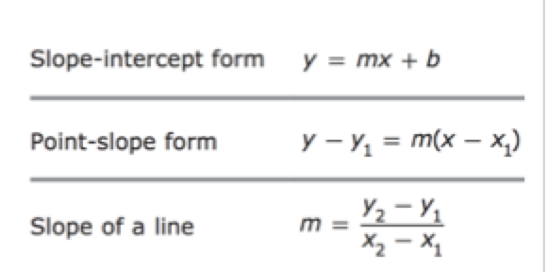
Lesson
Key Vocabulary
Linear function
Slope
Y-intercept
Slope-intercept form
Point slope form

Slide 5
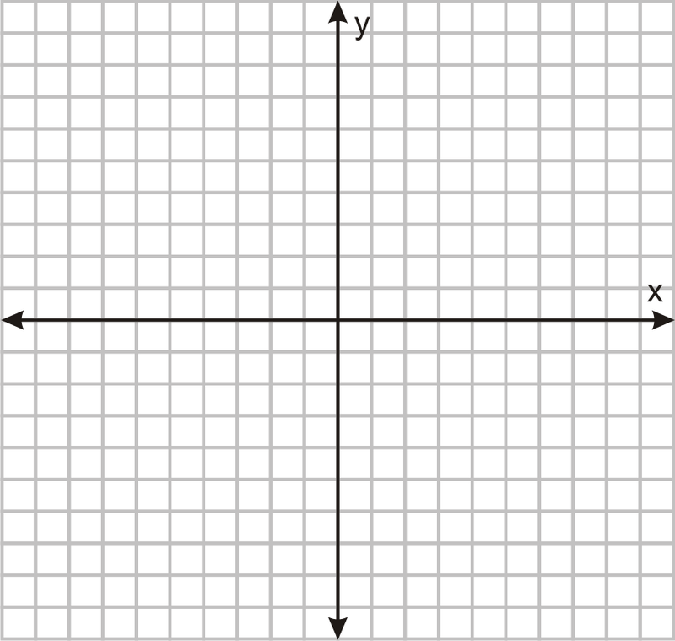

Slide 6
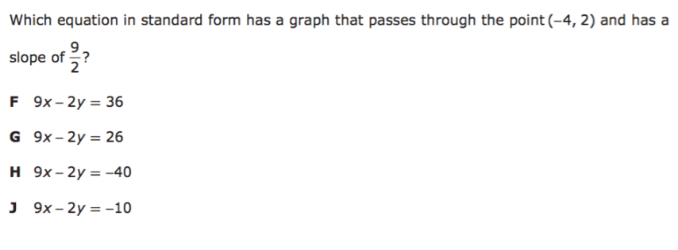
I Do

Slide 7
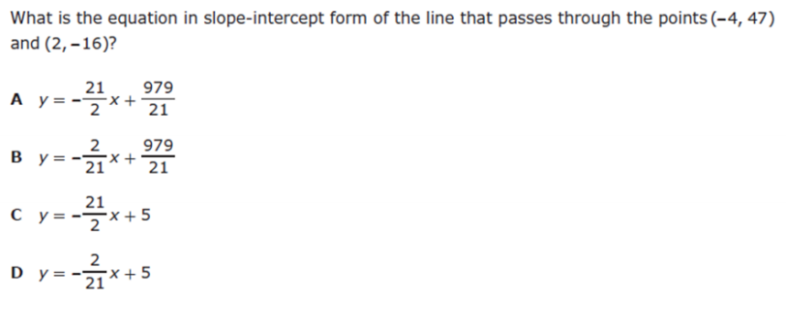
We Do – Student 1

Slide 8
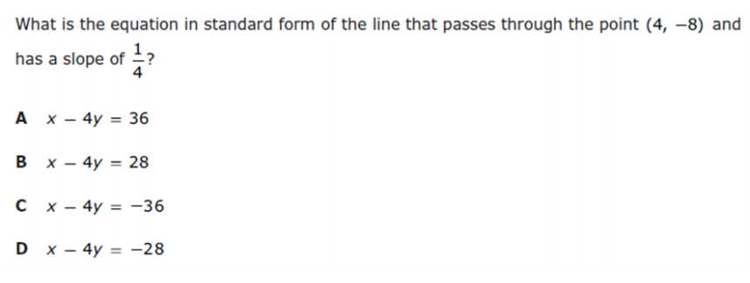
We do - Student 2

Slide 9
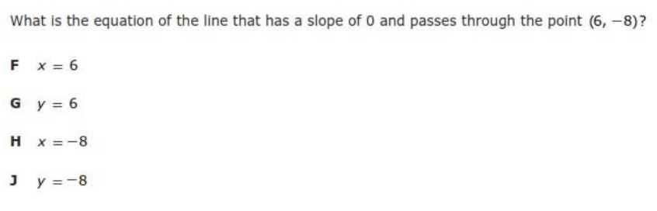
We do - Student 3

Slide 10
We Do

Slide 11
Debrief

