Slide 1

A.2(C)
Write linear equations in two variables given a table of values, a graph, and a verbal description.

Slide 2
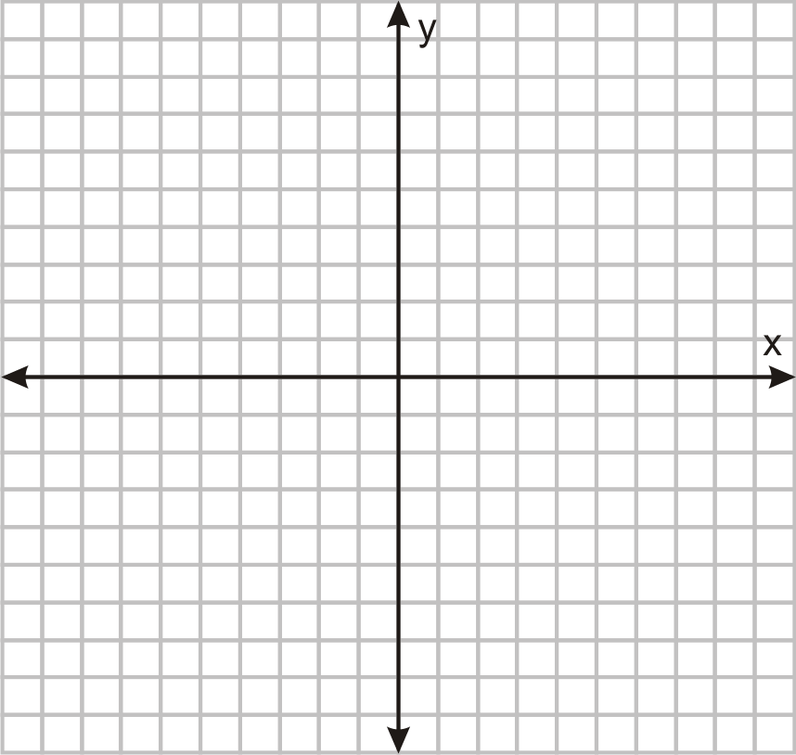
Fluency Practice [5 min]
Identify the slope and y-intercept from this graph?
How do you find slope from a table?
What does f(x) mean? Is h(x) or g(x) different from f(x)?
What key words help you to identify the slope in a word problem?

Slide 3
Problem Solving Strategies
Intervene’s Problem Solving Strategies:
Step 1: Show what you know
Step 2: Solve and Check
Step 3: Eliminate and Justify

Slide 4
Lesson
Key Vocabulary
Linear function
Slope
Y-intercept
Point slope form
Slope-intercept form
Standard form
Steps to writing equation
Identify slope
Identify point (preferably y-intercept, if given)
Plug into appropriate formula
Words that represent slope:
Every
Each (sometimes)
Per
Rate

Slide 6
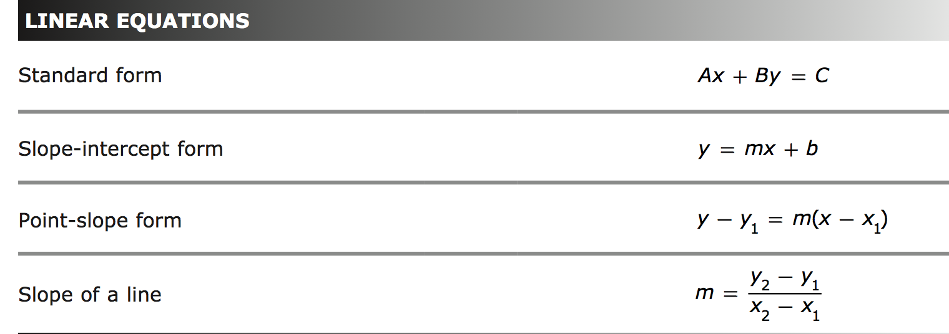

Slide 7
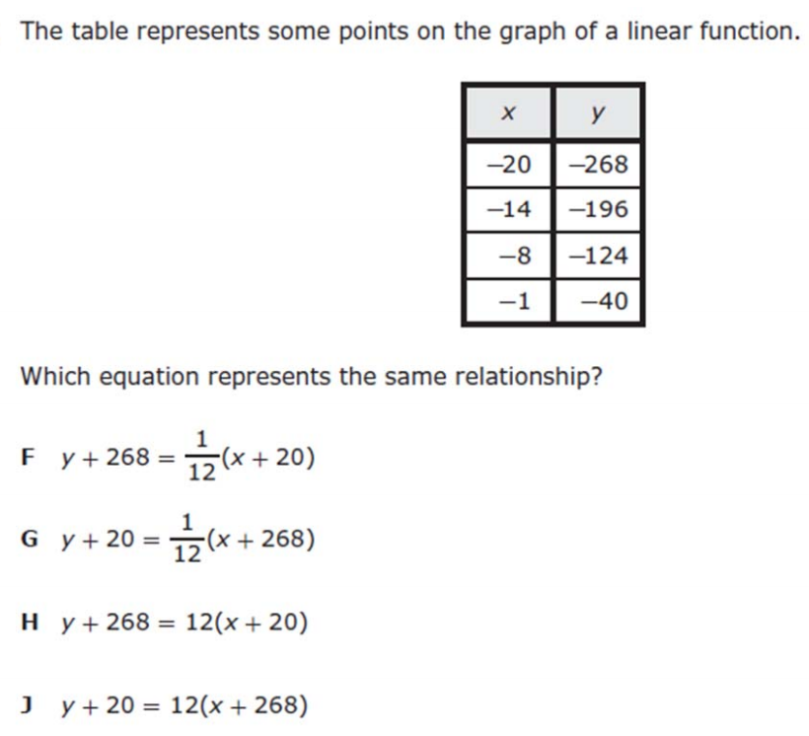
I Do [5 minutes]

Slide 8
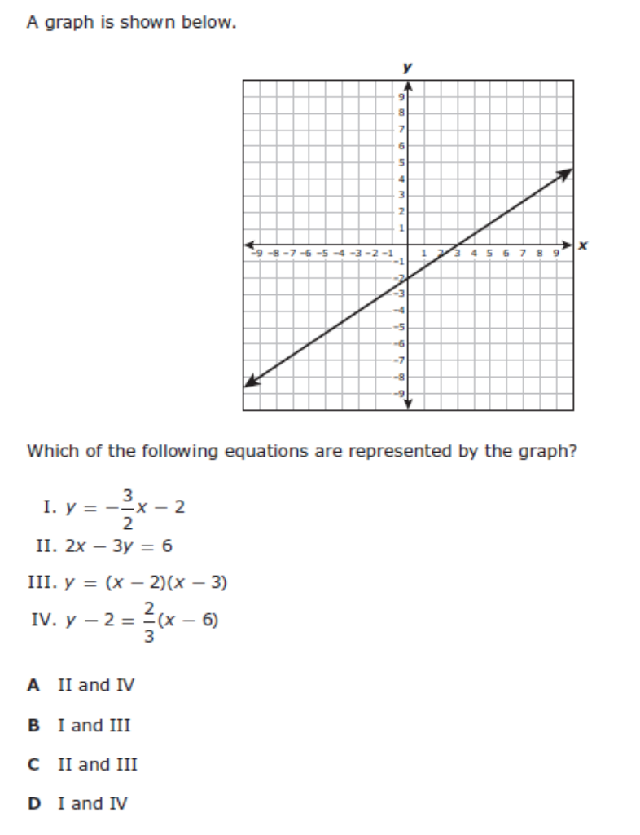
We Do – Student 1 [5 minutes]

Slide 9
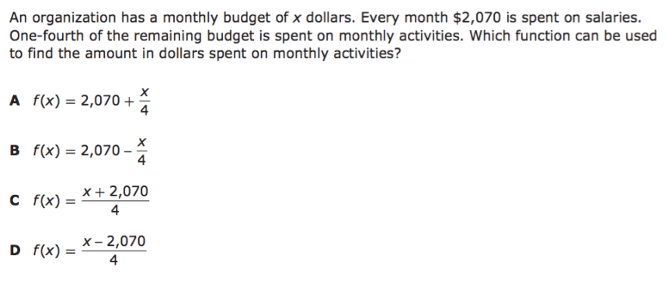
We do - Student 2 [5 minutes]

Slide 10
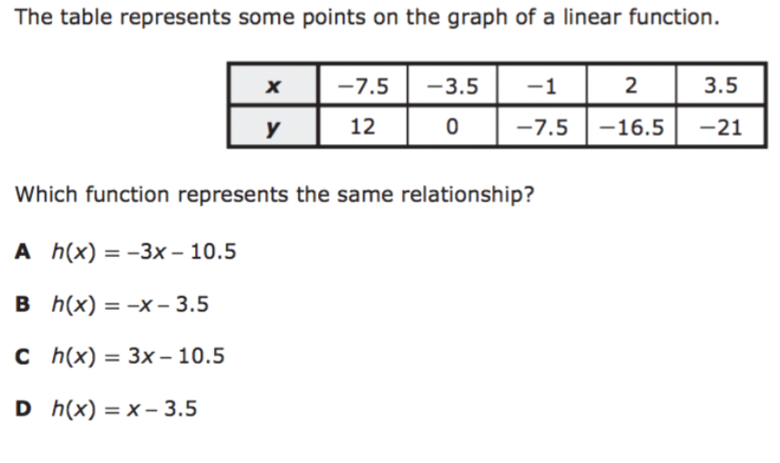
We do - Student 3 [5 minutes]

Slide 11
We Do [5 minutes]

Slide 12
Debrief [2 minutes]
Identify the slope and a point
Plug in one of the formulas
Rewrite into correct form

Slide 13
You Do [1 minute to explain]
Instructions for Content Dev:
Nothing to do here
Instructions for Tutor:
Have students click on the Quiz tab above (on their screen)
Instruct students to take the quiz on this objective, and remind to use their problem solving strategies

