Slide 1

A.2(D)
write and solve equations involving direct variation

Slide 2
Fluency Practice
x | y
-3 | 6
1 | 2
5 | -2
9 | -6
Do the points in table to the right make a linear function? How can you tell?
If your x value is 5, what is the y value for the equation y=4x
Solve the proportion: 2 10
x 20

Slide 3
Problem Solving Strategies
Intervene’s Problem Solving Strategies:
Step 1: Show what you know
Step 2: Solve and Check
Step 3: Eliminate and Justify

Slide 4
Lesson
Key Vocabulary
Linear function
Slope
Direct variation
Proportion
Constant of variation
Direct variation
y=kx
constant of
variation
**Cannot have a y-intercept

Slide 5
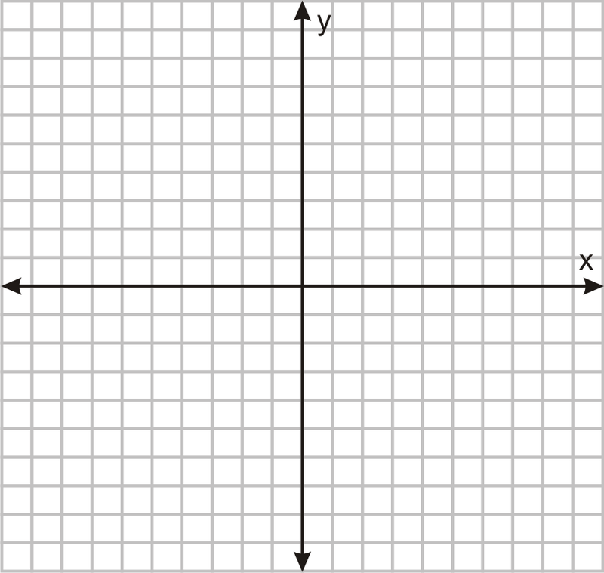

Slide 6
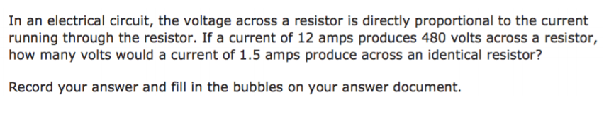
I Do

Slide 7
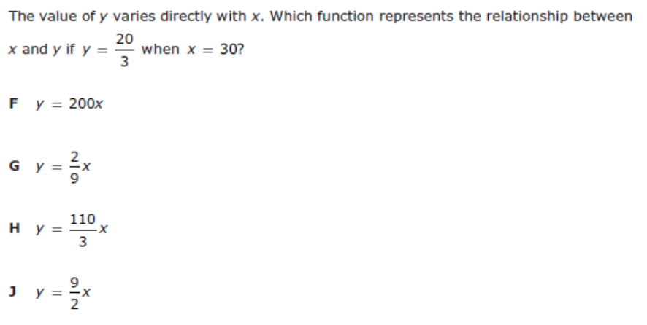
We Do – Student 1

Slide 8
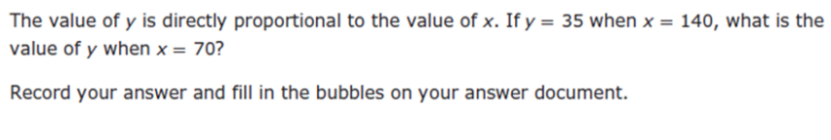
We do - Student 2

Slide 9
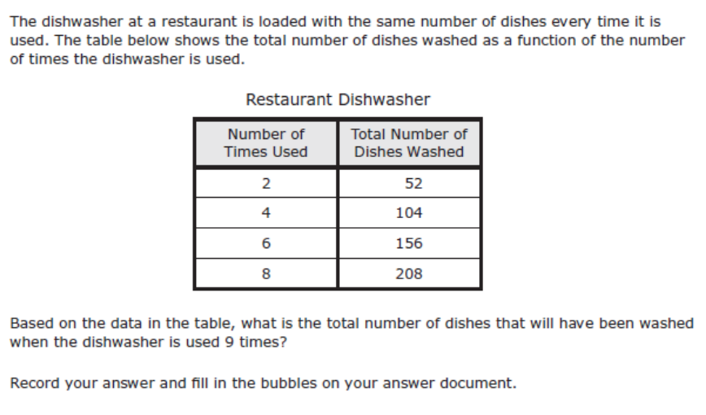
We do - Student 3

Slide 10
We Do

Slide 11
Debrief
Direct variation
y=kx
constant of
variation
**Cannot have a y-intercept

