Slide 1

A.2(E)
write the equation of a line that contains a given point and is parallel to a given line

Slide 2
Fluency Practice
x | y
-3 | 6
1 | 2
5 | -2
9 | -6
Find the slope of the table to the right.
Explain how you find slope from a graph.
Draw a pair of parallel lines.
Write the equation of a line with a slope of 2/3 and going through the point (5,-6)

Slide 3
Problem Solving Strategies
Intervene’s Problem Solving Strategies:
Step 1: Show what you know
Step 2: Solve and Check
Step 3: Eliminate and Justify

Slide 4
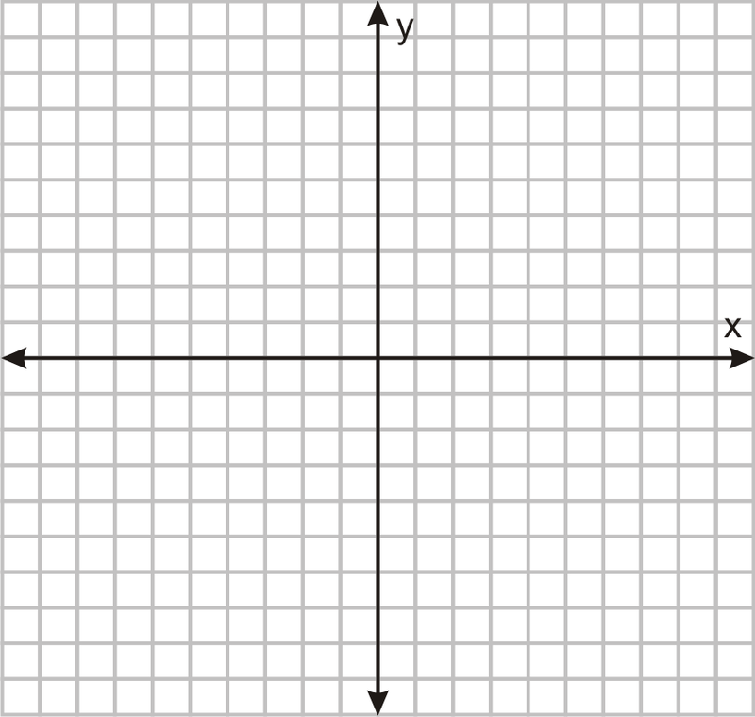
Lesson
Key Vocabulary
Linear function
Parallel
Slope
Slope-Intercept form
Point slope form
Parallel lines have the SAME slope.

Slide 5
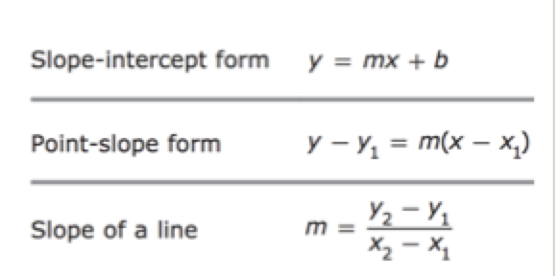

Slide 6

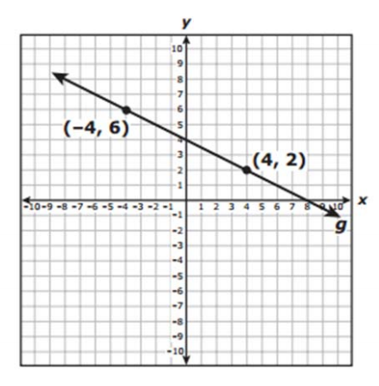
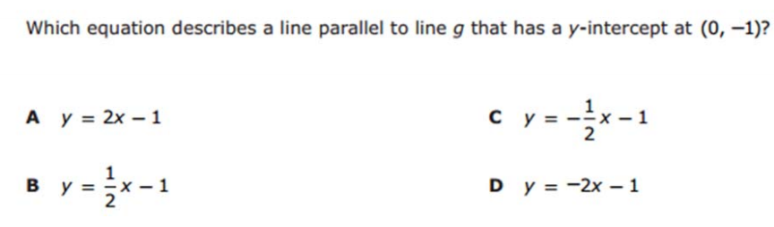
I Do

Slide 7

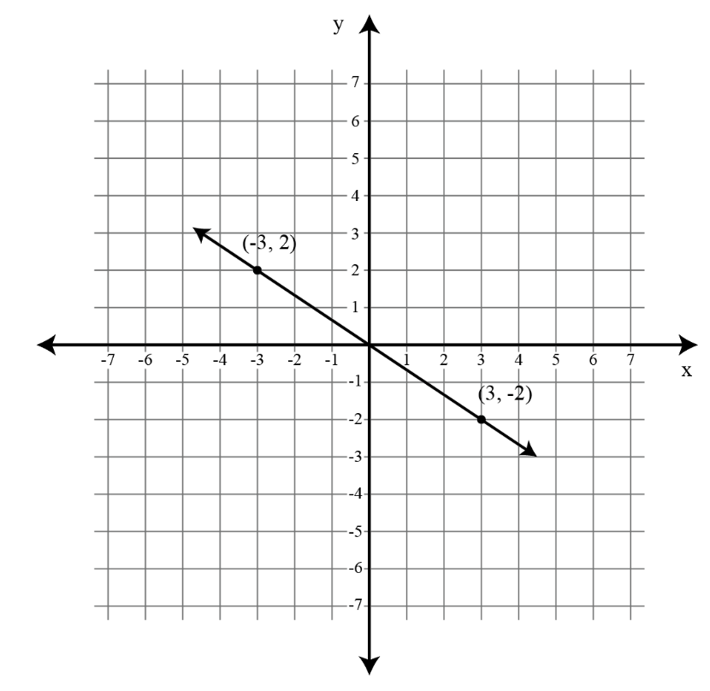
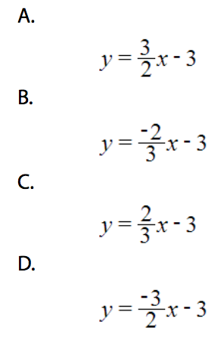
We Do – Student 1

Slide 8

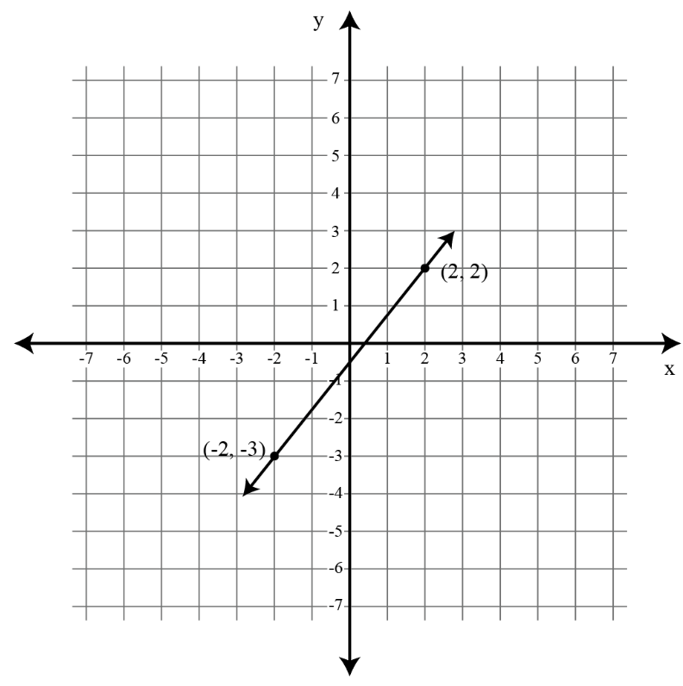
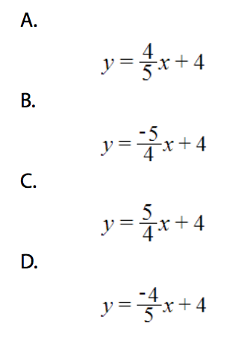
We do - Student 2

Slide 9

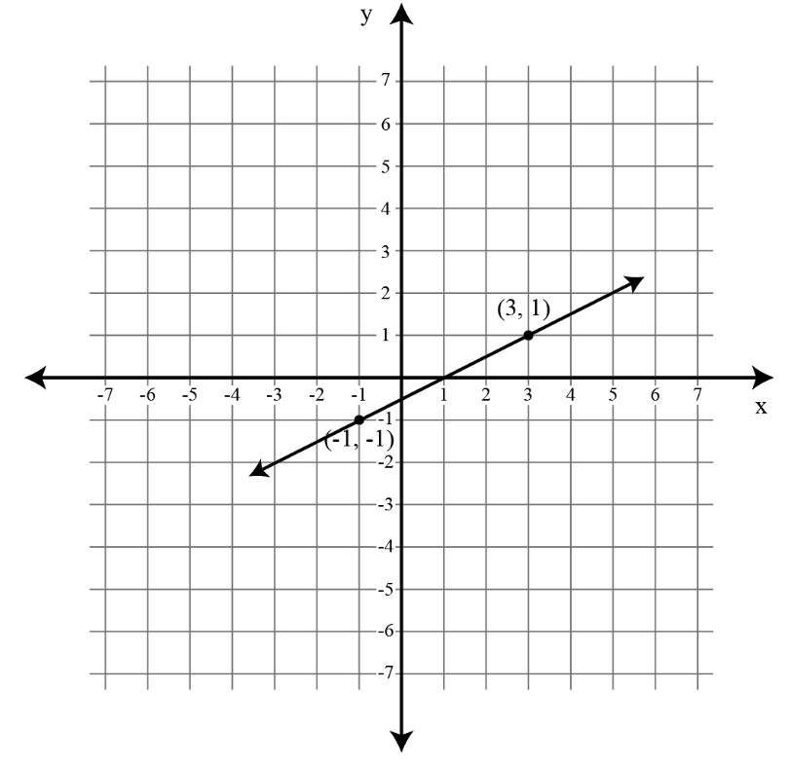


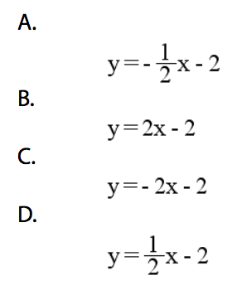
We do - Student 3

Slide 10
We Do

Slide 11
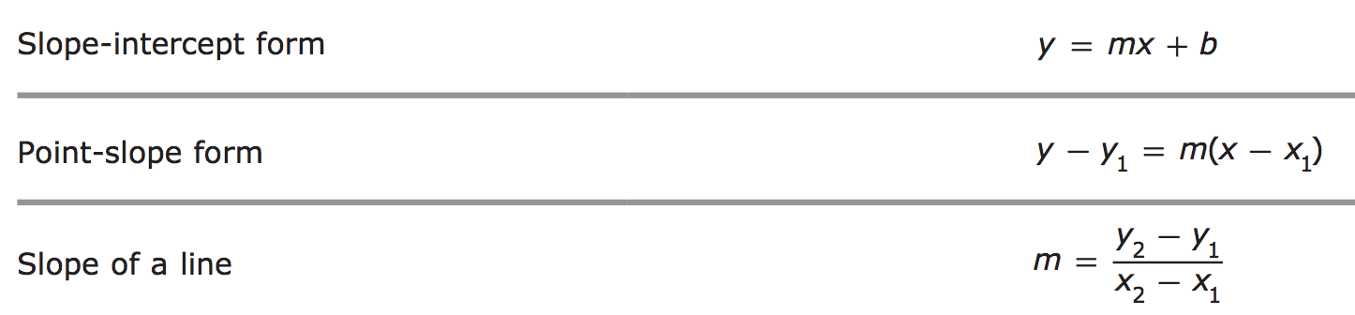
Debrief
Parallel lines have
the SAME slope

