Slide 1

A.2(H)
write linear inequalities in two variables given a table of values, a graph, and a verbal description

Slide 2
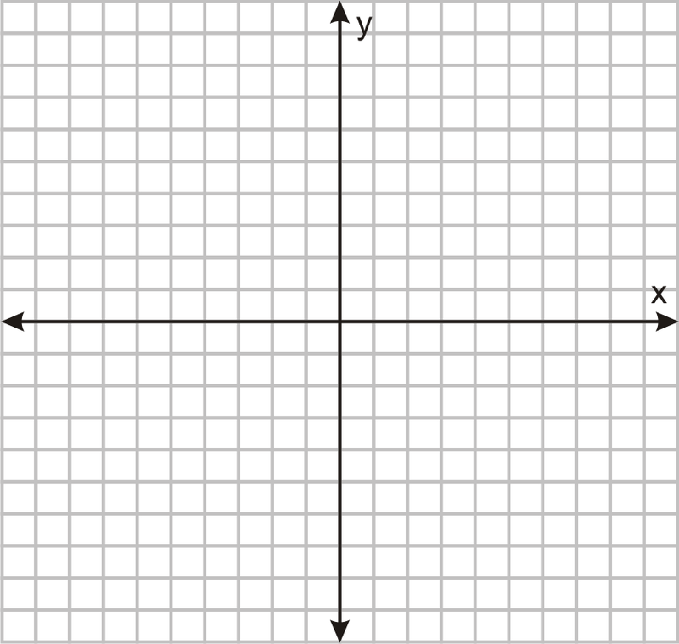
Fluency Practice
Graph the line 5 y= 3 x-4
What does the word “at least” mean? For example: You must have at least a grade of 70 to pass this course.
What do the following symbols mean:
< < > >

Slide 3
Problem Solving Strategies
Intervene’s Problem Solving Strategies:
Step 1: Show what you know
Step 2: Solve and Check
Step 3: Eliminate and Justify

Slide 4
Lesson
Key Vocabulary
Linear function
Inequality
Inequality Name | Inequality symbol | Type of line | Shaded area
Less than | < | Dashed | Below
Less than or equal to | < | Solid | Below
Greater than | > | Dashed | Above
Greater than or equal to | > | Solid | Above

Slide 6
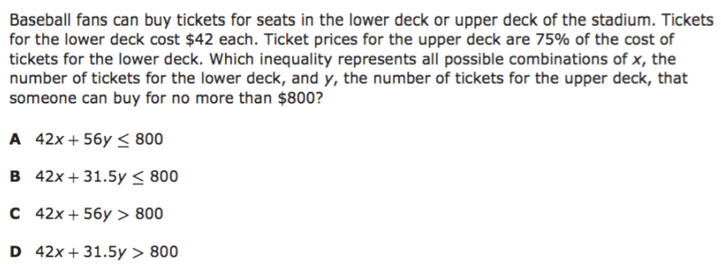
I Do

Slide 7
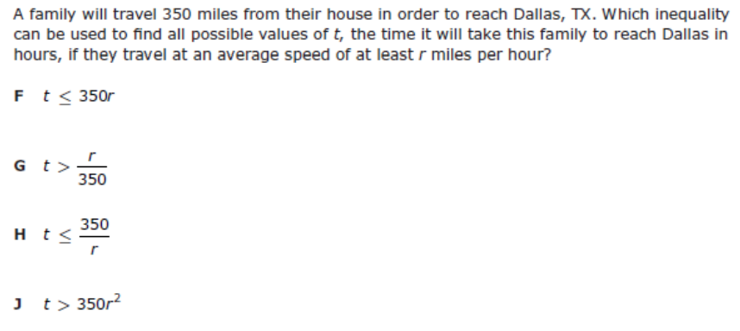
We Do – Student 1

Slide 8
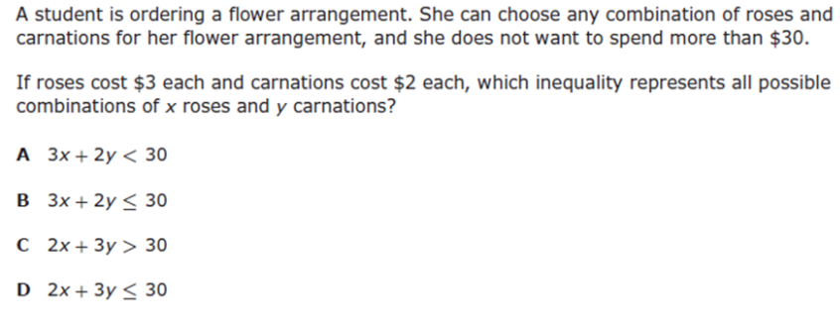
We do - Student 2

Slide 9
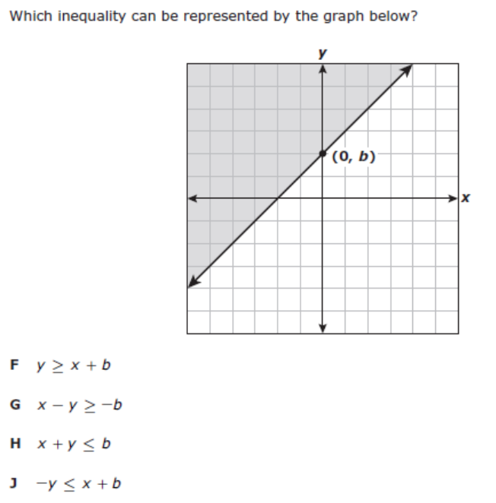
We do - Student 3

Slide 10
We Do

Slide 11
Debrief
Inequality Name | Inequality symbol | Type of line | Shaded area
Less than | < | Dashed | Below
Less than or equal to | < | Solid | Below
Greater than | > | Dashed | Above
Greater than or equal to | > | Solid | Above

