Slide 1

A.2(I)
write systems of two linear equations given a table of values, a graph, and a verbal description

Slide 2
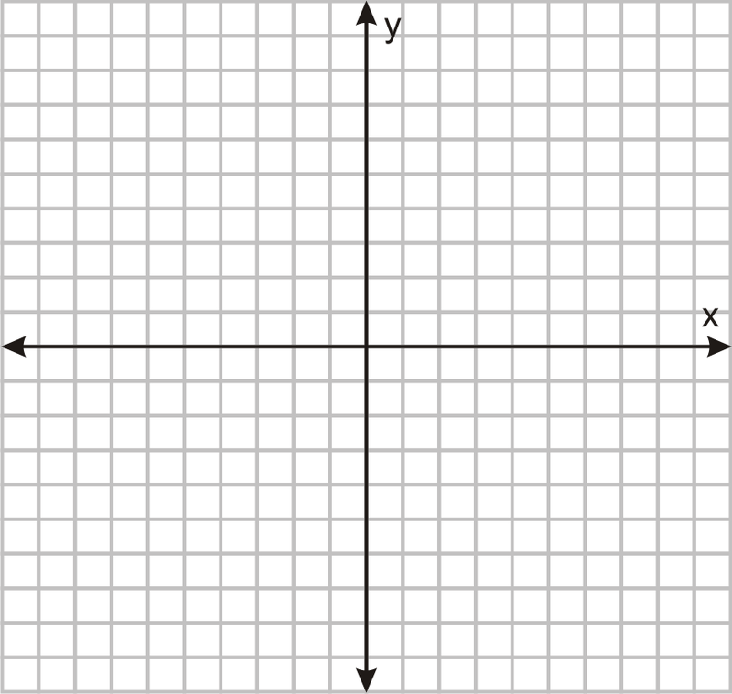
Fluency Practice [5 min]
Write the equation of the line graphed to the right.
How do you find slope the equation of a line
given a table?
What math operation do the following words represent:
Total Fewer Twice
More Half Per

Slide 3
Problem Solving Strategies
Intervene’s Problem Solving Strategies:
Step 1: Show what you know
Step 2: Solve and Check
Step 3: Eliminate and Justify

Slide 4
Lesson
Key Vocabulary
Linear equation
System of linear equations
Y-intercept
Slope
When writing systems of equations from word problems:
Identify your variables
Write the equations given the information provided

Slide 6
Math operations for words in real world problems

Slide 7
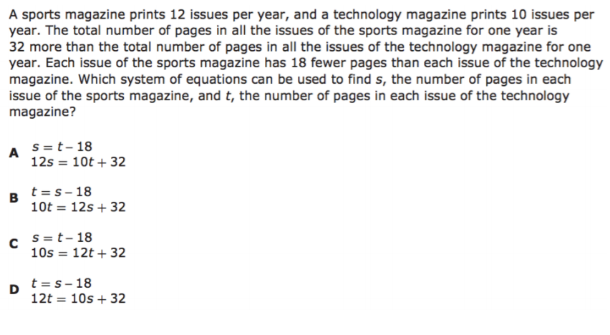
I Do [5 minutes]

Slide 8
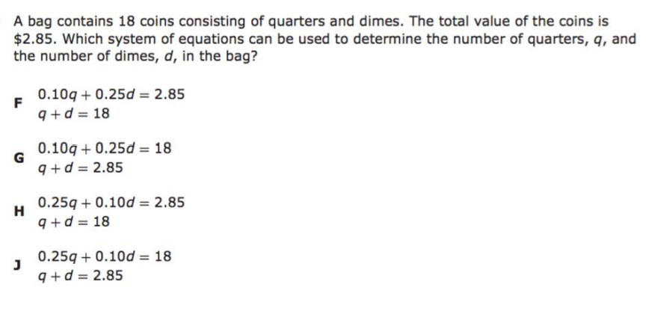
We Do – Student 1 [5 minutes]

Slide 9
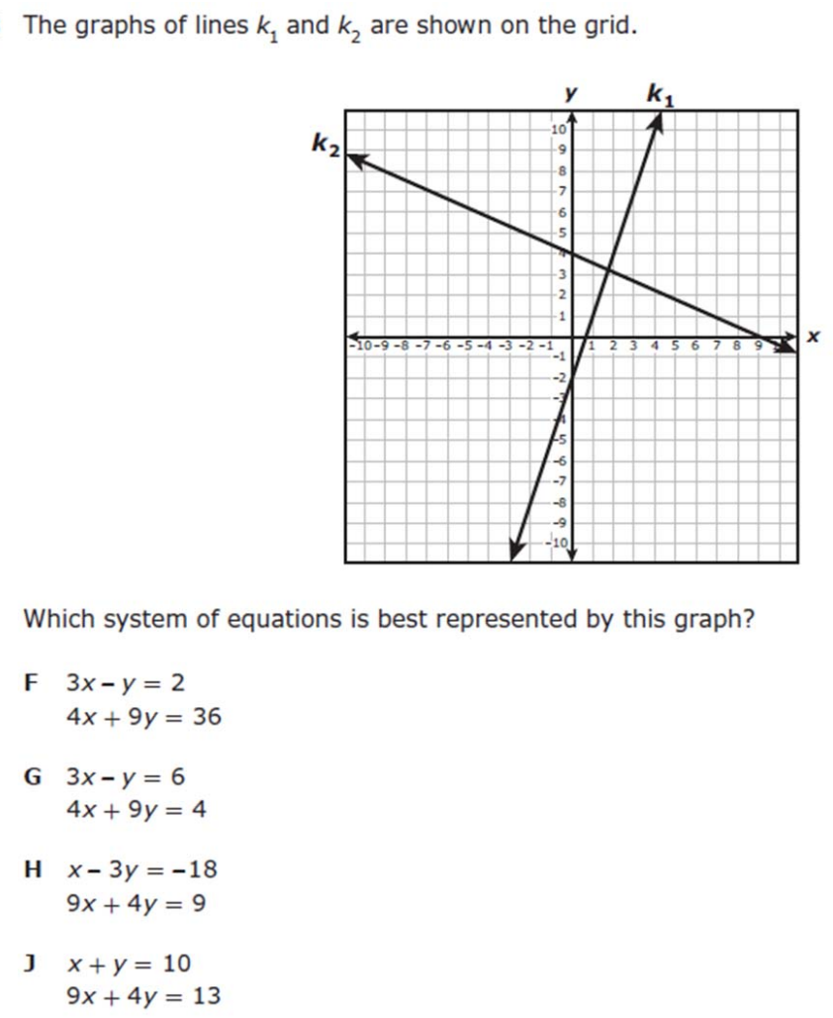
We do - Student 2 [5 minutes]

Slide 10
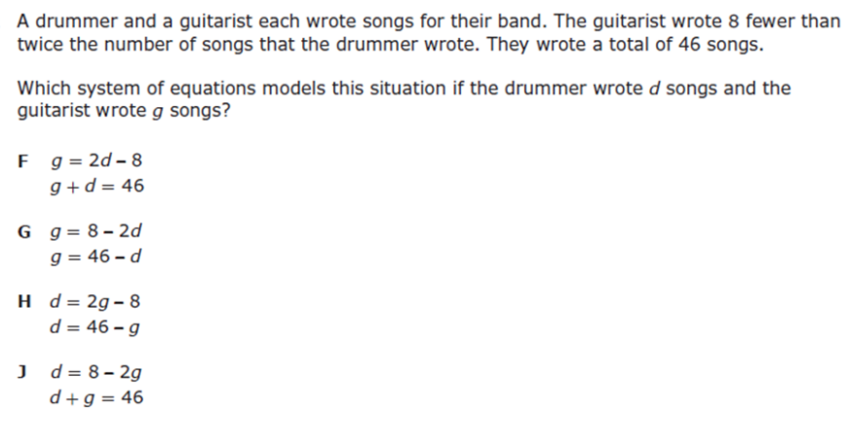
We do - Student 3 [5 minutes]

Slide 11
We Do [5 minutes]

Slide 12
Debrief [2 minutes]
System of linear equations means two lines in one graph
When writing systems of equations from word problems:
Remember to identify your variables, THEN write the equations given the information provided

Slide 13
You Do [1 minute to explain]
Instructions for Content Dev:
Nothing to do here
Instructions for Tutor:
Have students click on the Quiz tab above (on their screen)
Instruct students to take the quiz on this objective, and remind to use their problem solving strategies

