Slide 1

A.3(A)
determine the slope of a line given a table of values, a graph, two points on the line, and an equation written in various forms, including y = mx + b, Ax + By = C, and y – y₁ = m(x – x₁)

Slide 2
Fluency Practice
x | y
-3 | 6
1 | 2
Find the difference between the x and y values in the table to the right.
Which variable is the independent variable? Which is the dependent variable?
Solve for y: 2x+y=7

Slide 3
Problem Solving Strategies
Intervene’s Problem Solving Strategies:
Step 1: Show what you know
Step 2: Solve and Check
Step 3: Eliminate and Justify

Slide 4
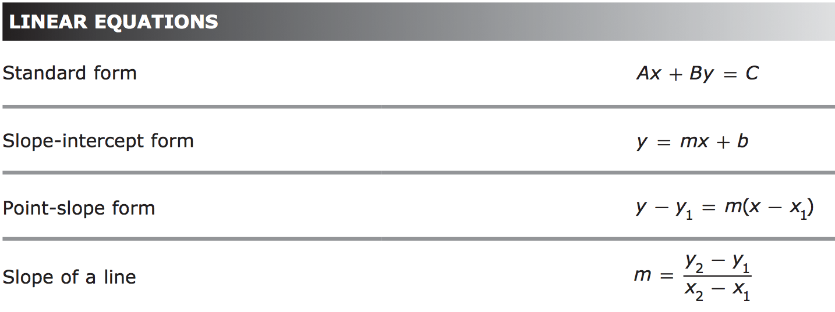
Lesson
Key Vocabulary
Linear function
Slope
Rate of change
Y-intercept
Slope-intercept form
Point slope form
Standard form

Slide 5
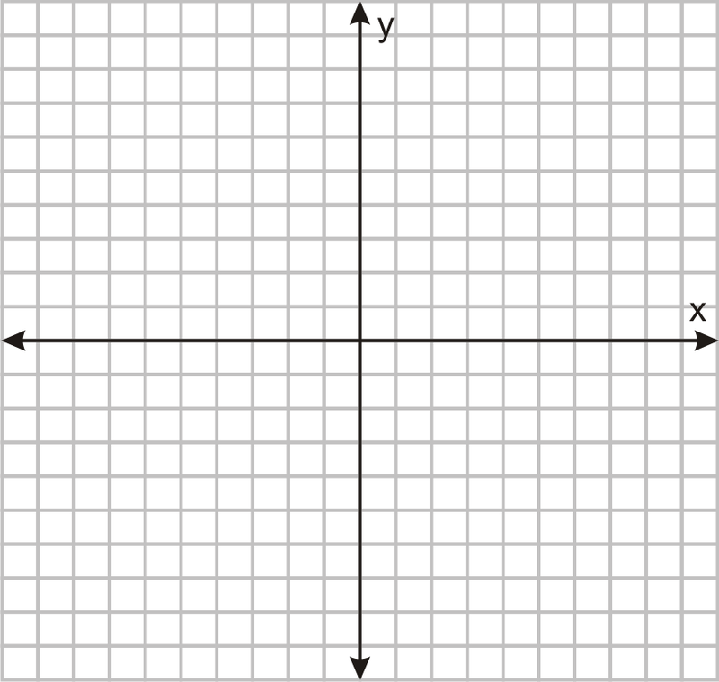
From a graph From a table
rise change in y
run change in x
From two points From an equation
Use the formula Solve for y
m= y₂-y₁ y=mx+b
x₂-x₁
slope

Slide 6
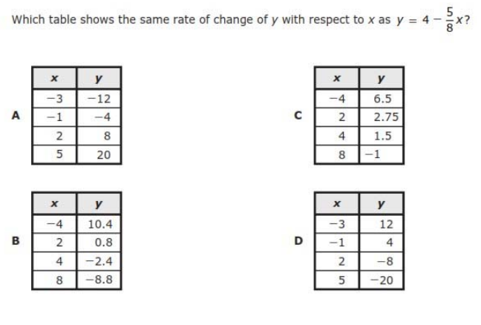
I Do

Slide 7
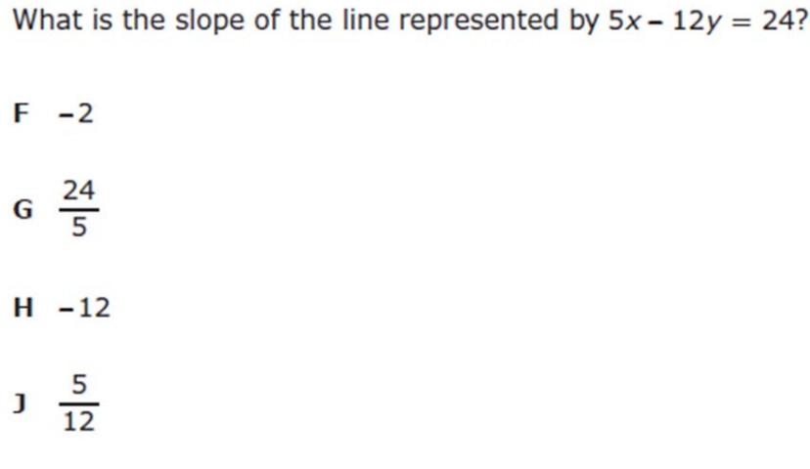
We Do – Student 1

Slide 8
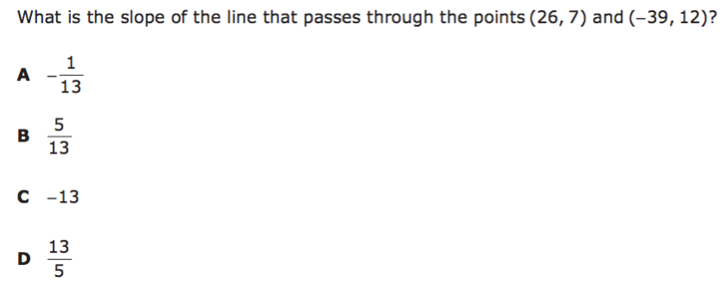
We do - Student 2

Slide 9
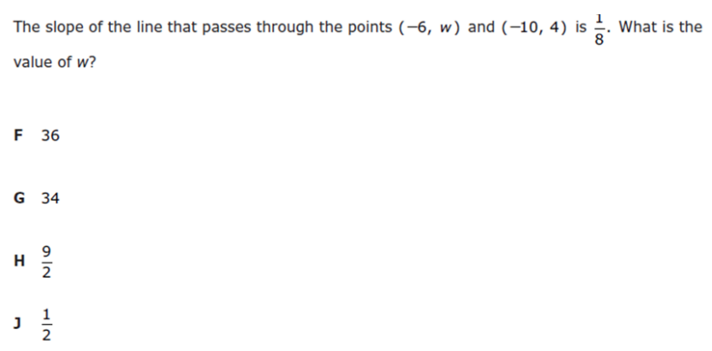
We do - Student 3

Slide 10
We Do

Slide 11
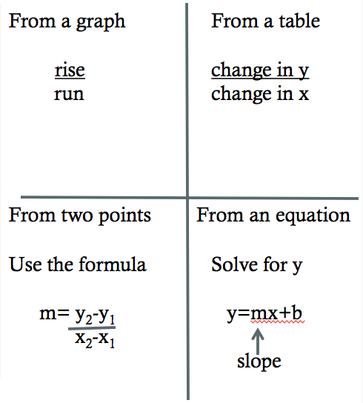
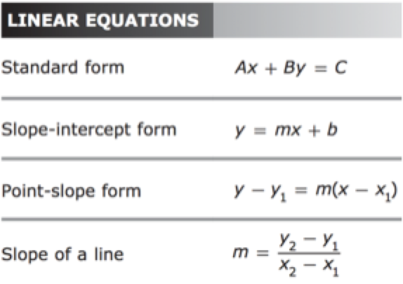
Debrief

