Slide 1

A.3(C)
graph linear functions on the coordinate plane and identify key features, including x-intercept, y-intercept, zeros, and slope, in mathematical and real-world problems

Slide 2
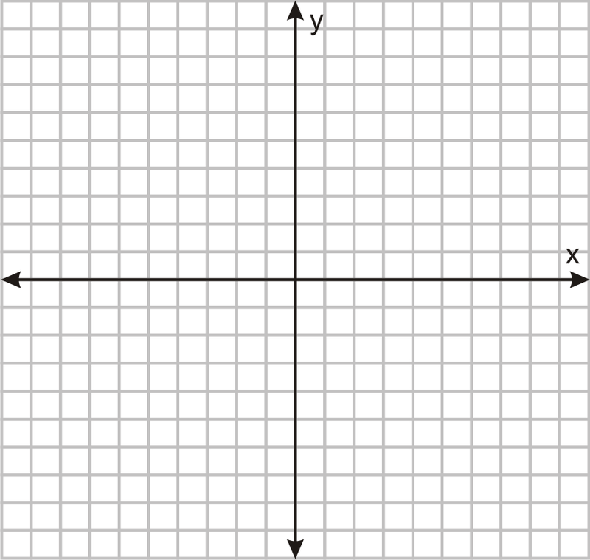
Fluency Practice [5 min]
Label the x and y axis on the graph.
What key words help you to identify multiplication in a word problem?
What do parallel lines look like?

Slide 3
Problem Solving Strategies
Intervene’s Problem Solving Strategies:
Step 1: Show what you know
Step 2: Solve and Check
Step 3: Eliminate and Justify

Slide 4
Lesson
Key Vocabulary
Linear function
Slope
Zeros
X-intercept
Y-intercept
Slope-intercept form
Words that represent slope:
Every
Each (sometimes)
Per
Rate

Slide 6
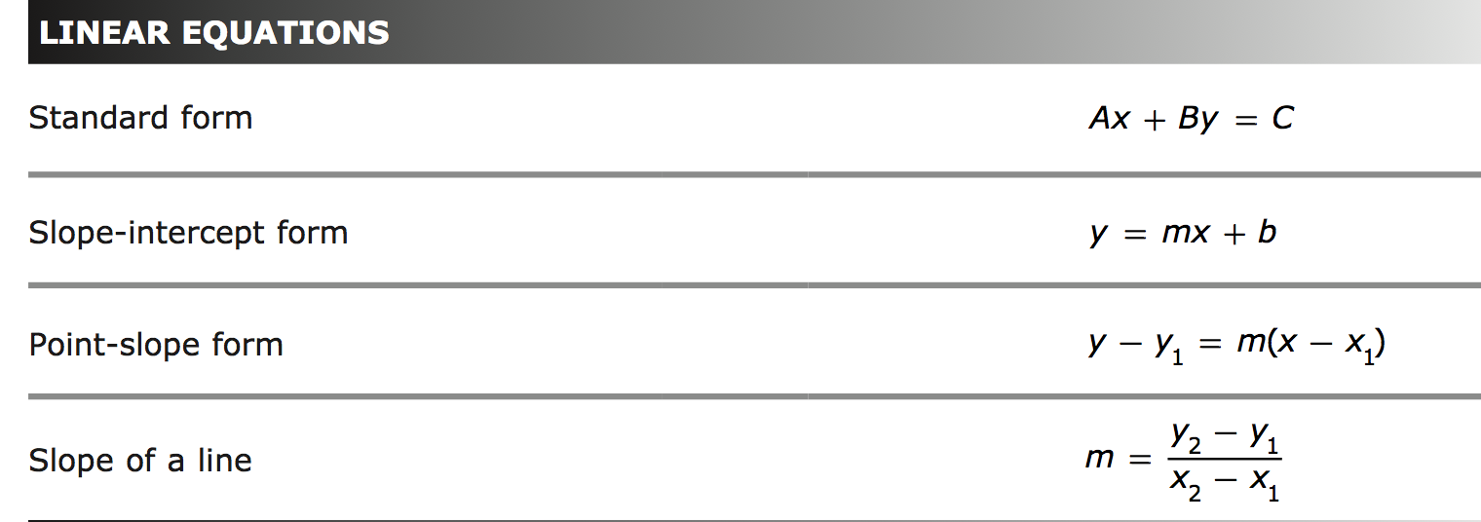

Slide 7
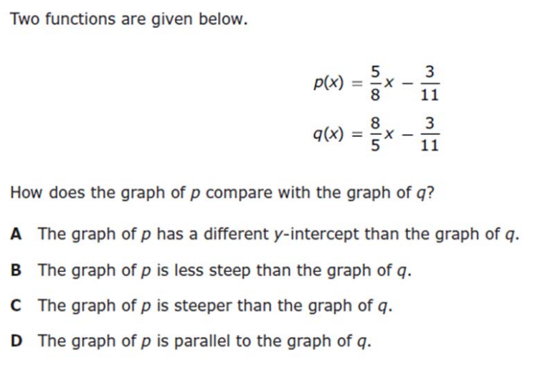
I Do [5 minutes]

Slide 8
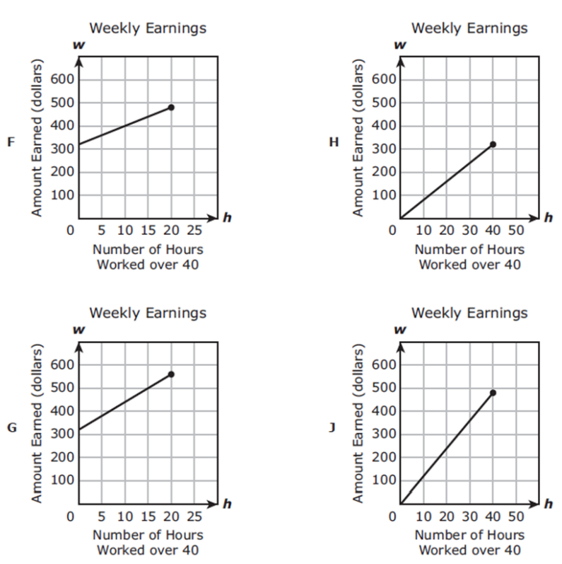
We Do – Student 1 [5 minutes]
A lifeguard earns $320 per week
for working 40 hours plus $12 per
hour worked over 40 hours. A
lifeguard can work a maximum of 60 hours per week.
Which graph best represents the
lifeguard’s weekly earnings in
dollars for working h hours over 40?

Slide 9
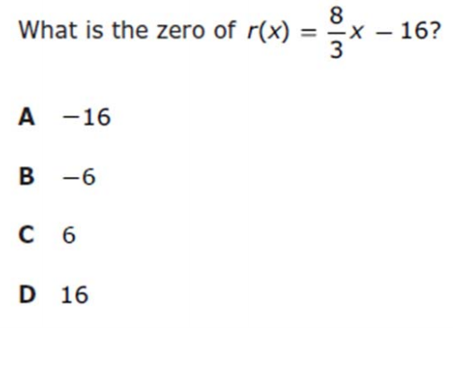
We do - Student 2 [5 minutes]

Slide 10
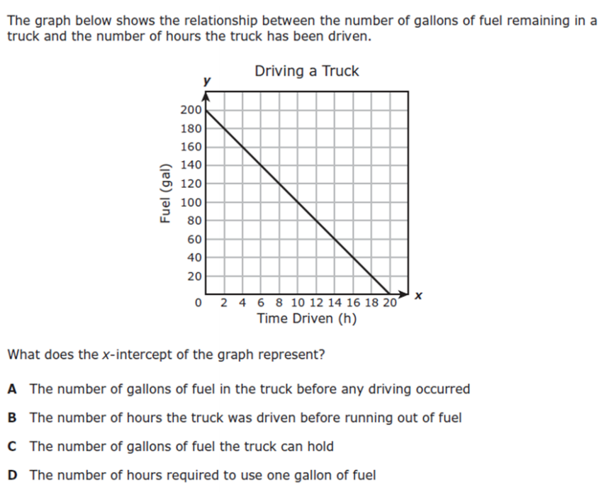
We do - Student 3 [5 minutes]

Slide 11
We Do [5 minutes]

Slide 12
Debrief [2 minutes]
You need the slope and a point to graph a line.
X-intercept and zeros are the same thing!

Slide 13
You Do [1 minute to explain]
Instructions for Content Dev:
Nothing to do here
Instructions for Tutor:
Have students click on the Quiz tab above (on their screen)
Instruct students to take the quiz on this objective, and remind to use their problem solving strategies

