Slide 1

A.3(D)
graph the solution set of linear inequalities in two variables on the coordinate plane

Slide 2
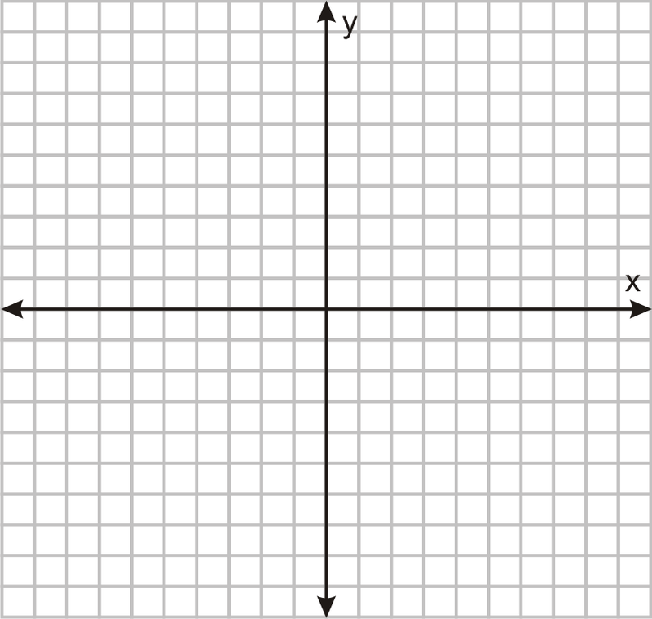
Fluency Practice [5 min]
Graph the line y= 3x-5
What are the names of these symbols: <, <, >, >
Solve the following inequality: 7-3x > 19

Slide 3
Problem Solving Strategies
Intervene’s Problem Solving Strategies:
Step 1: Show what you know
Step 2: Solve and Check
Step 3: Eliminate and Justify

Slide 4
Lesson
Key Vocabulary
Linear function
Linear Inequality
Slope
Y-intercept
Slope-intercept form
Inequality Name | Inequality symbol | Type of line | Shaded area
Less than | < | Dashed | Below
Less than or equal to | < | Solid | Below
Greater than | > | Dashed | Above
Greater than or equal to | > | Solid | Above

Slide 6
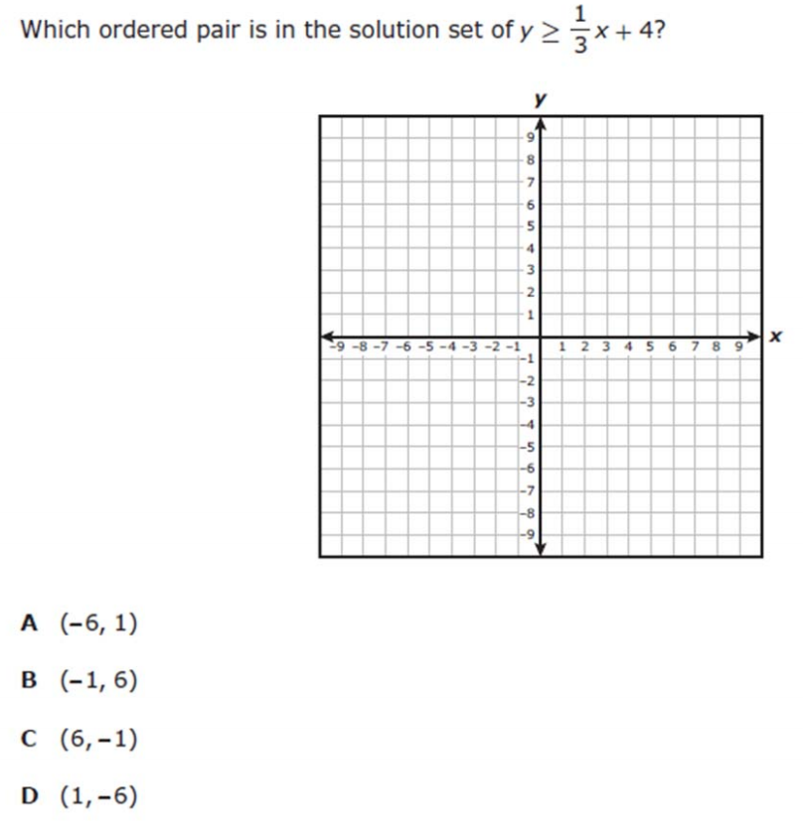
I Do [5 minutes]

Slide 7
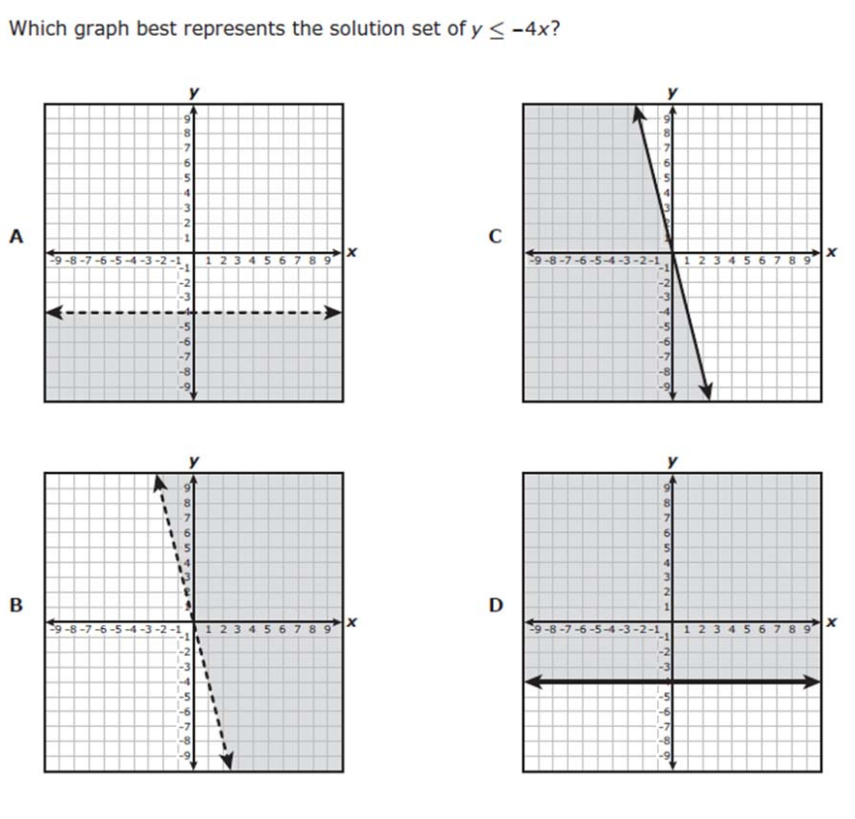
We Do – Student 1 [5 minutes]

Slide 8
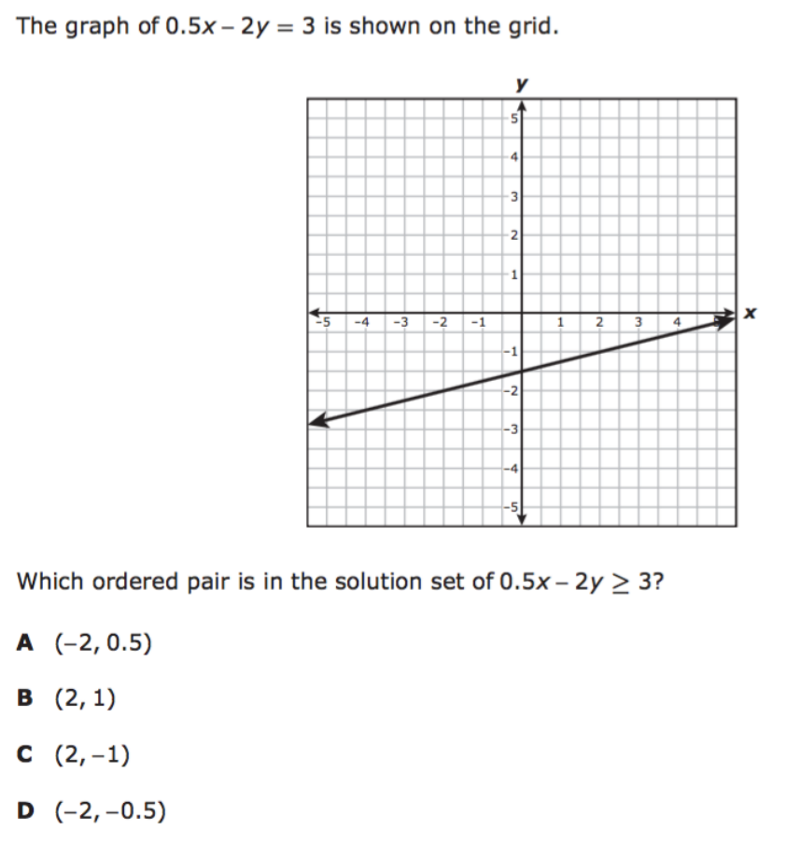
We do - Student 2 [5 minutes]

Slide 9
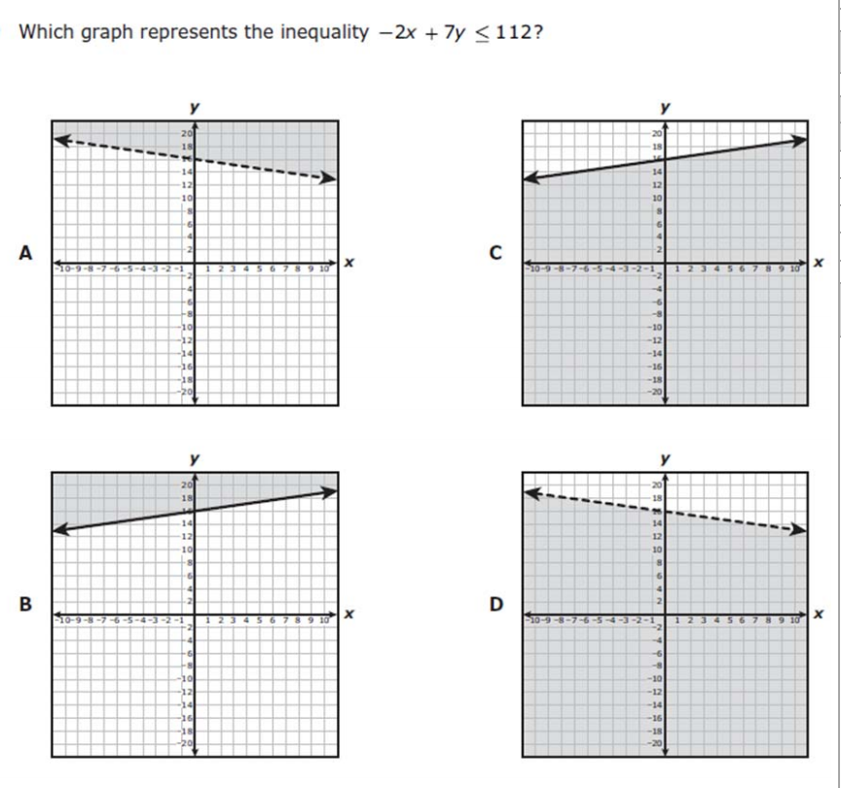
We do - Student 3 [5 minutes]

Slide 10
We Do [5 minutes]

Slide 11
Debrief [2 minutes]
Inequality Name | Inequality symbol | Type of line | Shaded area
Less than | < | Dashed | Below
Less than or equal to | < | Solid | Below
Greater than | > | Dashed | Above
Greater than or equal to | > | Solid | Above

Slide 12
You Do [1 minute to explain]
Instructions for Content Dev:
Nothing to do here
Instructions for Tutor:
Have students click on the Quiz tab above (on their screen)
Instruct students to take the quiz on this objective, and remind to use their problem solving strategies

